Slide 1
An Introduction to the Accellera Portable Stimulus Standard

Slide 2
Today's Speakers
Introduction: Srivatsa Vasudevan, Synopsys
Portable Stimulus Concepts & Constructs: Pradeep Salla, Mentor
Building System-Level Scenarios: Sharon Rosenberg, Cadence
Generating Tests from Portable Stimulus: Adnan Hamid, Breker
Hardware/Software Interface Library: Karthick Gururaj, Vayavya Labs
Coverage in Portable Stimulus: Srivatsa Vasudevan, Synopsys
Conclusion: Bishnupriya Bhattacharya, Cadence

Slide 3
Portable Stimulus The Next leap in Verification & validation Productivity
Srivatsa Vasudevan, Synopsys

Slide 4
A Brief History of Verification
Verification Productivity
Portable Stimulus
Standard
Methodology
UVM
VMM
OVM
System Verilog
CRV & MDV
ad hoc Verification teams
Directed
Testing
Verification?

Slide 5
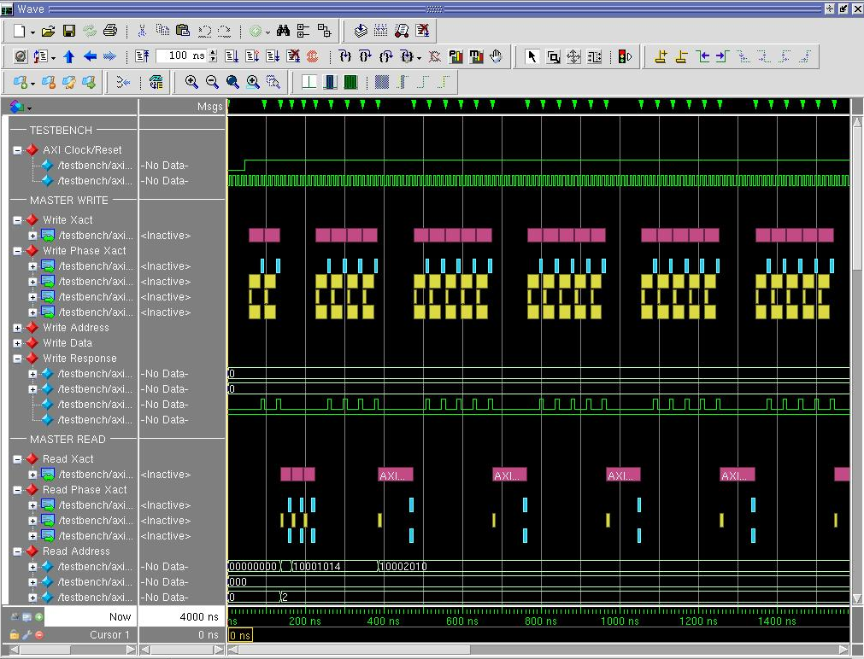
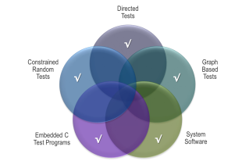
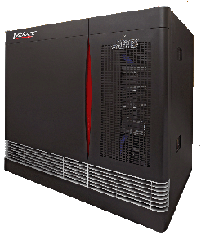
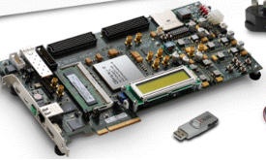
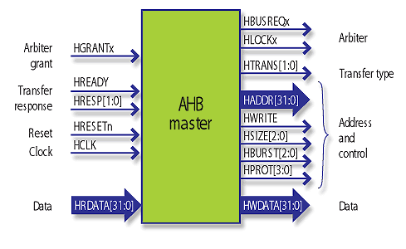
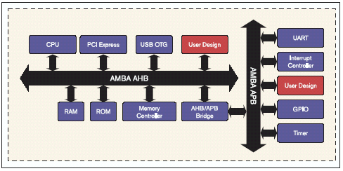
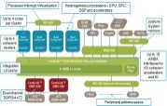
SoC-level Verification
Design complexity continues to increase
Outstripping Verification Productivity (again)
State space at system-level is too big for effective UVM Constrained-Random
Multiple platforms
Need to reuse Test Intent
Higher abstraction
Reuse from block to system
Map to different platforms
SIMULATION
STIMULUS
EMULATION
FPGA PROTO
IP BLOCK
SUBSYSTEM
FULL SYSTEM
Notes:
In order to understand why Portable Stimulus is needed, we have to look, yet again, at the problem of increasing complexity. Regardless of whether you measure design complexity by number of gates, amount of IP, number of embedded processors, software content, or any other metric, the relentless increase in complexity continues. This means that once again, we're at the point where Verification needs a productivity boost to be able to keep pace. One issue is that the verification process itself has become a larger problem where, to support large SoC design verification, many different execution platforms are used, from simulation to emulation and FPGA prototyping. Historically, each of these platforms required a different way of specifying tests, usually written by different stakeholders. We're at the point where productivity demands that we be able to reuse test intent across all these platforms. Just like synthesis enabled the design productivity jump from gate-level to RTL, and UVM enabled the verification productivity jump from directed testing to constrained random transaction-level testing, the problem of SoC-level verification requires a higher level of abstraction and, just like synthesis and constrained-random, the use of automation.

Slide 6
Reuse of Test Intent Across Platforms/Users
Different tests used throughout a project
Wastes Time
Error Prone
UVM constrained-random is too limited for directing SoC-level testing
C tests usually directed for specific use-cases
Hard to create
Miss corner cases
UVM
C
IP BLOCK
SUBSYSTEM
FULL SYSTEM
SIMULATION
EMULATION
FPGA PROTO
Notes:
Taking a closer look, a typical project tends to migrate from doing IP block testing in simulation using SystemVerilog and UVM, to running subsystem or full system tests in emulation or prototyping where the test might be C code running on an embedded processor. The cost of migrating tests from one format to another is very high. Even if you successfully convert your tests along the way, it still takes time to do, and errors are always introduced along the way. We've come a long way in using UVM to create constrained-random tests at the block level, but for performance and other reasons, as we'll see, UVM is not the best solution for creating complex system-level tests. System-level tests are typically written in C and, while they might be able to rely on a bit of UVM to drive external traffic, they are mostly directed tests, which limits their effectiveness as we all know. They are hard to create in the first place and, because SoC-level interactions are so complex, they often miss corner cases which is a huge problem.

Slide 7
Reuse of Test Intent Across Platforms/Users
Single specification of test intent is critical
Constrain and randomize at the Scenario Level by capturing:
interactions
dependencies
resource contention
Abstraction lets tool automate generation
of Correct-by-construction legal tests
for Multiple targets
with Target-specific customization
Portable Stimulus
UVM
C
IP BLOCK
SUBSYSTEM
FULL SYSTEM
SIMULATION
EMULATION
FPGA PROTO
Notes:
Instead, what we need is a single specification of the test intent that can be reused across all of these platforms and by all the different users in a typical project. The ideal way to ensure the portability, as we'll see, is to define the test at the scenario level, where we capture the interactions between the different parts of the system as well as their dependencies and resource contention issues, since these are usually the source of problems at the system level. By specifying the test intent at this higher level of abstraction, we can let a tool automate the generation of target-specific implementations of the tests, regardless of what platform we're targeting, and also to customize the generated test based on specific requirements of the desired platform. As we'll see, this also allows us to reuse these Portable Stimulus tests from project to project, where important factors like the number of embedded processors, or the number of available DMA channels or other design-specific parameters might change.

Slide 8
PSS Tool Operating in a UVM Environment
PSS Model
PSS tool composes UVM sequences for existing UVM environment from abstract use case specification
Tool handles verification checks and coverage collation against original spec
Streamlines testbench authoring using an “executable specification”
PSS Tool
UVM
Sequences
AXI
VIP
AXI
VIP
DMAC
UART
VIP
UART
DDR MEM
UVM Testbench

Slide 9
PSS Tool Operating in a SoC Environment
PSS Model
PSS tool generates synchronized
IO data and SW tests
Use cases may be reused from other process stages including simulation
A single scenario can drive complete test sets for emulation, reusing VIP
PSS Tool
UVM
Sequences
Sync
C-test
TB
AXI
VIP
CPU
DMAC
UART
VIP
UART
DDR MEM
SoC Testbench

Slide 10
What Portable Stimulus Is Not
A UVM replacement
A reference implementation
One forced level of abstraction
Expressing intent from different perspectives is a primary goal
Monolithic
Representations would typically be composed of portable parts
Two standards
DSL and C++ input formats describe 1:1 semantics
Tools shall consume both formats
Just stimulus
Models Verification Intent
Stimulus, checks, coverage, scenario-level constraints

Slide 11
concepts & constructs
Pradeep Salla, Mentor

Slide 12
The Steps to Creating a Portable Stimulus Model
Step 1: Identify Behaviors
Step 2: Identify Data Flow
Step 3: Where do Actions Execute?
Step 4: What System Resources are required?
component uart_c {
resource uart_r {…};
pool [1] uart_r uart_p;
bind uart_p {*};
action read_in_a {
output data_str data;
lock uart_r u_busy;
};
action write_out_a {
input data_str data;
lock uart_r u_busy;
};
}
Command
data_str
DMAC
Data
UART
MEM

Slide 13
The Steps to Creating a Portable Stimulus Model
Step 1: Identify Behaviors
Step 2: Identify Data Flow
Step 3: Where do Actions Execute?
Step 4: What System Resources are required?
component dma_c {
resource chan_r {…};
pool [1] chan_r chan_p;
bind chan_p {*};
action u2m_a {
input data_str src_data;
output mem_b dst_data;
lock chan_r chan;
};
action m2u_a {
input mem_b src_data;
output data_str dst_data;
lock chan_r chan;
};
action m2m_a {… };
}
Command
mem_b
data_str
DMAC
Data
UART
MEM

Slide 14
Defining the Data Structures
Portable Stimulus only cares about the structure of data
Data type defines scheduling constraints
buffer = sequential
stream = parallel
struct data_seg_s { rand int[4..1024] size; rand bit[63:0] addr; };
buffer mem_b : data_seg_s {
};
enum data_dir_e {in, out};
stream data_str : data_seg_s { rand data_dir_e dir; rand int[1..2] stop_bits; };
Command
mem_b
data_str
DMAC
Data
UART
MEM
Notes:
A flow object represents incoming or outgoing data/control flow for actions

Slide 15
Data Flow Objects
Specialized struct objects
Each may inherit from a struct; May not inherit from each other
OOP Inheritance
1:many
{
name
:struct_type
[rand] struct_fields;
}
buffer
stream
state
1:1
rd_i
strm
u2m
many:many
observed behavior
buff
read_in_a
m2m_xfer
m2m
u2m_xfer
Stream = Parallel
Buffer = Sequential
Notes:
Buffer objects represent data items in some persistent storage that can be written and read. Stream objects represent transient data or control exchanged between actions during concurrent activity State objects represent the state of some entity in the execution environment at a given time

Slide 16
Adding Data Constraints
Data constraints limit the solution space
Actions that share a data object must have compatible constraints
action read_in_a {
output data_str data;
lock uart_r u_busy;
constraint data.dir == in;
};
action u2m_a {
input data_str src_data;
output mem_b dst_data;
lock chan_r chan;
constraint src_data.dir == in;
constraint src_data.size == dst_data.size;
};
action m2m_a {
input mem_b src_data;
output mem_b dst_data;
lock chan_r chan;
constraint src_data.size == dst_data.size;
constraint src_data.addr != dst_data.addr;
};
Command
mem_b
data_str
DMAC
Data
UART
MEM

Slide 17
Constraints Narrow the Solution Space
buffer mbuf { bit[3:0] x;
constraint {x < 10;}
};
action do_b { input mbuf m;
constraint {m.x < 12;}
};
action do_a { output mbuf m;
constraint {m.x > 2;}
};
action do_g { output mbuf m;
constraint {m.x > 8;}
};
action do_p { input mbuf m;
constraint {m.x < 8;}
};
a
m.x>2
g
m.x>8
mbuf
x=3..11
mbuf
x =3..9
mbuf
x=9..11
mbuf
x = 9
mbuf
x=3..7
mbuf
x = Ф
b
m.x<12
p
m.x<8

Slide 18
Assembling the Top-Level Model
pss_top
component pss_top {
uart_c uart0;
dma_c dma0;
pool data_str stream_p;
bind stream_p {*};
pool mem_b mem_p;
bind mem_p {*};
}
buff_p
dma0
chan_p
u2m
m2m
m2u
strm_p
uart0
rd_i
wr_o
uart_p

Slide 19
Assembling the Top-Level Model
component pss_top {
uart_c uart0;
dma_c dma0;
pool data_str stream_p;
bind stream_p {*};
pool mem_b mem_p;
bind mem_p {*};
action loopback_test {
uart_c::read_in_a rd_i; dma_c::u2m_a u2m;
uart_c::write_out_a wr_o; dma_c::m2u_a m2u;
bind rd_i.data u2m.src_data;
bind wr_o.data m2u.dst_data;
bind u2m.dst_data m2u.src_data;
activity {
parallel { rd_i; u2m; }
parallel { wr_o; m2u; }
}
}
}
rd_i
d_str
u2m
memb
wr_o
d_str
m2u

Slide 20
Activity
activity {
that;
do an_a;
parallel {a1, a2};
sequence {a3, a4};
select {a5, a6};
schedule {a7, a8};
if (i == 0) {a9;} else {a10;}
repeat (2) {a11, a12};
foreach (arr[j]) { a13 with {a13.val == arr[j];};
}
T
i==0
F
Action instance traversal
that
Anonymous action traversal
a9
a10
an_a
Subject to flow/resource constraints
a11
a1
a2
a12
a3
a11
a4
a12
a13
a5
a6
a13
a7
a8
a13
a7
a8
a8
a7

Slide 21
Assembling the Top-Level Model
component pss_top {
uart_c uart0;
dma_c dma0;
pool data_str stream_p;
bind stream_p {*};
pool mem_b mem_p;
bind mem_p {*};
action loopback_test {
uart_c::read_in_a rd_i; dma_c::u2m_a u2m;
uart_c::write_out_a wr_o; dma_c::m2u_a m2u;
bind rd_i.data u2m.src_data;
bind wr_o.data m2u.dst_data;
bind u2m.dst_data m2u.src_data;
activity {
parallel { rd_i; u2m; }
parallel { wr_o; m2u; }
}
}
}
rd_i
d_str
u2m
memb
wr_o
d_str
m2u

Slide 22
Assembling the Top-Level Model
component pss_top {
uart_c uart0;
dma_c dma0;
pool data_str stream_p;
bind stream_p {*};
pool mem_b mem_p;
bind mem_p {*};
action loopback_test {
uart_c::read_in_a rd_i;
uart_c::write_out_a wr_o;
activity {
rd_i;
wr_o;
}
}
}
rd_i
d_str
u2m
memb
wr_o
d_str
m2u

Slide 23
Assembling the Top-Level Model
component pss_top {
uart_c uart0;
dma_c dma0;
pool data_str stream_p;
bind stream_p {*};
pool mem_b mem_p;
bind mem_p {*};
action loopback_test {
uart_c::read_in_a rd_i;
uart_c::write_out_a wr_o;
activity {
rd_i;
wr_o;
}
}
}
rd_i
d_str
u2m
memb
data
m2m
memb
wr_o
d_str
m2u

Slide 24
Mapping to Implementation
exec blocks define target language implementation for actions
Target-language templates (C or SV)
Import external procedures from legacy code
Exec blocks can only be defined for leaf-level actions
activity and exec body block are mutually exclusive
class uvm_test1 extends uvm_test_base;
virtual task body();
// …
init_uart_rx(1);
gen_uart_traffic(1, 128);
// …
init_uart_rx(2);
gen_uart_traffic(2, 27);
endtask
endclass
action read_in_a {
output data_str data;
lock uart_r u_busy;
constraint data.dir == in;
exec body C = """ init_uart_rx( {{data.stop_bits}} ); gen_uart_traffic( {{data.stop_bits}}, {{data.size}} ); """ }
}
int main(int argc, char **argv) {
// …
init_uart_rx(1);
gen_uart_traffic(1, 128);
// …
init_uart_rx(2);
gen_uart_traffic(2, 27);
return 0;
}
import void init_uart_rx(bit[1:0] stop_bits);
import void gen_uart_traffic(bit[1:0] stop_bits, int sz);
action read_in_a {
output data_str data;
lock uart_r u_busy;
constraint data.dir == in;
exec body {
init_uart_rx( data.stop_bits );
gen_uart_traffic( data.stop_bits , data.size );
}
}
}
action read_in_a {
output data_str data;
lock uart_r u_busy;
constraint data.dir == in;
exec body SV = """
init_uart_rx( {{data.stop_bits}} );
gen_uart_traffic( {{data.stop_bits}}, {{data.size}} );
"""
}
}
"Moustache" notation to refer to PSS fields

Slide 25
Summary
component uart_c {
resource uart_r {…};
pool [1] uart_r uart_p;
bind uart_p {*};
action read_in_a {
output data_str data;
lock uart_r u_busy;
constraint data.dir == in;
exec body {…}
};
action write_out_a {…};
}
component pss_top {
uart_c uart0;
dma_c dma0;
pool data_str stream_p;
bind stream_p {*};
pool mem_b mem_p;
bind mem_p {*};
action loopback_test {
uart_c::read_in_a rd_i;
activity {
rd_i;
wr_o;
}
}
}
pss_top
buff_p
dma0
chan_p
rd_i
d_str
u2m
u2m
m2m
m2u
memb
strm_p
wr_o
d_str
m2u
uart0
rd_i
wr_o
uart_p
component dma_c {
resource chan_r {…};
pool [1] chan_r chan_p;
bind chan_p {*};
action u2m_a {
input data_str src_data;
output mem_b dst_data;
lock chan_r chan;
constraint src_data.dir == in;
constraint src_data.size ==
dst_data.size;
exec body {…}
};
action m2u_a {…};
action m2m_a {…};
}
int main(int argc, char **argv) {
// …
init_uart_rx(1);
gen_uart_traffic(1, 128);
// …
init_uart_rx(2);
gen_uart_traffic(2, 27);
return 0;
}
Command
mem_b
data_str
DMAC
Data
UART
MEM

Slide 26
building system-level scenarios
Sharon Rosenberg, Cadence Design Systems

Slide 27
A Sub-system Example
virtual
Sequences
BUS
VIP
Command
DMAC
UART
VIP
Data
UART
DDR MEM

Slide 28
A Simple SoC Example
Virtual sequence
Cannot be reused
Quad-core CPU: Write, Read or Copy memory buffers
Encrypt or Decrypt Data
virtual
Sequences
BUS
VIP
Crypto
CPU
In fast platforms need UART transactor or HW
Decode Images or Videos
DMAC
UART
VIP
UART
DDR MEM
Graphics
Transmit or Receive Data
Multi-channel System DMA
So How do we achieve Vertical reuse?

Slide 29
A Simple SoC Example
Step 1: Define component types and their operations as actions
TB
write
Crypto
encrypt
CPU
copy
decrypt
read
The description of the stimuli space (e.g. using a firmware routine or a UVM sequence) is secondary
Step 2: Compose actions into activities to specify scenarios
DMAC
transfer
UART
VIP
UART
read_in
DDR MEM
Graphics
write_out

Slide 30
What are System-Level Scenarios?
The whole is greater than the sum of its parts!
And so are its bugs...
Application use-cases involve multiple IPs interoperating
Example – read video off a mass-storage device, decode, split audio data from video frames, process by dedicated multi-media engines
Stress and performance use-cases involve saturated utilization of shared resources
Example – all processors and DMA-enabled controllers access a certain memory controller in parallel
System low-power use-cases need to be crossed with functional scenarios
System coherency of caches/TLBs requires coordinated pattern of accesses from CPUs and non-processor masters

Slide 31
Reuse IP Models Step #1: Modeling
Actions are abstract, declarative, concise, well encapsulated units of behavior
write_out
UART
component uart_c {
action write_out { input data_stream_s src_data; };
action read_in { output data_stream_s dst_data; };
};
stream
component dma_c {
resource struct channel_s {};
pool [32] channel_s chan;
bind chan *;
action mem2mem_xfer { input data_buff_s src_data; output data_buff_s dst_data;
lock channel_s channel; constraint src_data.seg.size ==
dst_data.seg.size; };
...
};
stream
DMA
read_in
Crypto
component crypto_c {
action encrypt { input data_buff_s src_data; output data_buff_s dst_data;
constraint {
// operates on 128-byte blocks
(src_buff.seg.size % 128) == 0;
(dst_buff.seg.size % 128) == 0;
// output is encrypted, input not
!src_buff.encrypted;
dst_buff.encrypted;
}
};
};
buff
One action should not assume the existing of another action
transfer
buff
buff
encrypt
buff

Slide 32
SW Operations Modeling Step #1: Modeling
Processor cores are resources that can be locked or shared by other components' actions (e.g. for their control)
component cpu_c {
abstract action sw_operation {
lock core_s core;
};
action check_data : sw_operation { input data_buff_s src_data; };
action write_data : sw_operation {
output data_buff_s dst_data;
};
action copy_data : sw_operation {
input data_buff_s src_data; output data_buff_s dst_data;
constraint c1 {src_data.size == dst_data.size;}
};
};
CPU
buffer
check_data
component pss_top {
...
pool [4] core_s chan;
bind core_s *;
};
write_data
buff
buffer
copy_data
Attributes and constraints can be associated with resources
buff
resource struct core_s {
rand core_tag_e core_tag;
rand cluster_tag_e cluster_tag;
constraint {
cluster_tag == CLUSTER_A -> core_tag inside [CORE_A0, CORE_A1];
cluster_tag == CLUSTER_B -> core_tag inside [CORE_B0, CORE_B1];
};

Slide 33
Specifying Multi-IP Data Flows Step #2: Scenario Creation
start
action chain1 {
cpu_c::create_data_a write;
crypto_c::encrypt enc;
cpu_c::copy_data_a copy;
crypto_c::decrypt dec;
cpu_c::check_data_a check;
activity {
write;
enc;
copy;
dec;
check;
bind write.out_buff enc.src_buff;
bind enc.dst_buff copy.src_buff;
bind copy.dst_buff dec.src_buff;
bind dec.dst_buff check.in_buff;
};
};
create_data_a
create_data_a
databuf
size addr
tag
databuf
crypto_a
channel
core
crypto_a
channel
core
databuf
databuf
copy_data_a
core
copy_data_a
core
databuf
databuf
crypto_a
engine
core
crypto_a
engine
core
engine
databuf
databuf
action multi_chain {
activity {
schedule {
do chain1;
do chain2;
};
};
};
check_data_a
check_data_a
Resource conflict is automatically taken care of by serializing the contending actions

Slide 34
Specifying Coordinated Flows Step #2: Scenario Creation
A simple coherency scenario
CPU core writes data to cacheable region
A different core and a DMA read that same memory region
Actions can be realized with true RTL CPUs / device, or with testbench bus transactors
action simple_io_coherency {
cpu_c::write_data write;
cpu_c::copy_data_a copy;
dma_c::mem2mem_xfer_a xfer;
activity {
write with { out_buff.seg.cacheable == true; };
repeat (20) {
parallel {
copy with { core.instance_id != write.core.instance_id; };
xfer;
}
}
bind write.out_buff {copy.src_buff, dma_xfer.src_buff};
}
};
write_data_a
core
databuf
size addr
tag
cacheable
copy_data_a
core
m2m_xfer_a
DMA

Slide 35
Layering System Power Concern
Two power domains A, and B
Each power can be in mode S0 (active), S1 S2 (sleep modes)
Subsystem operations depend on respective domain active state
TB
Domain A
CPU
Crypto
Domain B
Should reuse base model of behaviors and scenarios as is!
DMAC
UART
VIP
UART
DDR MEM
Graphics

Slide 36
Defining Power Logic Step #1: Modeling
State object representing aggregate system power state
enum power_state_e {S0, S1, S2};
state power_state_s {
rand power_state_e dmn_A, dmn_B;
constraint initial -> { dmn_A == S0 ; dmn_B == S0 ; }
};
component power_ctrl_c {
pool power_state_s sys_pwr_statevar;
action change_power_state {
input power_state_s prev;
output power_state_s next;
};
};
enum attribute for each domain
Both domains start out active
extend pss_top {
power_ctrl_c power_ctrl;
bind power_ctrl.sys_pwr_statevar *;
};
State variable is bound to actions' inputs/outputs by state type
Power transition action reads the previous power state and establishes a new state

Slide 37
Introducing Power Dependencies
extend graphics_c::decode {
input power_state_s curr_power_state;
constraint curr_power_state.dmn_B == S0;
};
extend crypto_c::encrypt{
input power_state_s curr_power_state;
constraint curr_power_state.dmn_A == S0;
};
Input state with a precondition
pwr_state
dmn_A=S0
dmn_B=S0
change_pwr
pwr_state
dmn_A=S0
dmn_B=S2
change_pwr
pwr_state
dmn_A=S0
dmn_B=S0
Dependencies layered on top of existing action definitions in a non-intrusive way
encrypt
action encrypt_after_low_A {
activity {
do change_power_state with {
next.dmn_A != S0;
};
do encrypt;
};
};
Tool must infer additional action due to action precondition
PSS also supports overrides of types and instances

Slide 38
Exercising Power Scenarios Step #2: Scenario Creation
A PSS compliance tool analyzes the entire scenario and trims the scenario space
pwr_state
dmn_A=S0
dmn_B=S0
action rand_traffic {
activity {
select {
do cpu_c::copy;
do crypto_c::encrypt;
do graphics_c::decode;
}
}
};
action phased_pwr_traffic {
activity {
repeat (2) {
do change_power_state;
do rand_traffic;
};
};
};
change_pwr
pwr_state
dmn_A=S2
dmn_B=S0
copy
encrypt
decode
change_pwr
pwr_state
dmn_A=S0
dmn_B=S1
copy
encrypt
decode

Slide 39
Building system-level scenarios summary
PSS DNA is built for portability and reuse
Applicable both for bottom-up and top-down reuse
Can reuse both the model and scenarios intent
PSS Solving capabilities allows automation of system concerns
Take randomization and constraint-solving to the next level
We gathered a set of usage examples to demonstrate these capabilities
The examples will be part of the PSS release

Slide 40
Portable Stimulus IN C++11 (and semantic Equivalence to DSL)
Adnan Hamid, Breker Verification Systems

Slide 41
The UART Component in DSL
Step 1: Identify Behaviors
Step 2: Identify Data Flow
Step 3: Where do Actions Execute?
Step 4: What System Resources are required?
component uart_c {
resource uart_r {…};
pool [1] uart_r uart_p;
bind uart_p {*};
action read_in_a {
output data_str data;
lock uart_r u_busy;
};
action write_out_a {
input data_str data;
lock uart_r u_busy;
};
}
Command
data_str
DMAC
Data
UART
MEM

Slide 42
UART Component in C++
Step 1: Identify Behaviors
Step 2: Identify Data Flow
Step 3: Where do Actions Execute?
Step 4: What System Resources are required?
class uart_c :public component{
PSS_CTOR(uart_c, component);
class uart_r :public resource{…};
pool<uart_r> uart_p {"uart_p",1};
bind b {uart_p};
class read_in_a :public action {
PSS_CTOR(read_in_a, action);
output<data_str> data {"data"};
lock<uart_r> u_busy{"u_busy"};
};
type_decl<read_in_a> ri_t;
class write_out_a :public action{
PSS_CTOR(write_out_a, action);
input<data_str> data {"data"};
lock<uart_r> u_busy{"u_busy"};
};
type_decl<write_out_a> wo_t;
};
Command
data_str
DMAC
Data
UART
MEM

Slide 43
DMAC Component in DSL
Step 1: Identify Behaviors
Step 2: Identify Data Flow
Step 3: Where do Actions Execute?
Step 4: What System Resources are required?
component dma_c {
resource chan_r {…};
pool [1] chan_r chan_p;
bind chan_p {*};
action u2m_a {
input data_str src_data;
output mem_b dst_data;
lock chan_r chan;
};
action m2u_a {
input mem_b src_data;
output data_str dst_data;
lock chan_r chan;
};
action m2m_a {… };
}
Command
mem_b
data_str
DMAC
Data
UART
MEM

Slide 44
The Steps to Creating a Portable Stimulus Model
Step 1: Identify Behaviors
Step 2: Identify Data Flow
Step 3: Where do Actions Execute?
Step 4: What System Resources are required?
class dma_c : public component {
class chan_r :public resource{…};
pool<chan_r> chan_p{"chan_p",1};
bind b {chan_p};
class u2m_a : public action {
input<data_str> src_data{"src_data"};
output<mem_b> dst_data{"dst_data"};
lock<chan_r> chan{"chan"};
};
class m2u_a : public action {
input<mem_b> src_data{"src_data"};
output<data_str> dst_data{"dst_data"};
lock<chan_r> chan{"chan"};
};
class m2m_a : public action {… };
};
Command
mem_b
data_str
DMAC
Data
UART
MEM

Slide 45
Data Structures in DSL
Portable Stimulus only cares about the structure of data
Data type defines scheduling constraints
buffer = sequential
stream = parallel
struct data_seg_s { rand int[4..1024] size; rand bit[63:0] addr; };
buffer mem_b : data_seg_s {
};
enum data_dir_e {in, out};
stream data_str : data_seg_s { rand data_dir_e dir; rand int[1..2] stop_bits; };
Command
mem_b
data_str
DMAC
Data
UART
MEM

Slide 46
Data Structures in C++
Portable Stimulus only cares about the structure of data
Data type defines scheduling constraints
buffer = sequential
stream = parallel
class data_seg_s : public structure {
rand_attr<int> size {"size",
range<int>(4,1024) };
rand_attr<bit> addr {"addr",
width(63,0) };
};
class mem_b : public data_seg_s,
public buffer {};
class data_dir_e : public enumeration {
PSS_ENUM(data_dir_e, enumeration, in, out);
};
class data_str : public data_seg_s,
public stream {
rand_attr<data_dir_e> dir {"dir"};
rand_attr<int> stop_bits {"stop_bits",
range<int>(1,2) };
};
Command
mem_b
data_str
DMAC
Data
UART
MEM

Slide 47
Top-Level Model in DSL
component pss_top {
uart_c uart0;
dma_c dma0;
pool data_str stream_p;
bind stream_p {*};
pool mem_b mem_p;
bind mem_p {*};
action loopback_test {
uart_c::read_in_a rd_i;
uart_c::write_out_a wr_o;
activity {
rd_i;
wr_o;
}
}
}
rd_i
d_str
u2m
memb
data
m2m
memb
wr_o
d_str
m2u

Slide 48
Top-Level Model in C++
class pss_top : public component {
uart_c uart0 {"uart0"};
dma_c dma0 {"dma0"};
pool<data_str> stream_p {"stream_p"};
bind b1 {stream_p};
pool<mem_b> mem_p{"mem_p"};
bind b2 {mem_p};
class loopback_test : public action {
action_handle<uart_c::read_in_a> rd_i {"rd_i"};
action_handle<uart_c::write_out_a> wr_o {"wr_o"};
activity a {
rd_i,
wr_o
};
};
};
rd_i
d_str
u2m
memb
data
m2m
memb
wr_o
d_str
m2u

Slide 49
Generating Tests from Portable Stimulus
Adnan Hamid, Breker Verification Systems

Slide 50
Consider Two Deployment Models
PSS Model
PSS Model
PSS Tool
PSS Tool
UVM
Sequences
UVM
Sequences
Sync
C-test
AXI
VIP
TB
AXI
VIP
AXI
VIP
CPU
DMAC
DMAC
UART
VIP
UART
DDR MEM
UART
VIP
UART
DDR MEM
UVM Testbench
SoC Testbench

Slide 51
Exec Block Types
Specify mapping of PSS entities to their implementation
test.c
test.sh
#include <stdint.h>
void declared_func() {
…
}
void test_main() {
do_run_start();
fork_threads();
do_run_end();
}
void thread0() {
…
// step N
do_body();
…
};
void thread1() {
…
}
gcc –c test.c –DBARE_METAL
header
declaration
run_start
file
pre_solve
pre_solve
constraint solving
constraint solving
…
post_solve
post_solve
Could be SV
or other language
body
body
run_end
Could be multiple threads on one core,
or threads running on different cores

Slide 52
Three Strategies for Implementing Exec Blocks
Target Template: text templates for code generation
Import Function: import and call external procedures/functions, assign to non random attributes
Hardware/Software Interface: abstracted operations for registers, memory and interrupts

Slide 53
Target Template
class uvm_test1 extends uvm_test_base;
virtual task body();
// …
init_uart_rx(1);
gen_uart_traffic(1, 128);
// …
init_uart_rx(2);
gen_uart_traffic(2, 27);
endtask
endclass
action read_in_a {
output data_str data;
lock uart_r u_busy;
constraint data.dir == in;
}
int main(int argc, char **argv) {
// …
init_uart_rx(1);
gen_uart_traffic(1, 128);
// …
init_uart_rx(2);
gen_uart_traffic(2, 27);
return 0;
}
action read_in_a {
output data_str data;
lock uart_r u_busy;
constraint data.dir == in;
exec body SV = """
init_uart_rx( {{data.stop_bits}} );
gen_uart_traffic( {{data.stop_bits}}, {{data.size}} );
"""
}
}
action read_in_a {
output data_str data;
lock uart_r u_busy;
constraint data.dir == in;
exec body C = """ init_uart_rx( {{data.stop_bits}} ); gen_uart_traffic( {{data.stop_bits}}, {{data.size}} ); """ }
}
"Moustache" notation to refer to PSS fields
TB
AXI
VIP
AXI
VIP
AXI
VIP
CPU
DMAC
DMAC
UART
UART
DDR MEM
UART
VIP
DDR MEM
UART
VIP

Slide 54
Import Function
class uvm_test1 extends uvm_test_base;
virtual task body();
// …
init_uart_rx(1);
gen_uart_traffic(1, 128);
// …
init_uart_rx(2);
gen_uart_traffic(2, 27);
endtask
endclass
action read_in_a {
output data_str data;
lock uart_r u_busy;
constraint data.dir == in;
}
int main(int argc, char **argv) {
// …
init_uart_rx(1);
gen_uart_traffic(1, 128);
// …
init_uart_rx(2);
gen_uart_traffic(2, 27);
return 0;
}
import void init_uart_rx(bit[1:0] stop_bits);
import void gen_uart_traffic(bit[1:0] stop_bits, int sz);
action read_in_a {
output data_str data;
lock uart_r u_busy;
constraint data.dir == in;
}
import void init_uart_rx(bit[1:0] stop_bits);
import void gen_uart_traffic(bit[1:0] stop_bits, int sz);
action read_in_a {
output data_str data;
lock uart_r u_busy;
constraint data.dir == in;
exec body {
init_uart_rx( data.stop_bits );
gen_uart_traffic( data.stop_bits , data.size );
}
}
TB
AXI
VIP
AXI
VIP
AXI
VIP
CPU
DMAC
DMAC
UART
DDR MEM
UART
VIP
UART
DDR MEM
UART
VIP

Slide 55
Hardware/Software Interface Layer
class uvm_test1 extends uvm_test_base;
virtual task body();
// …
uart_regs.lcr.stop_bits = 1;
gen_uart_traffic(1, 128);
// …
uart_regs.lcr.stop_bits = 2;
gen_uart_traffic(2, 27);
endtask
endclass
import void gen_uart_traffic(bit[1:0] stop_bits, int sz);
action read_in_a {
output data_str data;
lock uart_r u_busy;
constraint data.dir == in;
}
int main(int argc, char **argv) {
// …
write_reg(UART_LCR, 1 << 2);
gen_uart_traffic(1, 128);
// …
write_reg(UART_LCR, 2 << 2);
gen_uart_traffic(2, 27);
return 0;
}
import void gen_uart_traffic(bit[1:0] stop_bits, int sz);
action read_in_a {
output data_str data;
lock uart_r u_busy;
constraint data.dir == in;
Uart_regs uart_regs;
}
import void gen_uart_traffic(bit[1:0] stop_bits, int sz);
action read_in_a {
output data_str data;
lock uart_r u_busy;
constraint data.dir == in;
Uart_regs uart_regs;
exec body {
uart_regs.lcr.stop_bits = data.stop_bits;
gen_uart_traffic( data.stop_bits , data.size );
}
}
TB
TB
AXI
VIP
AXI
VIP
AXI
VIP
CPU
DMAC
DMAC
UART
UART
DDR MEM
UART
VIP
DDR MEM
UART
VIP

Slide 56
The Hardware/Software Interface Library
Karthick Gururaj, Vayavya Labs

Slide 57
What is HSI?
Hardware/Software Interface layer is
…an abstraction responsible for device management
Device initialization, operations such as configure, transmit/receive
Registration of device capabilities
…set of constructs for capturing the Hardware aspects required to implement the abstraction
Programming registers, setting up descriptor chains, interrupt properties and handling, …
Capture all programming sequences
…to summarize: construct the programmer’s view of a device agnostic to the underlying verification environment

Slide 58
What HSI Enables
Stimulus Spec
(Test intent)
Test bench
(in SV)
Test cases
(in C, on host)
Test cases
(in C, on host)
Test cases
(in C, on target)
HSI Spec
(Test realization)
Driver
(in SV)
Driver
(in C, on host)
Driver
(in C, on host)
Driver
(in C, on target)
DMAC (DUT)
DMAC (DUT)
DMAC (DUT)
DMAC (DUT)
RTL Simulation
Accelerated simulation with Emulator
FPGA, w/ external PCIe master
FPGA, w/ embedded core
Test Intent is portable… but test realization environment specific?
HSI ensures Portability of test realization across Environments

Slide 59
What HSI Enables
Test cases
Test scenarios
Test cases
Driver for DMAC-A
Driver for UART-A
Driver for DMAC-B
Driver for UART-B
HSI Spec for DMAC-A
HSI Spec for UART-A
HSI Spec for DMAC-B
HSI Spec for UART-B
DMAC A
DMAC B
UART A
MEM
UART B
MEM
Enables Portability of Scenarios across Devices/SoCs

Slide 60
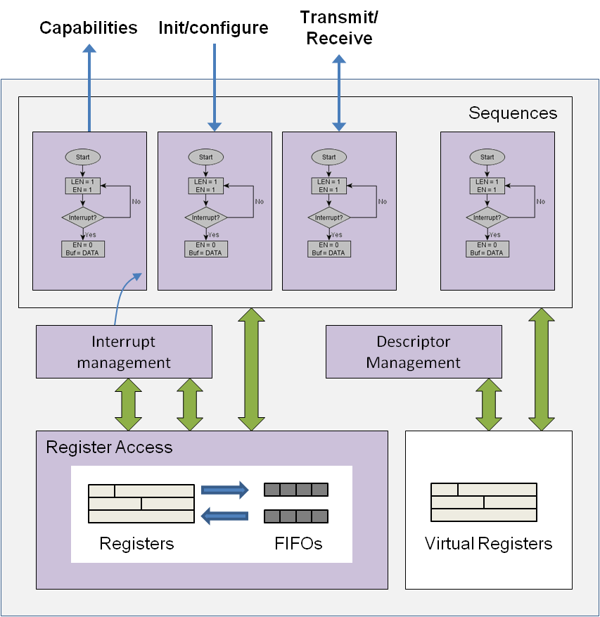
HW/SW Interface Spec Elements
Registers
FIFOs
Virtual registers
Descriptor management
Interrupt management
Sequences
Device capabilities

Slide 61
Test Realization Using HSI
All elements of HSI specification, including sequences, captured in C++
HSI specification will integrate with test intent (in PSS-C++ or DSL)
From HSI specification, driver APIs for desired environment/platform and language (C, SystemVerilog, etc) can be generated
HSI specification currently under discussion in the WG, expect updates in upcoming revisions
class dma_src : public pss::reg
{
public:
dma_src(/* ... */) : pss::reg (
description("Source address")
, offset(0x0)
, width(32)
, access(pss::PSS_ACCESS_RW)
, reset(0x0))
{ }
};
class dma_dst : public pss::reg
{
/* ... */
};
class chan_regs : public pss::reg_group
{
public:
dma_src src{"src"};
dma_dst dst{"dst"};
/* Other registers */
};
class dmac_regs : public pss::reg_group
{
public:
pss::vector<chan_regs> channel{"channel", 8};
/* Other registers */
};
class dmac_interrupts : public pss::intr_line
{
public:
pss::intr_event xfer_done{"xfer_done"};
/* ... */
};
class dmac : public pss::hsi
{
public:
dmac(/* ... */) { }
dmac_regs regs;
dmac_interrupts intr;
void mem2mem_xfer(dma_xfer_request &req)
{
regs.channel[req.rc].src = req.src_data.address();
regs.channel[req.rc].dst = req.dst_data.address();
regs.channel[req.rc].size = req.src_data.size();
regs.channel[req.rc].ctrl.src_incr = FIXED;
regs.channel[req.rc].ctrl.dst_incr = INCR;
regs.intr_enable.xfer_done = 1;
regs.channel[req.rc].enable = 1;
wait(intr.xfer_done);
}
};
Interrupts
Registers
Sequences
Register Groups

Slide 62
Coverage in Portable Stimulus
Srivatsa Vasudevan, Synopsys

Slide 63
Portable Stimulus Coverage Opportunity & Challenge
Examples of system level coverage:
Connectivity and addressability testing
Power state sequencing
Resource utilization - Did all internal memories get used by DMA tests?
==
Introduction of random => Need coverage to confirm usefulness
Portability challenge – collecting coverage in non-simulation environments
Lack of visibility in HW-based platforms makes traditional coverage collection difficult
Formalization of system level scenarios and models
Ability to formally describe coverage of the legal scenarios and attributes

Slide 64
Types of Coverage in Portable Stimulus
Action Coverage
Were all (or a specified subset of) defined actions executed?
Scenario (Action Sequence) Coverage
What legal sequences of actions were exercised? Aka “control path coverage”
Datapath Coverage
Were all legal sources and sinks for an action sequence datapath (input/output) covered?
Value Coverage
Think covergroups for attributes (config values, state values, … )
Resource Coverage
Any resources added to a resource pool that went unused?
Crosses of any of the above types

Slide 65
Defining Scenario (Action Sequence) Coverage
Scenarios are all legal behavior defined between entry and exit points
Choices are made by the tool between these points
e.g. alternative actions, resource usage, data source
If we can enumerate the choices, we can measure coverage of them
In theory a tool could also target this coverage
i.e. make choices based on what has/hasn’t been covered
Warning: with great power comes great responsibility
Be careful of the number of choices between your entry and exit points
Don’t try to target a coverage with more choices than atoms in the universe
Notes:
Note: Spiderman is very apropos, not just because of the quote, but because, well “action sequence”…

Slide 66
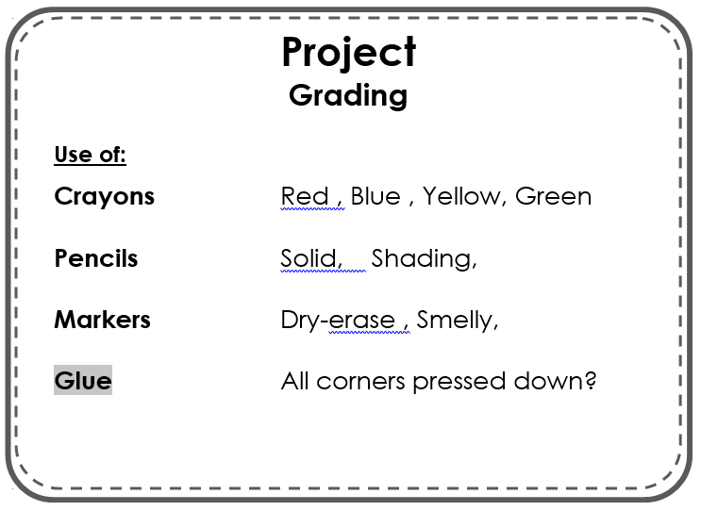
Monitoring Coverage
Stimulus monitoring
Generation time tool can output what it generated/scheduled
As long as test “passes”, the coverage data is valid
Runtime State monitoring
Requires generation of monitoring code
May be C/C++ code running on target cpu
–e.g. data sent out “trickbox” mechanism
May be “off-chip” monitoring via test ports
or other communication ports
B-
✓
✓
✓
✓
✓
Notes:
Remember the Portability Challenge of monitoring coverage on non-simulation platforms??

Slide 67
Simple Example: UART
Command
stream data_stream_s {
rand int size;
rand dir_enum direction;
rand bit[1:0] inside [1..3] stop_bits;
}
buffer data_buff_b {
rand int size;
}
DMAC
Data
UART
MEM
Generate pkt stream
DMA pkt stream into mem buffer
action u2m_xfer {
input data_stream_s src;
output data_buff_b dst;
}
action read_in_a {
output data_stream_s data;
};
action write_out_a {
input data_stream_s data;
coverspec {
size_cp : coverpoint data.size {
bins size_bins [1..20]:1;
}
};
Notes:
action data_in sends a pkt_stream into the data port.
action setup sets the uart in tx(1)/rx(0) mode, configures dmac with src address, dest address, and two flags indicating whether src/dest address increases or not. If uart is src/dest, address does not increment. If mem is src/dest, address does increment. If uart is transmitting, command sets the number of stop bits.
dma_d2m action takes a stream input, so it runs in parallel with data_in, uart in receive mode, data concurrently dma'd into mem via pkt_buf output. Will add dma_channel resource later
dma_m2d action takes a memory input, so it runs in parallel with data_out, uart in transmit mode, data concurrently dma'd into uart via pkt_buf input. Will add dma_channel resource later

Slide 68
conclusion
Bishnupriya Bhattacharya, Cadence

Slide 69
We Hope You Learned…
Portable stimulus is a high-value solution for many real problems we have today – even within a single platform
Portable stimulus can stretch productivity and quality across platforms, users, integrations, and configurations
Portable Stimulus Standard is a serious and timely industry effort under Accellera (over 15 companies involved)
How this standard offers unique concepts and constructs (components, actions, flow objects and resources) to build powerful scenarios that map with flexibility to target platforms.

Slide 70
We Hope You Will…
Participate in shaping this promising standard with your suggestions, use cases and requirements through:
your company’s Accellera representation
EDA vendor voicing your thoughts
reading the Early Adopter spec: http://www.accellera.org/downloads/drafts-review
providing feedback on Accellera Portable Stimulus Forum: http://forums.accellera.org/forum/40-portable-stimulus-discussion/
contacting any of the speakers or PSWG officers
Be an agent of change
Rethink verification and validation efficiency for your team and consumers
Cross the aisle and communicate with peers in other platforms to accomplish more reuse with portable stimulus

Slide 71
We Thank…
Accellera and DvCon India 2017 for offering PSWG the opportunity and real estate to deliver this tutorial to the community
All speakers who spent several hours and weeks preparing and improving this tutorial
All PSWG members for their feedback to improve this tutorial’s message and content

