Slide 1
A UVM Based Methodology for Processor Verification
Abhineet Bhojak, Tejbal Prasad
Freescale Semiconductor

Slide 2
Processor Verification Challenges
Presence of multicycle instruction along with single cycle instruction
Various hazards (e.g. WAR,WAW)
Dedicated Hardware Accelerator
Excessive number of GPR (~200)
Debug hooks for easier debugging
Stimuli Generator
Hazard scenario
Accelerator
Test generation
Meaningful program
Debug
Hooks for localization of failure
Need of multiple test
Jump & Loop cmd

Slide 3
Existing Technologies
Random test pattern generation (RTPG) and Test plan automation
Combine architecture specific knowledge and testing knowledge and uses a CSP solver to generate efficient test programs
there is a significant learning curve involved to leverage these RTPG’s in an industrial environment
Formal verification
Useful and efficient in some cases
it requires significant mathematics skill and computational resources to relate to the scenarios and analyze them
Pure directed testing
Gives confidence on different functionalities
Achieving desired coverage may take large amount of time

Slide 4
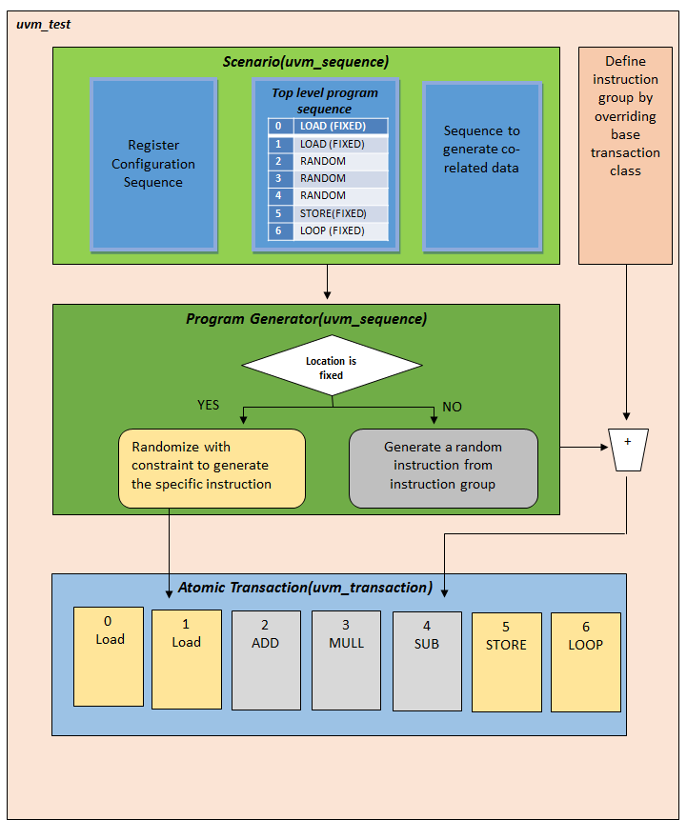
PROPOSED METHODOLOGY
Layered architecture
Scenario
Program Generator
Atomic Transaction

Slide 5
Proposed Stimulus Generation Flow
A fine blend of Top Down control and Bottom layer intelligence
Scenario
Skeleton of the program is generated
Program Generator
It does the decision making based on Scenario level information
Atomic Transaction
Data for the program is controlled
Size of the program is controlled
It Randomizes atomic transaction based on fixed/random type or to a fixed /random instruction
It randomizes all the fields and pack them into one instruction.
Provides the Top Down Control
Bottom layer intelligence
Extension for instruction grouping for better reuse
Takes care of infinite loop
Does instruction operand interlinking

Slide 6
Bottom Layer Intelligence
How to put in this intelligence w/o complicating constraint solver ?
Interesting scenario
load address1, R3
load address2, R4
add R3, R4, R5
store R5, address3
Potential Hazard Candidate
Conventional Way
Randomize the whole program
Use foreach constraint to make relation between instruction operand
Innovative Way
Randomize one instruction at a time.
Keep copy of last few instruction.
While randomizing current instruction 1st decide to what depth (rel_depth) you want to link it
Use last instruction copy & rel_depth to decide the current instruction operand

Slide 7
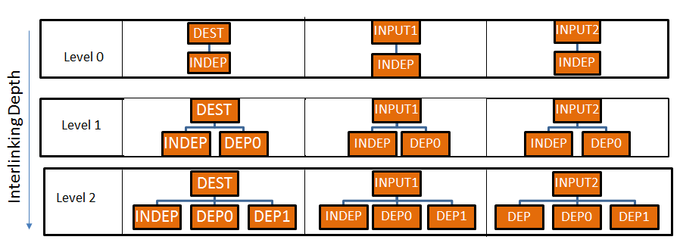
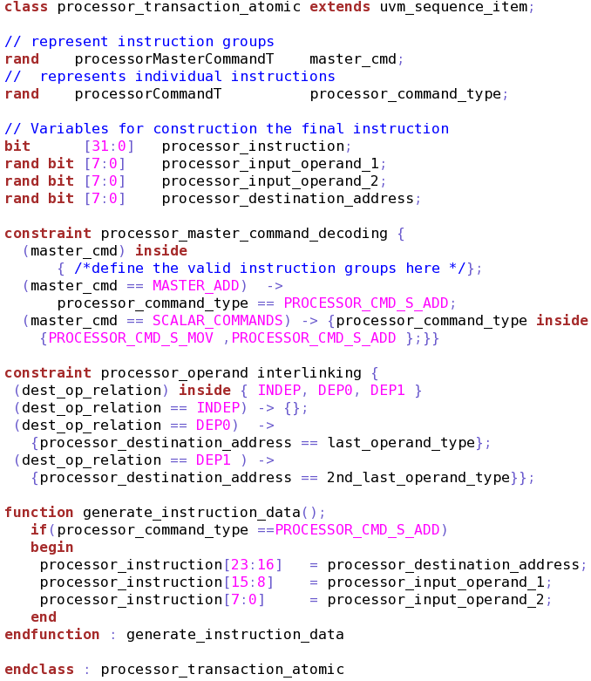
Bottom Layer Intelligence
Operand Interlinking

Slide 8
Bottom layer Intelligence
Jump Length constraints
Loop:
MOV R1,VAL
JMP LEN1
LEN1
INSTRUCTION GROUPS
BRANCH
BEQ
BLT
BGT
BN
BC
ALU
ADD
SUB
XOR
OR
CMP
W-MARK
FILL
SUB R1,1
BZ End
LEN2
JMP LEN2
LENGTH
SUB R1,1
BNZ Loop
End:
HALT
Infinite Loop Avoidance

Slide 9
Debugging Hooks
Debug cannot be an afterthought.
Localization of Failure
Scenario Replication
Zero time Reference model Vs pipelined processor
Checking only at interfaces is not enough for complex scenarios
At some point in time we need to run programs developed by other team
Switch based flow for directed stimulus
Out-of-order execution of pipeline Vs In-order execution of model
Need checker based on register content change – Data trace checker
File & queue based Checker
Debug of Debug

Slide 10
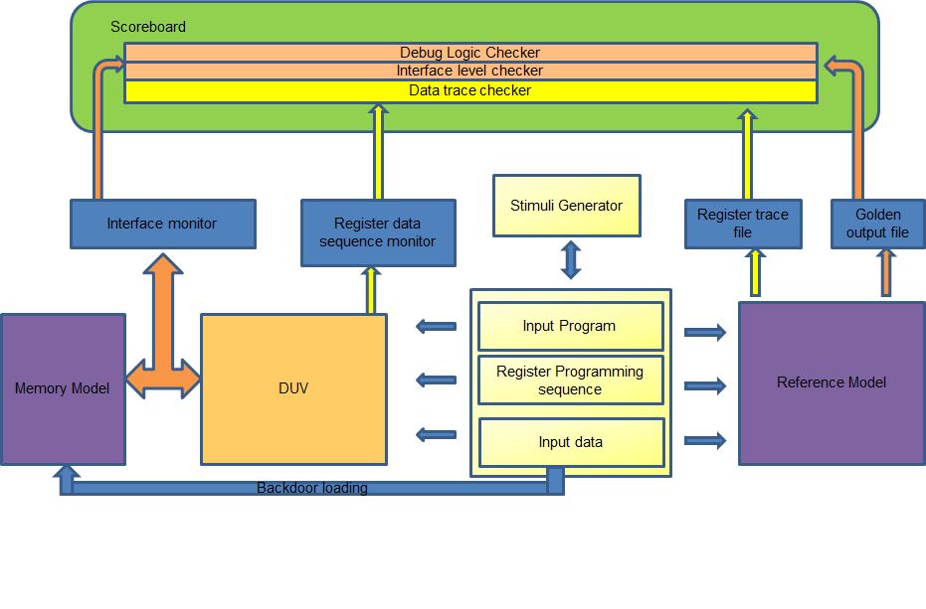
Debugging Hooks

Slide 11
Evaluation of the Proposed Flow
Design Complexity
Scalar, Vector & Matrix operation, 9 ALUs, 4 Multiplier, ~256 GPRs & Hardware Accelerator like SORT, HISTOGRAM etc
Verification
30 man weeks of effort, Verification Environment created from Scratch, ~200 test /15 K runs, ~10 k functional cover points, 200 odd defects were found
First Pass Success
No additional bugs found after IP signoff.
Silicon has been evaluated - considered to be a first pass success.

Slide 12
Thank You Q & A

