Slide 1
A real-world clock generator class for UVM
Rhitam Datta, Design Engineer
Ankit Somani, Design Lead

Slide 2
Topics
Introduction
Importance of clocking signal in design verification: SerDes Illustration
Irregularities in clock
Module based clock generator
Proposed class based clock generator
Generic architecture of class based clock generator
Simulation results
Summary

Slide 3
Introduction
A particular type of signal that toggles between a high state and low state, typically used to manage various operations in digital circuits.
A typical example is a periodic square wave with 50% duty cycle.
Time period $T$
Frequency $F= \frac{1}{T}$

Slide 4
Introduction
It can have duty cycle not equal to 50%.
High time
Low time
It can have different rise time and fall time.

Slide 5
Importance of clocking signal in design verification: SerDes Illustration
parallel_data[7:0]
parallel_clk
serial_data
Serializer
serial_clk

Slide 6
Importance of clocking signal in design verification: SerDes Illustration
parallel_data[7:0]
serial_data
parallel_clk
DeSerializer
serial_clk

Slide 7
Importance of clocking signal in design verification: SerDes Illustration
Exhibits low pass characteristics and includes noise
par_data
par_data
Channel
clk
Serializer
DeSerializer
clk

Slide 8
Importance of clocking signal in design verification: SerDes Illustration
par_data
par_data
clk
Serializer
Channel
DeSerializer
clk
A
B

Slide 9
Importance of clocking signal in design verification: SerDes Illustration
Exhibits low pass characteristics and includes noise
Channel
1 UI
A
B
Transmission of Lone 1 data stream over channel

Slide 10
Importance of clocking signal in design verification: SerDes Illustration
Exhibits low pass characteristics and includes noise
Analog waveform of data
Channel
1 UI
A
B
Transmission of Lone 1 data stream over channel

Slide 11
Importance of clocking signal in design verification: SerDes Illustration
Exhibits low pass characteristics and includes noise
Channel
1 UI
A
B
<1 UI
Transmission of Lone 1 data stream over channel

Slide 12
Importance of clocking signal in design verification: SerDes Illustration
parallel_data[7:0]
serial_data
parallel_clk
DeSerializer
serial_clk
1 UI
Stimulus : Ideal datastream
Ideal scenario simulation

Slide 13
Importance of clocking signal in design verification: SerDes Illustration
parallel_data[7:0]
serial_data
parallel_clk
DeSerializer
serial_clk
<1 UI
Stimulus : Real datastream
Real scenario simulation

Slide 14
Importance of clocking signal in design verification: SerDes Illustration
Ideal clock
Ideal Stimulus
1 UI
Non- Ideal clock
Non- Ideal Stimulus
<1UI

Slide 15
Importance of clocking signal in design verification: SerDes Illustration
Ideal clock
Non- Ideal clock

Slide 16
Importance of clocking signal in design verification: SerDes Illustration
Ideal clock
Non- Ideal clock

Slide 17
Irregularities in clock
Causes the deviation from the periodicity of a periodic signal, often in relation to a reference signal.
Sourced by crystal, electromagnetic interference , cross talk with other signals etc.
May effect the time period or the phase of the clock.
Can be classified in two categories,
Unintentional deviations are always present.
Intentional deviations are introduced to counter certain undesired phenomenon as EMI.

Slide 18
Irregularities in clock
Crystal PPM error
The deviation from the nominal clock frequency, expressed in terms of parts per million (PPM).
$$f_{obs}=f_{0}(1±\frac{crystal_ppm_error}{{10}^{6}})$$

Slide 19
Irregularities in clock
Wander error
Slow noise components, frequency less than 10 Hz, often are considered as Wander.
$$t_{obs}=\left\{\begin{aligned}t_{0}±wander_amount, & clock_cycle_no=mn \\ t_{0}, & else\end{aligned}\right.$$

Slide 20
Irregularities in clock
High probability jitter (HPJ)
Consists of various components such as duty cycle distortion, data dependent jitter, periodic jitter etc.
Generated by passing PRBS data pattern through a low pass filter.

Slide 21
Irregularities in clock
Tonal jitter
Comprised of a single fundamental frequency and prominent in the context of jitter tolerance test of RX.
$$\left.t_{tonal}=t_{tonal_max}\sin\left(2πf_{tonal}nt_{0}) where n=\right.\{1,2,3,…\right\}$$

Slide 22
Irregularities in clock
Gaussian jitter
Caused by silicon imperfection, certain types of cross talk, thermal vibration etc., can be bounded or unbounded.
$UUGJ\left(x\right)=\frac{1}{σ\sqrt{2π}}e^{−\frac{τ^{2}}{2σ^{2}}}$ where τ = x-µ

Slide 23
Irregularities in clock
Gaussian jitter
Caused by silicon imperfection, certain types of cross talk, thermal vibration etc., can be bounded or unbounded.
$$CBGJ\left(x\right)=\left\{\begin{aligned}\frac{1}{σ\sqrt{2π}}e^{−\frac{τ^{2}}{2σ^{2}}}, &|τ|<τ_{max} \\ 0, &|τ|≥τ_{max}\end{aligned}\right.$$

Slide 24
Irregularities in clock
Spread spectrum clocking
Spectrum is spread around the center frequency of clock, to counter effect of EMI.
$$\left.t_{ssc}=t_{ssc_max}\sin\left(2πf_{ssc}nt_{0}) where n=\right.\{1,2,3,…\right\}$$

Slide 25
Module based clock generator
Interface
DUT (Module)
Base Test
Clock Generator (Module)
Test Bench (Module)
UVM Test case

Slide 26
Module based clock generator
Interface
DUT (Module)
Base Test
Clock Generator (Module)
Adding clock control signals
Test Bench (Module)
UVM Test case

Slide 27
Module based clock generator
Interface
DUT (Module)
Base Test
Clock Generator (Module)
Adding clock control signals
Test Bench (Module)
UVM Test case

Slide 28
Module based clock generator
Interface
DUT (Module)
Base Test
Clock Generator (Module)
Adding clock control signals
Test Bench (Module)
UVM Test case

Slide 29
Module based clock generator
Interface
DUT (Module)
Base Test
Clock Generator (Module)
Adding clock control signals
Test Bench (Module)
UVM Test case
Interface becoming bulkier!

Slide 30
Proposed Class based clock generator
Interface
Base Test
DUT (Module)
Clock Generator (Class)
Interface size reduced!
Test Bench (Module)
UVM Test case
Clock control signals not required!

Slide 31
Generic architecture of class based clock generator
class clock_gen ();
// Contents of the class clock gen
endclass : clock_gen
class uvm_base_test extends uvm_test ;
/// Other declarations
clock_gen clk_gen_h ;
function void build_phase (uvm_phase phase) ;
// Other functionalities
clk_gen_h.build () ;
endfunction : build_phase
task run_phase (uvm_phase phase);
// Other tasks
clk_gen_h.configure () ;
clk_gen_h.run () ;
endtask : run_phase
endclass : uvm_base_test

Slide 32
Simulation results
Crystal PPM error

Slide 33
Simulation results
Crystal PPM error

Slide 34
Simulation results
Crystal PPM error

Slide 35
Simulation results
Wander error

Slide 36
Simulation results
Wander error

Slide 37
Simulation results
Wander error

Slide 38
Simulation results
High probability jitter
Tonal jitter

Slide 39
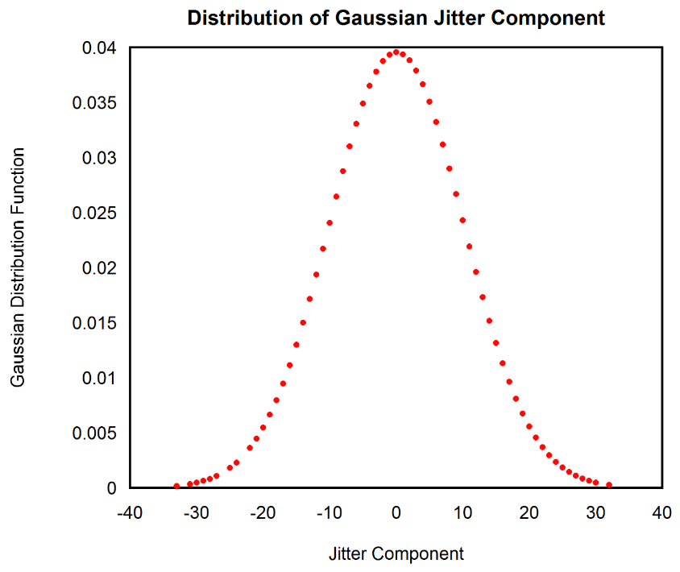
Simulation results
Gaussian jitter

Slide 40
Simulation results
Spread spectrum clocking

Slide 41
Simulation results
Frequency configurability
Duty cycle configurability

Slide 42
Summary
Clocking signals plays important role in verification.
In test bench clocks can be generated by module based clock generator or class based clock generator.
In the proposed method, class based clock generator is instantiated inside the base test of UVM.
This gives direct control over clock generator.
Interface becomes lighter as no clock control signals are required.
Class based clock generator is configurable and can inject non-idealities in clock signals.

Slide 43
Questions ?

