Slide 1
A Generic Configurable Error Injection Agent
for All On-Chip Memories
Niharika Sachdeva, Arjun Suresh Kumar, Raviteja Gopagiri, Anil Deshpande, Somasunder Kattepura Sreenath, Damandeep Saini
Samsung Semiconductor India Research (SSIR)

Slide 2
Agenda
01
Configurable parameters
and patterns
06
Motivation
02
07
On chip Memories
Agent in action
03
08
ECC encoding and decoding
Results
04
09
Existing methodologies
Conclusion
05
10
Proposed Agent
Future scope

Slide 3
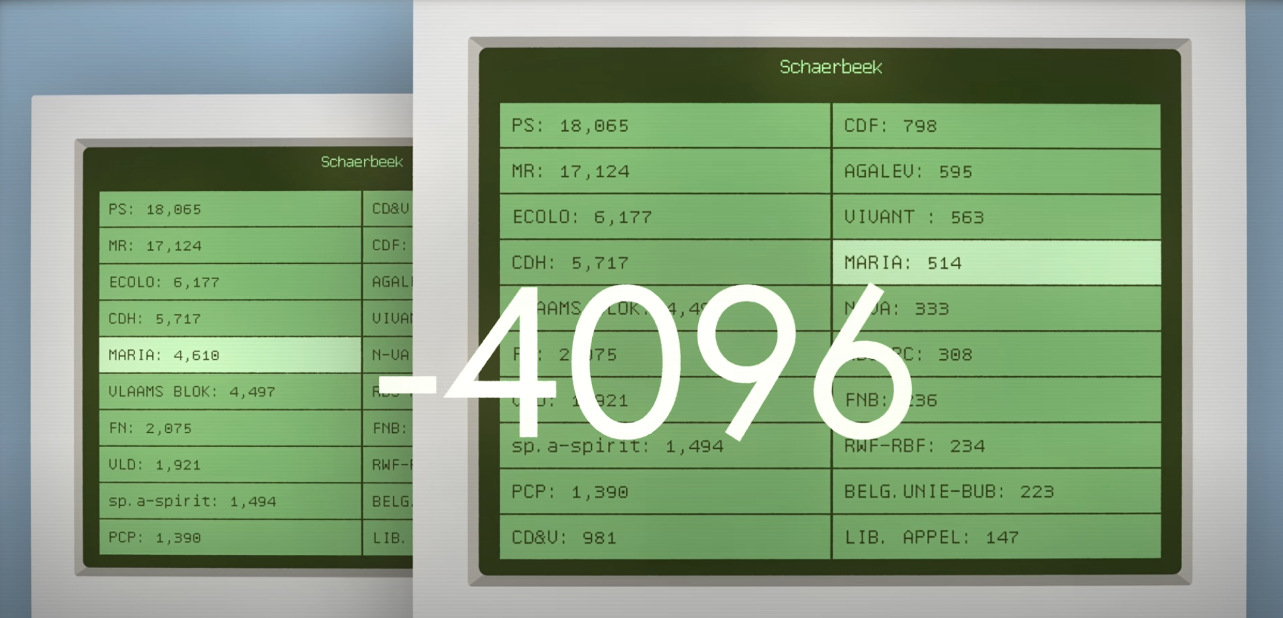
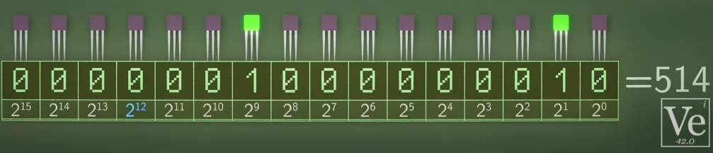
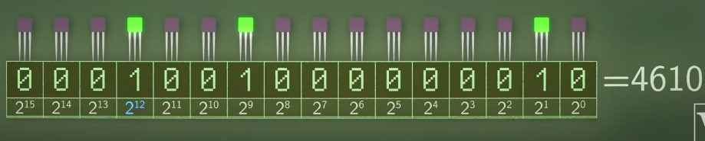
Motivation
Federal Voting: 18th May 2003, Belgium
Memories exist everywhere
High Probability of Bit Flips
Need for Error Correction and Detection
Agnostic verification of ECC Algorithm
Memory Errors
Soft Errors
Hard Errors

Slide 4
On-Chip Memories
On-Chip Memory
Random Access
SRAM
MRAM
EPROM
DRAM
PROM
FLASH
Read-Only
NAND
NOR
EEPROM

Slide 5


Error Detection and Correction
ECC Encoder
ECC Decoder
Data_out[m:0]
Data_rd[m:0]
Detection or uncorrectable flags
Data_in[m:0]
Write data
Read data
Flip or error
Corrected Data[m:0]
parity_out[n:0]
Parity_in[n:0]
Techniques
Parity Code
Checksum
Cyclic Redundancy Check
Hamming code
BCH code

Slide 6
Existing Methodologies
Formal Based
Formal Reasoning
Formal Modelling
Simulation Based
  Error injection (Reactive)
  Memory transaction patterns required

Slide 7
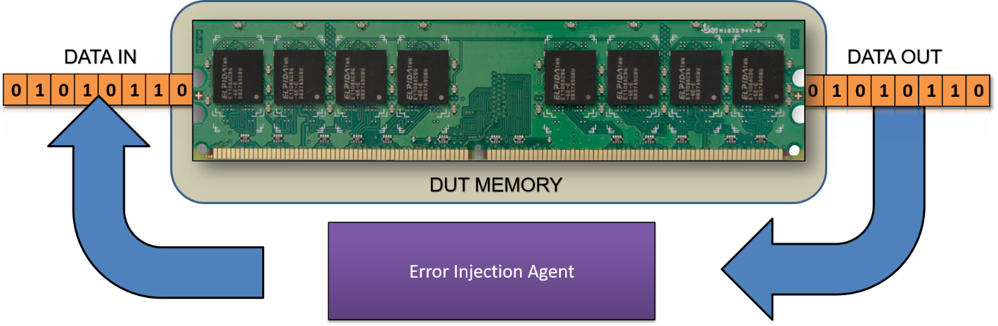
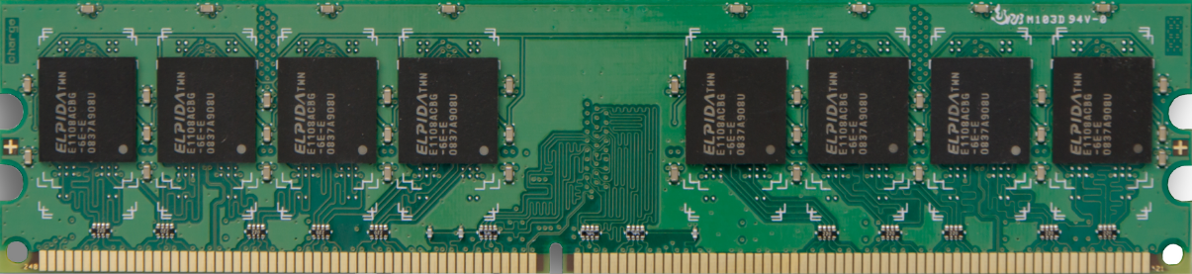
Proposed Agent
Existing VE
Error Injection Agent
DUT IP
0
1
1
0
1
Virtual Interface
1
2

Slide 8
Proposed Agent
TB_TOP (Existing Memory Controller/SoC/StandAlone Memory)
CONFIG_ERRINJ_AGENT
Configuration Class
Virtual Interface
Sequences
Sequencer
DUT
Memory
Virtual Sequencer (Target VE)
Driver
Monitor
Scoreboard
Coverage

Slide 9
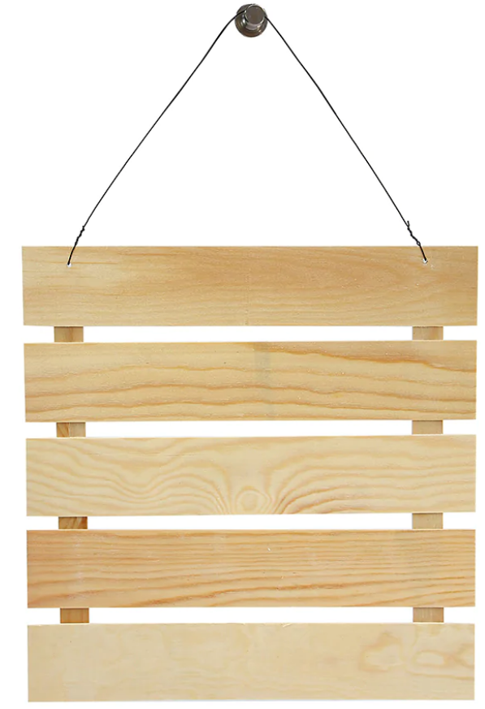
Configurable Parameters and Patterns
Type of Error
SEI,DEI,TEI,MEI
Error Injection Mode
Random,Fixed,Incremental address mode
Ratio mode
MEI in ratios
Non stop mode
Continuously Error injection
Fixed Error Position
Address and Position range
Used to create Stuck at faults
Error Count
Error to be injected on a selected range of Address
Number of ECC’s
In incremental mode, user can configure number of errors injected.
Use Reference Memory
Parallel testing for those blocks whose data width is covered by different ECC modules
To enable or disable checks for Memory DATA IN and DATA OUT
March C
{↨ w0, ↑ (r0, w1), ↑ (r1, w0), ↓ (r0, w1), ↓ (r1, w0), ↨ r0}
Scan
{↑ w0, ↑ r0, ↑ w1, ↑ r1}
Checkerboard
{↑ w0/1, ↑ r0/1; ↑ w1/0, ↑ r1/0}
Random
{↑ w, ↑ r, ↓ w, ↓ r, ↨ w, ↨ r}

Slide 10
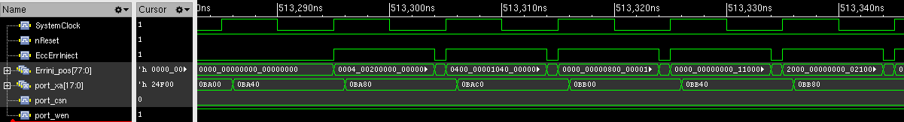
Agent in action
SRAM Memory Signals:
Indicates Read Operation on XA address
EccErrInject:
Tells if Error was injected
ErrinjPos:
Tells which bit position was flipped

Slide 11
Results
Memory Type | Data width | No of ECC Blocks | Number of coverage bins (RTL design code) | Simulation time saved to achieve 100% coverage | Test bench development time saved
MRAM | 64 data bits + parity bits | 1 | 7100 | 25% | 40%
MRAM | 2*(128 data bits + parity bits) | 2 | 18400*2 | 35% | 45%
SRAM | 32 bits + parity bits | 1 | 400 | 20% | 50%
FLASH | 32 bits + parity bits | 1 | 1589 | 25% | 35%

Slide 12
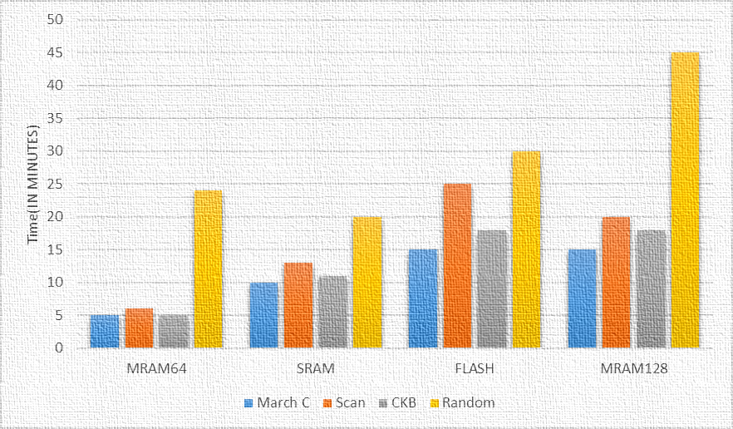
Results

Slide 13

Conclusion & Future Ahead
Early detection of bugs in embedded ECC logic
Comprehensive and early coverage closure for ECC circuit logic
No overhead in simulation time
Easy to integrate with any UVM environment
Optimizing on memory test patterns to close verification faster
Extension on actual memory netlists (non-behavioral model) and then compare the performance metrics.

Slide 14

Questions & Comments

