Slide 1
PSS Case Studies in Real-Life Projects:
H/W Sequence Programming Guides with PSS
PSS Functional Tests for ATE / HVM
M. Rubin^{c}, S. Khaikin^{c}, S. Kumar^{q}, K. Hilligesª
ª Advantest, ^{c} Cadence, ^{q} Qualcomm

Slide 2
Agenda
What is PSS
Existing Industry Trends and usage
Emerging trends and new applications:
  H/W Programming Guides
  Unified environment for Post-Si / ATE
Introduction to PSS realization layer and Core Library
Executable H/W Programming Guides with PSS – deeper dive [Santosh Kumar - Qualcomm]
Unified PSS environment for Post-Si / ATE – introduction
[Klaus Hilliges - Advantest]

Slide 3
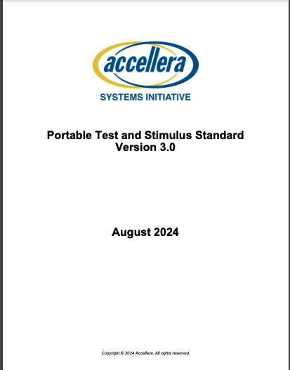
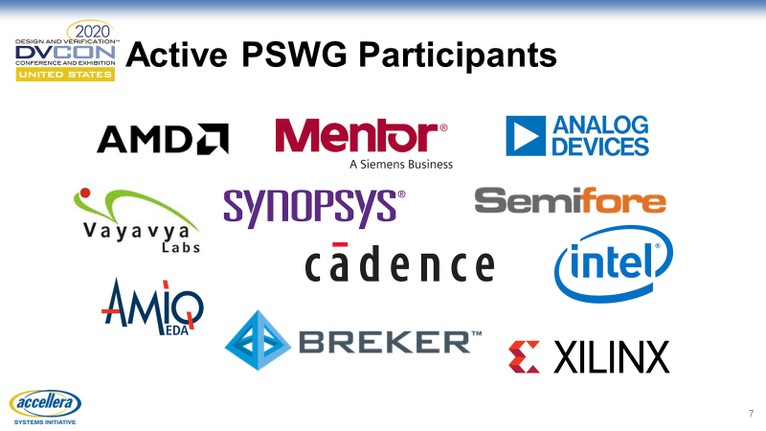
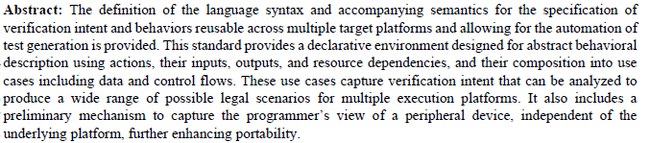

What is PSS – Portable Test and Stimulus Standard
PSS is :
Abstract:
…This standard provides a declarative environment
designed for abstract behavioral description
using actions, their inputs, outputs, and resource
dependencies, and their composition into use cases
including data and control flows.
Modeling Mindset + Methodology
Set of Abstractions
Language for Modeling Scenario Spaces
These use cases capture verification intent
that can be analyzed to produce a wide range
of possible legal scenarios for
multiple execution platforms …
Domain-Specific
Portable
Industry Standard
https://www.accellera.org/images/
downloads/standards/pss/
Portable_Test_Stimulus_Standard_v3.0.pdf
Notes:
What is PSS ? In short, it is an industry standard, developed by Accellera Working group. You can download the LRM from Accellera website.
To answer “what is PSS” in more detail, let’s parse through a couple of sentences from it’s abstract. It contains a few keywords that highlight some key concepts and considerations.
First concept is “declarative environment”. Unlike procedural computer languages, where programmer must code step-by-step instructions to accomplish a goal, declarative environments are primarily about describing the goal itself, along with modeling rules that capture legal paths for reaching this goal. Because of this difference, PSS reflects a different mindset which lends itself to certain usage methodology.
This declarative environment is designed to capture abstract behavioral description. PSS defines the required set of abstractions. Any time we talk about “abstractions”, we need to ask what these abstractions represent, especially what detail they abstract away. For the most part, PSS defines abstractions that gloss over test implementation detail. In PSS, it is all about system use-case. It is a behavioral modeling language that spans scenario spaces.
Having said that, PSS is not about modeling just any behavior in life. It is specifically about *verification* intent, meaning that PSS is domain-specific. In other words, PSS focuses on the essential domain-specific semantic layer and links with other languages to achieve other related purposes.
The abstract also mentions multiple execution platforms, hinting at the fact that Portable Test and Stimulus Standard is, indeed portable.
Finally, PSS is an industry standard, supported by key EDA vendors and used by a wide variety of semiconductor companies within constantly widening scope of applications, which we will cover during the talk.

Slide 4









Usage of PSS – Current Industry Trends
Portability and Reuse
Test Automation
Coverage maximization
Ready-To-use content
Shift-Left
*Companies with public PSS related papers

Slide 5
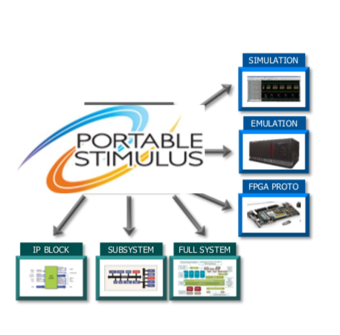
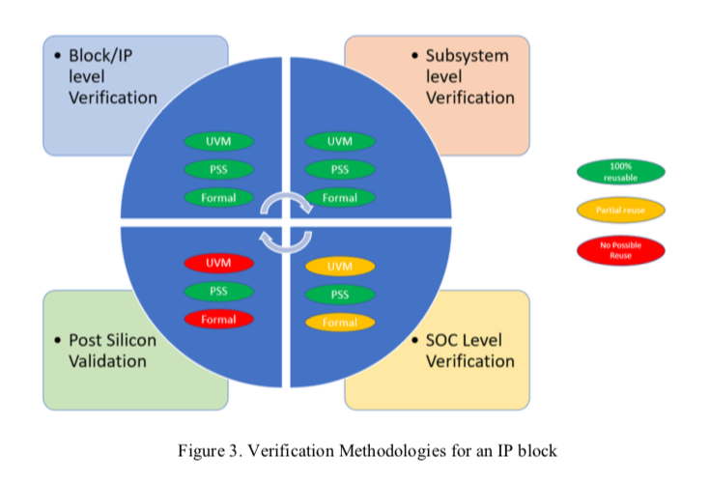

Source: Intel paper at DVCON Americas
Portability and Reuse
Vertical Reuse from IP to SoC
Portable Test intent and Register programming sequences
Generate Tests for UVM Testbench or CPU Cores
Horizontal Reuse across engines
Abstract test definition at PSS with flexible realization per target platform
Project to Project reuse
Abstract tests and configuration enables smooth transition between projects
e.g. existing C driver routines or SV sequences
Built-in tests binding to Simulation VIPs, accelerated VIPs

Slide 6
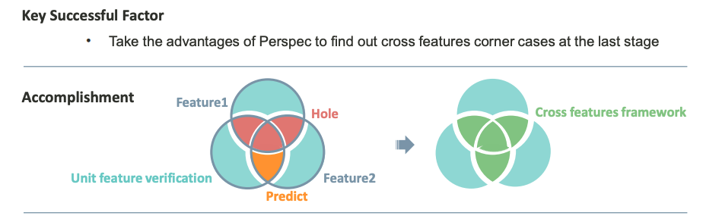
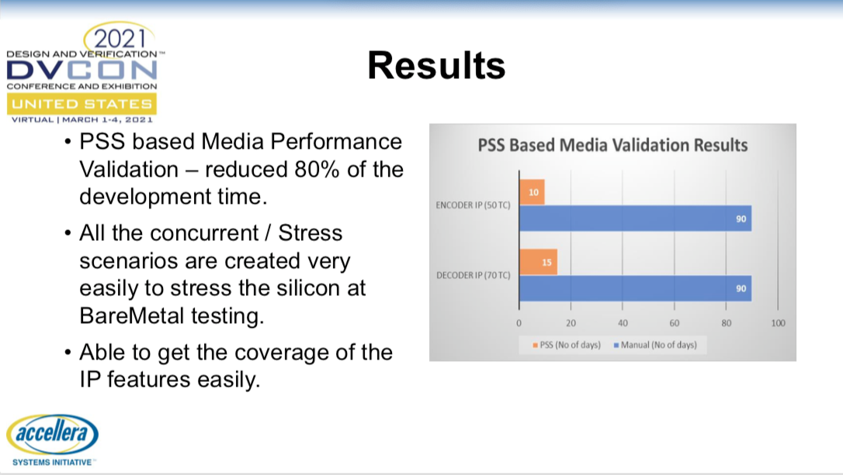
Test Automation
Efficient Test Authoring
Use powerful PSS solvers to create tests that are hard to code manually
Automated stimulus generation
Random control and data flow scenario scheduling
Partially defined tests
Enables the user to define the critical aspects of a scenario space
Easily direct test generation to target legal scenario space
Easy to cross scenarios and create corner cases that are hard to manually predict
Perspec automatically generates relevant tests based on
Source: MediaTek paper at CDNLive
Notes:
Key use case: coalesce IP and Subsystem flows into full chip tests
Use action inference to partially specify the tests, focusing on the goal

Slide 7
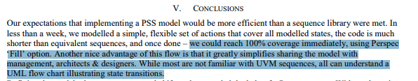
Coverage Maximization
Upfront analysis of legal scenario space
Directs solving to reach all interesting cover points
Efficient regression planning
Generate and run tests that contribute to coverage
Unified coverage analysis
Collect and analyze coverage from all execution platforms
Coverage can be analyzed and reasoned before test execution
Source: TI paper at DVCON Europe
Source: MediaTek paper at CDNLive

Slide 8
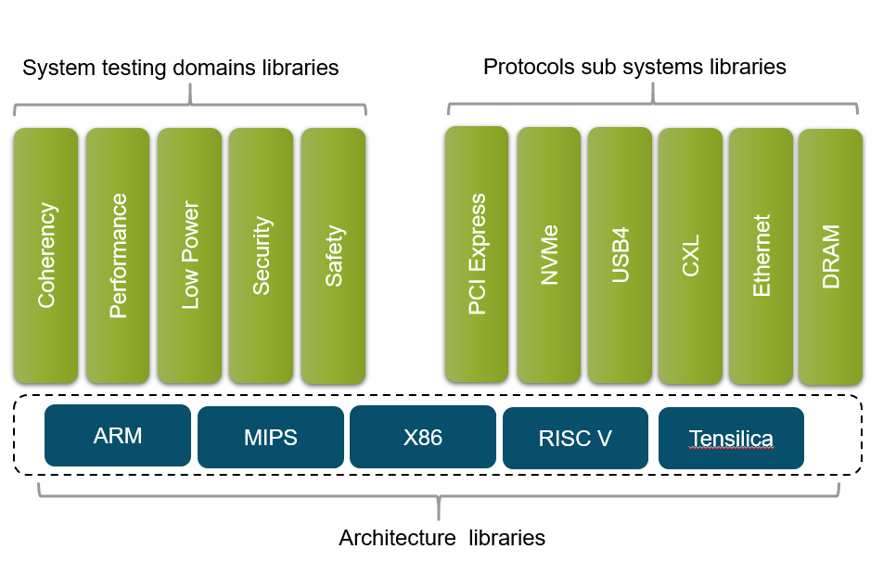


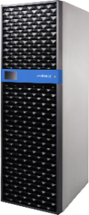
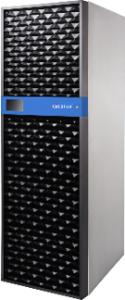
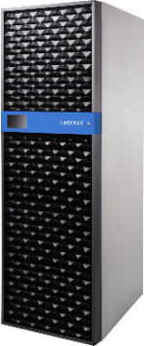



Ready-To-use content
Tests Libraries for common SoC domains
Highly configurable, out of the box solution for verifying cross concerning SoC verification problems
Multiple Architecture support
Tests scenarios are decoupled from the target design architecture
Pre-integrated with VIP and AVIP
Run seamlessly on CPU cores or through VIP/AVIP
Delivered with test suite, verification plan and user extensible scenarios
Can be targeted to execute on virtual platforms, simulation, emulation, FPGA or post-silicon environments
Can be targeted for ARM, RISC-V and x86 based designs
Xcelium
Simulation
Helium
Virtual Platform
Palladium
Emulation
Protium
Prototyping

Slide 9
PSS/Perspec™ Sweet Spot
Fast value demonstration/saves time/expertise
Pain of creating effective tests
Complex SOC, Embedded tests
Out-of-the-box content for CPU-sub systems
(ARM, RISC-V, x86)
Emulation/fast platforms
Pain of less/lack of infrastructure for test/debug

Slide 10
Industry’s adoption of PSS and Perspec
Industry moves to mass adoption
  Multiple real-life industry reports
Gradual growth of PSS echo-system
  vendor support, 3rd party training, public material
Penetration across wide range of existing applications
New applications and trends emerge:
  PSS for Device Programming Sequences and executable H/W Programmer’s Guides
  Unified PSS environment for Post-Si testing on ATE
*Companies with public PSS related papers

Slide 11
Emerging trends and new applications

Slide 12
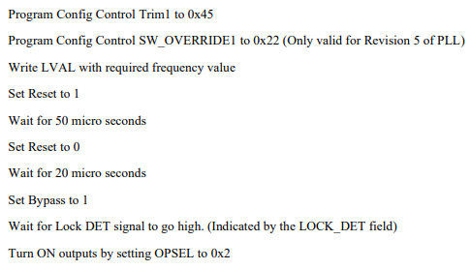
PSS for Device Programming Sequences and executable H/W Programmer’s Guides: Scope and Motivation
Why NOT Natural Language ?
Lacks precision
Ambiguous
Informal – difficult to automate
No Single source of truth
  No traceability
  No back propagation
HPGs must be executable AND portable
  IP → SV/UVM/UVM_REG
  SS → UVM/C
  SoC → C
Natural Language Documents
IP level verif
Conversion to SV/UVM sequences
SubSystem level verif
UVM/C driver conversion
Instance mapping for registers
SoC level verif
C driver conversion
Re mapping of register instances
SoC bare metal Si validation
C driver functions
Firmware bringUp
Software quality driver code
Notes:
For interpretation example : talk about “ wait for 5 clock cycles” as an example where this might be vague
Does not talk about which clock
For higher integration levels this may have to be converted to time rather than cycles to insert delay
Info regarding specific versions or parameters of an IP
Verification of a prog seq → validation of scenarios that require such sequences

Slide 13


Deploying Portable, Executable HPGs, at Scale:
Register structural description converted to PSS Reg model
Designers Author sequences in PSS instead of natural language
PSS REG PKG Generator
NATIVE Mode Verification
(using CPU)
ENV where a processor in RTL drives stimulus. Scenario is a proc executable that is run in a Simulation, Emulation, prototyping or Silicon ENV
C Seq output
REG DESC
C ENV
Designers
PSS REG MODEL
PSS HW SEQ
UVM Agent based verification
ENV where the scenario and initialization sequences are driven using a TB component such as an UVM Agent
DPI-C Seq output
PSS TOOL
(Perspec)
EXPORT MODE
PSS Models
UVM ENV
DV Engineers
SOLVE-GEN MODE
Hybrid ENV based verification
HPG Doc
FW reference generated where tool generated output cannot be currently used directly as Production code
DV ENVs that are built using PSS can integrate the PSS HW sequences as realization layer of their model
Scenario models couple with initialization actions built using the HW Seq as building blocks
HW Seq Doc
C Test output
PSS ENV
FW reference

Slide 14

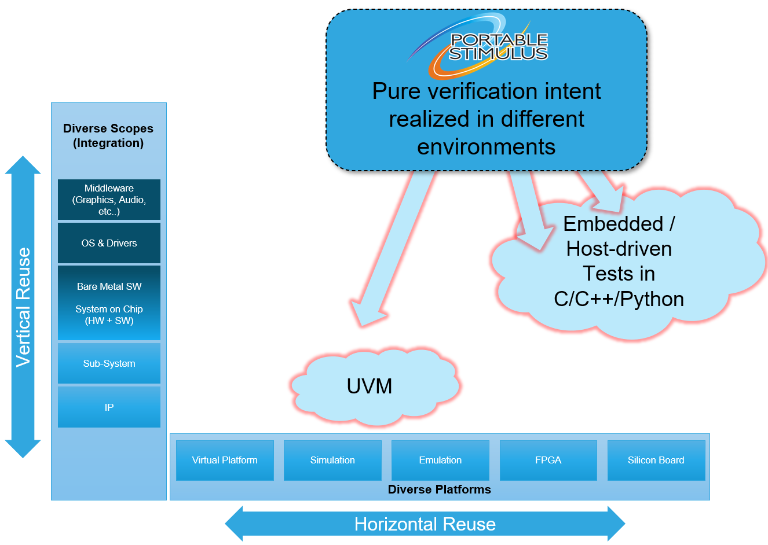
Shifting Left with PSS
Layered Architecture of PSS Separates
Test Intent from Implementation
Typical PSS environment:
  Hierarchy of abstract models – SoC, SubSys, IP
  Residing on top of Test Realization Layer
Scenario Modeling Layer: Abstract Description of Behaviors
Captures Use-Case Scenarios and Leaf (atomic) Behaviors
Declarative Language
component IP_uart {
action init{}
action config{}
action tx{}
action rx{}
}
component IP_dma {
resource chnl{}
…
}
Architect
Verification
Engineer
Test Realization Layer: Implementation of Leaf-Level Behaviors
Captures Device Programming Logic
Procedural Language
Core Library for modeling Programmer’s view of H/W
FW
Developer
Programmer’s view of a generic H/W device:
System Memory and Address Spaces
Data layout and access operations
MMIO regions and register files
Target APIs - firmware and driver libraries
HW
Designer

Slide 15
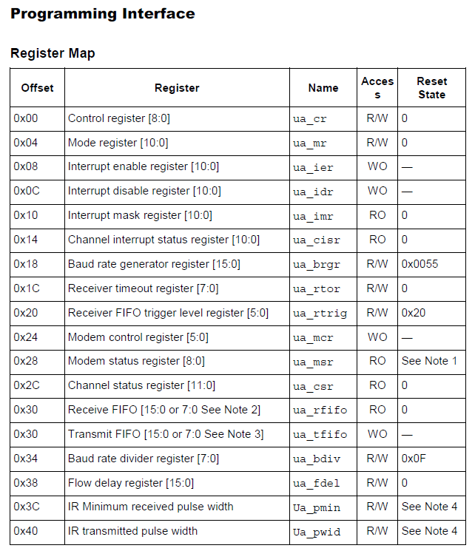
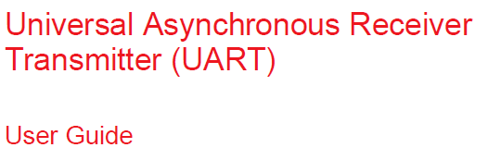
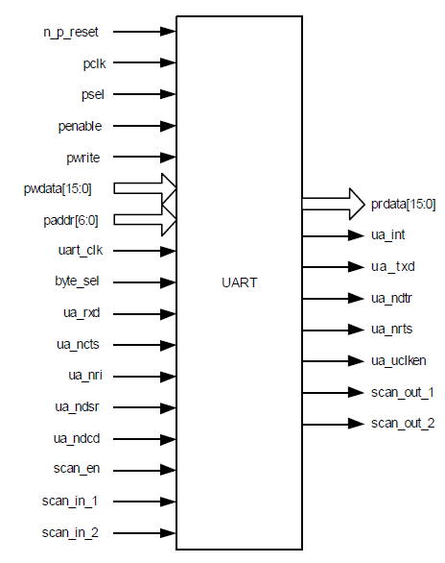
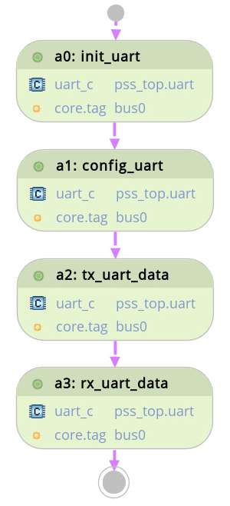
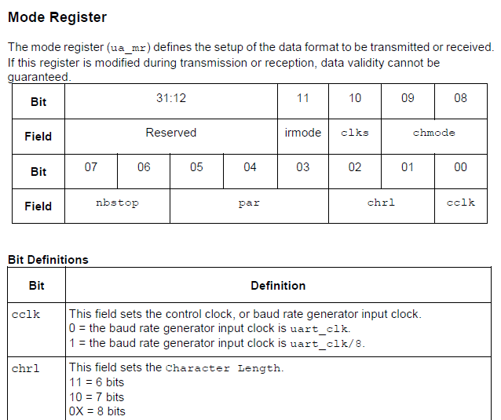
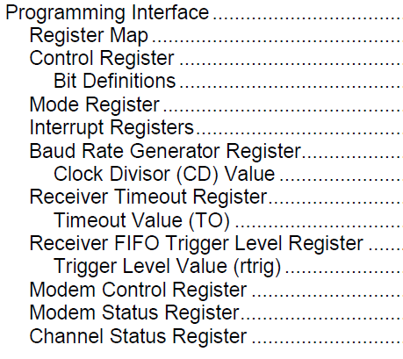
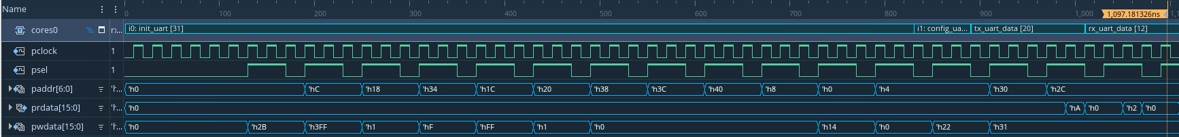
HSI example: APB Programmable UART IP
Program UART registers to activate the device via HW/SW Interface
Review H/W Programming Guide Documents
Typical Use-Cases:
IP HW/SW Verification
Driver Development
HSI
Exercise four basic UART behaviors:
initialization
configuration
data transmission – TX,RX
HSI
Notes:
This slide explains the concept of HSI (H/W – S/W Interface) and typical work-flow of

Slide 16
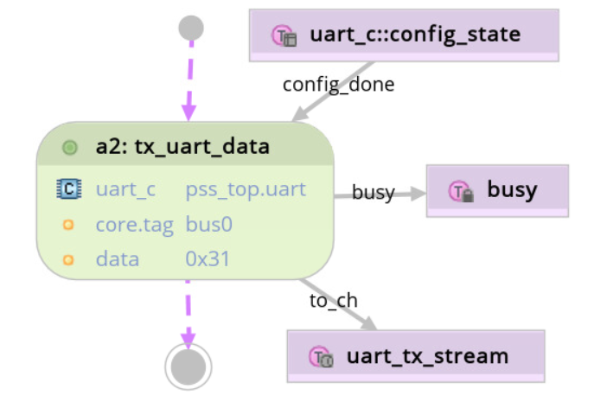
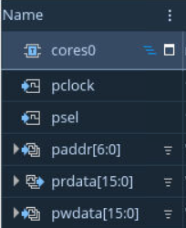
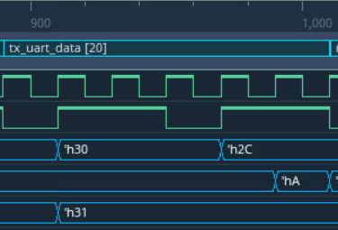
The Anatomy of PSS Layered Architecture: Zoom-in into a PSS Action
action tx_uart_data: uart_base {
output uart_tx_stream to_ch ;
input config_state config_done;
constraint config_done.done == true;
// Only one tx at a time
lock uart_tx_status_r busy ;
rand bit[8] data;
constraint to_ch.data == data;
}
Atomic actions correspond directly to operations of the underlying system under test and test environment
Scenario Modeling Layer
Atomic actions capture high-level characteristics of a behavior using inputs, outputs, attributes and constraints
Test Realization Layer
extend action tx_uart_data {
exec body {
// UART transmit FIFO register - local copy
uart_ctrl_ua_tfifo_reg_s tfifo;
// Populate local copy with the transmit data
tfifo.data[7:0] = data;
// Write local register copy into H/W
comp.regs.ua_tfifo.write(tfifo);
// Wait for TX completion – polling a register
while (comp.regs.ua_csr.read().tempty == 0) {
message(NONE, "Checking Transmit done");
yield(); }
}}
PSS is Aspect Oriented
Keyword extend allows adding functionality to existing actions, without creating a new action type
Realization layer:
Implementation of runtime
behavior of leaf-level actions is specified with procedural constructs inside exec blocks

Slide 17
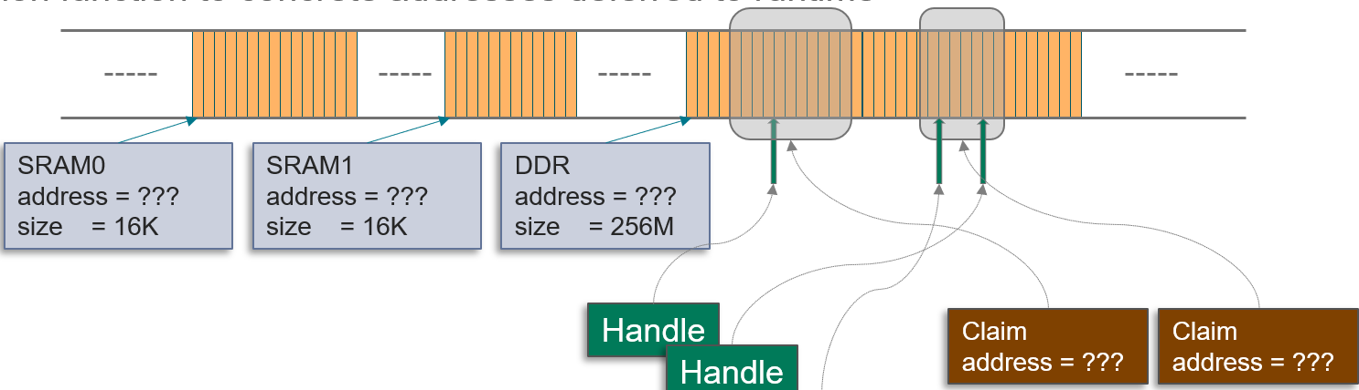
PSS Test Realization Layer: Key Ingredients
Portable Device Programming Code
Exec Blocks
Exec blocks utilize procedural constructs to interact with Programmer’s view of a device via
register access functions
memory access functions
imported target functions
Procedural Constructs
Control Flow Constructs
Conditional Constructs
Native PSS Functions
Assignments
Scoped Blocks
Iterative Constructs
Variables
Operators and expressions
Programmer’s view
of H/W device
PSS Core Library
Memory Model
Register Model
PSS Core Library and Foreign Procedural Interface enable modeling of
Device Programmer’s view
Execution Context Model
Memory Access Functions
Register Access Functions
Foreign Procedural Interface
Address Handles
Registers
Executor Claims
Address Claims
Register Groups
Imported Target Functions
Executors
Address Regions
Executor Groups
Address Spaces
Basic PSS Language Features
Essential elements of PSS language, used by upper layers
Plain Data Types
Domain-Specific PSS Types
Aggregates
Scalars
Structs
Structural Entities
Behavioral Entities
Collections
Components
Pure Components
Compound Actions
Atomic Actions
Templates: Generic Parameterized Types
References

Slide 18
Simplifying Register Programming with a RAL
Register Access Layers exist to simplify reading/writing registers and avoid mistakes
  Define mnemonics for registers and fields, so we don’t have to remember addresses and bit positions
Most methodologies have one or more RAL
  C/C++ -- structs, unions, macros
  UVM – UVM register model
  PSS – PSS register-access layer
Most device-specific RALs are generated from a higher-level description
void init_uart(char *regs, char bits,
char stop, char pen, char pev) {
regs[3] = ((bits-5) | stop << 2 |
pen << 3 | pev << 4);
}
void init_uart(uart_regs *regs, char bits,
char stop, char pen, char pev) {
uart_lcr_reg val;
val.bits = (bits-5);
val.stop = stop;
val.parity_en = pen;
val.parity_even = pev;
regs->lcr = val;
}

Slide 19
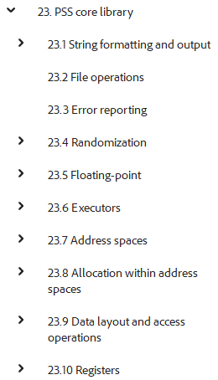
PSS RAL Overview
PSS defines data types for capturing a RAL in the Core Library
The PSS RAL targets the requirements of bare-metal software tests
  Light-weight, intended to enable tools to scale to huge register maps
  Portable across execution platforms and integration levels [IP, SubSys, SoC]
The RAL for an IP is easily reused in a larger system context
  Self-contained and addressed relative to its parent
Provides access methods that simplify programming-sequence creation
  Read/write by integer value
  Read/write by bitfield view
  Read/modify/write operation to update fields with compact code

Slide 20
Defining PSS Register Layout
PSS packed struct specifies register field layout
  Specify width of each field
  Position specifies the offset within the register
PSS register group collects registers
  Contains reg fields defined in terms of packed structs
  Implements a function to map fields to relative offsets
PSS RAL types are defined in the PSS Core Library
struct uart_ctrl_ua_mr_reg_s : packed_s<> {
bit[1] cclk;
bit[2] chrl;
bit[3] par;
bit[2] nbstop;
bit[2] chmode;
bit[1] clks;
bit[1] irmode;
bit[20] reserved;
}
pure component uart_ctrl_regs : reg_group_c {
reg_c<uart_ctrl_ua_cr_reg_s,READWRITE,32> ua_cr;
reg_c<uart_ctrl_ua_mr_reg_s,READWRITE,32> ua_mr;
pure function bit[64] get_offset_of_instance(string name) {
if (name == "ua_cr“) return 0x0;
if (name == "ua_mr") return 0x4;
}
}

Slide 21
Reading/Writing Registers with the PSS RAL
rand bit[2] stop_bits;
constraint stop_bits == 2;
exec body {
ua_mr_reg_s mr_reg_temp;
mr_reg_temp.par = 1;
mr_reg_temp.nbstop = stop_bits;
mr_reg_temp.chmode = 0;
// Write Mode Register
comp.regs.ua_mr_reg.write(mr_reg_temp);
}
PSS registers provide several read/write APIs
Single-call read-write-modify simplifies programming sequences
Register Access Function | Purpose
void write(packed_s reg_struct) | Write register struct
packed_s read() | Read register struct
void write_val(bit[SZ] reg_value) | Write register value
bit[SZ] read_val() | Read register value
rand bit[4] mode;
rand bit[16] coeff;
exec body {
comp.regs.cr.write_fields(
{"mode", "coeff"}, // field names
{mode, coeff}); // values
}
Register Access Function | Purpose
void write_masked(R mask, R val) | Masked write of a struct
void write_val_masked(bit[SZ] mask, bis[SZ] val) | Masked write of a integer
void write_field(bit[string name, bit[SZ] val) | Write a named field
void write_fields(list<string> names, list<bit[SZ]> vals) | Write a set of named fields

Slide 22
How is a PSS RAL Created?
We could hand-type, of course…
But, many tools exist to help
RTL
IP-XACT
UVM
Register
Automation
Tool
PSS
SystemRDL
Docs
Custom
(CSV, XML)
Etc…

Slide 23
Executable Hardware Programming Guides using PSS Register Library – Deep Dive

Slide 24
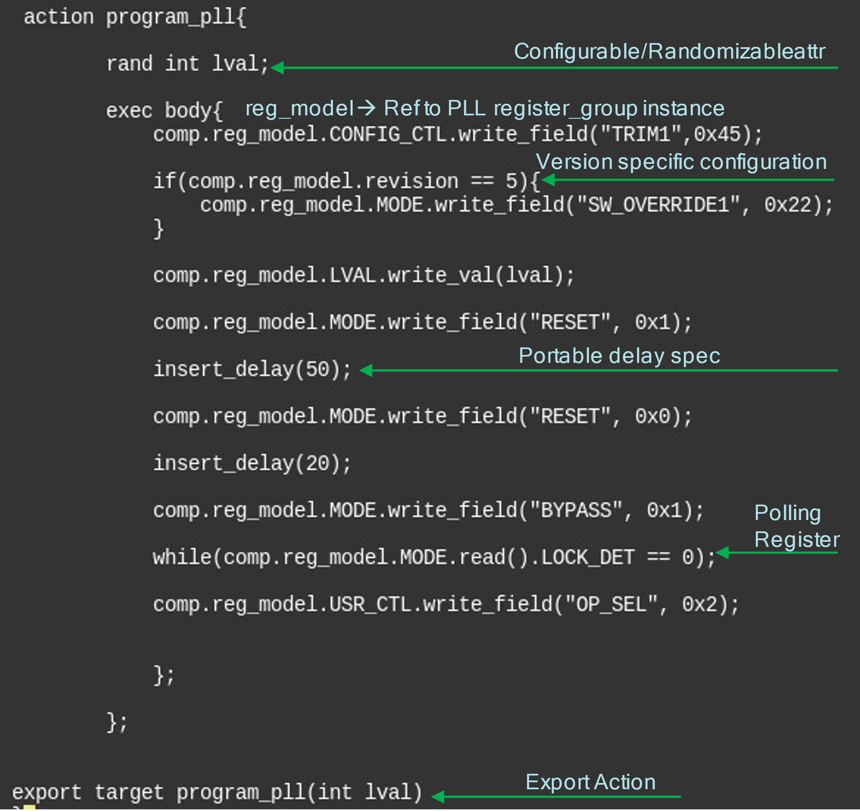
Natural Language vs PSS sequence
Notes:
Advantages: portable, formal, standardized, randomizable, target PI available to invoke generic platform functions e.g. insert_delay()

Slide 25
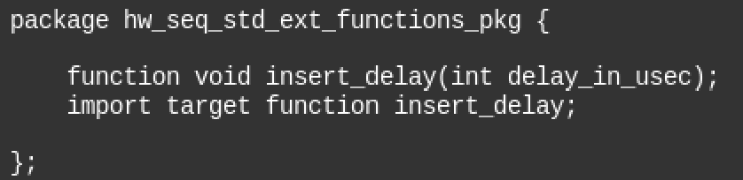
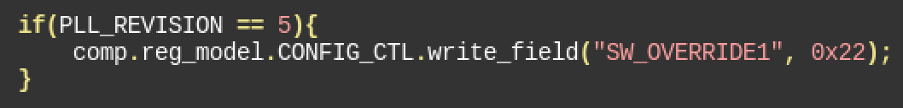
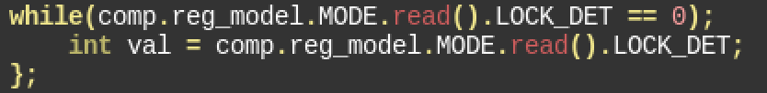
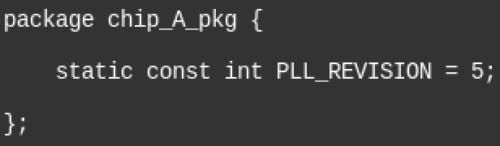
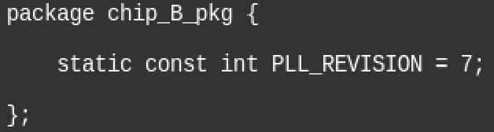
Key PSS Sequence Highlights
Imported target functions Allow standardized prototype
  Type mapping from PSS to target language
  Commonly used functions could be standardized in a package
Control flow
  Gen/solve time control
  Run time control
Product configuration
  Extensions allow appropriate definitions of the package to be loaded

Slide 26
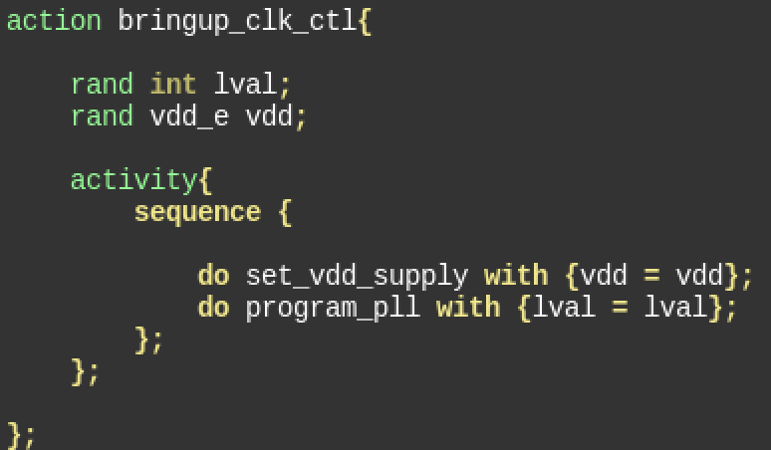
Compound sequences
Bringup_clk_ctl is constructed using building block actions
  Ability to express sequencing order
  Control configurable values of underlying actions

Slide 27
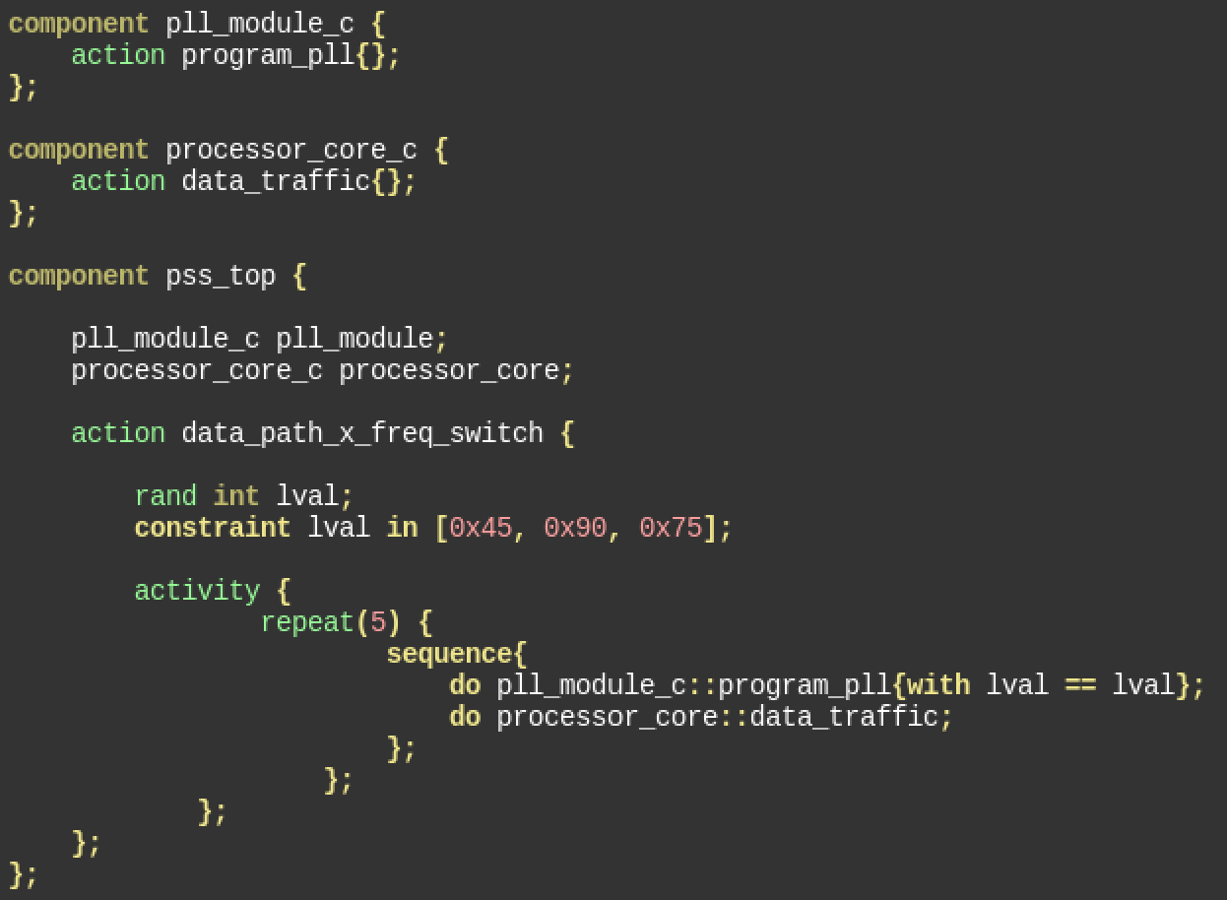
Native PSS Scenario integration
Pll_module_c is the component containing the programming sequence definition
  represented by the action program_pll
  Implemented using pss_reg as seen earlier
Processor_core_c is a component that represents a proc IP in the system
  Contains actions to perform data_traffic
Data_path_x_freq_switch
  Represents the scenario action
  This is the action that is solved and code generated that is run on a target platform

Slide 28
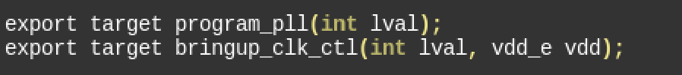
PSS export
Argument list and argument type
Export statement
Action name
Function prototype
Export is the ability PSS provides to convert an action into an API
  Enables use of the PSS described sequences in non-PSS environments
The export statement specifies the rules for the export
  Function prototype
Argument list
  subset of the action attributes
  argument attributes are unsolved during export
  non argument attributes are solved as per constraints
Action to be exported
  Action could be atomic or compound

Slide 29
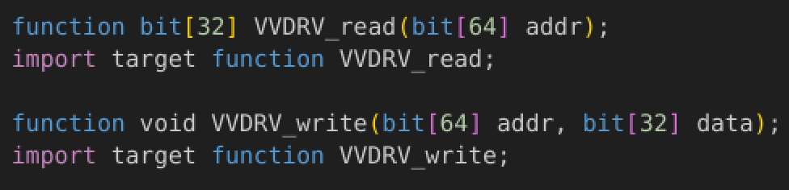
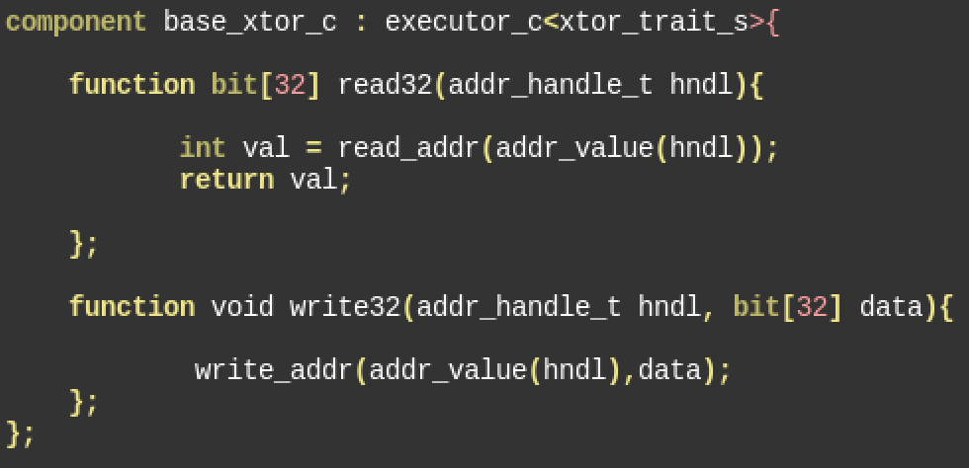
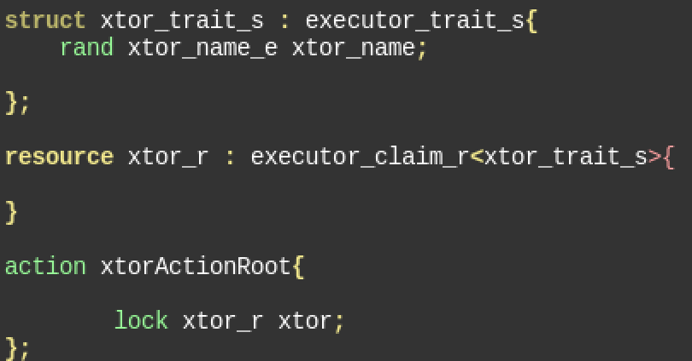
Executor customization
Functions called in exec body could be customized as per the executor chosen for the action
  This could be pre defined primitives such as write32, read32 etc
  Could also be user defined executor functions provided by extending executor_c component
  Read32 and write32 as explained earlier are automatically mapped to the provided executor function in the generated code
Executor customization is the key concept we will use to utilize the PSS described sequences in a non PSS ENV

Slide 30
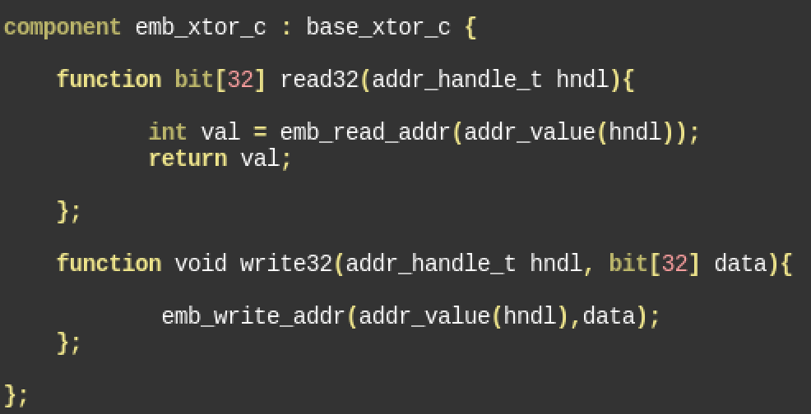
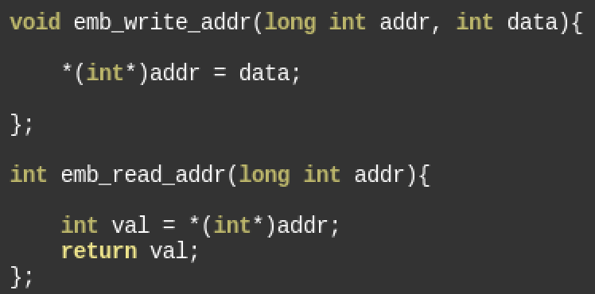
Embedded ENV integration workflow
Emb xtor addition in pss model
External Function C file
Embedded executor component is added to the PSS model
Templatized using the same standard trait struct (since inheriting from base_xtor_c)
Export of the action is done by setting xtor.trait.xtor_name == emb_cpu
This will set the read and write APIs for the registers to the functions provided for this xtor type (emb_xtor_write/emb_xtor_read)

Slide 31
Embedded ENV integration workflow
main(){
  Initialize(initCfg);
  test();
  post_test_check();
}
Initialize(initCfg){
  power_config(pwrCfg);
  Clock_config(clkCfg);
}
Clock_confing(clkCfg){
  program_pll(clkCfg.lval)
}
Pll_config.c
Program_pll(lval)
Power Driver_lib
Test content lib
Clk Driver_lib
periph Driver_lib
Program_pll(int lval){
//hand written
}
Program_pll(int lval){
//pss_export
}
Compile and Link
Test image
PLL_config.c is the file containing the exported action
Generated by PSS tool (eg Perspec)
Provides control on API name, file name, output dir control etc for smoother integration
Existing Test Code is used as is
No change to existing setup
Only required drivers are updated with generated Code
Allows for staged transition
Clk Ctl
Memory
CPU
Power Ctl

Slide 32
Test Bench example
TB TOP
TEST
UVM Reg model
Test Sequence
Config Sequence
UVM Reg wr/rd API
ENV
Virtual
Sequencer
RAL layer
AHB Agent
AHB Read/Write
DUT
Sequencer
AHB Config Intf
Driver
Monitor

Slide 33
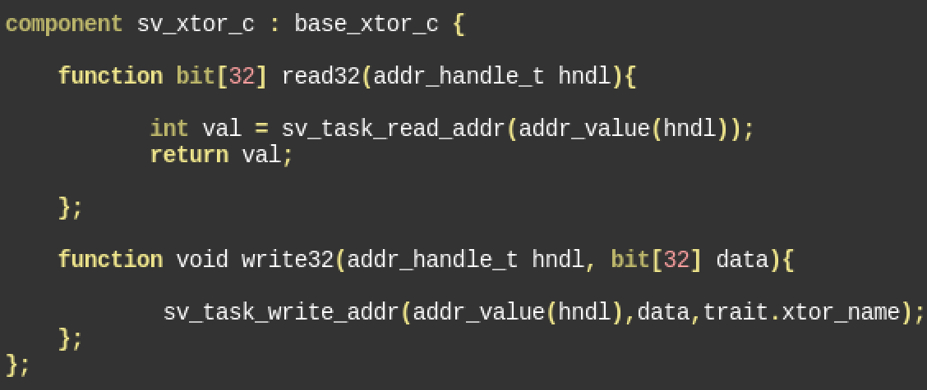
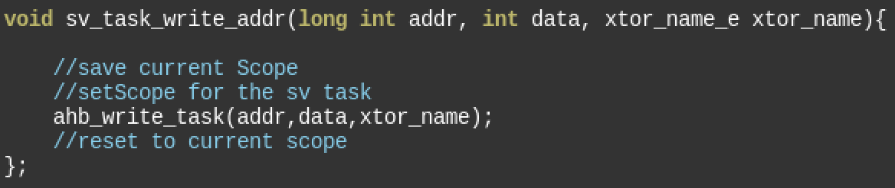
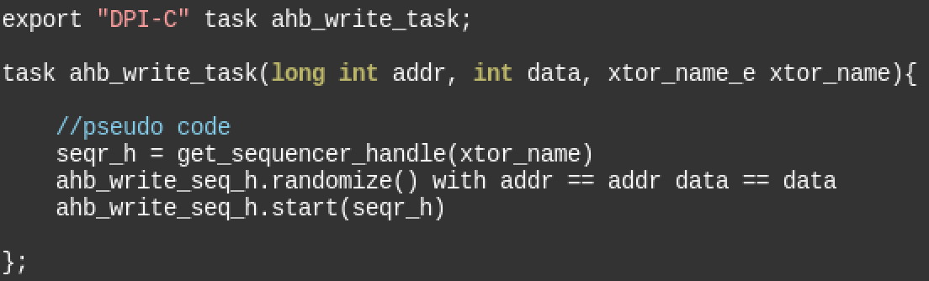
SV/UVM ENV integration example
Sv_xtor_c also templatized using the xtor_trait_s
Actions exported for use in SV/UVM env should have the xtor.trait.xtor_name set to sv_cpu
sv_task_write_addr is DPI-C function defined that also takes in xtor_name as argument
Ahb_write_task uses the xtor name to retrieve the sequencer handle
  This is important for cases where the TB has multiple UVM agents bound to different DUT interfaces

Slide 34
SV/UVM ENV integration example
Program_pll is the exported API
Generated by the PSS tool
PSS tool generated DPI-C compliant code
Task_program_pll in the init_task is a DPI-C import
Program_pll is compiled and linked with as a shared object with the simulator
my_test represents an existing uvm_test in a TB
The virtual sequence called by the test calls different SV tasks in a particular order
Any task/sub-task that represents a device programming sequence can be substituted by the one generated by the PSS tool
My_test
Virtual seq
Program_pll()
Init_task
Task_Program_pll
scenario_task

Slide 35
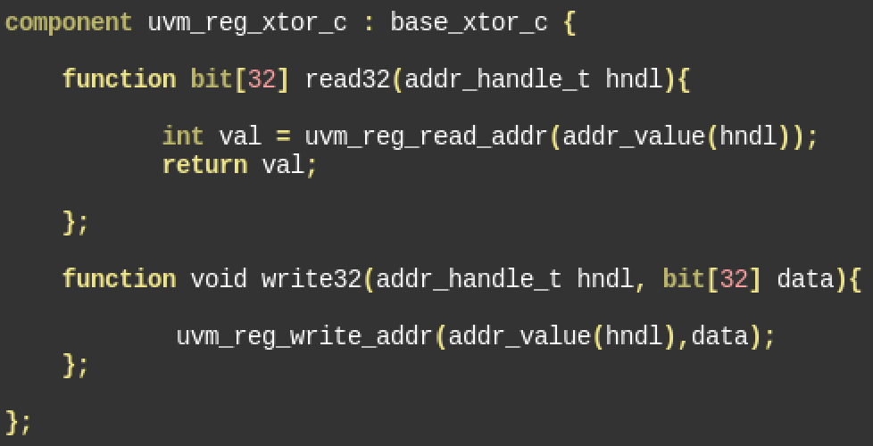
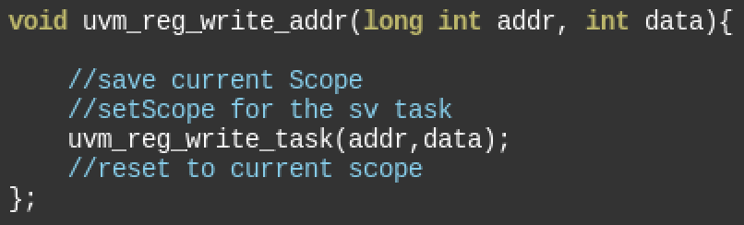
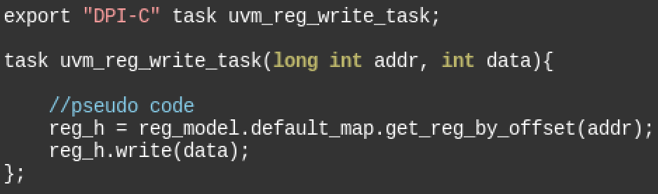
UVM reg integration
uvm_reg based integration is very similar to the regular sv_uvm approach
Main difference is in the implementation of the task
PSS export provides only address and data
The task retrieves the corresponding register handle using the get_reg_by_offset method
This allows use of any existing RAL layer in the test bench
Also allows use of any existing uvm_reg based coverage models

Slide 36
Summary
PSS provides a rich set of constructs to
  Describe a register model
  Describe complex device programming sequences
  Standardize and Import target platform functions (delay, message etc)
Export construct
  Allows converting PSS actions into an API
  Executor customization further tunes generated code for specific platforms
Platform integration in multiple environments
  We could see integration into existing tests and test benches
  Embedded, SV/UVM and UVM reg based environments

