Slide 1
Power Dynamics: Shaping the future of the data centric era
Amir Attarha, Ph.D.
Siemens EDA
DVCON US 2025
Notes:
Some key trends I understood
#1: Things are changing a lot around the SW, SW defines what HW needs to be. That’s why companies are doing purpose build accelerators, because it exactly does what workload wants to do. They are not serving a generic market; they are focusing on what workload wants to do.
#2: focus has shifted to system level design, optimization and validation. System level simulation, digital twin has become very important. To build a digital representation of your entire system.
#3: There is big change with Arm architecture native acceleration in the market. This is an inflection point in Virtual platform Virtual offering in our space. I think, we understand this trend very well and we are fully aligned with our offering.
#4: Chips and systems are getting complex and large. You still need to verify those chips and systems, for that you need a complete HW offering, that can handle complexity, scalability and deliver performance to execute SW aplications and workloads

Slide 2
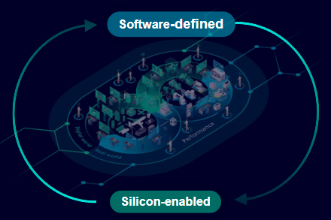
The impact of power in a SW-defined world
Industry trend
Power challenges
Power analysis
In SW-defined world

Slide 3
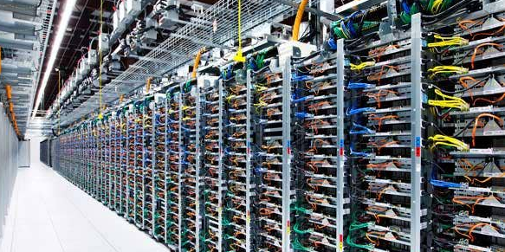
Semiconductor industry at-a-glance
1960 1980 2000 2020 …..
Notes:
The semiconductor industry has undergone three significant growth waves since the 1960s. The first wave, known as the computer era, spanned from 1960 to 2000 and was driven by the advent of mainframes, minicomputers, and personal computers. The second wave, the mobile era, occurred from 2000 to 2020, fueled by the proliferation of notebooks and smartphones. Currently, we are in the third wave, the data-centric era, which began in 2020. This era is powered by the exponential growth of big data across cloud, network, and edge computing, accelerated by advancements in AI and 5G technologies. The surge in data volume is propelled by digital transformation in areas such as mobile communication, gaming, AR/VR, autonomous driving, medical science, blockchain, and healthcare

Slide 4
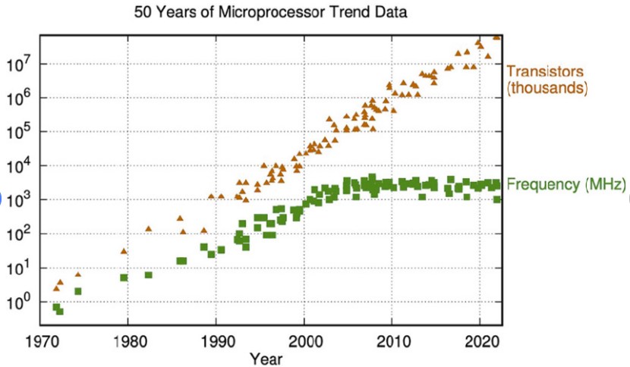
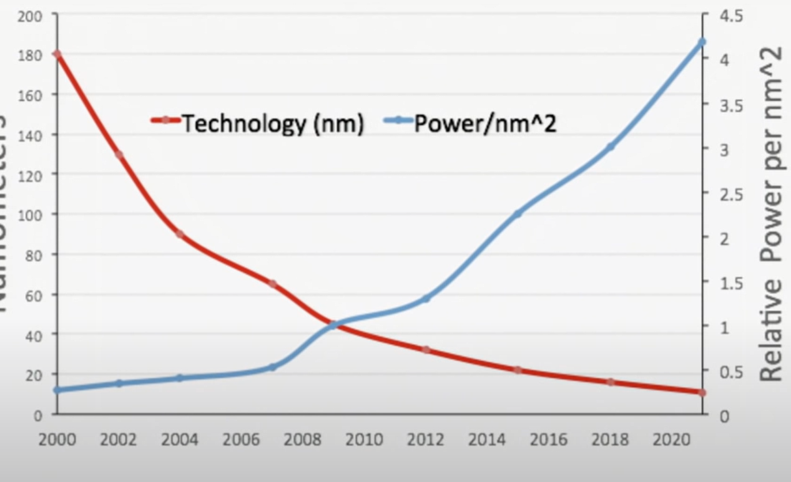
Semiconductor industry at-a-glance
1960 1980 2000 2020 …..
Notes:
For over five decades, the semiconductor industry has been largely driven by Moore's Law, which forecasted that the number of transistors on a chip would double approximately every two years. This rapid advancement in performance and cost-effectiveness was made possible by Dennard scaling, which allowed for a reduction in chip area while maintaining constant power densities. However, in the mid-2000s, the thinning of gate oxide layers led to increased transistor leakage, resulting in a slowdown of frequency and single-thread performance scaling. To sustain the momentum of Moore's Law, innovations such as multicore architectures and software parallelism have been introduced. Today, processors for AI and high-performance computing applications are highly parallel and contain billions of transistors.

Slide 5
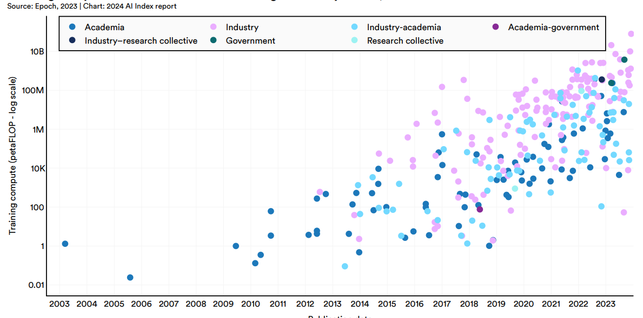
Data centric era is synonymous with AI
Massive computation
High-bandwidth memories
Cutting-edge communication
Maximum parallel processing (no idle phase)
Source: Epoch, 2023 | Chart: 2024 AI Index
Notes:
In AI, 'compute' refers to the computational power needed to train and run machine learning models. The complexity of the model and the size of the training dataset are key factors that determine the amount of compute required. As models become more sophisticated and the data used for training grows, the demand for computational resources rises accordingly.
In this slide, we're highlighting how the data-centric era is closely linked to the rise of AI. The growth of AI was enabled by hardware inventions for massive computational power, high bandwidth memory, and advanced communication technologies. One of the key aspects that sets AI apart is its maximum parallel processing, where there's no idle phase. However, this relentless demand for processing power has a significant impact on power consumption.
This graph [Stanford AI index report, https://aiindex.stanford.edu/report/] illustrates the exponential increase in training compute for significant AI models over the past two decades, with a particularly sharp rise in the last five years. This surge in compute demand has profound implications. This graph is on log scale.

Slide 6
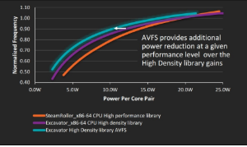
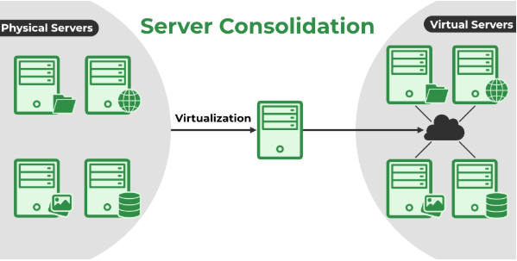
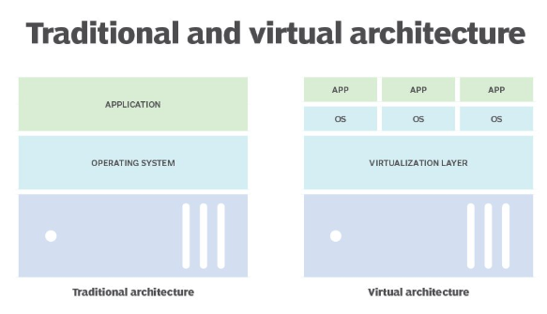
Data center and power
40-80% of the long-term operation cost of a data center
Power Usage Effectiveness (PUE): data center’s total electricity usage/electricity used by IT equipment
Average annually PUE in 2021: 1.57
Common methods for reduction of IT equipment power
AMD
Notes:
https://www.geeksforgeeks.org/server-consolidation-in-cloud-computing/
Dynamic voltage/frequency scaling DVFS
Consolidating servers by assigning tasks to fewer servers and shutting down idle ones
Evenly allocated workloads among servers through load balancing

Slide 7
The magnitude of AI energy consumption is astounding
ChatGPT service in early 2023: 464 MWh/day
Google AI service is estimated to consume
electricity as much as Ireland
Equivalent of 18,000 US family usage

Slide 8
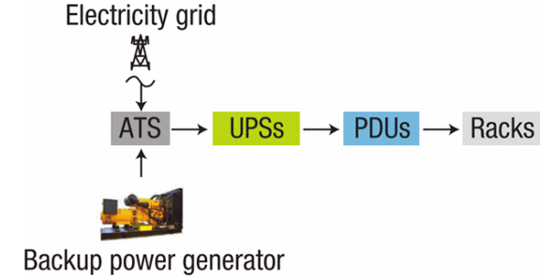
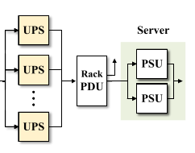
Question: How much power loss do you expect while delivering power to CPU?
ATS: Automatic Transform Switch
UPS: Uninterruptible power supply
PDU: Power Distribution unit
PSU: Power Supply Unit
PFC: power factor correction
PoL: point-of-load
Notes:
Energy-Efficient Workload Placement in Enterprise Datacenters
Publisher: IEEE
Cite This
PDF
Quan Zhang; Weisong Shi
All Authors

Slide 9
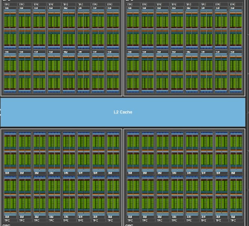
Can current power methodology address upcoming data centric challenges?
Power depends on end-user software
Architectural changes introduce new challenge
Power analysis comes late in the design cycle
PVT corners are needed to be considered much ealier
Notes:
Increasing power density has led to “dark silicon” on chips​. Not all cores in many core systems can operate simultaneously. Left picure
In the data centric-era, architecture and application dictates

Slide 10
Power impacts: from micro to macro in the data centric era

Slide 11
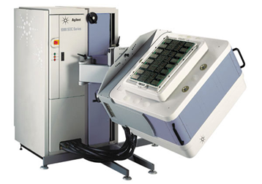
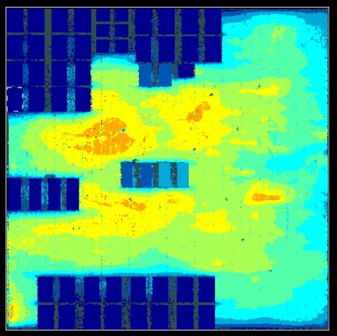
Power impacts: packaging cost and complexity
DFT
thermal
package
cooling

Slide 12
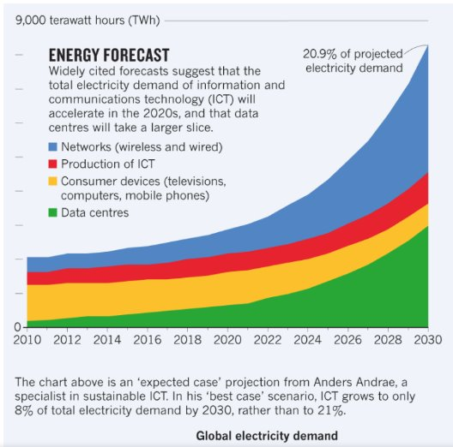
Power impacts: from micro to macro
Data Centers could consume 20% of total electricity by 2030

Slide 13
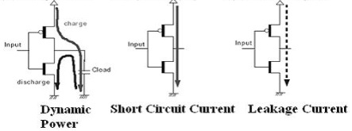
Power management and reduction

Slide 14
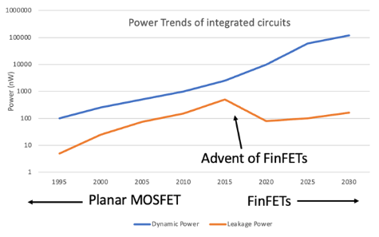
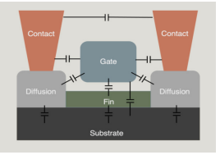
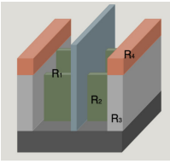
Technology and leakage reduction
The use of fin-shaped channel enables better control of the gate, hence reducing the leakage current

Slide 15
Structures for implementation power management
Power Domains
State Retention
Isolation
Level Shifting

Slide 16
Dynamic power reduction
From system to circuit

Slide 17
Dynamic power reduction
System level
DVFS
Race to IDLE
RTL
Clock gating
Data gating
AVS
Big/little
Memory gating
Bus encoding
Circuit level
Multi-vth cells
Multi-bit flops
Technology
Near Memory Processing
Chiplet
SW level
Power aware scheduler
Predictive Load balancing
Instruction reordering
Linking
Low Power instruction issues using compiler Assist
Algorithmic
Using AI to predict
Linear-complexity multiplication (L-MUL)
DeepSeekV3 Multi-head Latent attention

Slide 18
What is glitch?
Glitches can be classified into two types
Inertial Glitch
Events on the input do not cause change on the output
Pulse-width smaller than gate delay
Contributes to internal power only
Transport Glitch
Extra transitions on the output of the gate
Pulse width more than gate delay
Contributes to internal and switching power

Slide 19
RTL glitch power estimation Building design with physical awareness
Lib/LEF
P&R Tech File
Fast Physical-aware Engine
Netlist
RTL
Delay-aware Waveform Reconstruction
Power
Estimation
SPEF
Power Report with Glitch Power
SDC
UPF (Optional)
SDF
Fast Synthesis
Fast CTS
Fast P&R
DEF (Optional)
Name Map
Switching Act
Multi-Core
RTL Glitch Power Estimation
Fast physical design compilation
Delay annotation from internally generated SDF and glitch filtering
Delay aware reconstruction to identify extra transitions occurring due to delays
Clockless Glitch Identification for accuracy and performance
Back-annotation of Glitch Power from netlist to RTL (ML based solution)

Slide 20
Delay-aware waveform reconstruction engine
CLK
CLK
FLOP1 OUT
FLOP1 OUT
+
SDF
FLOP2 OUT
FLOP2 OUT
Extra transitions due to delays (Glitches)
INV OUT
INV OUT
AND OUT
AND OUT
Zero Delay Waveform
Reconstructed Delay Aware Waveform
Delay-aware waveform reconstruction engine
Uses delays from internal SDF to reconstruct delay-aware waveform from 0-delay RTL waveform
All extra transitions (glitches) captured accurately and accounted for
Power consumed by glitches can be computed by dynamically derating the extra transitions

Slide 21
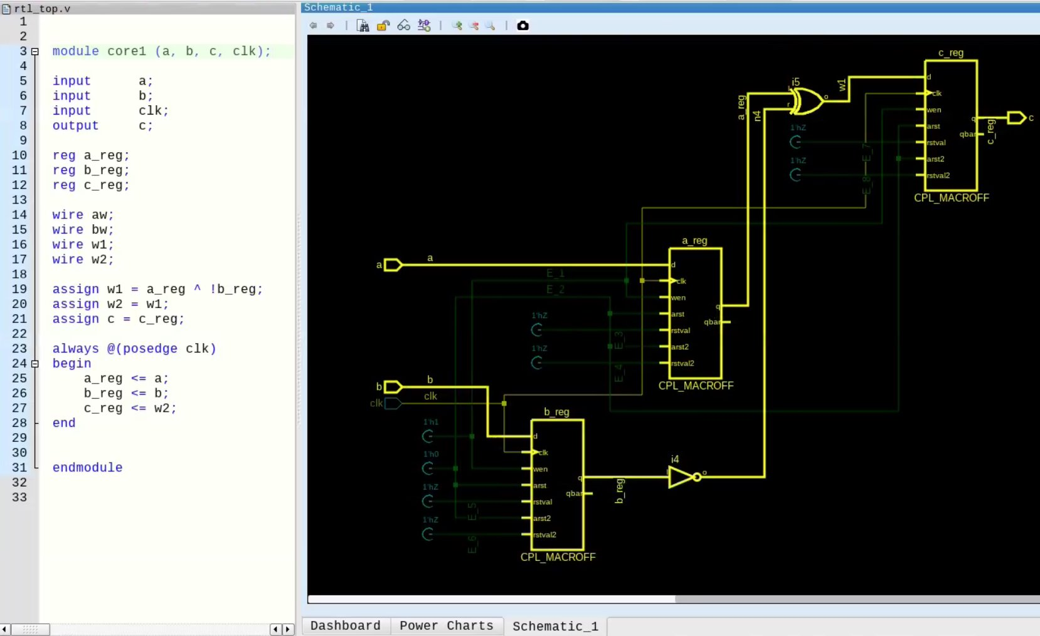
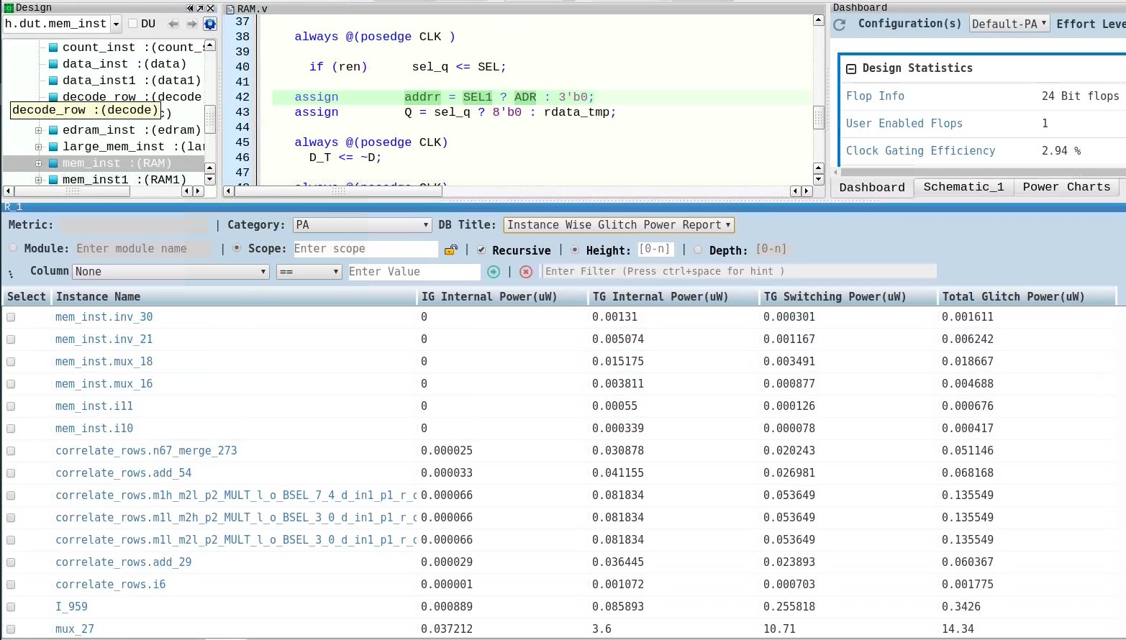
Annotating glitch power from internal netlist to RTL ML based model to apply glitch power computed at gate-level to RTL instances
Glitch Toggle Count
Max. Fanout
Area of Cell
Train ML Model with Glitch Power on the internal netlist
Use ML Model on RTL to back annotate glitch power numbers on combinational clusters
Instance-wise RTL glitch power report leveraging an ML trained model
Uses gate-level instance properties
Extracts characteristics for each instance which are used for training the model
Glitch Toggle Count
Fanout
Area of Cell
Total Glitch Power(Output)
Weights from the trained ML model applied to RTL instances, enabling instance-wise glitch power report at RTL stage
Cross-probable between RTL, schematic and report
Obtain Weights
Glitch Power Numbers
Instance-wise glitch power
Enables Glitch Source paths in RTL and its correspondence with internal netlist

Slide 22
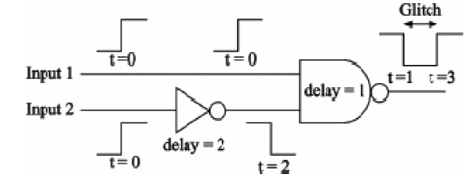
Dynamic power reduction -- glitch
Glitch power
15-40% of power consumption
Budget for it
Use real vectors
RTL design
Structural check : reconvergence
Data gating
Implementation layout :
gate sizing
delay balancing
Foundry: glitch proofed library cells

Slide 23
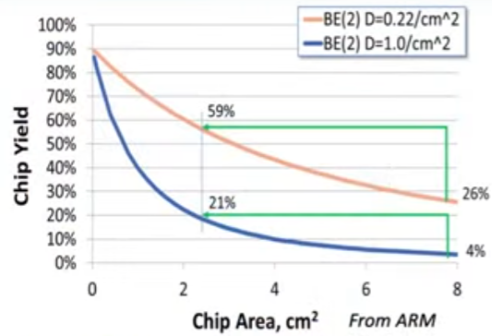
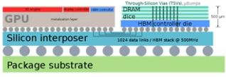
Chiplets i.e. heterogenous integration
Integrating smaller chiplets from different process technology nodes on the package
larges dies on a single SoC using advanced nodes → very expensive and low yield

Slide 24
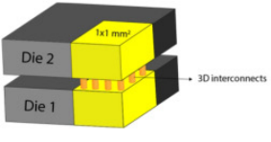
Chiplets i.e. heterogenous integration
Transitioning from one node to the next incurs additional expenses (designing/productizing/software/firmware)
Not all functions on the chip benefit from node scaling
Reduction of interconnect power
Optimization per chiplet

Slide 25
Guided power optimization
RTL flow

Slide 26
Comprehensive low-power optimization throughout the RTL design cycle
Logic Restructuring
Fine-grained Clock, Memory and Data Gating
Early Power Checking
Guided Power Reduction
Automatic Power Optimization
Vectorless
Vectored
Industry proven Automatic low-power RTL Generation
Static RTL Checks
Dynamic Checks
Power Estimation
Unrestricted | © Siemens | DVCon 2025 | Amir Attarha | Siemens EDA

Slide 27
Early design checks with PowerPro Power linting on early RTL without vectors (Structural)
Examples of
Static Checks
Early RTL analysis can be performed with RTL only
No requirement for vectors
Reports various metrics that point to poorly implemented design from the perspective of Power
Multiple metrics available to configure user acceptable thresholds
Ungated Memories
Ungated Macros
Ungated Memory Inputs
Ungated Mux Inputs
Not Combinationally Enabled Flops
Constant CGICs
Functionally Redundant CGICs
Structurally Redundant CGICs

Slide 28
Micro-architectural and combinational redundancies
Examples of
Functional Checks
Clock Toggle Data Stable
Redundant Memory Address Toggles
Redundant Memory Data Toggles
Redundant Mux Toggles
Stable Memory Access
Memory Bypass Potential
Memory Access Profile
Shift-register to Circular Buffer
Wasted toggles lead to wasted power!
Redundant toggles do not contribute to functionality and waste power
Dynamic analysis can reveal potential power saving opportunities early on
Leads to areas of wasted power and helps fix them
Requires functional vectors, fast turn-around time

Slide 29
Dynamic power reduction
System level
DVFS
Race to IDLE
RTL
Clock gating
Data gating
AVS
Big/little
Memory gating
Bus encoding
Circuit level
Multi-vth cells
Multi-bit flops
Technology
Near Memory Processing
Chiplet
SW level
Power aware scheduler
Predictive Load balancing
Instruction reordering
Linking
Low Power instruction issues using compiler Assist
Algorithmic
Using AI to predict
Linear-complexity multiplication (L-MUL)
DeepSeekV3 Multi-head Latent attention
…
…

Slide 30
Questions for thought
Are you running power analysis early using real end-user software?
Are you confident that you met your power numbers before silicon comes back?
Have you ensured that all the user defined clock gating cells are saving power rather than wasting energy?
If you exceed your thermal budget, how do you deal with consequences?
Are power and dynamic IR drop during DFT impacting your time to market?
Are you power numbers in the lab , exceed 30% or more your estimation?

Slide 31
Traditional power flow
Challenges:
Focusing on power with synthetic tests
Very long time to get data with real workloads
Very long time to get power numbers
Long feedback loop to RTL team
Feedback to RTL team
IP1 (RTL)
Power Tool
testbench
Synthetic tests (short and not realistic)
RTL
Netlist
netlist
Feedback to RTL team
System-level integration
System-level verification
System-level verification
IP2 (RTL)
Power Tool
testbench
SAIF generation
Synthetic tests (short and not realistic)
Feedback to RTL team
Average/peak power
Power Tool
Very long Turnaround Time
Timeline for traditional power flow

Slide 32
Shift left vision of power analysis
Power data generation
Early in the design cycle
Power data generate with real workloads
Generating actionable power metrics
Achieving high accuracy
measure
Implement
and track
Power data analysis
execute
focus
align
Experiment

Slide 33
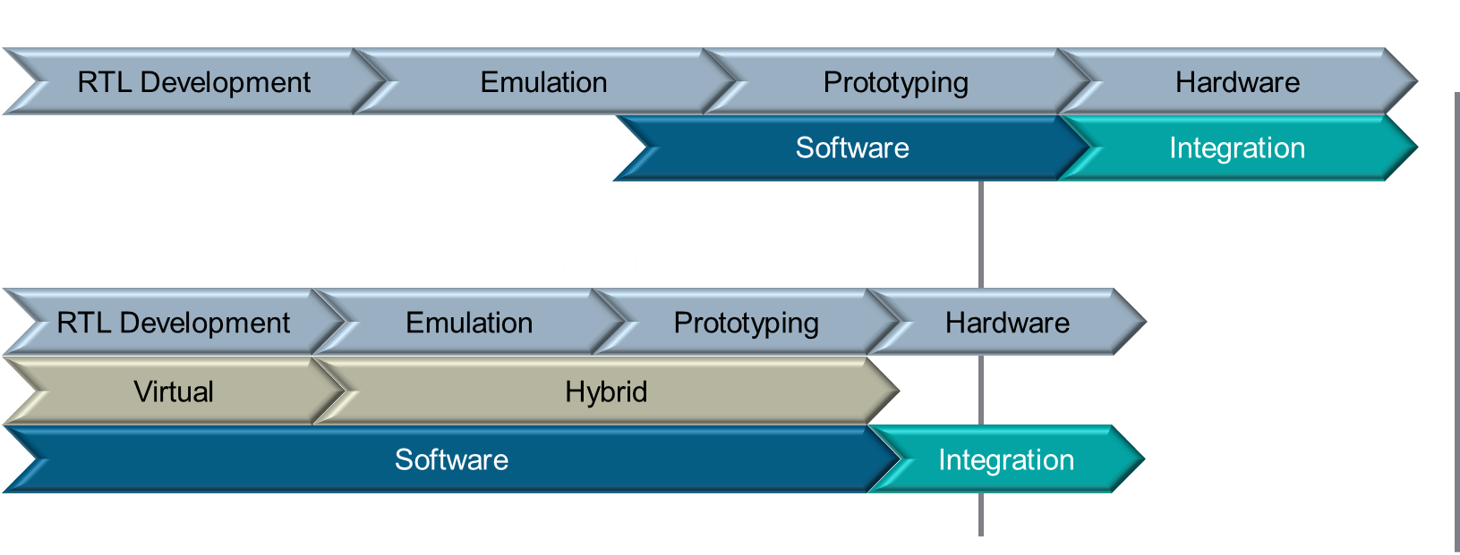
Shift left
Start software development earlier, using realistic workloads, to identify issues as early as possible
Quantify power and performance earlier
Reduce overall product development timeline

Slide 34
Full spectrum development – with Innexis Developer Pro
Pre-RTL software development
SW/HW co-validation
Pre-silicon system validation
High speed early software development
Hybrid: virtual platform + high-accuracy emulation and prototyping hardware
Full RTL hardware validation on emulator or prototyping hardware
Shift-left software development and validation, with common tooling
Software workload
Applications and benchmarks
Android, Linux, RTOS, AUTOSAR, Hypervisor
Virtual SoC model
Hybrid SoC model
RTL SoC
CPU
GPU
CPU
GPU
CPU
GPU
Memory
Peripherals
Memory
Peripherals
Memory
Peripherals
Innexis
Veloce CS
Notes:
Make it clear that there are 2 possible entry points for this flow, either Virtual or for other customers starting with Hybrid makes more sense

Slide 35
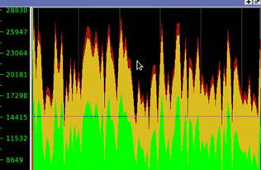
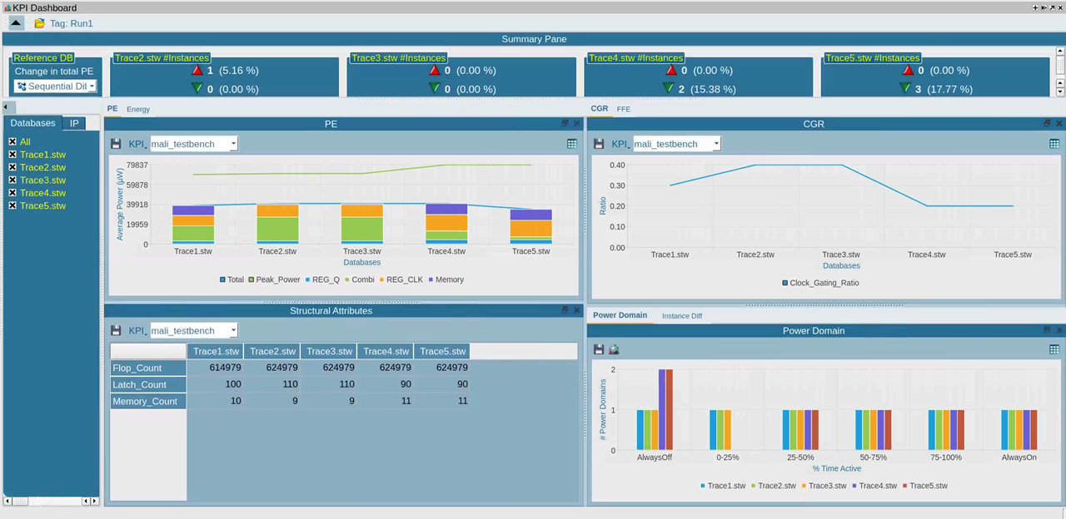
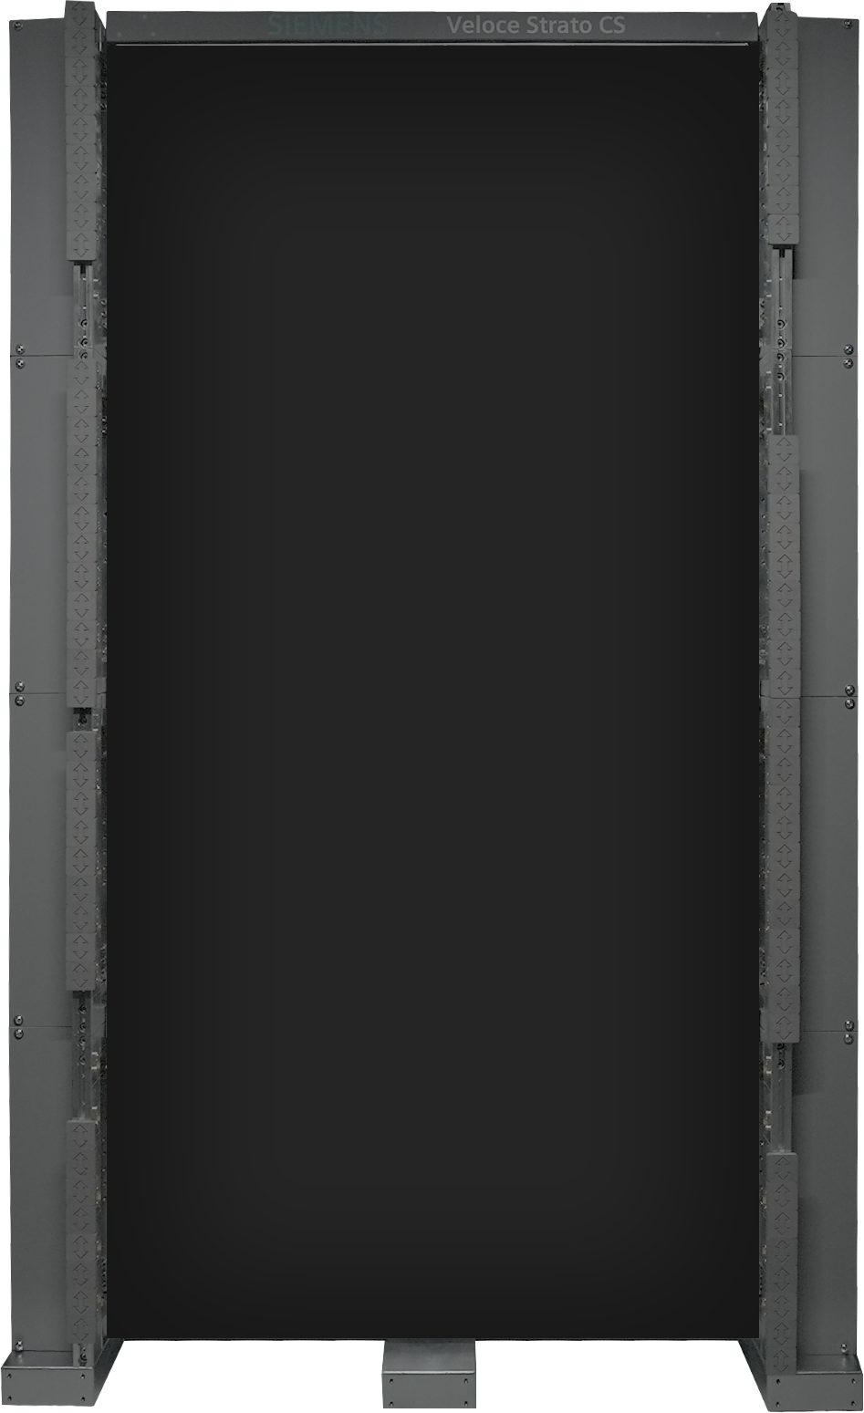
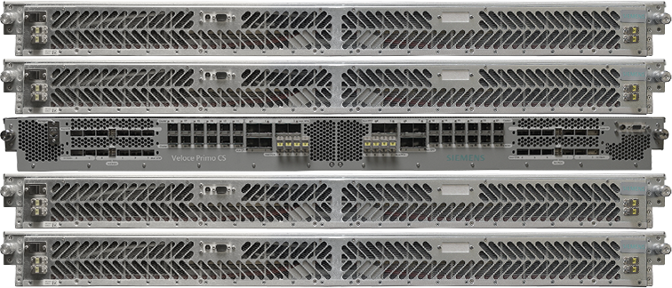
Compelling solution for design teams
Design
Liberty
Power trend analysis
UPF
Time-base CGE
Workload
Time-based FFE
Capturing power profile for entire workload
Capturing key power indicators at cluster or SoC level
Accurately finding peaks
Generating power profile for Billions of cycles
Making key decisions based on real data
Notes:
Add data Table to this slide
This is how the flow works:
Input consists of the following: Design (RTL/Gate), stimulus, liberty files, UPF (optional) which are read compiled using Veloce OS SW. Compiled database is then run on Veloce to generate waveform database (stw). STW consists switching activity for all the design signals. This STW is primarily used for all power related flows.
1. File-based flows to generate FSDB/SAIF files for power tools
2. API based flow with PowerArtist and PowerPro
3. Power trend analysis – generating activity plot, activity map and activity factor

Slide 36
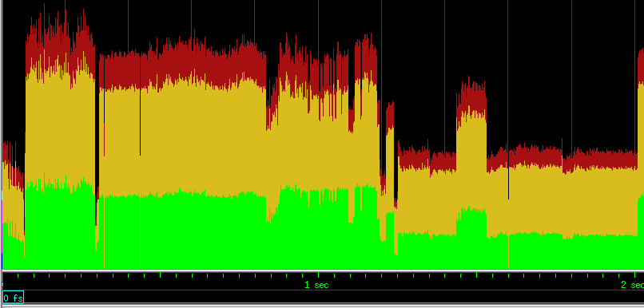
Power profile/heat map for realistic benchmarks allows focusing on right area
Hot zone
optimization possibility
Is this benchmark interesting for power analysis?
IDLE
Optimization possibility
Notes:
Deciding on benchmarks/workloads for Power
Different micro-architecture decisions with Power impact
Dynamic di/dt: Power Profile + grouping of IPs on the same power rail
Identifying hot zones: Sustain period of high power

Slide 37
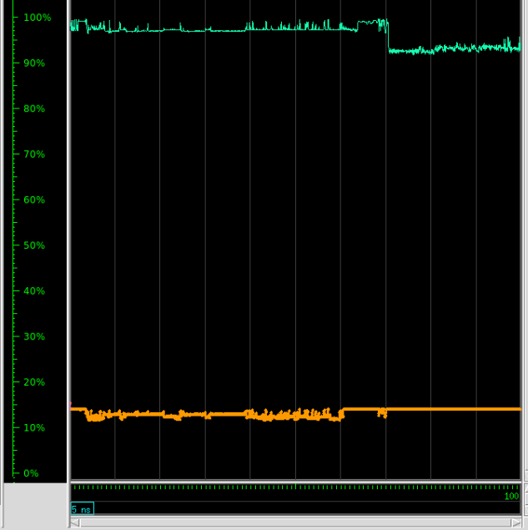
Cycle accurate power profile, CGE and FFE for entire duration of workload
Power profile for each instance
Power profile enables peaks and possible dynamic di/dt detection
Time-based CGE/FFE at SoC level and within 1% accuracy from power tools
CGE instance3
Time-based CGE/FFE based on global/local clocks
CGE instance1
Notes:
Deciding on benchmarks/workloads for Power
Different micro-architecture decisions with Power impact
Dynamic di/dt: Power Profile + grouping of IPs on the same power rail
Identifying hot zones: Sustain period of high power

Slide 38
Key metrics for power optimization for entire duration of workload
Capture key power metrics (CGE, FFE etc.) at SoC level while running SW applications
Both user clock gating elements and Clock gating inference are applied
Quality of Clock gating impacts Dynamic Power
Veloce measures CGE to assess effectiveness of clock gating for real world applications
Flip Flop Efficiency identifies when data is static over a period and the reg is clocked:
Revisit your pipeline
IO exclusivity clock gating using XOR
Q
Q
Clk
Clk
En
En
block
block
Clk
Clk
En
En
Q
CGE (clock gating efficiency)=30%
FFE (% of Q toggles vs received clocks) = 43%

Slide 39
Ensuring every user defined clock gating cell provides power efficiency This metric may lead to significant power saving
CGC cells are placed in the design to save power.
CGC will increase energy consumption with low efficiency
Register bank
Clock gate
CGCE% | Inclk | InClk: Effective freq(MHZ) | InClk: #gated inferred flop | InClk Avg FFE | OutClk | OutClk Fanout | …
0.0129 | Top.a.b | 100 | 46869 | 1.43e-5 | Top.a.b.c | 47429 | …
97.225 | … | 100 | 15590 | 3.38 | … | 15590 | …
… | … | …

Slide 40
Key power indicators are provided by default
Right instances to focus
Data for sub blocks
Design Hierarchy
# Reg/Latch: number of registers/latches in this instance
#Gated Inferred flop: # of inferred clock gating elements
Avg PT: Average Power
Peak PT: Peak Power
Avg FFE: Average Flip Flop Efficiency
Avg CGE (G/L): Average Clock gating efficiency (global/local)
This data and much more details can be dumped in CSV for post analysis

Slide 41
Power analysis is a journey: tracking data throughout this process
Power data needs to be kept for various RTL releases and tests for comparison
Trend will help the design team and architecture team to identify possible issues
There are many hardware and software related parameters which can impact power It is crucial to be able to collect the data and compare scenarios
An infrastructure for data-oriented power analysis is provided
workloads
RTL releases
SW/Firmware settings
Comparative analysis
Power Metrics
PowerStream
Trend analysis
Power data analysis
VDA
Mongo DB

Slide 42
Power KPI – comprehensive tracking and comparison of important power parameters
Several power KPIs are tracked and can be compared across workloads and design versions
Power trend (Total, Peaks, All 4 components (Memory/Reg-CLK/Reg-Q/Comb))
Clocks level CGE and FFE
Blocks level CGE and FFE
Power domains
Average power trend
Sequential comparisons

Slide 43
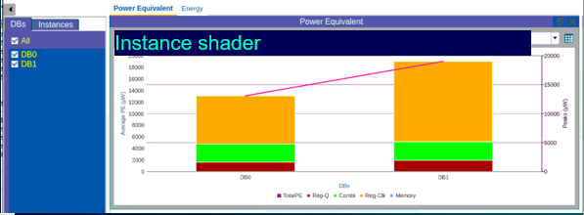
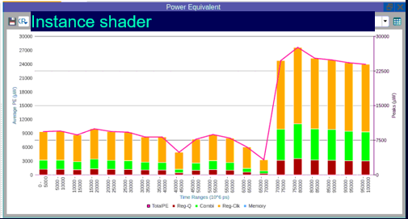
Comparative analysis
Comparing power data of Manhattan and Angry bird tests on “Shader instance”
Manhattan test on “Shader instance”

Slide 44
Clock gating efficiency @ SoC level over time for different instances per different parent clocks
CG
CG
clk_0
CG
CG
CG
Root_clk
Instance_0
clk_1
CG
Instance_1

Slide 45
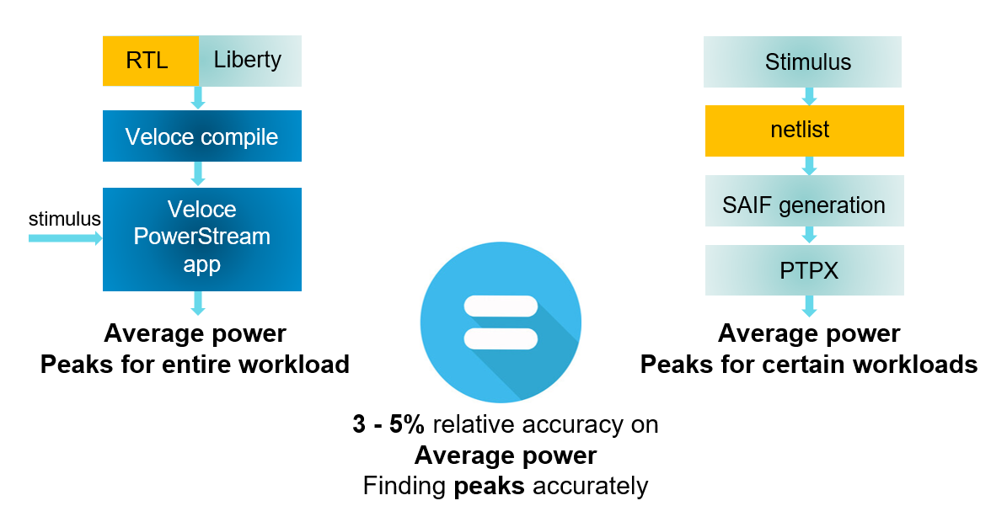
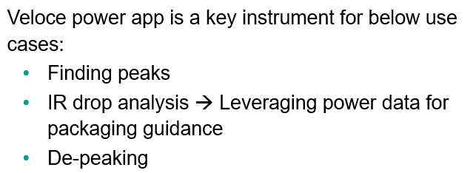
Accuracy is always a requirement
Correlated with power signoff Tool
Companies with accuracy requirements for early RTL power analysis
Notes:
Add ARM logo
Add Alibaba logo
Add 10-15% RTL sign off relative accuracy
Gate level 5%

Slide 46
Veloce PowerStream is a game changer: SPEED disproportionately matters
Benefits:
Much shorter turnaround time (8~10X faster)
Much earlier to real workload analysis (6~8 weeks)
Recommendations based on real workload
Many more workloads (50 → 1000)
Feedback to RTL team
IP1 (RTL)
PowerPro
testbench
Synthetic tests (short and not realistic)
RTL
Feedback to RTL team
System-level integration
System-level verification
IP2 (RTL)
PowerPro
testbench
PowerStream
Synthetic tests (short and not realistic)
Power profile and power metrics
Action-oriented recommendations
short Turnaround Time
Timeline for game changer Veloce PowerStream flow
Notes:
Add slide before that
Ask pranab what workloads are they running?

Slide 47
IP power profiling/analysis using system level workloads
System Level run with modular replay instrumentation
IP #1 Power run
CPU
Veloce Strato
Workload
GPU
Application
CPU
OS
Workload
IP #2 Power run
IPn
GPU
Workload
Firmware
Bare metal
IP #3 Power run
Workload
IPn
Smaller HW capacity for IP power data generation
Faster turn-around time for power analysis
Enabling much easier job placement (IP vs Full SoC)

Slide 48
Identifying peaks and valleys
with Power profile
Measuring the elevation
with Power tools

Slide 49
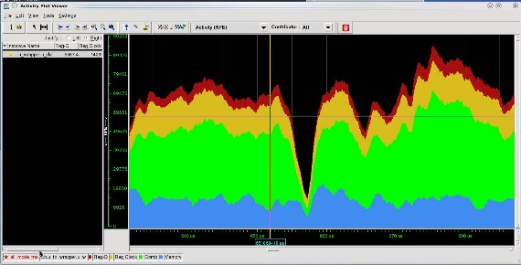
Power journey: billions of cycles to detailed power data on interesting areas
Power tools
Power profile
billions of cycles
Power estimator
Streaming API
Identify areas of interest
OR
File-based
SAIF/FSDB
Checkpoint
periodically
Power optimizer
Replay from closest interval
Notes:
Complete power flow from Veloce to power numbers.
Generate activity plot to check the power profile
Use the profile to identify window for power estimation
Use any power tool using files-based flow for power estimation
Use PowerArtist or PowerPro for power estimation for long workloads using API flow which is faster than file based flows

Slide 50
Veloce PowerPro differentiated solution Delivers high performance for virtually unlimited capacity through design partitioning
Veloce Power App
Generate file SAIF/FSDB
Power tools
Average power
peak power
Traditional file-based flow
vs
Streaming API based flow with Power Tools
Faster
Smaller disk space
Entire workload
Average power
peak power
Veloce Power App
Dynamic API Read
PowerArtist
PrimePower
vs
Streaming API based flow with PowerPro
Faster
Virtually unlimited capacity
Entire workload
Average power
peak power
Veloce Power App
Dynamic API Read
Design Partitioning
PowerPro
Notes:
Enables power calculations at full SoC level with representative (long) customer benchmarks/ workloads
Delivers ~10x faster time to power compared to file based flows. Switching activity data from Veloce is streamed to Ansys PowerArtist/PowerPro. Parallel execution of Veloce and PowerArtist/PowerPro
Eliminates intermediate file generation and file consumption. Eliminates concern of handling large FSDB files by power tools
Useful for below applications.
1. Booting Linux and similar operating systems
2. High performance gaming application: PUBG, angry birds
3. Profiling of key segments in application
Why do we need to use streaming API compared to SAIF:
1- more accuracy
2- no need for SDPD SAIF
3- no need for forward SAIF

Slide 51
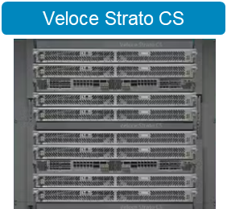
Veloce Power App + PowerPro provides versatility for different phases of the design cycle
RTL
Liberty files
RTL
Liberty files
Full netlist
Liberty files
netlist
netlist
RTL
Liberty
PowerPro
PowerPro
Liberty
Liberty
PowerPro
SDC
SDC
SDC
SDF
SDF
Mapping file
Mapping file
SPEF
SPEF
Notes:
Forward SAIF
Netlist IP1, netlist IP2

Slide 52
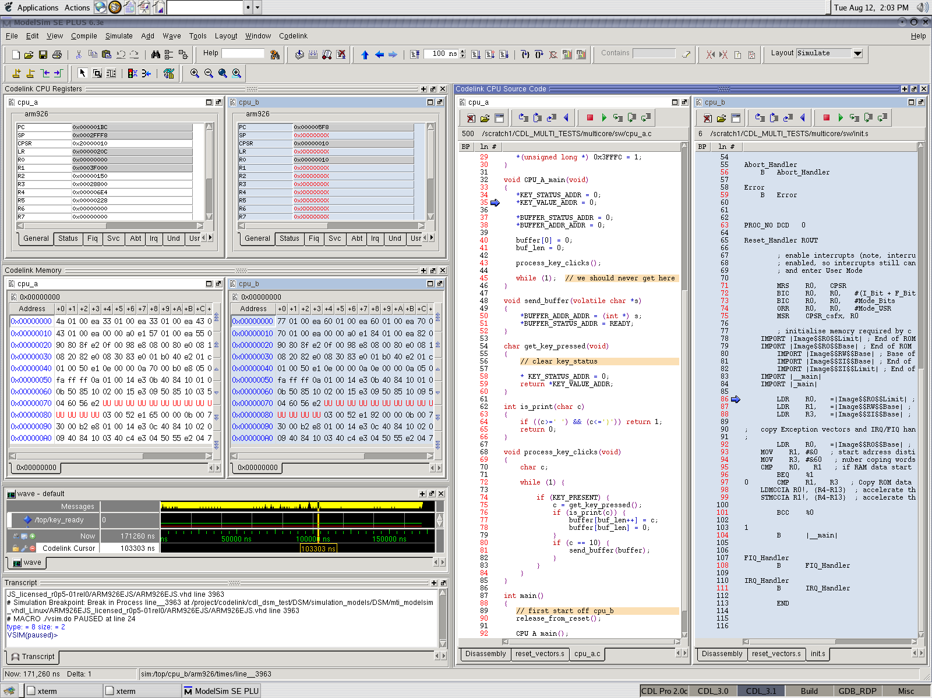
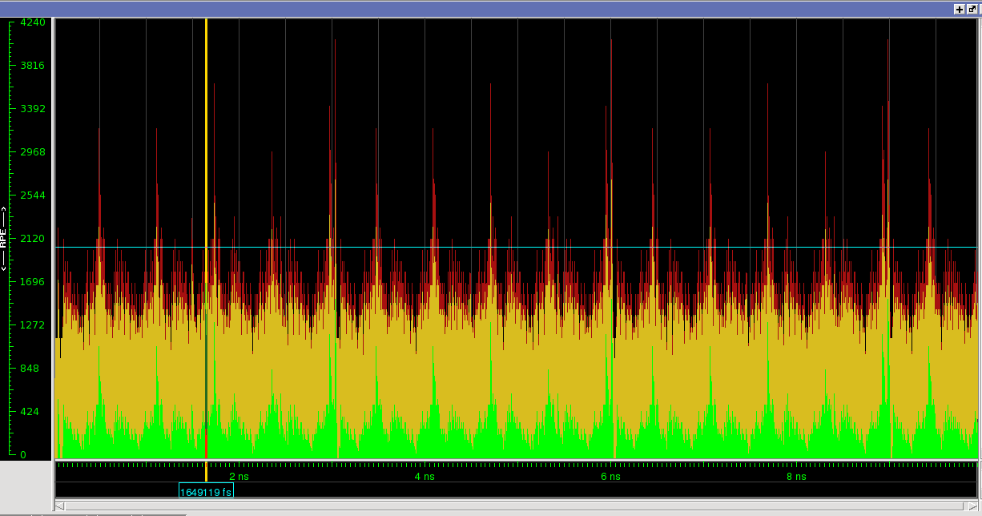
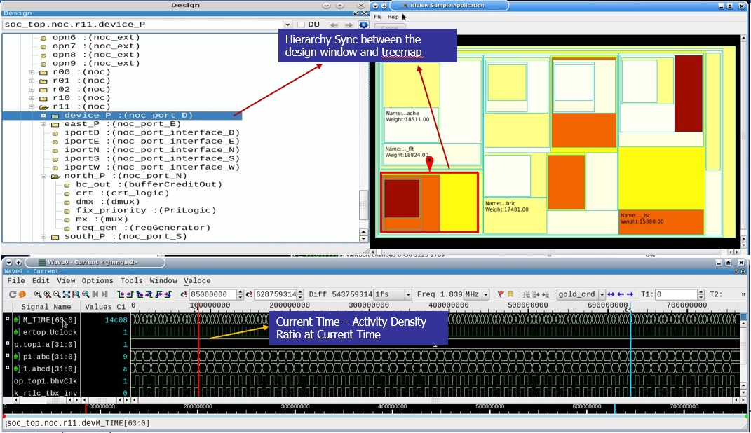
Hardware/software co-verification and power analysis while running real applications
Power Profile
Getting to root cause faster
waveform
SW trace
KPI metrics
Notes:
Activity helps identify design modules which have high toggle/power consumption. Activity map works in conjunction with activity plot where when you move cursor on activity plot, activity map changes color displaying toggle profiles of the design modules.
Here block with red color means highest toggle/power consuming block while white means one with least/negilible toggle. Activity map does not ave any physical data, the size of the block represents the size of logic in modules.

Slide 53
MUST: Early power analysis with real workloads!
Power analysis needs to be performed as early as possible with real workload
Highly configurable platforms will provide missing pieces to enable real workload analysis in early design cycle
Running 100s of benchmarks early in the design cycle is possible and essential!

Slide 54
Power impacts: What you can do…
Data centers could consume 20% of total electricity by 2030 ….
….or we can reduce that with effective power management

Slide 55
Thank you
Published by Siemens 2025
Amir Attarha
Senior Product Manager, HAV, Siemens EDA amir.attarha@siemens.com

