Slide 1
Techniques to identify reset metastability issues due to soft resets
Reetika – Siemens EDA
Sulabh Kumar Khare – Siemens EDA

Slide 2
Contents
Reset Domain Crossing (RDC)
Soft Resets
Safe and Unsafe RDC paths
Design Scenarios
Proposed Methodology
Results
Conclusion
References

Slide 3
Reset Domain Crossing (RDC)
Complex designs and SoCs - split the chip into multiple reset domains
Data transfer between reset domains are termed as RDC’s
Asynchronous reset assertion at transmitting flop domain causes data change at the receiving flop domain
This asynchronous event may occur in the setup and hold time of receiving flop clock domain which may induce meta-stability in receiving flop

Slide 4
Handling RDC Issues
Strategies to avoid meta-stability in Reset Domain Crossings
Synchronizers
Isolation Techniques
Data Qualifiers/ Data Isolation
Clock Gating Isolation
Reset Ordering
But there may occur another problem which is not captured traditionally
It does not represent two different asynchronous reset domains
Happens due to transmitter reset's clock causing an asynchronous event
Known as issue due to soft reset

Slide 5
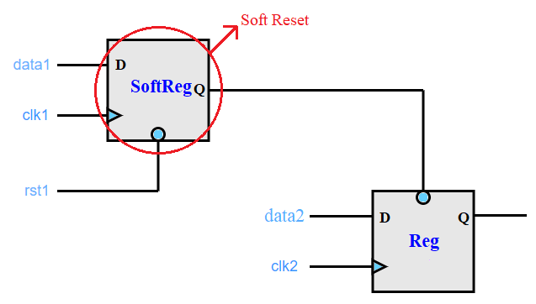
Soft Reset
Internally generated reset
Allows to reset a specific portion of the design without affecting the entire system
Common technique to test a specific area of the design
always @(posedge clk1 or negedge rst1)
if (!rst1)
SoftReg <= 1'b0;
else
SoftReg <= data1;
always @(posedge clk2 or negedge SoftReg)
if (!SoftReg)
Reg <= 1'b0;
else
Reg <= data2;

Slide 6
Safe and Unsafe RDC
RDC path with different asynchronous reset domains on the transmitter and receiver does not conclude that the path is unsafe
RDC path through the transmitter to the receiver register in which metastability can propagate is termed an unsafe path
RDC path having same asynchronous reset domains on the transmitter and receiver does not necessarily imply that it is a safe path
RDC path through the transmitter to the receiver register in which no metastability can propagate is deemed to be safe path
Different soft resets in a design can induce metastability and cause unpredictable reset operations

Slide 7
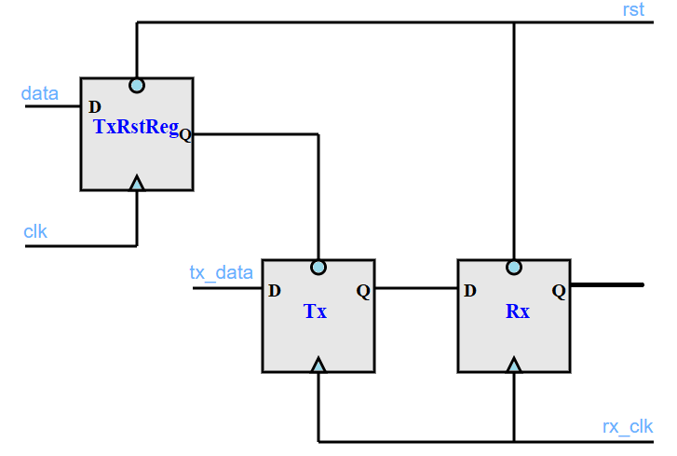
Design scenario-1
Transmitter and receiver are driven by the same asynchronous reset domains
Transmitter register is driven by a soft reset from a different clock domain
Change at the input of the soft reset to the transmitter reset can cause an asynchronous assertion at the transmitter, which could cause metastability
data of TxRstReg can change in clk clock domain, which can lead to asynchronous assertion of Tx flop in the rx_clk clock domain – UNSAFE PATH

Slide 8
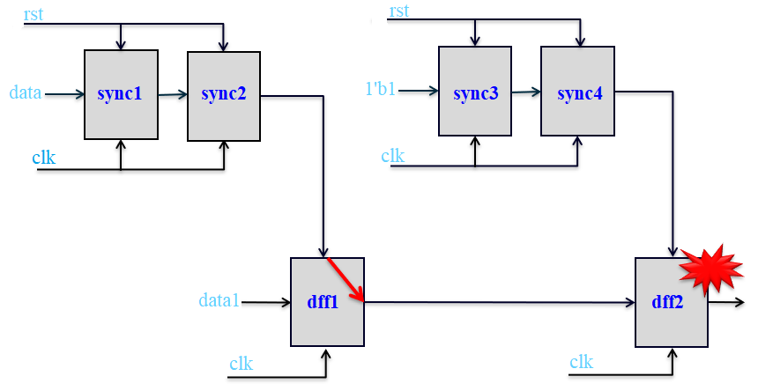
Design scenario-2
Transmitter and receiver are driven by the same asynchronous reset domains
Transmitter register is driven by a soft reset from a same clock domain
Path from reset of dff1 flop to the output of dff1 flop is not timed
Soft reset sync1 can cause a setup/hold violation for the dff2 flop and result in potential metastability
SAFE PATH – Need to confirm static timing analysis

Slide 9
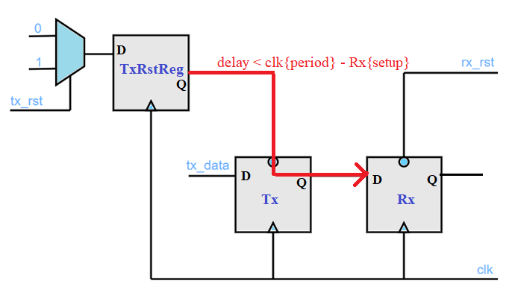
Design scenario-3
Transmitter and receiver - driven by the different asynchronous reset domains
Transmitter register is driven by a soft reset from a same clock domain
Change at the input to the destination register when the transmitter reset is asserted is synchronous to the clock – no potential metastability
Need to confirm that static timing analysis times the path from the soft reset through the transmitter flop to the receiver flop
SAFE PATH – Need to confirm static timing analysis

Slide 10
Proposed Methodology For RDC Verification
Reset Domain Crossing Analysis
Review and fix the critical Reset Domain Crossings
Soft Reset Detection
Specify Clocks
and Resets
Clock and Reset Detection
Reset Tree Analysis
Fix issues in reset tree

Slide 11
Tackle Soft Reset Specific Metastability
Unsafe RDC’s
(soft reset is used in different clock domain)
Apply Reset Ordering, Isolation or Synchronization strategies
Create data path crossings from one soft reset domain to another
Detect the Soft Resets
Safe RDC’s
(soft reset is used in same clock domain)
Static Timing Analysis (STA)

Slide 12
Results
Design with 374546 register bits, 8 latch bits and 45 RAMs
Identified around 131 reset domains in the design
19 asynchronous domains defined by the user
81 asynchronous reset domains inferred by the tool
Without soft reset analysis - reported around 40000 RDCs

Slide 13
Results
With soft reset analysis
Identified 34 soft resets
Resulted in additional violations for RDC paths with transmitter soft sources in different clock domains
These paths are critical and were missed in the initial run
Some RDC violations were converted to cautions (RDC paths with a transmitter soft reset in the same clock domain)
These paths would be safe from metastability if they meet the static timing analysis
Number of crossing without soft reset analysis

Slide 14
Conclusion
Need for intelligent reset domain crossing analysis - Improves quality of the RDC verification process
Although the reset domains on transmitter and receiver end are same, soft resets used in different clock domain can result in critical metastability
Soft resets used in same clock domain need static timing analysis
Validation on real SoCs confirms that the issues due to soft resets are practical and must be taken care of as part of a static RDC methodology to prevent silicon re-spins

Slide 15
References
[1] Akanksha Gupta, Ashish Hari, Anwesha Choudhary, “Systematic Methodology to Solve Reset Challenges in Automotive SoCs”, DVCON Europe 2019
[2] Yossi Mirsky, “Comprehensive and Automated Static Tool Based Strategies for the Detection and Resolution of Reset Domain Crossings”, DVCON
[3] Chris Kwok, Priya Viswanathan, Ping Yeung, “Addressing the Challenges of Reset Verification in SoC Designs”, DVCon US, 2015
[4] Questa® RDC User Guide, version 20.3d, 2021

Slide 16
Thank You!

Slide 17
Q and A

