Slide 1
PropGen: An Automated Flow to Generate SVA Properties for Formal and Simulation methods
Amith Shambhu, Vishal Dalal
Infineon Technologies, Bangalore.
Basavaraj Naik
Infineon Technologies, Munich.

Slide 2
Contents
Introduction
Problem Statements
Proposed Solution – PropGen Flow
PropGen Architecture
PropGen for FSM Design Verification (DV)
Porting assertions from Formal Verification (FV) to Simulations
Results
Conclusion

Slide 3
Introduction
Today’s Design Under Test (DUT) verification is challenging
Complexity of these DUTs’ is increasing
State space explosion
Design specifications constantly change
Verification of complex DUT poses several challenges
Intricate Test Bench (TB) architecture
Corner case bugs misses
Coverage scenario
DV Quality is utmost critical
DV automation is a MUST
Combination of both simulation and FV techniques needed

Slide 4
Need for DV Automation
Design complexity
Subsequent design changes
Coverage
Labour intensive to generate the Tests manually
Repetitive efforts to regenerate tests, assertions etc
Undetected bugs
Corner cases covered?

Slide 5
Problem Statements
Assertions are derived from the specifications
Specifications and Design undergo multiple changes during the execution
Assertion generation need to be automated to save repetitive efforts
Is Simulation coverage alone enough to do quality DV sign-off?
Can Formal Verification (FV) help to automate and verify exhaustively?

Slide 6
Proposed Solution – Property Generator (PropGen)
PropGen can fill the automation gap
Relies on design specification (e.g. VISIO/XML/XLS) to generate SVA assertions
Checks various Use Cases
Register access checks
Safety critical sub-blocks
FSM Verification
User inputs limited for RTL Input/output ports
Needed for SV bind
Fully automated flow

Slide 7
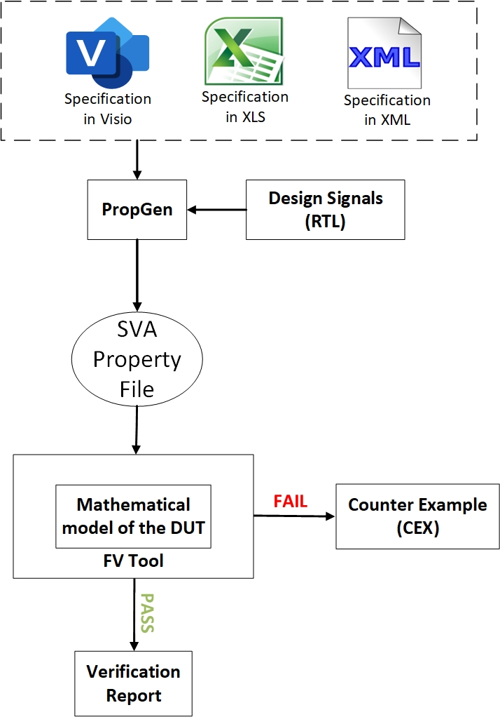
PropGen Flow
Specifications formats supported
Widely used
Automated flow
Generated directly from Specifications
Minimal user inputs
Compatibility
Portable from FV to simulations
Minimal constraints in FV

Slide 8
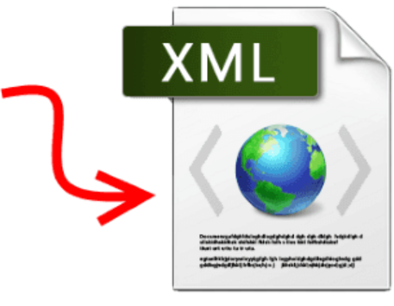
PropGen Architecture
PropGen
SVA Templates
Spec to XML converter
SVA Property File
SVA Templates
Design I/O signals (RTL)

Slide 9
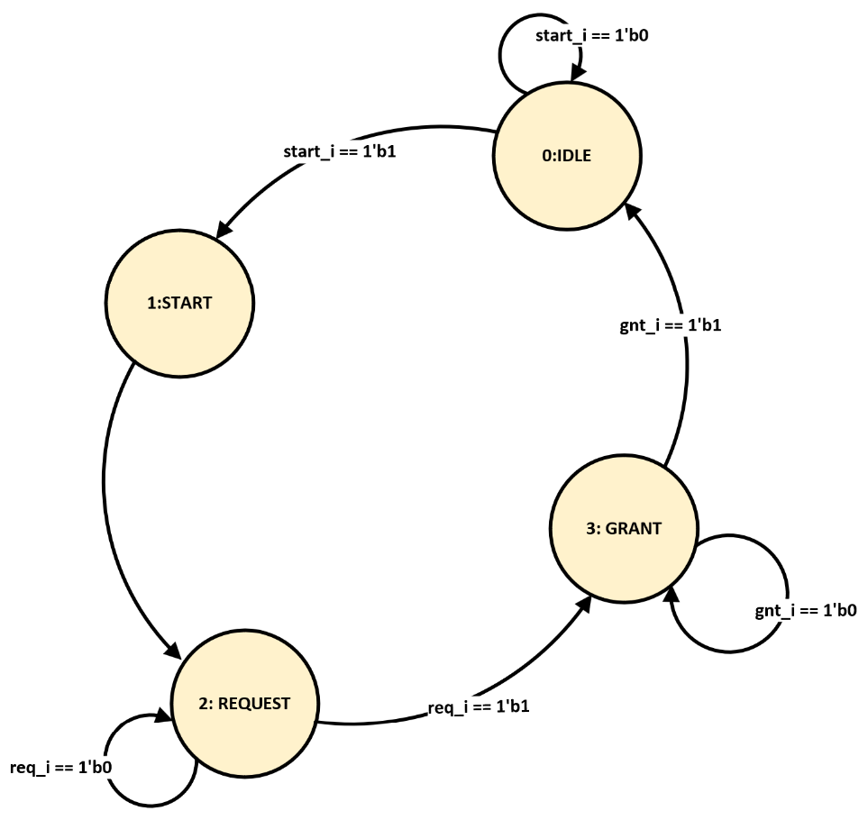
PropGen Stages
fromState | toState | condition
0:IDLE | 0:IDLE | start_i == 1’b0
0:IDLE | 1:START | start_i ==1’b1
1:START | 2:REQUEST
2:REQUEST | 2:REQUEST | req_i == 1’b0
2:REQUEST | 3:GRANT | req_i == 1’b1
3:GRANT | 3:GRANT | gnt_i == 1’b0
3:GRANT | 0:IDLE | gnt_i == 1’b1
Visio to XML
XML to SVA
property state_cond_trans(STATE1, cond, STATE2);
@(posedge Clk) disable iff(!AsyncRst)
(state == STATE1) && cond |=> (state == STATE2);
endproperty
check_IDLE_to_START_condition : assert property(state_cond_trans(IDLE,(start_i== 1’b1),START));

Slide 10
PropGen Use Cases
PropGen is applied to generate SVA for
Register verification for various access policies
Safety critical building blocks integration verification
FSM verification
PropGen generated properties are
Achieve 100% code coverage at block level FV
Portable from block level FV to IP level simulations
Block level DV signed off using FV
End-to-end data integrity checks signed-off using simulations

Slide 11
PropGen for FSM DV
1
State Transition Checks
Deadlock Checks
5
DV Scenarios
Async Reset Checks
2
4
State Output Value Checks
3
Livelock Checks

Slide 12
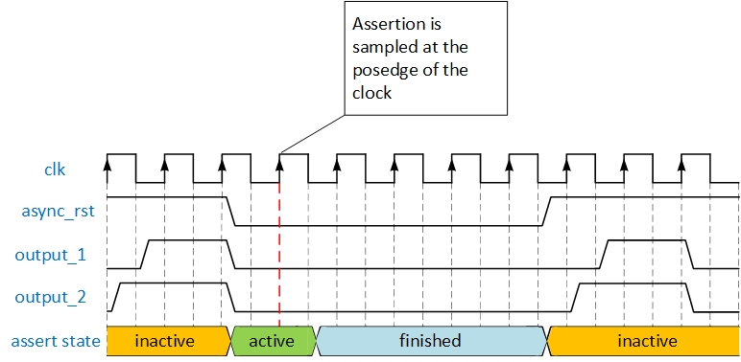
Assertions Pass at Block Level FV
FV use unconstrained clock
@(posedge Clk)
(!async_rst) |-> (!output_1) && (!output_2);

Slide 13
Porting Assertions from FV to IP Level Simulations
Block level FV assertions are portable to simulations
Some of FV assertion don’t enter Active state in simulations ---> Not sampled
Clock gating is done at IP level during Async reset ---> Shuts-off the clock to sub-block
Assertions in simulations remain at “inactive” state (Async Reset)

Slide 14
Resolving Porting Challenges
Use the built-in SV feature $assertoff()
Selectively disable assertions (e.g. clock gating)
Only selective assertions from block level FV are disabled
Usage : $assertoff (0, dut_top.<assertion binding_hierarchy path> )
Rest of the assertions Re-used at IP level simulations
Effort saving
Huge focus on verification Re-use
No need to convert FV “assume” to IP level “assert”

Slide 15
Black boxing of Multipliers
Issue
Multipliers are often black boxed by FV tools.
They are complex and resource intensive
Significantly increase the runtime of FV
Impact
One assertion got impacted due to auto black-boxing
Failed in FV as random values were driven
Passed in simulations as multipliers were NOT blackboxed
Fix
This is shown as a warning message in FV
Need to be carefully reviewed before final waive-off
Avoid auto black-boxing of multipliers

Slide 16
Results
 | FSM Designs
 | PropGen DV |  |  |  | Manual DV
 | FSM1 | FSM2 | FSM3 | FSM4
# SVA Properties | 103 | 48 | 29 | 97 | Same #
First FV report | 0.5 D | 0.5 D | 0.5 D | 0.5 D | 10 D( 90%)
Formal Code coverage | 100% | 100% | 100% | 100% | 100%
FV to Simulations portability | YES | YES | YES | YES | YES
SVA re-generation for design changes | 0.25 D | 0.25 D | 0.25 D | 0.25 D | 4 D ( 90%)
(*D = Days)
Notes:
Include up arrow in Manual DV column for 90% to show efforts got increased here

Slide 17
Conclusion
Specification based flow
SVA generated directly from specification provided in Visio/XLS/XML
Minimal manual user intervention
Simple and easy to use
DV cycle optimization
~90% DV schedule improvement
100% code coverage achieved using FV
Portable from sub-block to IP level
Assertions portable from block level FV to IP level simulations

Slide 18
References
[1] Smith, A., et al. "Accelerating Design Verification through Automated Techniques." IEEE Transactions on VLSI Systems, vol. 42, no. 2, pp. 245-256.
[2] Johnson, B., and Lee, C. "Efficiency Improvement in Design Verification through Automation." IEEE Design & Test of Computers, vol. 39, no. 4, pp. 78-84.
[3] A. Shambu, V. Dalal, B. Naik and S. M, "Automation of FSM Verification Using Formal Tools," 2023 International Conference on Communication, Circuits, and Systems (IC3S), BHUBANESWAR, India, 2023, pp. 1-5. DOI: 10.1109/IC3S57698.2023.10169571.
[4] 1800-2017 - IEEE Standard for SystemVerilog--Unified Hardware Design, Specification, and Verification Language. IEEE, 2017.
[5] Chen, Q., Wang, L., & Li, Z.,"Formal Verification of ASICs: Challenges and Opportunities". IEEE Transactions on Computer-Aided Design of Integrated Circuits and Systems, 42(5), 987-1001, 2023.
[6] S. Johnson, B. Anderson, "Efficient Verification Strategies for Complex ASIC Designs." IEEE Transactions on VLSI Systems, vol. 30, no. 5, pp. 987-1001 2022.
Notes:
Please add references here

Slide 19
Thank you!
Q & A

