Slide 1
Statistical Analysis of Clock Domain Crossing
Rajat Singla (rsingla@nvidia.com), Tanneru Sai Pavan (tsaipavan@nvidia.com), Naveen Dugar (naveen@realintent.com), Varun Sharma (vsharma@realintent.com)

Slide 2
Agenda
Traditional CDC Verification Methodology
Problem Statement
Proposed RCA Methodology
RCA’s Integration in the Current Flow
Impact
Observations
Conclusion
Future work

Slide 3
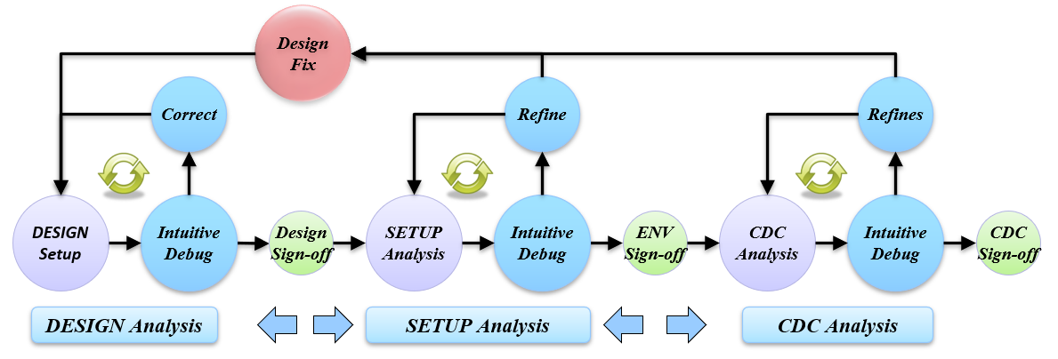
Traditional RTL-CDC Methodology
Design Analysis: Meridian accepts different inputs, performs parsing, and conducts verification on these inputs. ​
Setup Analysis: The tool examines user specifications (definitions of clocks, resets, constants, inputs, outputs)
CDC Structural Analysis: The tool scans the design, identifying structures that do not conform to safe CDC requirements.

Slide 4
PROBLEM STATEMENT
RTL-CDC analysis encounters the following challenges:
SoC Design Complexity: Multi-million instance, thousands of clock domains, 2000+ IP’s
Designers spend a lot of time initially for improving CDC setup ​
Low SNR in Existing Static EDA tools.
Ever-increasing number of CDC static checks require more tool and domain expertise.
Impact of Incomplete Constraints
Difficult to filter out the actual violations from the noise
Wrong constraints can potentially mask real violations

Slide 5
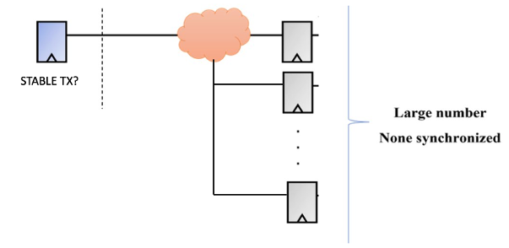
Proposed RCA Methodology
*Simplified Version; multiple checks available
Initially large quantum
200k CDC crossing violating
Enabled RCA checks
Fixed RC STABLE check
Added potential constraint fix
76k CDC Crossing violating
Constrained Flagged Signal: <Signal1>
Function($\text{No}\text{.} \text{of} \text{violations} \text{in} \text{which} \text{this} \text{Tx} \text{appears}\text{,}$
$$\text{Total} \text{No}\text{.} \text{of} \text{tool} \text{reported} \text{CDC} \text{crossing}\text{) }> \text{Threshold}$$

Slide 6
IMPACT
Inclusion of RCA checks offers several benefits:
Significantly optimizes CDC verification process for TAT, license cost, and engineering effort
Expedites the CDC setup time during analysis of new designs
Identifies and highlights design-updates like new clocks or resets, and their relationship with pre-existing setup
Helps validate constraint setup to prioritize real CDC violations over possible false issues

Slide 7
IMPACT
CDC Violation Reduction with the Proposed RCA Flow
Design | CLK Groups | Design Size: eq NAND2 gates in Mil Instances | Conventional CDC Violation Count | RC1 | RC2 | RC3 | Percentage Reduction in CDC Errors*
Design-1 | 81 | 3.51 | 56586 | 13 | 6 | 11 | 86%
Design-2 | 25 | 0.30 | 13036 | 0 | 1 | 74 | 77%
Design-3 | 20 | 3.40 | 5987 | 0 | 0 | 32 | 76%
Design-4 | 730 | 20 | 42850 | 0 | 81 | 162 | 57%
Design-5 | 57 | 12 | 12814 | 0 | 0 | 113 | 56%
Design-6 | 5 | 0.02 | 1130 | 0 | 0 | 3 | 45%
Design-7 | 27 | 9.59 | 15836 | 22 | 1 | 42 | 40%
Design-8 | 17 | 5.71 | 1165 | 0 | 0 | 6 | 38%
Design-9 | 78 | 11.40 | 9475 | 0 | 0 | 15 | 37%
Design-10 | 22 | 0.35 | 2380 | 0 | 0 | 5 | 31%
Design-11 | 72 | 5.29 | 10006 | 1 | 0 | 5 | 29%
*Results shown are without use of waivers
*Reduced if suggested recommendations by RCs are applied on the design
*Suggestions have been reviewed initially before applying, but are not signed-off by the design team yet

Slide 8
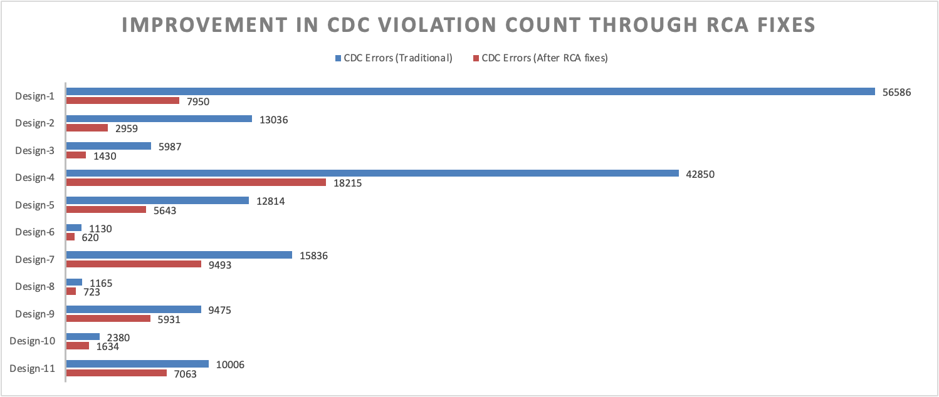
IMPACT
*Results shown are without use of waivers
*Reduced if suggested recommendations by RCs are applied on the design
*Suggestions have been reviewed initially before applying, but are not signed-off by the design team yet

Slide 9
OBSERVATIONS
We uncovered that the outputs of shallow latches within a particular structure could be constrained as stable signals. Since this structure was highly repeatable and present in multiple IPs, applying project-level constraints allowed us to effectively reduce the violation count.
Many of RCA violations were related to DFT logic, which needed refinement.
Identified an asynchronous behavior due to the absence of a clock constraint on a specific mode reset. RCA made this debug easier.
Encountered receiving flops or ports with high fan-in that were deemed irrelevant and were consider don't care for CDC analysis.

Slide 10
Conclusion
Root-cause groups checks are a group of statistical checks that help in constraining the design.
RCA checks prove to be more effective with designs that have high structural violation count.
RCA checks help reducing the noise in CDC results. Redundant/false violations are eliminated mostly, and the verification engineers are left with real CDC violations.
Future steps
Incorporate RCA in the flow and have a reasonable and actionable way of providing the set of suggestions from RCA to the designers.
Implement and adopt incremental CDC to achieve substantial reduction in turnaround time for reviewing and resolving CDC violations.
Enhance the accuracy of RCA reporting by incorporating insights from the evaluation process.
Utilize the knowledge gained to develop new and improved RCA checks.

Slide 11
Questions

