Slide 1

Formal Verification + CIA Triad: Winning
Formula for Hardware Security
Vedprakash Mishra, Anshul Jain
Intel Corporation

Slide 2
Contents
H/W Security
CIA Triad
Case Study
Big Fuzz ?
Or
Genuine Concern ?
Confidentiality
Integrity
Availability
Design Details
Security Bugs
Insights
FV for Security
Conclusions
Role of FV
FV Approach
Results

Slide 3

Hardware Security
In SOCs, several agents compute cores, accelerators and IO devices interact to process workloads
All agents may not be equally trustworthy
What does Security mean for Hardware?
Critical aspect of overall cybersecurity
Even the most robust software protections can be compromised if the underlying hardware is vulnerable
Hardware security attacks exploit vulnerabilities and steal assets
Assets such as control and status registers (CSRs), encryption/decryption keys, regions in memory, etc.
Goal of Hardware Security?
Protect sensitive assets from hackers
Prevent security attacks from causing performance and functional breakdown

Slide 4

Role of FV in Hardware Security
All possible system states
A rigorous mathematical technique for proving design correctness through exhaustive exploration of all input combinations and system states
All possible system states
Valid Invalid
Input Input
Powerful technique for exposing security flaws/vulnerabilities of designs “well in-time (pre-silicon)”
Valid Invalid
Input Input
Verifies that a design works as per specification and satisfies a set of security properties, such as confidentiality, integrity, and availability
If your IP handles secure information of the SOC chassis, then this talk will
Help in Security Verification Planning through Formal Verification
Create awareness about potential attack scenarios and their implications
Prepare to take risk mitigation steps and achieve shift-left

Slide 5
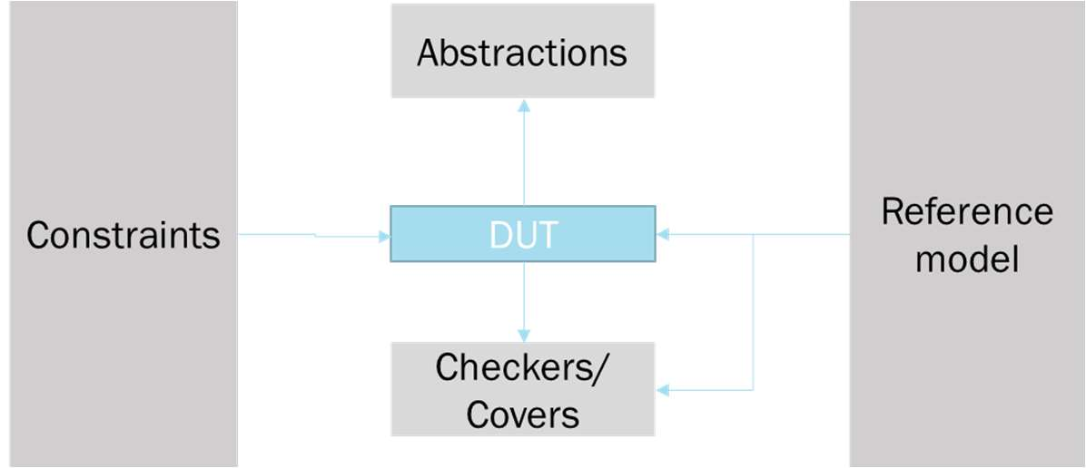
Role of FV in Hardware Security (Contd.)
Crucial for exploring a wide range of input scenarios (compliant and non-compliant) to detect potential security weaknesses
ENHANCE MODELLING
RELAX CONSTRAINT
Upgrade abstractions, reference models, incorporate threat modeling, define security properties and assertions for effective security verification
Benefits: Enhances design resilience against unknown vulnerability attacks, aids in early vulnerability detection, and provides a more robust security verification process

Slide 6

CIA Triad
Verifying the design satisfies CIA, we ensure the hardware is secure
Confidentiality ensures the data is only accessible to authorized parties
Confidentiality
Integrity ensures that data is not tampered with or modified during transportation
Integrity
Availability
Availability ensures the system is operational and accessible when needed

Slide 7
Confidentiality: Secure Access of Assets
Insecure source or destination IDs
Processor
Cache
Accelerator
Memory
Memory Fabric
DRAM
secret
Critical input exposed
IO Fabric
SRAM
Un-synced
micro-architectures
Device
Memory
Device
Memory
Critical headers
/bits corrupted
Identification and role attributes for initiators and responders play a vital role in hardware systems.
They uniquely identify entities, define their roles, and enable secure access, authentication, authorization, and accountability
By incorporating these attributes, hardware systems ensure authorized interactions, prevent unauthorized access, and maintain confidentiality
Unsecure Access
What happens if the initiator attributes are modified in the transit?
A fake or spoofed attribute may end up granting an untrusted initiator access to an asset while it should have been denied

Slide 8


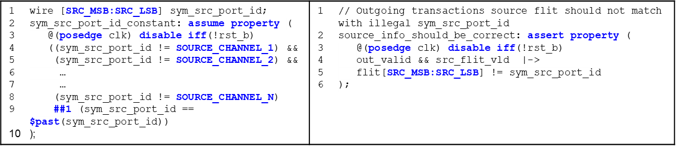
Confidentiality: FV Approach
Ensures that transactions having incorrect attributes (E.g., Src/Dest IDs) i.e., not belonging to allowed hardware allowed Port IDs should not be propagated.
Enables the verification of properties related to attribute constraints, which play a crucial role in preserving confidentiality
FPV
Similarly, properties like “if a particular transaction is filtered (based on the attributes) then it cannot be seen on the output interface” should also be written

Slide 9
Integrity: Accurate and Consistent Service
Integrity is a critical aspect of security, ensuring data and systems' accuracy, consistency, and trustworthiness
Breaching integrity involves unauthorized changes to the completion response of a legal transaction, leading to severe consequences for system reliability and data integrity
Manipulating the completion response can compromise the service provided, falsely indicating success or failure, leading to incorrect actions, compromised data processing, and potential security breaches
The consequences of such manipulation can range from financial losses, operational disruptions, compromised data integrity, to potential security breaches, depending on the context and system involved

Slide 10


Integrity: FV Approach
To ensure the integrity of a system, it is essential to deploy both functional correctness properties and data correctness measure
Functionality correctness checker:
If the transaction is legal as per decoded attributes and read/write of config register is allowed/read, then only a successful completion should be sent, otherwise unsuccessful completion
Data correctness checker:
If config register was read, then completion data sent should match the read data

Slide 11
Availability: Hang free system (No DoS)
Pipeline hang or stuck stages can impact security availability, potentially leading to a denial of service (DoS) attack
01
IP was able to detect that the transaction is corrupt. Should IP discard that transaction or raise an error?
(E.g., Number of flits sent by intruder is incorrect, FSM is stuck waiting for correct number of flits)
Corrupted transaction was a non-posted transaction; shouldn’t an unsuccessful completion is required ?
(Non-posted transaction requires completion response, otherwise entire architecture will hang)
Let’s say IP sent an unsuccessful completion, but instead of sending one completion response sent two.
(One request-one response)
02
03

Slide 12
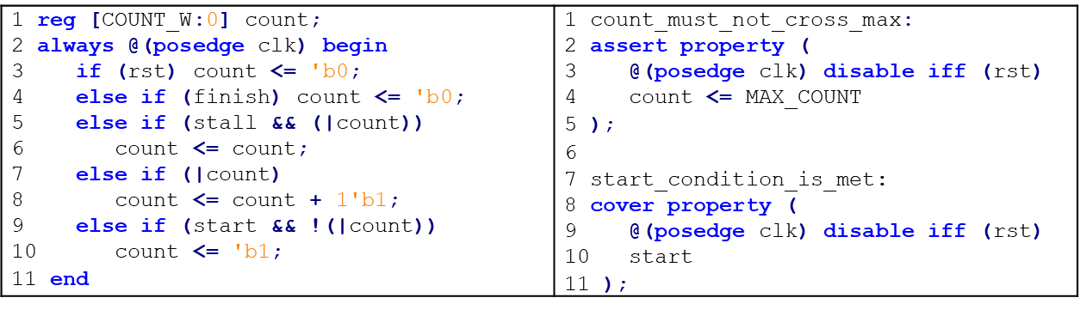
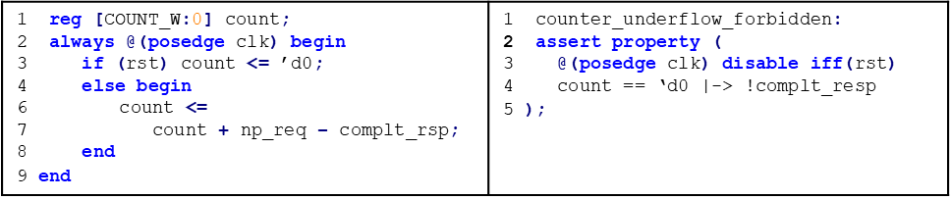
Availability: FV Approach
FV can also be used to detect potential pipeline hangs and ensure the correctness of the
pipeline design
Safety and Correctness : If an illegal transaction is received then unsuccessful completion corresponding to this transaction should be sent out within finite number of cycles
Spuriousness: Number of completion responses sent should never be more than number of non-posted request received

Slide 13
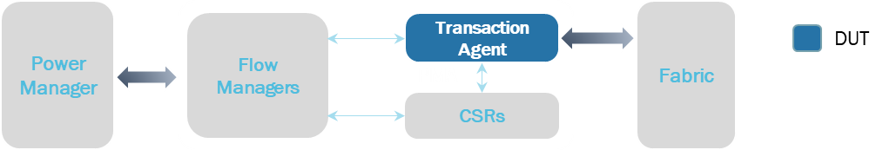
Case Study : Design Details
IP is responsible for integrating different subsystem IPs in a System-on-Chip (SOC) and providing a unified modular interface
It manages interactions with subsystem IPs for power and reset management purposes, directing transactions to the corresponding power manager or reset handler
IP also routes transactions related to config registers and static registers to the appropriate modules for configuration and control of settings within the subsystem IPs

Slide 14
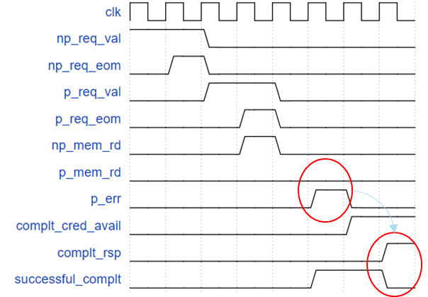
Case Study: Bug Example
Manipulation-of-service bug caught through FPV
Correct Decoding
Non-posted request received first, had successful access of CSR. Corrupted post was correctly decoded, and an error was flagged
01
02
Completion response corresponding to the non-posted request was not asserted due to the unavailability of credits
Zero
Credits
03
Successful field got de-asserted because of the posted error when credits became available and incorrect completion response got reported
Incorrect
Response

Slide 15
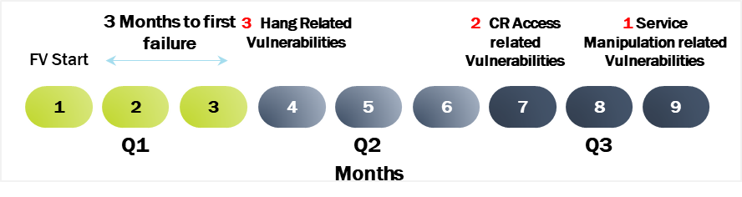

Case Study: Results
Unsecure Access to CRs: Transaction Agent (TA) claims transactions without security attributes, allows the attackers to modify/access Control/Status Registers (CSRs) (2 vulnerabilities)
Denial of Service/ Hang: TA fails to check header containing security attributes for malformed transaction, exposes TA to attackers for create hangs (3 vulnerabilities)
Manipulation of Service: TA unable to ignore malformed transactions appropriately, allows attackers to corrupt successful responses by injecting malformed transactions (1 vulnerability)
Issues related to Integrity and availability are hard to catch by formal apps like Security Path Verification (SPV). FPV has selective advantage over here because of its exhaustiveness

Slide 16




Conclusion
FPV allows checking confidentiality, integrity, and availability simultaneously, unlike traditional security approaches that may focus solely on confidentiality.
Exploiting the same functional properties with loosened constraints can verify security leaks, making formal setup reusability possible with minimal effort.
For security-critical IPs, formal verification should be employed to check both functional, performance, and security aspects.
Formal verification is an effective method for detecting and mitigating security risks in hardware designs, ensuring security, and vulnerability-free hardware while achieving shift-left.

Slide 17
THANK YOU

