Slide 1
ASIL B/D Fault Campaign Strategy for Computer Vision core using Soft Test Library (STL)
Shiva Pokala, Engineer, Staff
Vasista A, Engineer, Staff
QUALCOMM India Private Limited

Slide 2
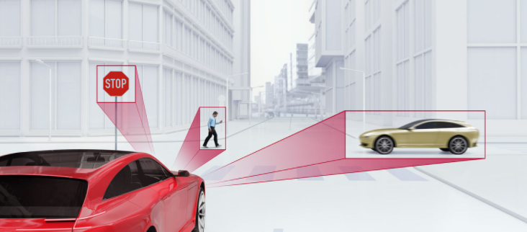
Functional Safety – ISO26262
Goal of ISO26262 is to ensure safety throughout the lifecycle of automotive system
Automotive Safety Integrity Level (ASIL) is Key component of ISO26262
ASIL varies from A (Lower) to D (Highest)
Faults Classification
Fault diagnostic coverage metric requirement for automotive chipsets
Geometric Correction and feature detection
Motion Detection &
Direction Prediction
Object Detection and Classification
Figure 1 : ADAS Processing Block Diagram

Slide 3
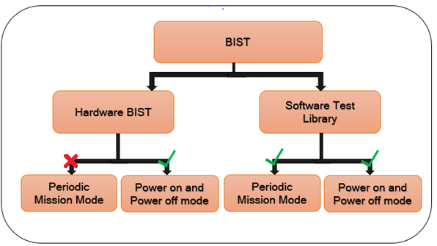
Problem Statement
BIST is the standard safety mechanism implemented to detect faults which can potentially lead to catastrophic errors in the design
Hardware BIST is used during Power ON and Power Off Mode
Hardware BIST does not provide any periodic Testability solution in Mission Mode. It can be achieved with STL running periodically.
No methodology and process in place for the implementation, Software periodic testing
Fig 2 : BIST Methodology

Slide 4
Proposed Solution : STL Flow
Fig 3 : STL Flow Of Operation
Visual analytics core :
FuSa critical core
Generates accurate motion vector for the object detection
In-Vehicle infotainment (IVI) and Advanced Driver Assistance System (ADAS).
Software Test libraries (STL) :
Detect incorrect data computation
Fault detection mechanisms that run periodically to identify the failure
Informs the Safety manager to take appropriate action

Slide 5
Proposed Solution : STL Fault Campaign Flow
Fault Campaign methodology flow
FMEA / FMEDA :
Provides the info about failure modes(FM), associated design hierarchies and associated safety mechanisms.
FSM :
To generate SFF (Standard Fault Format) containing the info about faults and safety mechanisms targeted per failure mode.
Fault Pruning:
Fault reduction using Structural analysis with Formal FuSa tool.
Z0IX Fault Simulation (FSIM):
Faults specified in SFF are injected in the design and fault simulations are triggered.
Reports Diagnostic coverage for each failure mode.
FMEA / FMEDA
VCS Simulation for eVCD generation
Identify FMs associated with SW based safety mechanisms
Z01X Logic Simulation
Update Test Stimulus to meet Target STL DC requirements
Generate SFF and associated PSM’s OBS and DET points
Z01X Fault Simulation
Formal FuSa : Structural analysis for fault pruning
Target DC Achieved
Fig 4 : Fault campaign methodology flow

Slide 6
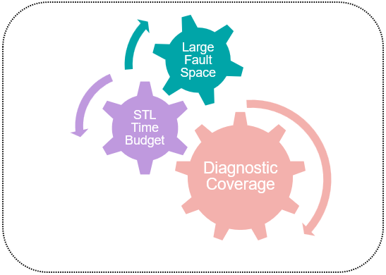
STL faster convergence on Fault Campaigning
Methods to Quickly Converge on Fault Campaign
Code Coverage Grading
Broad set
of Detection Points
Formal based Fault Pruning
Hyper Faults Convergence
Parallel simulation Flow
Fig 5 : Fault Campaigning Challenges
Fig 6 : Faster Fault Campaigning Convergence Techniques

Slide 7
Results
STL is first time enabled in Visual analytics core, achieved required ASIL STL safety requirements
Fault pruning using structural analysis resulted fault reduction.
Overall DC for Visual analytics core achieved with optimal test vectors identified from simulation grading

Slide 8
Conclusion
Z01X based STL fault campaign is the solution proven to meet targeted ASIL fault coverage target defined by FMEDA process
Z01X is successfully deployed in Visual analytics Core DV environment
Formal FuSa setup successfully enabled for structural analysis-based fault reduction
Based on simulator coverage grading, the testcases are identified for STL fault campaign
Target Diagnostic Coverage is achieved and STL time budget is met, identified testcases are enabled in SW STL application
Future Scope :
Controllability and Observability analysis for fault pruning using FORMAL FuSa

