Slide 1

Fast Convergence Modular Advanced Smart-Hybrid Testbench (FCMAST) to automate and expedite
SoC Gate Level Simulations closure
Harshal Kothari, Eldin Ben Jacob, Chandrachud Murali,
Sriram Kazhiyur Sounderrajan, Somasunder Kattepura Sreenath

Slide 2
Agenda
Introduction: Problem statement & FCMAST solution
Traditional techniques to standardize GLS
Mix of traditional & automation techniques
Fast convergence innovation techniques to expedite GLS
Simulation performance optimization wrapper
Custom simulation strategies for faster runs
Results and future scope

Slide 3
Introduction
GLS integral in ASIC verification but slow.
Need to optimize env & performance without compromise on quality.
Huge TAT in TGLS & PAGLS: 150hr+ with full chip netlist.
Not enough time for audit & reviews before TO.
FCMAST employs hybrid TB, self-aware checkers, env and log audits & automations, DSNR, CnR, perf optimizations, AI & ML based failure debug & wavemining.
Modular project-agnostic env & automation to expedite GLS closure by 65% using FCMAST.
Motivation
Implementation Solution
Result
Problem Statement

Slide 4
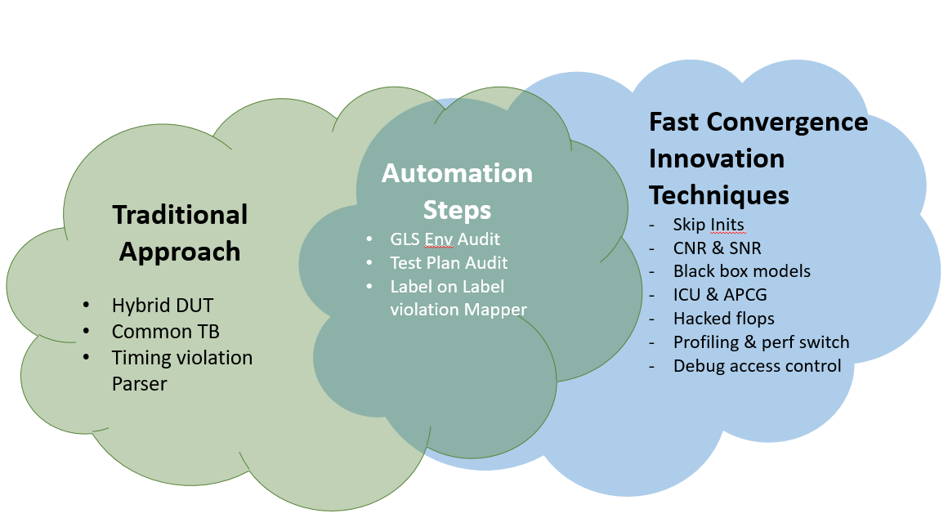
FCMAST Flow

Slide 5
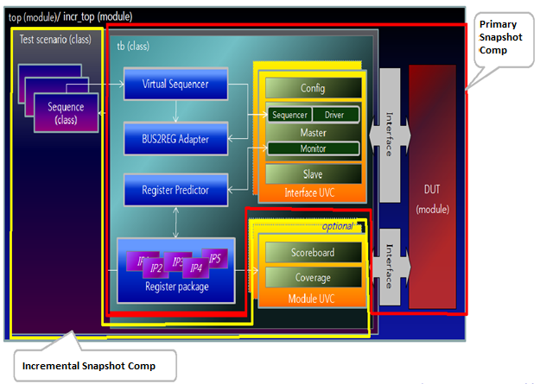
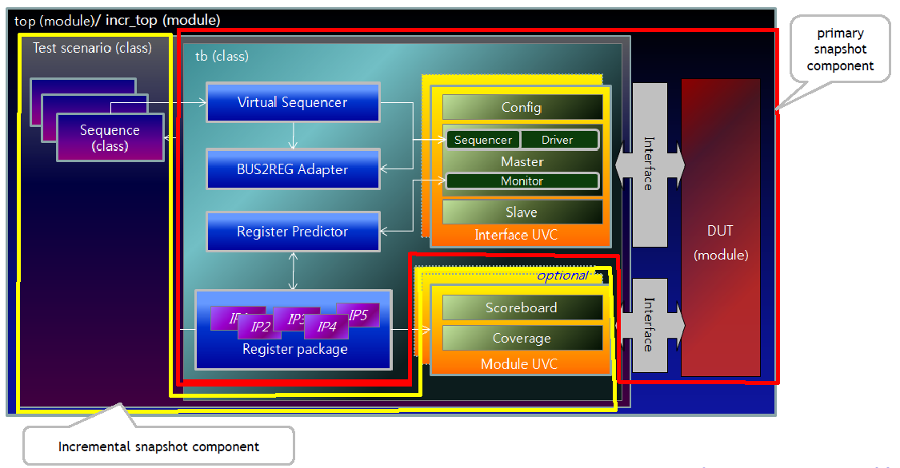
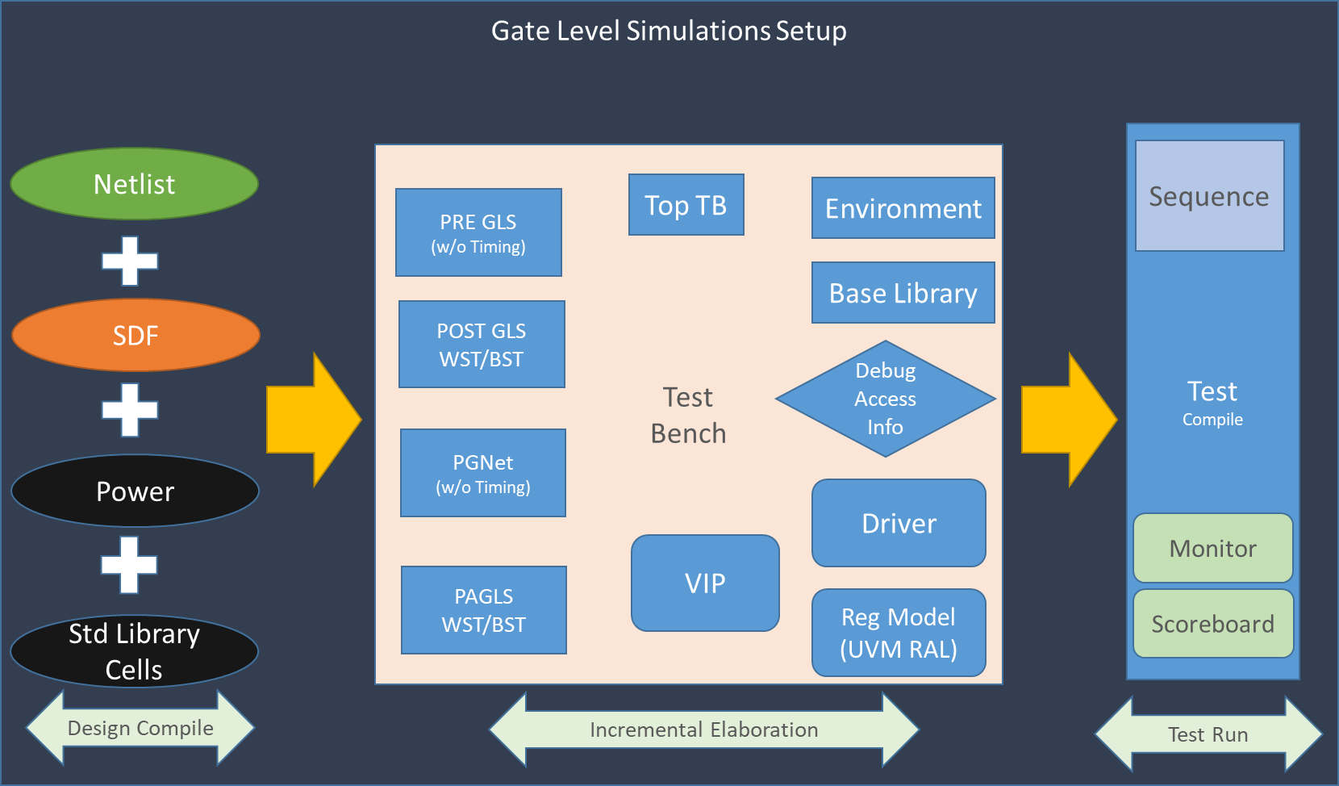
Traditional Methods
Common TB: Standardization, reusability, scalability

Slide 6
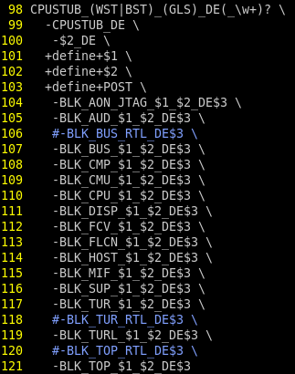
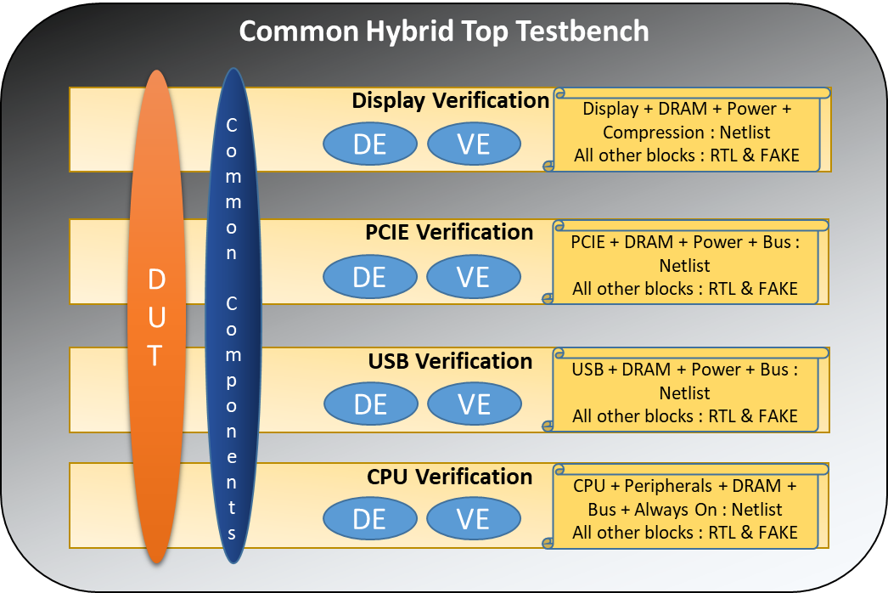
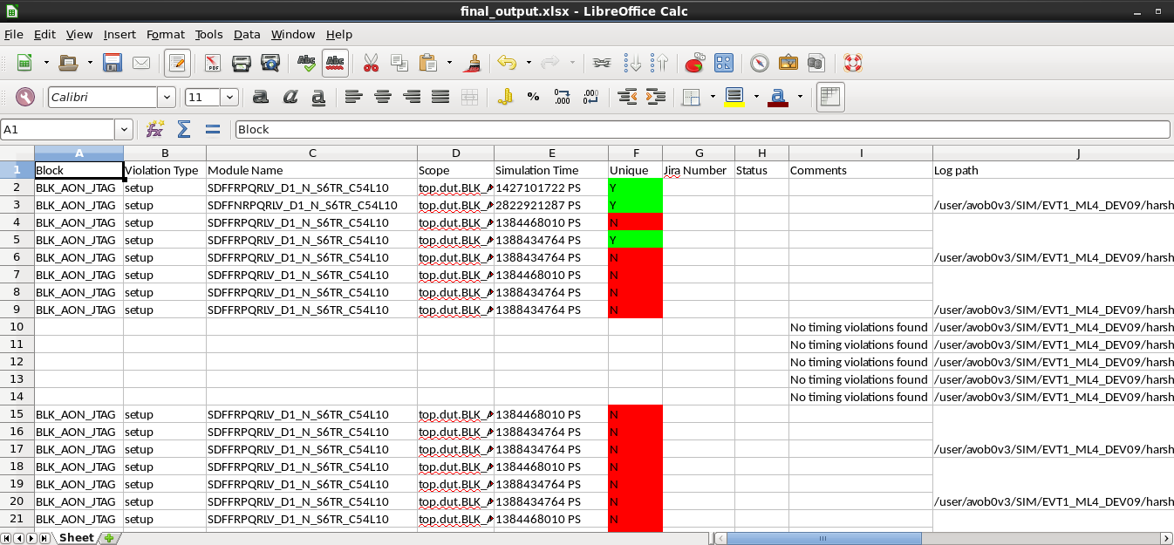
Traditional Methods
Hybrid DUT: On the fly Model Type (RTL/Netlist/Fake) picked based on IP/BLK Verification Environment (VE)
Timing Violation Parser

Slide 7
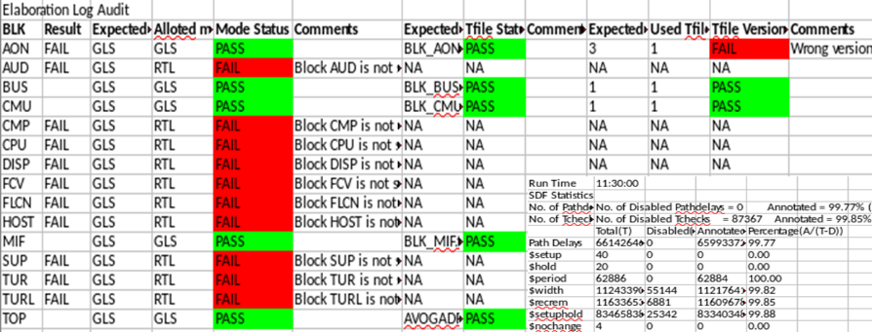
Mix of Traditional and Automation Techniques
Environment Audit: Using elab and sim logs
  BLK wise results available before run finishes
    Rerun iteration elimination & efficacy enhancement
Elab Check
Sim Check
RTL/Netlist Check
PASS
FAIL
SDF/Tfile Version
PASS
FAIL
Depot Control

Slide 8
Mix of Traditional and Automation Techniques
Vplan audit: Automated log paths checks & reviews from testplan
  Regression output management utility
  Parses based on existence, error filters, passing signature
  HTML & CSV output, can be filtered based on DUT/Label

Slide 9
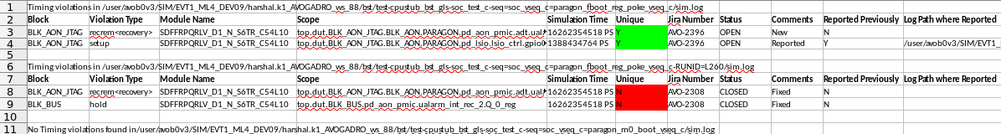
Mix of Traditional and Automation Techniques
Violation Mapper
Identify timing violation
Check for uniqueness
Report occurrence: Line number & sim time
Identify violation type, violating time
Check for label on label support ticket mapping
Check for first occurrence in present release
Compare against previous label and ticket update
Violation Mapper: Label on label report generation utility
Automated checks for timing violations
Eases tracking
  Ensures 0 timing violations by
  tapeout
Eliminates duplication/rework

Slide 10
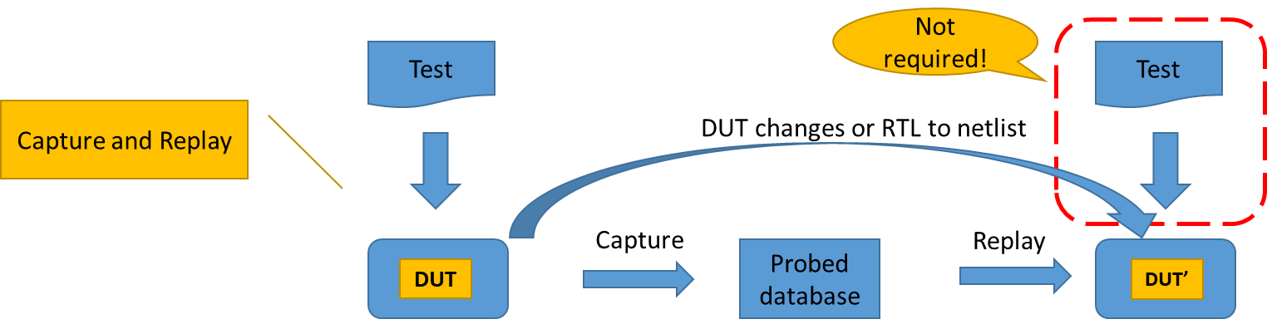
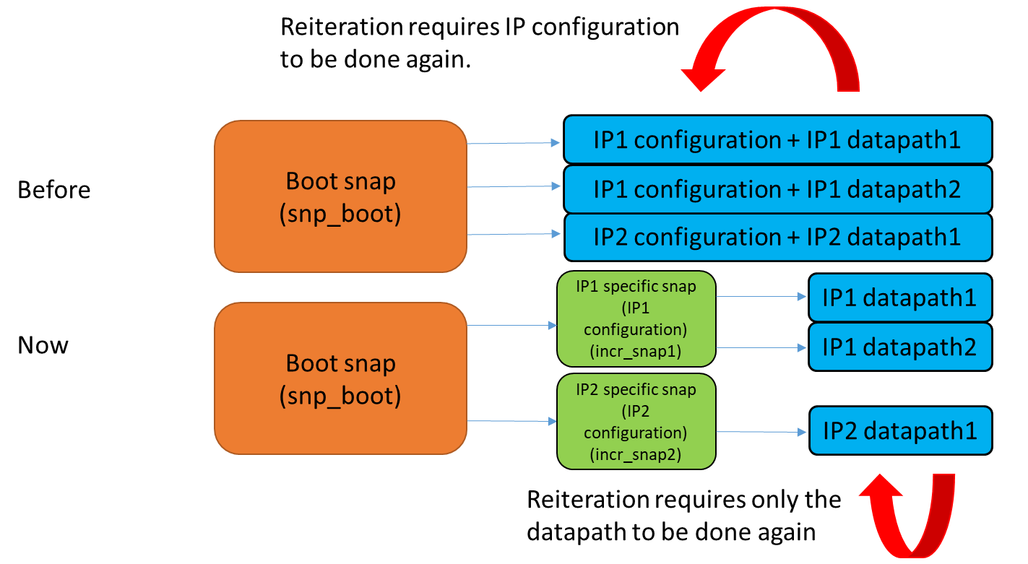
Simulation Performance Optimization Wrapper
Capture and Replay
  Capture database of failure in RTL
  Replay scenario in ECOed netlist for confidence
  Run the actual full chip GLS
Incremental Checkpoint Utility
  Use SoC wide boot snap to generate IP wise init snap
  Use init snap to run IP tests
  Prevents rerunning IP init multiple times
  Reduces the overall init snap generation time via Dynamic Save and Restart

Slide 11
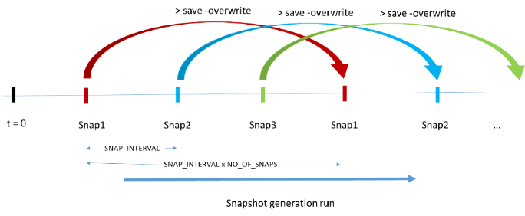
Simulation Performance Optimization Wrapper
Automatic Periodic Checkpoint Generation (APCG)
Periodically stores the simulation state of the run
Multiple checkpoints at a time
Flexible period for checkpoint generation
Auto-deletion of oldest checkpoints

Slide 12
Custom Simulation Strategies
Design/ Testbench/ Tool/LSF based alterations to reduce simulation time
CSS
Custom Simulation Strategies
Initialization skip
Reduces the no. of writes/reads for DRAM/Firewall/ Clocks/PHY init
Power up skip
Reduces the PM register config, reset releases, non-directed BLK power up, high speed clocks etc.
Netlist + RTL
Hybrid DUT: Sim time for RTL is lesser
Netlist + Black Box
Reduces logic for non-targeted blocks
Automated Afile
AI & ML based debug access permissions
Performance switches
Profiling result analysis and tool speed-up
LSF machines
Dedicated or higher compute capacity slots
Testbench
Based
Optimizations
Tool/LSF
Based
Optimizations
DUT Configuration
Based Optimizations

Slide 13
SPOW+CSS: Fast Convergence Innovation Techniques Improvements
Consistent 2.8x-4.4x performance gain over 100 tests
Scenario | Compile | Boot test | Mem test | CPU test | Power test | Disp test | PCIE test
Traditional | 23hrs | 38hrs | 71hrs | 60hrs | 62hrs | 66hrs | 72hrs
Skip Init runs | 23hrs | 28hrs | 45hrs | 42hrs | 38hrs | 40hrs | 55hrs
Skip Power up runs | 23hrs | 24hrs | 38hrs | 36hrs | 34hrs | 46hrs | 53hrs
GLS + RTL runs | 13hrs | 24hrs | 38hrs | 36hrs | 34hrs | 46hrs | 53hrs
GLS + FAKE runs | 12hrs | 20hrs | 29hrs | 30hrs | 26hrs | 32hrs | 38hrs
Improvement | 1.9x | 1.9x | 2.4x | 2x | 2.3x | 2x | 2.2x

Slide 14
Consolidated FCMAST Results
IP/BLK wise improvement metrics:
FCMAST optimization in regression:
Scenario | Boot test | Memory tests | CPU tests | Power tests | Display tests | PCIE tests
Initial avg | 50hrs | 156hrs | 120hrs | 98hrs | 186hrs | 264hrs
FCMAST Optimized avg | 18hrs | 26hrs | 25hrs | 24hrs | 28hrs | 29hrs
Improvement | 2.7x | 6x | 4.8x | 4.1x | 7x | 9.1x
Initial Metrics |  |  |  |  |  | FCMAST Improved Metrics
Block | Total Tests | No. of netlist labels | Avg Iterations for first pass | Avg run time (hrs) | Total runtime (hrs) | Avg Iterations for first pass | Avg run time (hrs) | Improved Total runtime (hrs) | Net Improvement (X times)
A | 19 | 8 | 4 | 85 | 51680 | 1 | 48 | 7296 | 7.1
B | 12 | 8 | 4 | 76 | 29184 | 1 | 33 | 3168 | 9.2
C | 4 | 8 | 2 | 94 | 6016 | 1 | 42 | 1344 | 4.5
D | 3 | 7 | 3 | 63 | 3969 | 1 | 35 | 735 | 5.4
E | 2 | 8 | 2 | 67 | 2144 | 1 | 31 | 496 | 4.3
F | 14 | 8 | 4 | 78 | 34944 | 1 | 38 | 4256 | 8.2
G | 8 | 8 | 3 | 163 | 31296 | 1 | 101 | 6464 | 4.8
H | 22 | 8 | 4 | 102 | 71808 | 1 | 44 | 7744 | 9.3
I | 13 | 6 | 3 | 73 | 17082 | 1 | 24 | 1872 | 9.1
J | 17 | 8 | 4 | 68 | 36992 | 1 | 28 | 3808 | 9.7
K | 6 | 8 | 5 | 152 | 36480 | 1 | 86 | 4128 | 8.8
L | 10 | 8 | 3 | 79 | 18960 | 1 | 31 | 2480 | 7.6

Slide 15
Conclusion and Future Scope
Achieved
4x-10x performance & efficiency improvement
Proven across 2 SoCs for AR/VR & 3DIC HPC application
Highly automated env: Reduces resource requirement
Infra $$$ saving: Up to 65% lesser license and disk-space costs
AI & ML based tools for automated debug & wavemining
Configurable no. of snapshot steps in ICU
Automated env correction & rerun after audit failure
HPDF wise reporting in Violation Mapper

Slide 16
Thank you!
Questions?

