Slide 1
Robust Low Power Verification Strategy for a Complex 3DIC System with Split Power Management Architecture
Atiq Jamadar, Ayush Agrawal, Subramanian R, Sekhar Dangudubiyyam

Slide 2
AGENDA
Introduction
Challenges in Verifying 3DIC
Split Power Management Architecture
Conventional SOC Verification Environment
Robust Verification Environment
Results
Conclusion

Slide 3
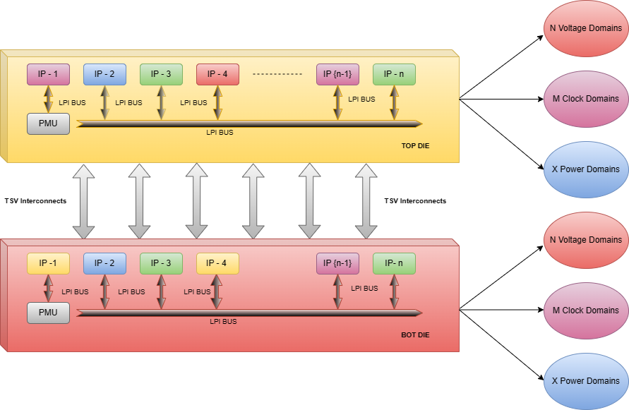
INTRODUCTION
Integrate more and more transistors in same area while satisfying Moore’s Law
SOC Consists of different power domains, clock domains and voltage domains.
Prohibitively expensive to verify that a design works in all possible power domains.

Slide 4
CHALLENGES IN VERIFYING 3DIC
Controlling power consumption in split power management architecture
Cross die low power handshake complexity is more compared to single SOC
Power balls at DUT increases since 3DIC have two SOCs
Cross Die power domain combinations are more
Cross Die Power switching combinations are more

Slide 5
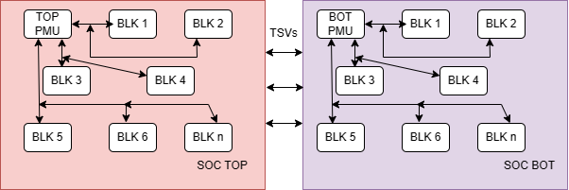
SPLIT POWER MANAGEMENT ARCHITECTURE
Each SOC have their own Power Management Unit(PMU).
Once the resets of BOT dies are released, control would be shifted to TOP die and its PMU releases resets one by one.

Slide 6
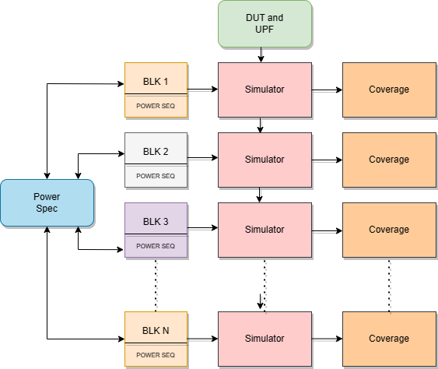
CONVENTIONAL SOC VERIFICATION ENVIRONMENT
IP owner has to write his own sequence and verify low power datapath of the block.

Slide 7
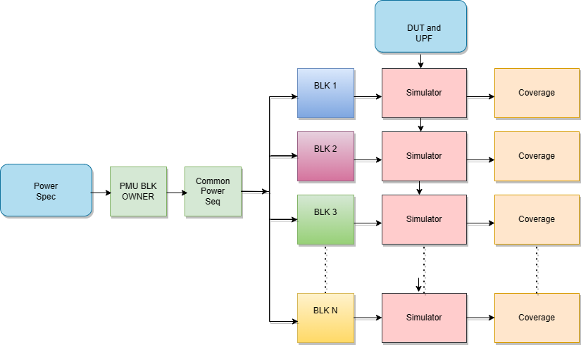
ROBUST VERIFICATION ENVIRONMENT
A generic sequence which can control power gating, power transitions for all IPs present in both SOCs

Slide 8
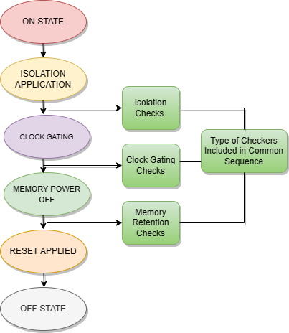
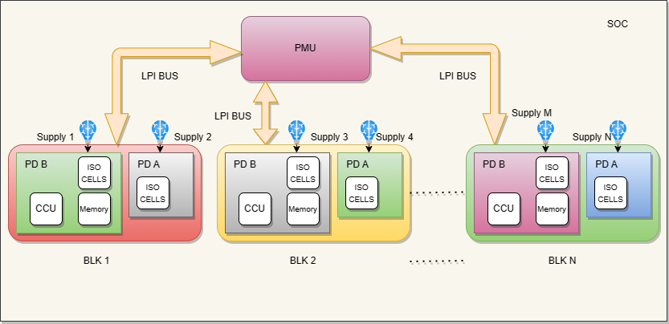
Low Power Verification
All IPs have to go through low power transitions it would be difficult to write test sequence for each IP separately specially in case of 3DIC.
Using generic sequence takes less effort and it saves time to write test sequence

Slide 9
Continued…
Low Power Verification
Isolation Application → Once power down request from PMU is applied, isolation is applied at the boundary of power domain(PD).
Clock gating → After isolation applied clock are requested to shut off from PMU.
Memory Power Off → Power switch of memory is turned off. If data of the memory has to retain then retention bit is set otherwise data is lost
Reset Application → Applying reset to the block.

Slide 10
Common Sequence Implementation
Sequence consist of below power verification scenarios.
Local Power Gating (LPG)
All Other Power Gating (AOPG)
SOC Power Gating (SOCPG)
SOC Mode Switching(SOCMSW)

Slide 11
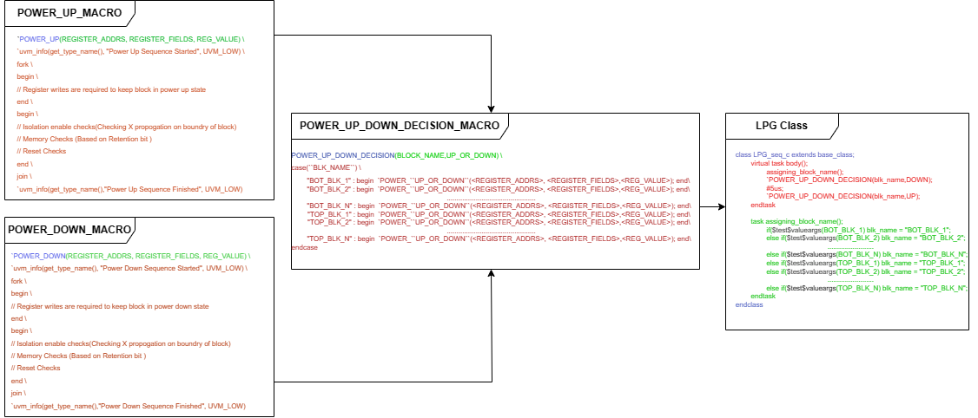
Continued…
Common Sequence Implementation
Low Power Gating
Power gating or turning OFF one IP and keeping rest of the IPs ON

Slide 12
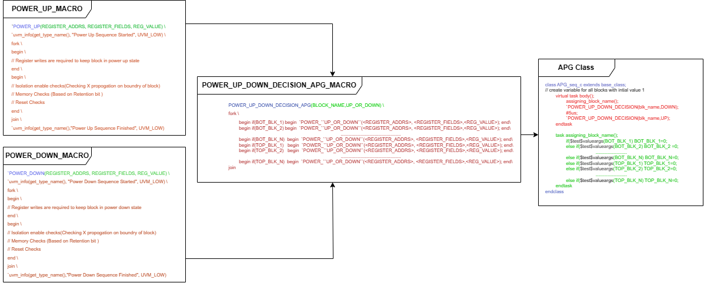
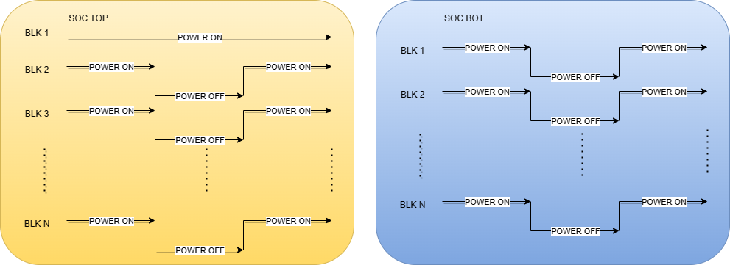
Continued…
Common Sequence Implementation
All Other Power Gating
Keeping a IP ON and powergating rest of the

Slide 13
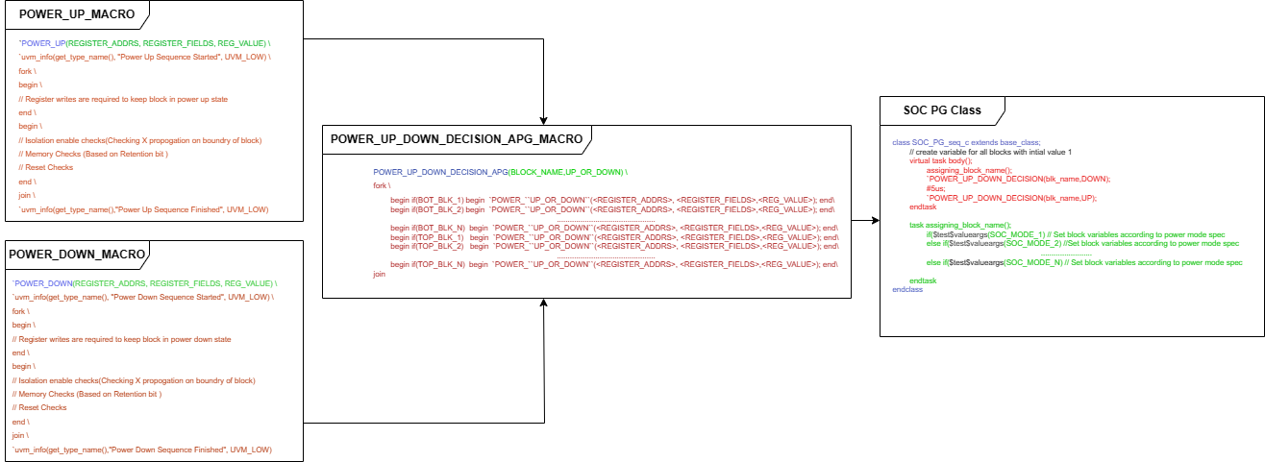
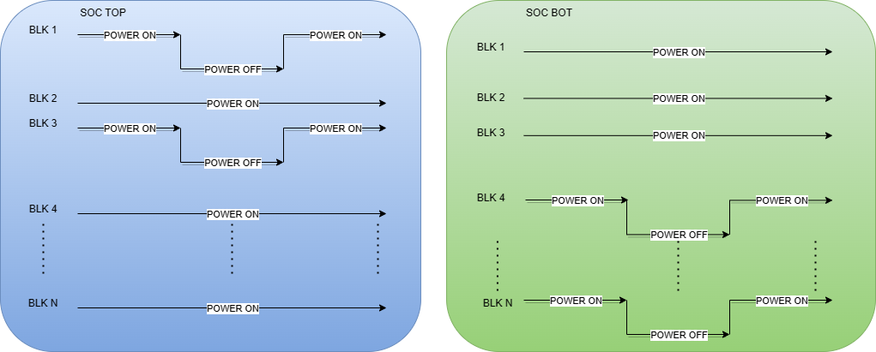
Continued…
Common Sequence Implementation
SOC Power Gating
Powergating scenario based on the power modes provided by RTL designers

Slide 14
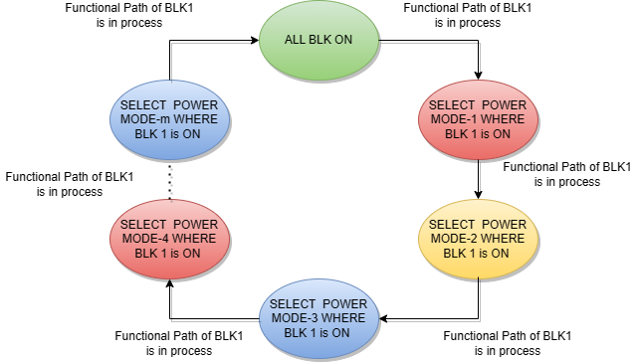
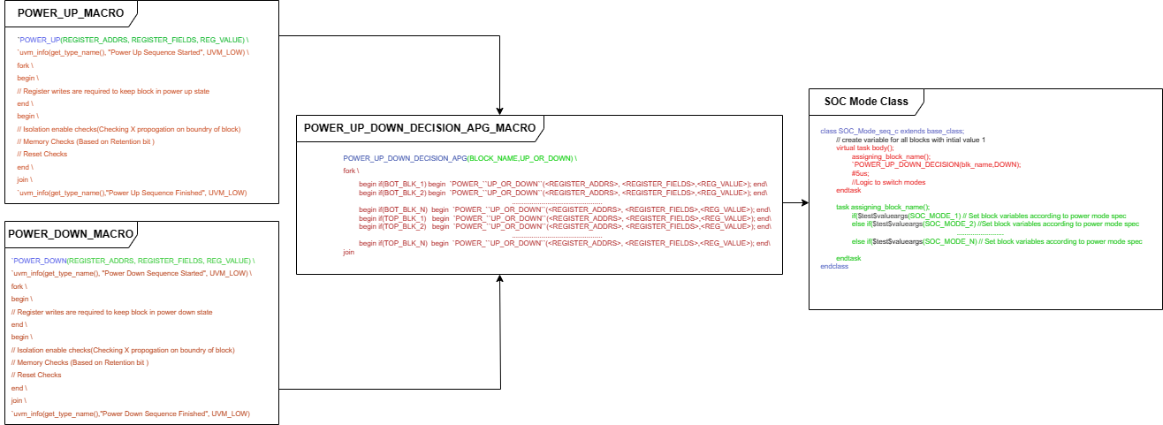
Continued…
Common Sequence Implementation
SOC Mode Switch
Switching from one power mode of SOC to another power mode

Slide 15
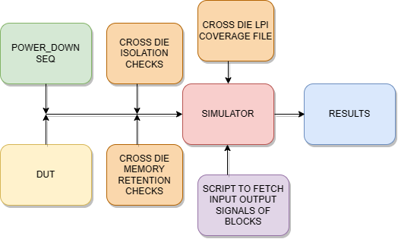
Common Checks included in generic sequence
Cross Die Isolation X-propagation Checks
Cross Die Reset Checks
Cross Die Memory Retention Checks

Slide 16
RESULTS
Cross die Low Power Handshake bugs
In a power gating scenario of processor serially (one by one present in top die and bot die) found low power handshake bug
Software Initiated Reset bug
CCU(Clock Controlling Unit) bug
Found UPF isolation issue using isolation checks where wrong isolation value causing complete SOC to turn off when block is turned off.

Slide 17
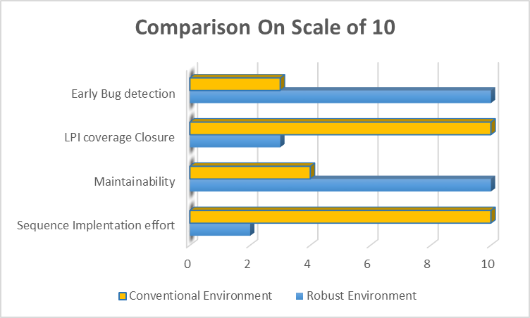
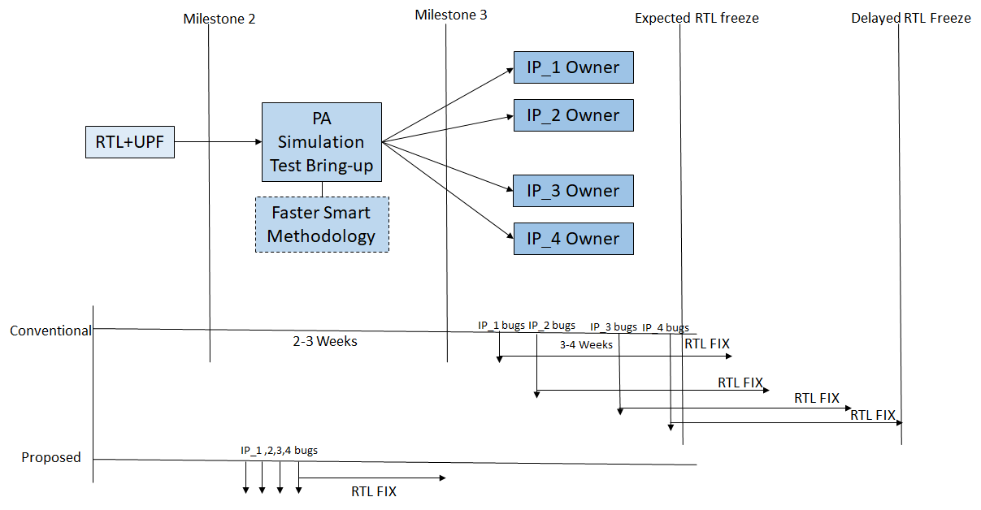
Continued…
RESULTS

Slide 18
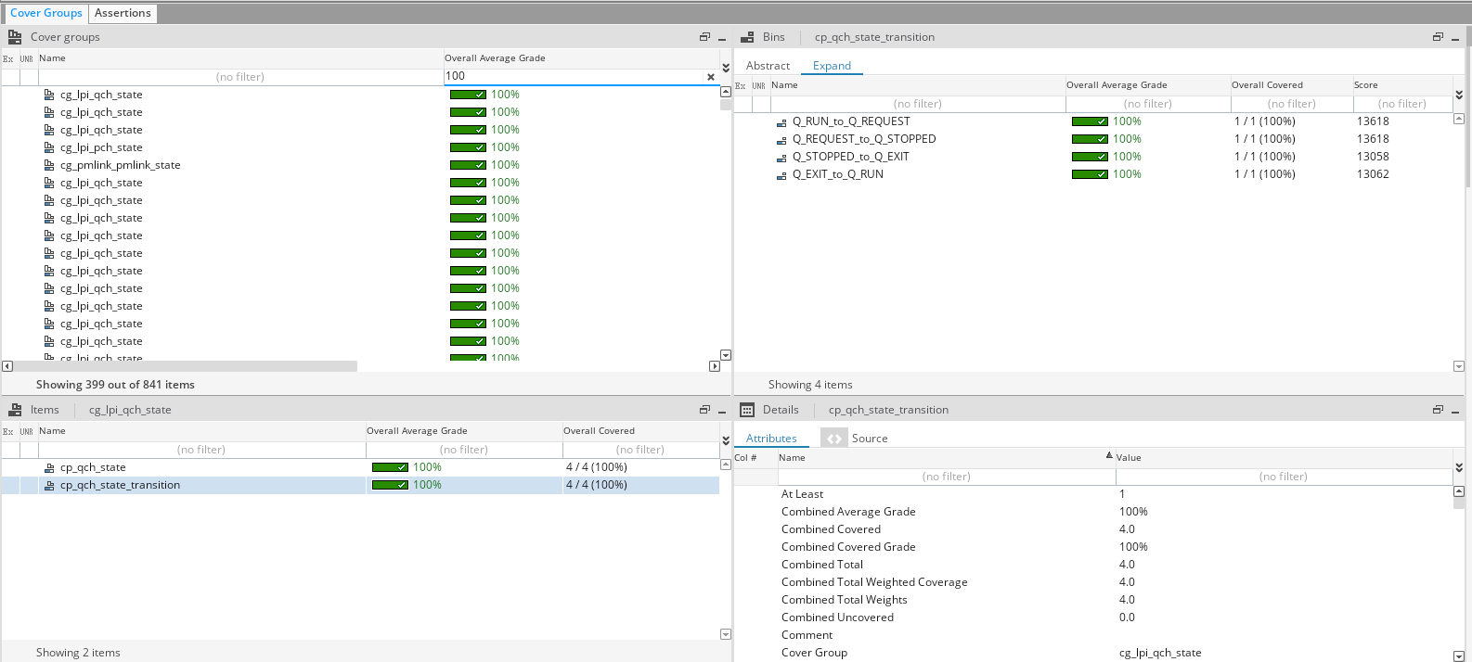
Continued…
RESULTS

Slide 19
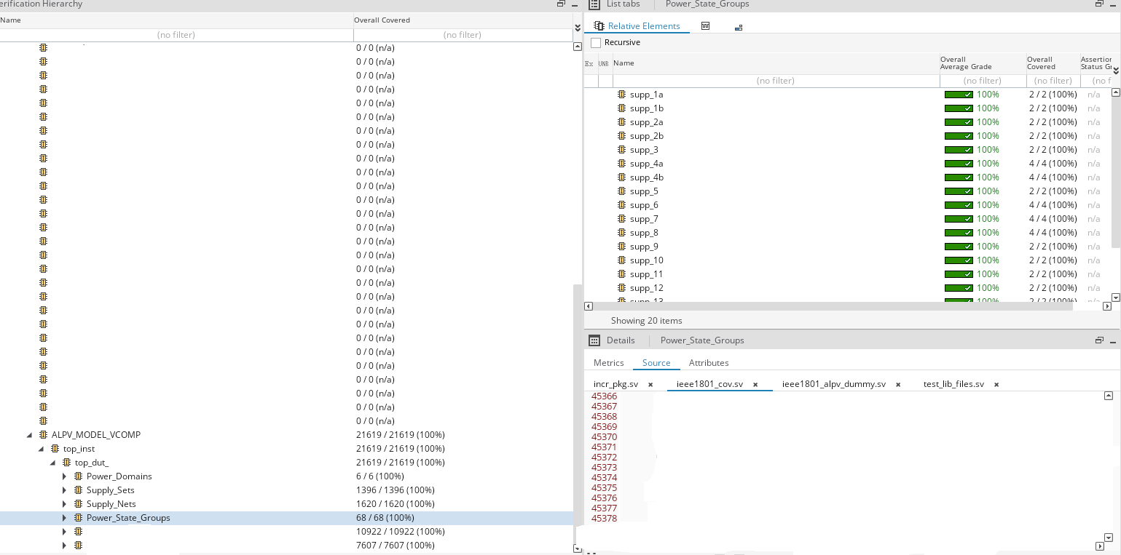
Continued…
RESULTS

Slide 20
CONCLUSION
This paper presents robust verification environment for verifying all possible power mode transitions, voltage switching, isolation control, and power Includes shutdown conditions within the verification cycle along with functional coverage of low power interface and power mode coverage. This approach is around 40% more efficient than conventional approach and helps to detect crucial bugs at early stage of verification cycle.

Slide 21
Questions

