Slide 1
Disaggregated methodology in Multi-die SoC– A Server SoC Case Study
Rohit Kumar Sinha, Intel India

Slide 2
MOTIVATION: Disaggregation in Multi-die SoC
With growing power, performance, cost, and form factor challenges, traditional monolithic solutions don’t work
To handle such challenges, one such approach is “disaggregation”, in which a design is broken into several “chiplets” which are connected using specialized die-to-die (D2D) IPs.
Need a framework to create, optimize, edit, and manage interconnects for disaggregated systems
Server-SoCA is a multi-chiplet product with the compute die and base die being manufactured separately but connected on the platform through advanced packaging techniques
Paper talks about the challenges associated with Server SoCs which includes multi-die chiplets and how to we handle multi-die voltage domain crossing, metastability and connectivity challenges

Slide 3
Disaggregation Methodology Classification
Die-Die Interconnects
Interconnects between stacked die that enable vertical interconnects between
multiple die in a 3-D stack. Die-Die interconnects created using -
Wafer-to-Wafer attach process
Die-to-Wafer attach process
Die-Die attach process
On-package Die-Die Interconnects
For ex-2D and Enhanced-2D Interconnects: Interconnects between die within the package that enable lateral connections.
Die-to-Package Interconnects
Interconnects between the die and the package, typically known FLI
Within-Package Interconnects
Interconnects within the package that enable lateral connections between
two nodes or electrodes. Scaling projections of within-package interconnects are not discussed in this chapter.
Package-to-Board Interconnects
Interconnects between the package and the next level, which is typically the motherboard, are referred to as the second level interconnect (SLI)

Slide 4
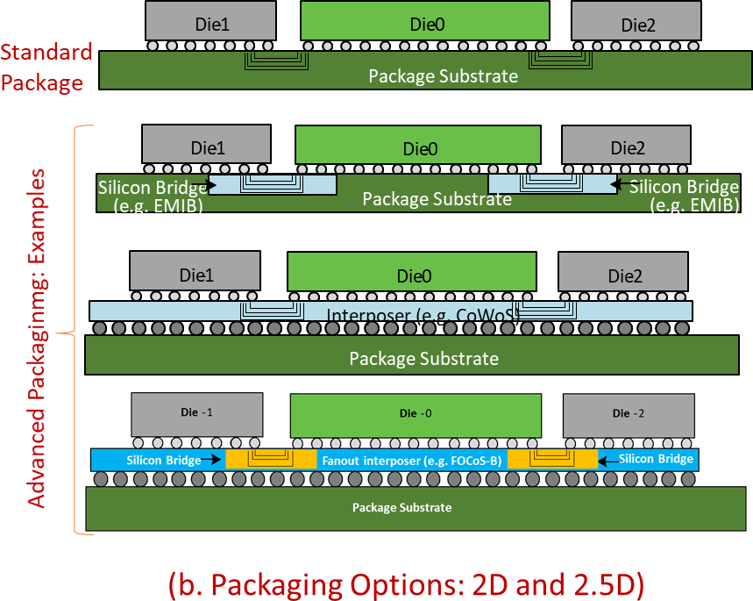
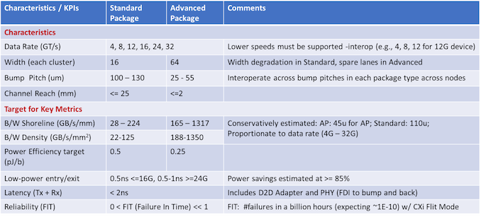
DISAGGREGATION PACKAGING OPTIONS
Source : https://www.anandtech.com/show/17288/universal-chiplet-interconnect-express-ucie-announced-setting-standards-for-the-chiplet-ecosystem

Slide 5
Disaggregation FLOW
Tool is a compiler framework built on EDA Solution tools that helps to create, optimize and manage chiplet interconnect
It can be majorly used for generation and optimisation of 3D-IC or disaggregated system RTL and UPF.
Tool was developed to ease the complex work on System level Pinlist, RTL, UPF creation and their alignment across dies.
The goal of Tool is to centralize all required inputs under one tool that will generate top to bottom, correct by construction system level collaterals which is fully aligned between the dies.
Tool can also supply a bump connection to the system dies, to ease D2Ds and IOs integration internal to the dies
Tool’s solution consists of a) standard chiplet interfaces, b) system description and interconnection using high-level language primitives

Slide 6
Disaggregation Nomenclature
Chiplets/Dies/Tiles | Different dies that form the 3D-IC System.
Interface Specification (ifc_spec) | A file in a pre-defined ASCII or Python format used to define the specification of a standard protocol or ad-hoc protocol.
Link | A container that is used to define a collection of standard logical bundles or ad-hoc logical bundles.
 | A link can contain one or more logical bundles.
 | One or more logical bundles put together form the specification of a standard interface protocol or ad-hoc interface protocol for die-to-die interconnects.
Logical Bundle | A collection of ports specifying a particular logic function within a link.
Connections or Connectivity (conn) | Definition of how different chiplets in a 3D-IC system are connected using combination of links and (or) logical bundles.

Slide 7
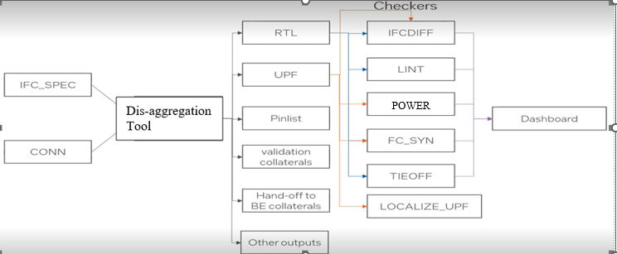
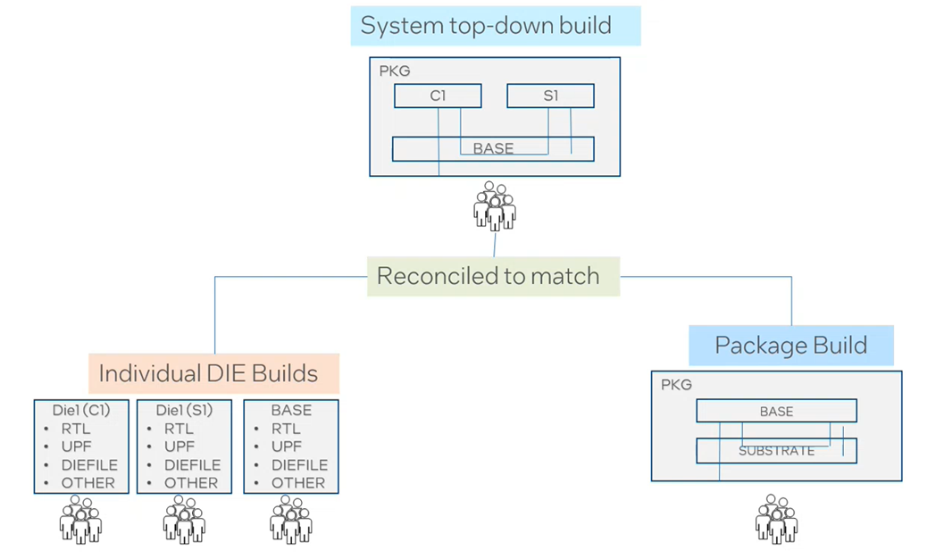
Disaggregation Tool Frameqwowrk
The flow requires 2 main inputs –
standard chiplet interfaces
system description and interconnection using high-level language instructions

Slide 8
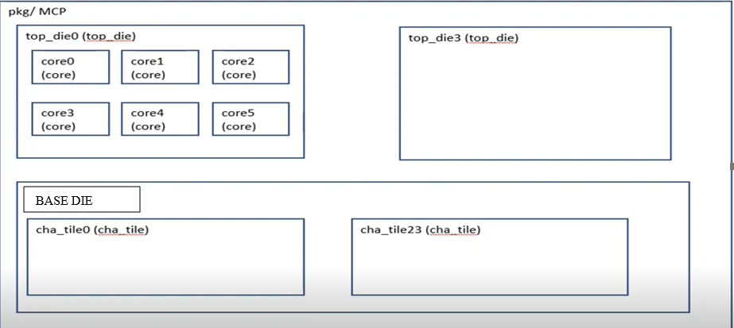
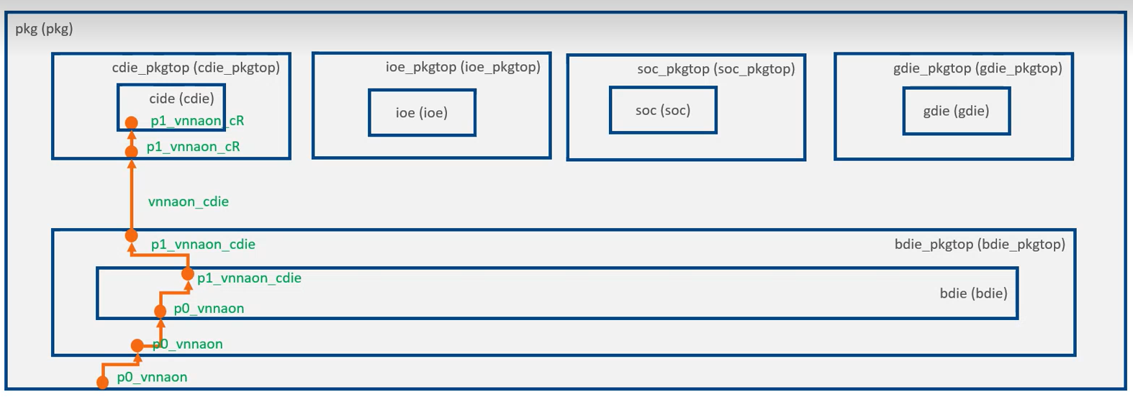
Server SoCA – MutiChiplet Solution

Slide 9
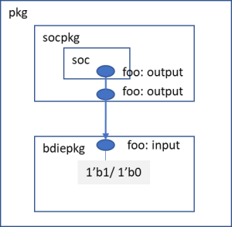
Results: Disaggregation Flow
Die-to-Die (D2D) and Die-to-Package (D2P) connectivity
User Defined ports names at Die interface (due to back port)
Python Connectivity Files
Checkers –LINT, Low Power, IFCDIFF, FC_SYN, SPA_COMPARE, Localize UPF, pkgball ports checker, top/ bottom side port checks, PROBE checks
Reports - Tieoff, Pinlist.xlsx, Web Dashboard
Outputs – RTL, UPF, Handoff to Backend collateral, Alias RTL for validation
TieOffs that are caught during the package level connectivity validation and using the disaggregation tool, it can be identified at the front end level itself.

Slide 10
CONCLUSION: Disaggregation in Multi-die SoC
The execution of the first generation of server disaggregation project has been full of challenges concerning FDI design deliverable schedule and quality due to the IP widespread across multiple chiplets. The new methodology resulted in the below advantages over traditional excel based connectivity validation
Utilization of standard interfaces and high-level primitives for chiplet interconnect creation (IMPACT: 6X ↓ in # of lines of code)
Provision of robust automation and a dashboard (RESULT: 3X ↓ # of Iterations between Front-End & Back-End Teams)
Enablement of easy-to-create reusable interfaces for creating product configurations (IMPACT: 4X ↓ net-net engineering effort)
Provision of an end-to-end methodology for cross-disciplinary teams to optimize their workflow

Slide 11
Questions
Finalize slide set with questions slide

