Slide 1

An Efficient Verification Methodology to Achieve DV Sign-off with Emphasis on Quality and Quicker DV Cycle
Piyush Agnihotri, Nirmal Kumar,
Arnab Ghosh, Parag S Lonkar

Slide 2
Agenda
Introduction and Need for quicker DV cycle
Conclusion and Future Scope
DV Flow Enhancements at each stage
1
2
3
4

Slide 3
Typical DV Flow
Tremendous growth in semiconductor industry
Higher computation, high bandwidth and quick time to market
Pressure to perform DV in tight timelines with focus on quality
Optimization of DV signoff is required using scripting/methodologies
Integration Phase
Coding and Debug Phase
Coverage closure
?

Slide 4
INTEGRATION PHASE

Slide 5
Automated TB Generation Script
Integration done using Python script
Inputs -> RTL code , XLS sheet with required details
Output -> Testbench files with required code .

Slide 6
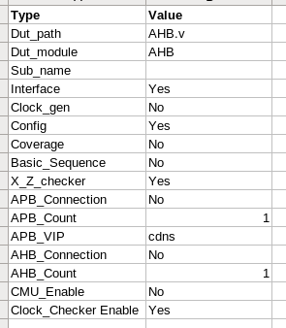
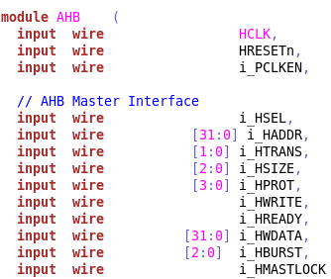
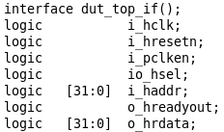
TB Generation Flow
Input XLS
+
RTL Code
=
Output files
Script command : python <script_name> <Input_xls_name>

Slide 7
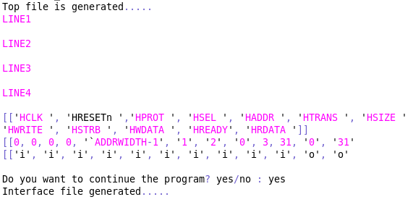
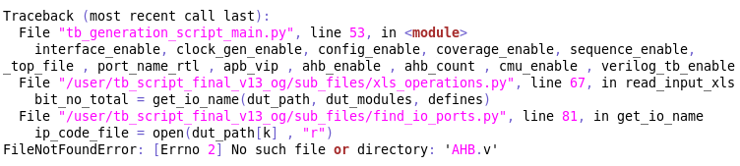
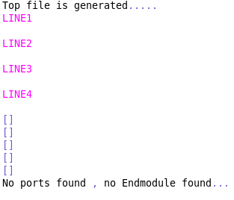
Log Files
Log file with no errors . Expected interface file is generated with required signals
Error thrown by script as DUT file is not found
DUT file did not have the endmodule , so script aborted TB generation

Slide 8
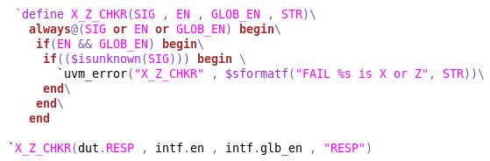
Utility Files
The script generates other utility files also like x_z_checkers , config files . The config file is created with all input ports , constrained with min and max values.
X_Z Checker
Config File
Notations used : i_<sig> : Input signals , o_<sig> : Output , io_<sig> : Inout , r_<sig> : real

Slide 9
CODING & DEBUG PHASE

Slide 10

Connectivity Check
Registers to Ports Connectivity script
Perl script to reduce manual efforts, If there is some pattern in registers and signals names
Script extracts the source and destination signals based on design input and creates a CSV
Registers Bank
Signals/Ports

Slide 11
Save-Restore (S-R) Technique
Fast results while re-running sim in debug phase
Saving 50-60% of sim running time
Increases regressions throughput
Very useful in high speed links where linkup takes much time.

Slide 12
S-R Execution Flow (Ref : Unipro IP)
When the EDA option “process_save” is added at elaboration time then “$save” system task is available to save the snapshot
Enabling the S-R option
Saving the init sequence
Reloading the snapshot
Sim starts from saved snapshot. e.g Unipro 2.0 IP ref log file

Slide 13
COVERAGE CLOSURE PHASE

Slide 14
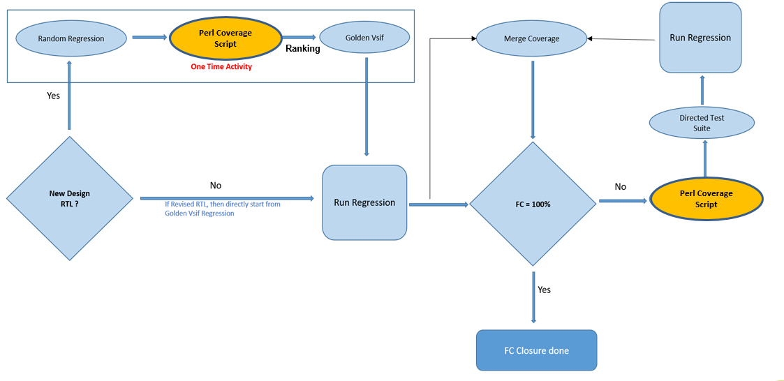
Fast Coverage Closure Using Scripting
Enhanced coverage closure by using a perl script and ranking vsif approach
Directed test-vectors generation using perl script
Very useful in revised RTL coverage closure

Slide 15
Coverage Hole Script Execution
To obtain the latest coverage database, extract the information of un-hit bins
Create directed test suite to hit the remaining bins with single run
Very useful if having many random parameters in a vector (ex: PMC in Unipro)
Input file generated by Coverage Holes Script (Ref: UniPro)
Example code of Power Mode Change (PMC)

Slide 16

Integration Phase
Coding and Debug Phase
Coverage closure
?
Testbench Quality Analysis

Slide 17
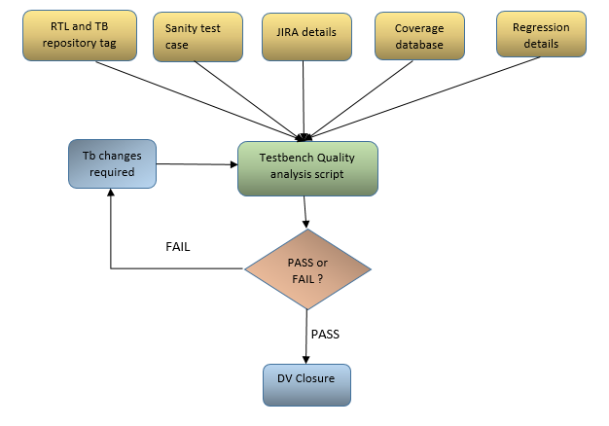
Testbench Quality Analysis Flow
Done during the Final DV closure stage
Makes use of a Perl script developed in house.
Checks whether every aspect of the testbench are followed perfectly.
DV closure is allowed only when all the QA related metrics are passed.

Slide 18
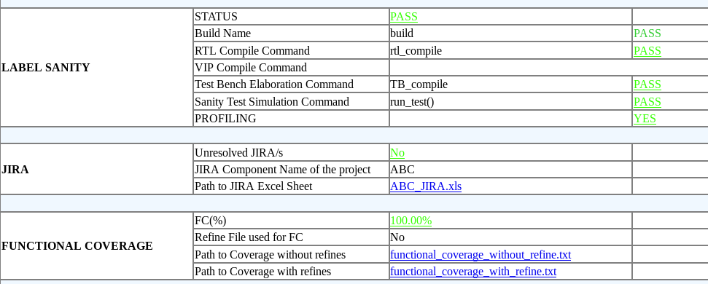
Metrics Checked by QA
Whether the testbench is on latest repository tag
Register definition files are updated .
Sanity testcases are passing or not .
Whether all RTL issues are resolved or not .
Functional and Code Coverage is 100% or not
Whether all regression runs are passed .
Usage of Force statements

Slide 19
Disk Space Optimization
Additional feature in Quality Analysis script
The script extracts the details of the disk space occupied by each workspace in terms of code files and waveform dump files .
Conditions for a workspace to be deleted.
When the workspace is having older DV label
When the cumulative size of waveform dump files are more than the threshold limit

Slide 20
Impact of Disk Space Optimization

Slide 21
Results
DUT Ports Count | Time Taken (Manual Coding) | Time Taken (Automation script + DV engineer inputs)
50 | 0.5 day to 1 day | Less than 30 mins
200 | 2 days to 3 days | Less than an hour
Bringup Phase
Test Vectors Scenarios | Without Save-Restore | With Save - Restore
Bring-up Related Failure | 60 – 80 mins | 60 – 80 mins
Basic Data-path Failure | 6 hrs – 12 hrs | 3 hrs – 6 hrs
Hibern8/Line Reset/POR failures | 1 day – 3 days | 12 hrs – 1.5 days
Debug Phase
Milestone | Without Ranked vsif and scripting approach | With Ranked vsif and scripting approach
Final Coverage Closure (100% FC) | 7 weeks – 10 weeks | 4 weeks – 6 weeks
Coverage Closure Phase

Slide 22
Conclusion & Future Scope
Advantages of scripting in DV closure
Reducing the manual effort in repetitive tasks and focus more on critical tasks
Helps to follow standard DV techniques through Quality Analysis
Adding more metrics for evaluation in Quality Analysis
Merging the art of coverage closure with Machine Learning

Slide 23

Questions & Comments

