Slide 1
Performance Analysis And Acceleration of High Bandwidth Memory System
Rohit Devidas Chavan, Jyoti Verma, Sekhar Dangudubiyyam

Slide 2
AGENDA
Objective
HBM3 Subsystem Architecture
Performance Analysis for HBM3
Protocol Analysis for HBM3
Target Metric Numbers
Results and Key Takeaways
Future Work Identified for the Methodology

Slide 3
objective
Get graphical and statistical reports of IPs performance.
To identify and overcome protocol related design issues.
Single FSDB file for debugging violations and simultaneous performance analysis.
Auto-performance report generation alongside simulation results.
Resolving protocol violations to increase design performance.
To get a pictorial overview of parameter violations with corresponding timestamps.

Slide 4
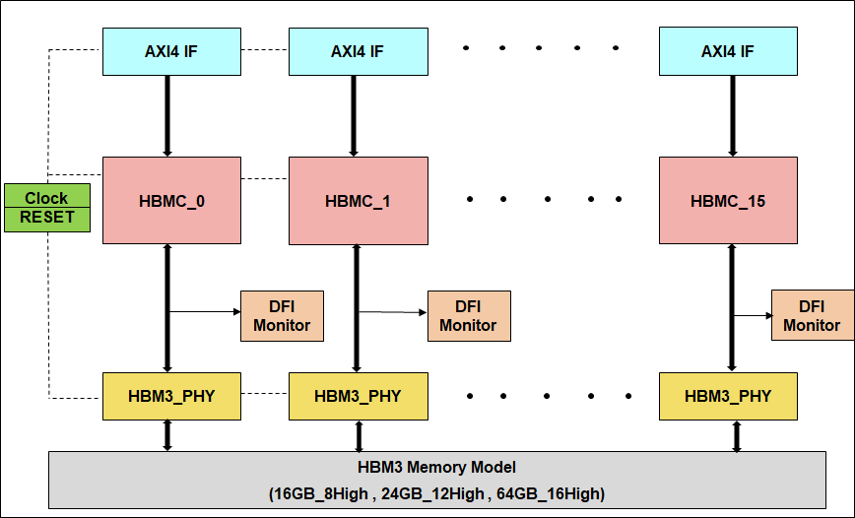
HBM3 Sub-System Architecture
Subsystem consists of 16 channels.
We have used AXI-4 VIPs to generate data traffic.
DFI Monitor has been integrated to monitor DFI interface.
HBM3 memory model has been used with different density and stack configurations.
Three different frequencies are tested which are 4800MHz, 5600MHz and 6400MHz.

Slide 5
Performance Analyzer Features
Graphical charts for accurate analysis
Parameters like active_to_active_delay, self_refresh_entry_to_exit_delay, etc. gives a good graphical representation of system’s performance w.r.t. the simulation time.
Constraint checking and violation tracing
Thresholds can be fixed for parameters according to the scenario, and violations will be highlighted by performance analyzer.
Identifying system bottlenecks
Performance analyzer provides multiple memory related metrics such as bandwidth, page accesses, traffic profile and un-optimized spaces between commands.
Exportable reports
Reports and charts generated by the performance analyzer can be exported to widely accepted formats, such as HTML and CSV for better analysis.

Slide 6
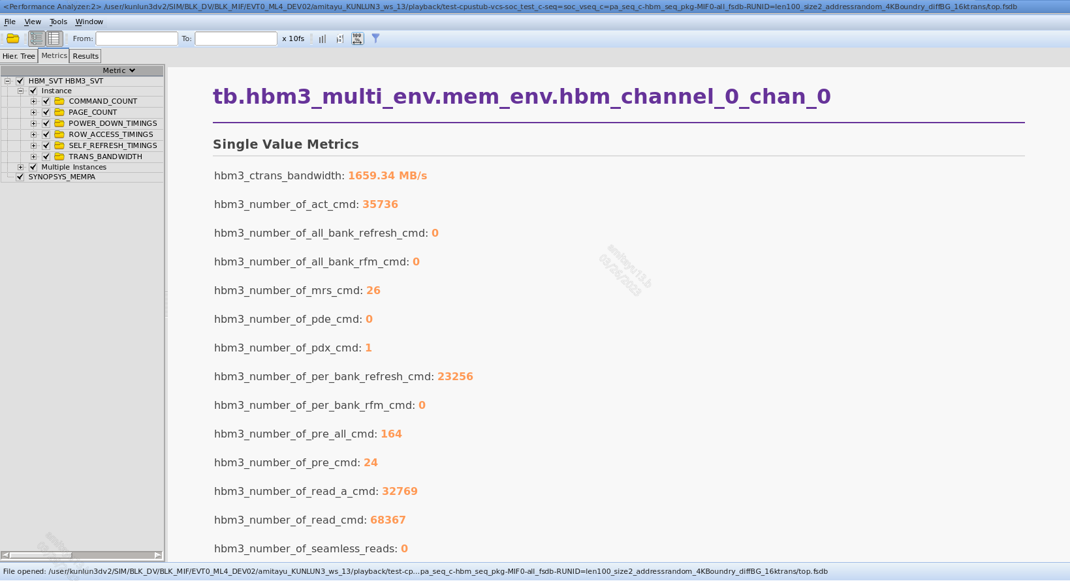
Metric View
The improved performance of our subsystem was achieved due to fast analysis with protocol analyzer.
Protocol analyzer helped us fine tune our scenarios w.r.t. address mapping and data traffic.
After using directed addresses to different row, column, bank and bank groups, the performance increased significantly.
Selected HBM3 Channel Instance
Available Metrics
Single Value Metrics

Slide 7
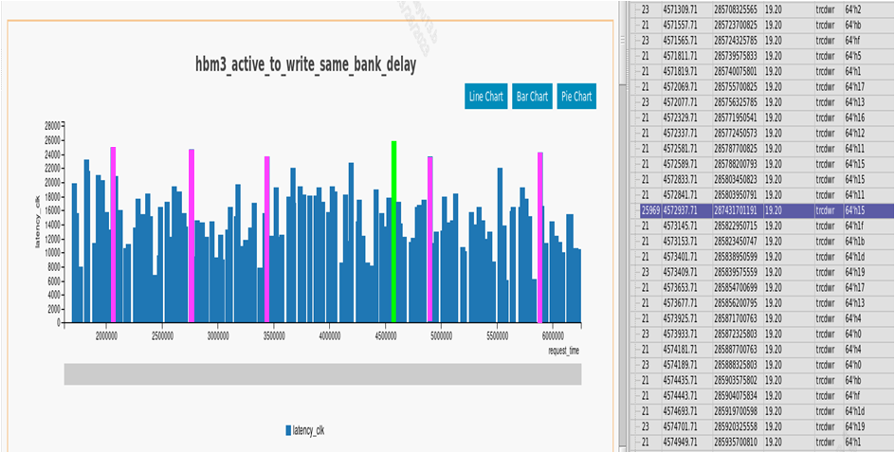
Parameter Graphical View
The graph represents the delay between activate to write command to a bank.
This graph also gives us the time instances where violations have occurred.
Parameter Violation
Multi Value Instance Metrics
Metric Result Details

Slide 8
Target Metric Numbers
Initial Numbers
Bandwidth
453.14 MBps
Page Hit:Page Miss
1964.43
Page Hit:Page Empty
2.23
Target Numbers
Bandwidth
>= 1500 MBps
Page Hit:Page Miss
>= 6000
Page Hit:Page Empty
>= 4

Slide 9
Protocol Analyzer Features
Detailed transactions
Thorough details of any specific transaction like issued time, command type, physical address, etc.
Quick error detection
Smart log for quick error detection. Protocol violations are highlighted and are back annotated to the specification documents.
Synchronized debugging
Waveform window, Protocol analyzer and Smart log can be synchronized for easy debug.
Speeding up debug
Extensive filtering to pin pointed commands for accelerating the debug process.

Slide 10
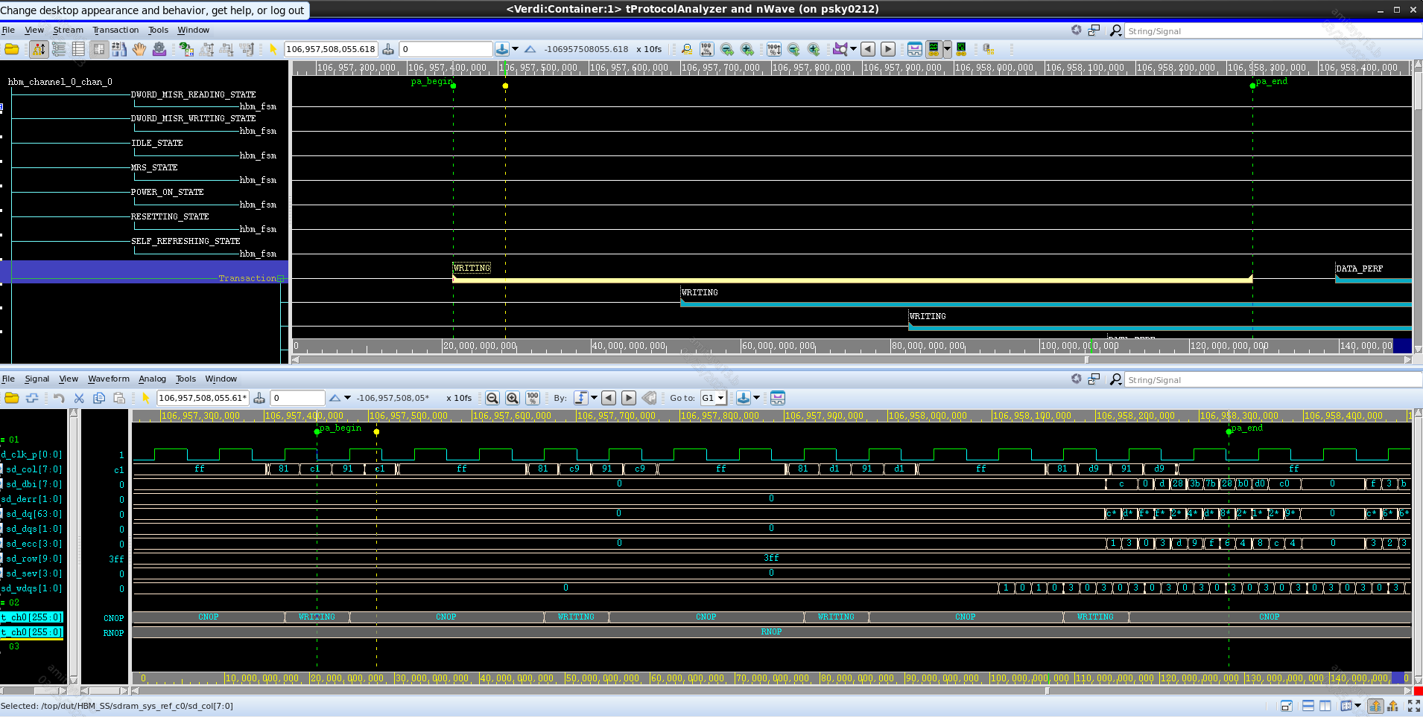
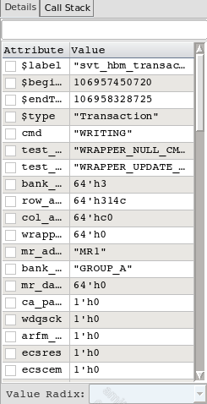
Protocol Analyzer View
This view consists of protocol analyzer window, nWave window, and details of a transaction.
All the shown windows are time synchronized.
Protocol Analysis
Command Details
Waveform Analysis

Slide 11
Bandwidth Shaping
Metrics Scenario | Bandwidth (MB/s) | Page hit scenario count | Page empty scenario count | Page miss scenario count
Length (beats) -> 100 Size (bytes) -> 4 Address -> Random Transactions -> 1,000 | 453.14 | 15,615 | 5,243 | 6
Length (beats) -> 100 Size (bytes) -> 4 Address -> Random Transactions -> 16,000 | 1,103.95 | 1,90,550 | 85,277 | 97
Length (beats) -> 100 Size (bytes) -> 4 Address -> Every next transaction to a unique bank group Transactions -> 16,000 | 1,659.34 | 1,66,484 | 35,688 | 24

Slide 12
Effort Tabulation
Category | Highlights | Total turnaround time / Effort*
HBM3 Initialization | Protocol analyzer helped us in resolving tINIT related parameter failures. | ~ 47 - 51 | < 7
IEEE 1500 Interface Bring-up | Proper release of RESETn and WRSTn. Violations while issuing IEEE 1500 instructions. | ~ 8 - 10 | 2 - 3
Bandwidth (BW) Improvement | Protocol analyzer helped us find scenarios to improve performance of our subsystem. We tweaked the row, column, bank and bank group mapping to achieve max BW. | ~ 20 | ~ 5
Without Protocol Analyzer | With Protocol Analyzer
*All values are in terms of number of iterations

Slide 13
Future Scope
Extending to other High Speed IPs
This methodology can be extended to other memories or IPs like PCIE, USB, NOR flash etc.
Adding user-defined SQL based metrics
Can be used to create self-defined IP specific metrics for better visualization and enhancement.
Tracking the performance for a specific stage of the simulation
Scenarios like TRAINING which are included by default can be skipped for actual performance measurement.
Golden metric development
Collating multiple pre-defined metrics into a single one for better decision making.

Slide 14
Questions

