Slide 1
Tackling the verification complexities of a processor subsystem using Portable Stimulus
Vivek Gopalkrishna
Ponnambalam Lakshmanan
Nitish Swamy

Slide 2
Agenda
Introduction and need for PSS
PSS based verification process
Prerequisites for deploying PSS framework
PSS implementation in ADI project
PSS for SPI in all target platforms
Defining scenario space
Verify compatibility with the existing verification setup
Modeling plan
PSS integrated verification setup: Simulation, emulation, VP and FPGA
Results

Slide 3
DV Challenges
Verification Productivity
Creating all possible scenarios to test design
DV
Challenges
Achieving 100% Coverage
Duplication of test content across platforms
Under pressure to do more, faster
Reuse across Projects and platforms

Slide 4
PSS: The Latest Verification Trend
Portable Stimulus Standard (PSS) is a new standard from Accellera
Allows stimulus reuse across multiple platforms
Vertical reuse
Horizontal reuse
Works at higher layer of abstraction, reusing the verification environments
Enhanced test quality with simplified test authoring
Allows better coordination, resource sharing and increased productivity
DSL (Domain specific Language) is used for Modelling

Slide 5
PSS Based Test Development Process
Architect
IP
Design/DV
System
Design/DV
Apps
Eval
Software
Test
Defines Use Cases, PSS Models
IP DUT,
PSS Models
DUT,
PSS Models
Scenarios
Device
Drivers
Scenarios
PSS Framework
TLM Model, VP
SystemC
Simulation
SV, UVM
C/C++
Evaluation,
Customer
Boards
C/C++
Emulation,
FPGA/VP
Silicon
C/C++
Tester
Different patterns

Slide 6
Horizontal and Vertical Reuse
PSS
Verification intent captured at higher abstraction
Integration
levels
SOC
(HW+SW)
Embedded/ Host C test
Sub system
UVM
IP
Portability wall
VP
Simulation
Emulation
FPGA
Silicon
Execution
platform
Notes:
Shift left portability

Slide 7
PSS Terminologies
Represent the design elements that make up the hierarchy
Eg: spi, i2c, uart
Elements which capture test behaviors in a PSS model
Eg:spi_config, uart_tx
A set of action instances, flow objects and scheduling constraints which makes up testcases
Represents incoming or outgoing data/control flow for actions
Eg: buffer, state, stream
Hardware design resources that are needed to perform the test functionalities
Eg: dma channels, processor cores
Flow Objects
Activity (Scenario)
Component
Action
Resources

Slide 8
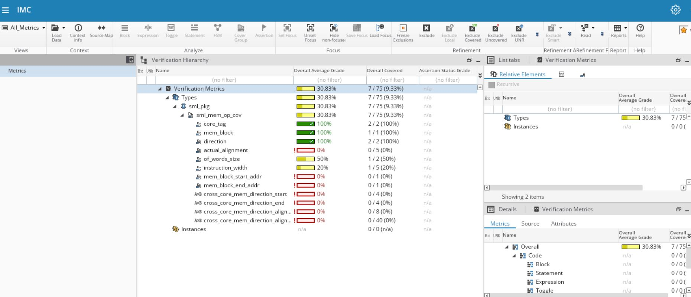
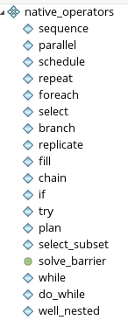
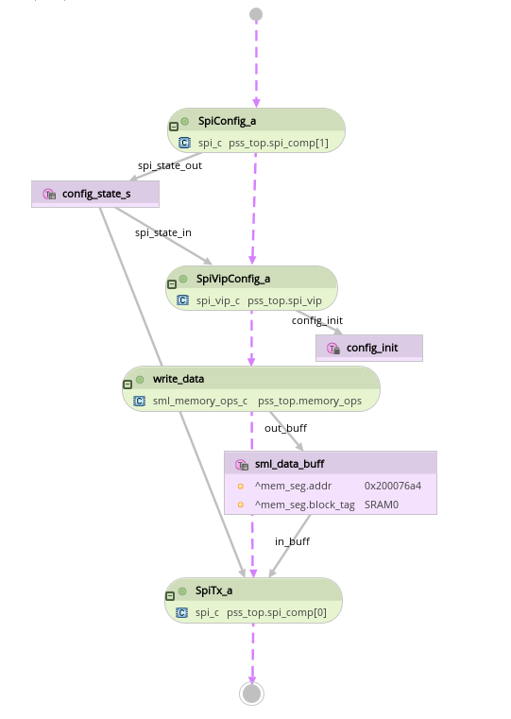
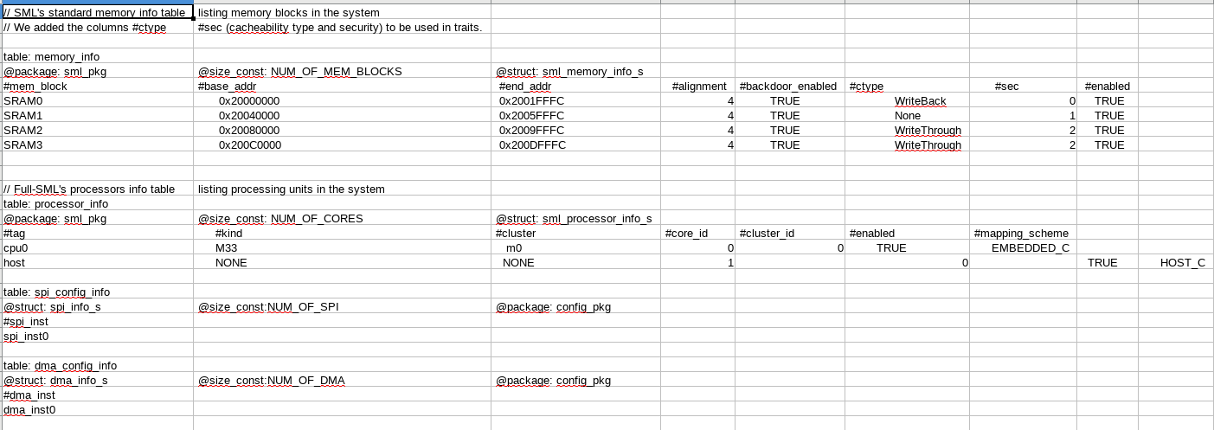
PSS usage flow
native operators
target
platform
integration
Coverage viewer
Solved scenario diagram
Spec doc
Tool libraries
(memory and processor tables)
Simulation
SV test
Coverage analysis & debug
Spec driven PSS models
(resources, components, actions, data structures, covergroups)
C test
Virtual Platform
Emulation
C test
Merged coverage
Test generation coverage
FPGA/Si
C test
Model writer
Runtime simulation coverage
config.csv
Test writer
memory and processor info table
Abstract Use-case creation
(scenarios, native operators)
Solving and Test generation
(C, SV, C+SV)
Run on multiple platforms
design topology config table
test_table.csv
Notes:
SML: System methodology library
UML: Unified modeling language

Slide 9
Prerequisites for deploying PSS framework
Understand the need for PSS
Define scenario space
Verify compatibility with existing verification setup
Detailed Modeling Architecture and development plan
PSS-integrated verification setup plan
Get the buy-in from all stake holders
Qualify the subsystems/IPs in the design for PSS
Capture all the modes of operation with config variables and their legal range of values
Identify the C/SV APIs
PSS modeling details with components, data flow objects and actions planned
Functional coverage plan
Design/DV/Eval/SW/Emulation/Post-Si to develop unified flow

Slide 10
PSS Adoption and Results

Slide 11
Processor subsystem
Core
MAILBOX
Security module
I2C
QSPI
PINMUX
RTC
WDT
SPI
DMA
UART
GPIO
GPT

Slide 12
Need for PSS in this Project
Test content reuse across Platforms
Virtual Prototyping Platform, DV simulation, emulation, FPGA
Generate complex test scenarios, for different configurations of the subsystem
Unified randomization
Offload the randomization to PSS engine to be able to generate a flattened directed testcase.

Slide 13
SPI with PSS: Defining Scenario space
SPI can be configured for the following scenarios of operation
State: initiator or target
Mode of operation: half duplex, full duplex
Tx/Rx DMA: enabled or disabled
Continuous chip select: enabled or disabled
Various interrupt controlling fields
Tx/Rx transaction count

Slide 14
SPI with PSS: Existing verification setup
A reference test was chosen for initial bringup:
UVM Test
SPI DUT
(Initiator)
SPI VIP
(Target)
hdtx
init
seq
SPI VIP
test_cfg. randomize()
Score board
main.c
wait4tb
dut config
Test end
Tx
sync2tb

Slide 15
Modeling plan
How PSS can capture the verification requirements
Identify the modeling elements
data structures, components, resources, actions, scenarios
Identify the data flow objects
buffers, streams, states
Plan for integration with target platforms
exec block implementations, constraints
VIP modeling
executor threads, mailbox synchronization
Capturing the design architecture in csv file
Cores, IP instances, Memory mapping
Architectural diagram

Slide 16
Modeling plan - SPI
Modeling elements and data flow objects
component
pss_top
actions
spi_c
config
state
spi_vip_c
Flow objects
state
spi_config_a
buffer
spi_vip_config_a
sml_write_data
sml_buf
stream
spi_tx_a
data stream
spi_rx_a

Slide 17
Modeling plan - SPI
Model + Integration with target platforms
pss_top
spi_c
Actions + data flow elements
spi_vip_c
Actions + data flow elements
Challenge faced
Generating tests with both C and SV target languages for core and agent threads.
Mailbox
(SRAM1: 0x2004000)
Solution
Stub codes for target platforms
Dual executable setup with automated mailbox syncs
Config.csv
cores = 1, vip executor = 1,
spi_inst = 1, dma_inst =1,
memory map
Executables, schemes

Slide 18
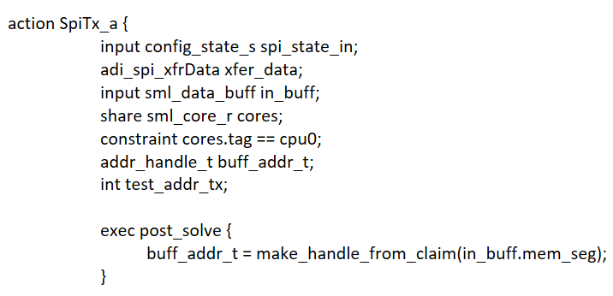
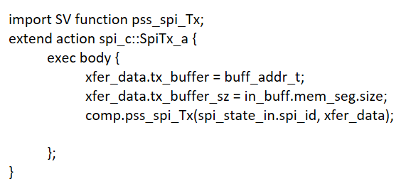
Separation of test intent with implementation
Test intent captured in SpiTx_a action
Test implementation specified in exec body

Slide 19
PSS Test generation flow
PSS SPI Model
pss_spi_modeling.pss
pss_spi_modeling.pss
Generated tests
generated_test.c
(Generated core test)
pss_spi_al.c
(Wrapper file)
Solver
generated_test_sv.c
(Generated vip test)
pss_spi_sv_bindings.pss
pss_bindings.sv

Slide 20
PSS integrated SPI test
PSS Generated
Functions
Template SV UVM test
Exec implementation
syncs
PSS Generated C thread
init seq
cortex sync
wait4tb
C functions
mailbox sync
F2.0 reg write()
mailbox sync
dut config
wrapper write()
SV tasks
mailbox sync
test_cfg
mailbox sync
testcfg
vip config
vip config()
vip config
vip config()
mailbox sync
sml write
mailbox sync
PSS generated SV thread
spi tx
wrapper Tx()
F2.0 Tx()
cortex sync
sync2tb
test end

Slide 21
PSS on Emulation
Emulator
Simulator
Interface
dut config
dut config
mailbox sync
Challenges faced
mailbox write
Memory accesses for mailbox communication
Tb-syncs for polling operations
mailbox sync
interface task calls
Virtual UART
vip config()
vip config
Supports sending/receiving data from terminal for FW validation.
Supports all the standard and non-standard baudrates.
sml write
sml write
mailbox read
Solution
mailbox sync
Interface tasks for mailbox write and read with tb_import and tb_export.
Polling logic ported to emulator with an added export_event to the TB.
spi tx

Slide 22
PSS on Virtual Prototyping platform
Linux
Windows
Spec driven PSS models
(resources, components, actions, data structures, covergroups)
Seamlessly ported to VP
RUN
design.exe: System C model
Tool challenge faced
License checkout failure due to VP being run on C compilers on Windows.
Virtual UART
Supports sending/receiving data from terminal for FW validation.
Supports all the standard and non-standard baudrates.
Solution
Hooks provided to resolve the licensing issue.
Abstract Use-case creation
(scenarios, native operators)
Solving and Test generation
(C)
generated tests
Compile
(IAR Workbench)

Slide 23
PSS on Custom FPGA
Challenges faced
System configuration based on C# project. Reg read write APIs in C#
DUT FPGA
Virtual UART
Spec driven PSS models
(resources, components, actions, data structures, covergroups)
JTAG
Supports sending/receiving data from terminal for FW validation.
Supports all the standard and non-standard baudrates.
Solution
Ported the setup to C. PSS generates individual tests for DUT to be run by core and for test agent FPGA
generated tests
Abstract Use-case creation
(scenarios, native operators)
Solving and Test generation
(C)
generated tests
Test agent FPGA
JTAG

Slide 24
Results
Portability of test-intent across all execution platforms achieved.
PSS has helped us shorten the design verification cycle, with an estimated reduction of 50% of time spent in test generation for Emulation, VP, FPGA and Firmware
Randomization of attributes is offloaded to the PSS engine, thereby reducing the effort and time on the run time simulator.
Recreation of bugs caught across platforms made easy.
Next Steps
Enabling test generation coverage extensively to generate meaningful tests.

Slide 25
Acknowledgements
Nitish Jindal, Rajiv Nadig, Paul Drum, Jatin Nagpal, Sonal Patil, Akshata Kulkarni, Shriyanshi Kapoor, Kyle Jansen and Kajal Majalatti from ADI for the continuous effort in modeling and bring-up.
Gnaneshwara Tatuskar, Sandeep Katti and Ranjith S for their consistent guidance and tool support.

Slide 26
Questions
© Accellera Systems Initiative

