Slide 1

Advanced RISC-V Verification Technique Learnings for SoC Validation
Using Breker SystemVIP for RISC-V System Ready
David Kelf, CEO, Breker Verification Systems
Nambi Ju, Principle Engineer, Breker Verification Systems

Slide 2
Agenda
Test Suite Synthesis and SystemVIP
RISC-V Core Verification SystemVIP
RISC-V SoC Verification SystemVIP

Slide 3
Agenda
Test Suite Synthesis and SystemVIP
RISC-V Core Verification SystemVIP
RISC-V SoC Verification SystemVIP

Slide 4
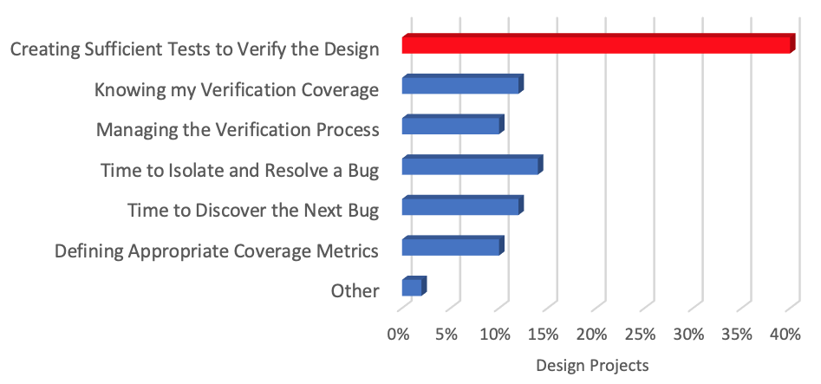

The High Cost of Developing Test Content
Largest Functional Verification Challenge
Can we re-use the same knowledge ?
Can we abstract verification intent ?
Testbench
Block UVM
Lack of abstraction & reuse
SOC Integration
Ad hoc verification methods
System Validation
Low coverage real workloads
Source: Wilson Research 2020
Project Resource Deployment
Verification:
Debug
25%
Design:
32%
Verification:
Content Development
30%
Verification:
Other 13%
DUT
Test development drives debug
Complex tests hard to get right
Why? Resource Intensive Test Content

Slide 5
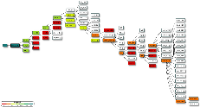

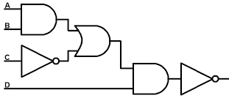


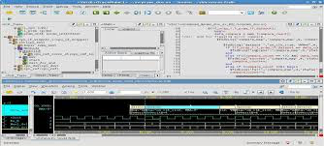

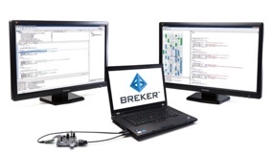
Test Suite Synthesis… Analogous to Logic Synthesis
Design Synthesis
Test Suite Synthesis
Scenario
Model
Breker
Core Technology
Specification
Model
Describe intent
Cam
PP
DC
Sys
SD
Constrain
AI Planning
Algorithms
Constrain
Timing/Area
Constraints
Coverage
Constraints
Specify goals
3D Coverage
Closure
Synthesize
Synthesize
AI Planning Algorithms
Generate implementation
Stimulus
DUT
Checks
Coverage/Debug
Synthesizable
VerificationOS
Optimize
Optimize
Map to platform
UVM
SoC
Silicon

Slide 6
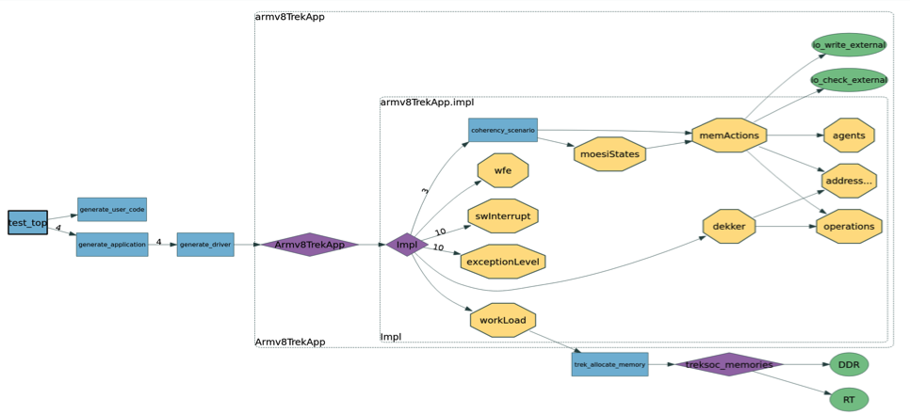
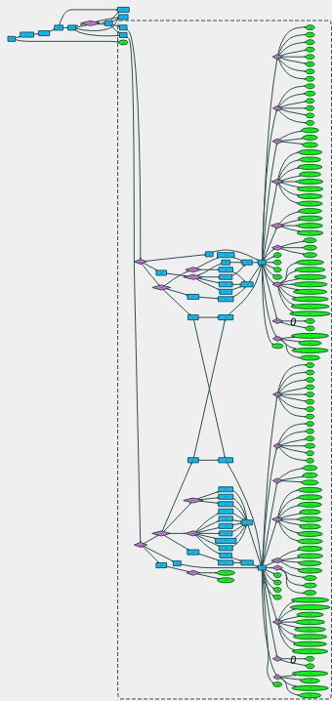
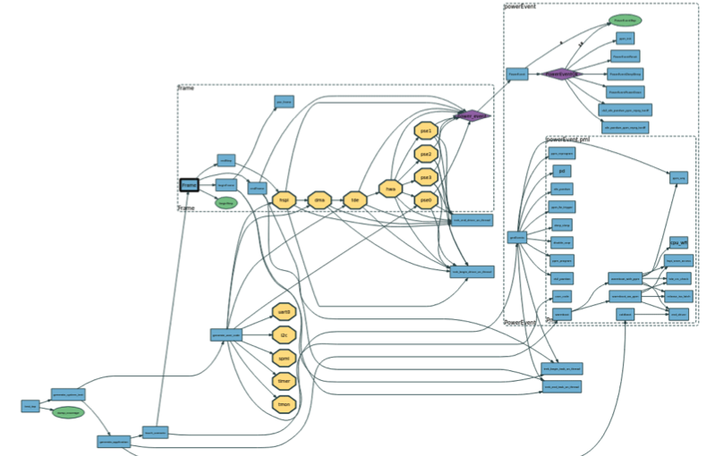
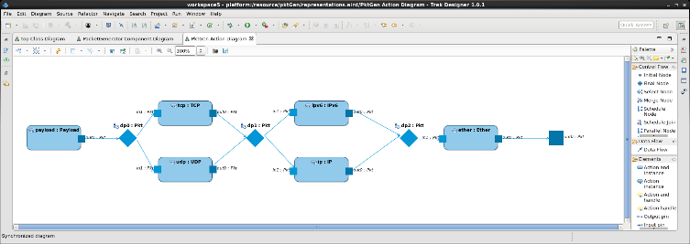

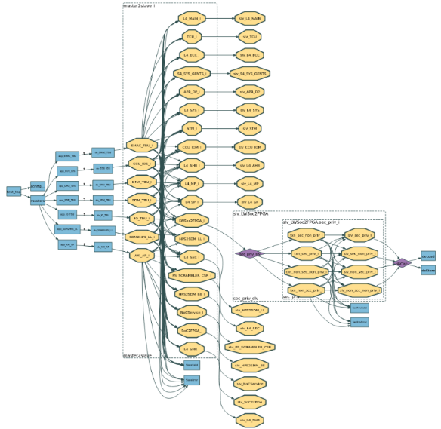

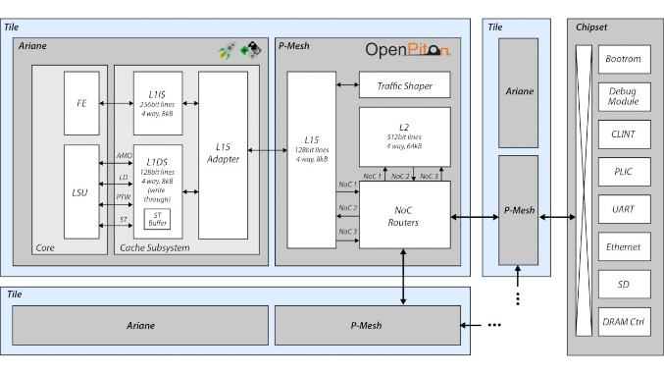
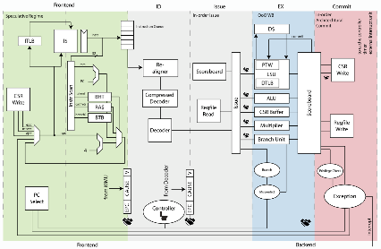
Breker SystemVIP Library
SoC SystemVIP Library
The RISC-V Core TrekApp provides fast, pre-packaged tests for RISC-V Core and SoC integrity issues
The Coherency TrekApp verifies cache and system-level coherency in a multiprocessor SoC
The End-to-end IP TrekApp IP test sets ported from UVM to SoC
The Power Management TrekApp automates power domain switching verification
The Security TrekApp automates testing of hardware access rules for HRoT fabrics
The Networking & Interface TrekApp automates packet generation, CXL, UCIe interface tests

Slide 7

Constrained Random vs AI Planning Algorithm Synthesis
Constrained Random Generation
UVM SV & other PSS tools
AI Planning Algorithm
Breker Test Suite Synthesis
states
states
legal state
illegal state
Black
Box
target state
White
Box
time / cycles
time / cycles
Design black box, shotgun tests to search for key state
Low probability of finding complex bug
Starts with key state and intelligently works backward through space
Deep sequential, optimized test discovers complex corner-cases
White Paper Discussing AI Planning Algorithm Test Generation on Breker Website

Slide 8

A Look At RISC-V
Open Instruction Set Architecture (ISA) creating a discontinuity in the market
Appears to be gaining significant traction in multiple applications
Significant verification challenges
  Arm spends $150M per year on 10¹⁵ verification cycles per core
  Hard for RISC-V development group to achieve this same quality
  Lots of applications expands verification requirements
  Requires automation, reuse and other new thinking

Slide 9
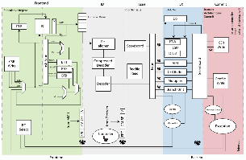
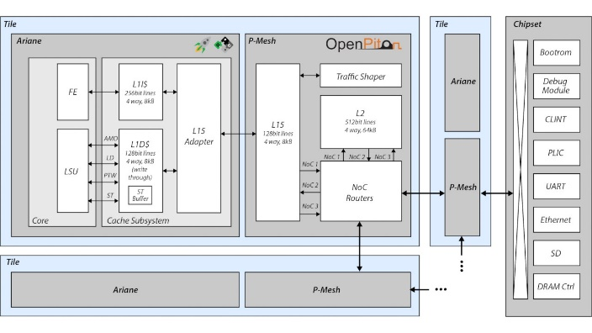
RISC-V Verification & Validation Tasks
Complexity
SoC Integrity
Power/Performance Profiling
Security
Core Integrity
Power Management
Complexity
Interrupts/Paging/Memory Order
Interrupts/Paging/Memory Order
Micro-architecture functionality
CPU Cores
ISA compliance
Cache Coherency
First Instruction Completion
Firmware Integrity
Complexity
Firmware
End-to-End Use Cases
Concurrency Testing
Uncore IPs
HW/Firmware Compatibility
Complexity
IP Integrity
VIP
VIP
End-to-End Use Cases
IP DUT
IP DUT
VIP
Concurrency Testing
VIP
Testbench
Testbench
IP Configuration

Slide 10
Breker RISC-V SystemVIP Portfolio
SVIPs for SoC Integrity
SoC Cache Coherency
Memory Ordering
Power Management
System Interrupts
…
SVIPs for Core Integrity
Register Hazards
Load/Store
Core Cache Coherency
Core Interrupts
…
CPU Cores
SVIPs for Firmware Integrity
Firmware
Mem2Mem (dma)
IO Offload (PCIE/Eth)
WQ Servicing
…
Uncore IPs
SVIPs for IP Integrity
VIP
VIP
Mem2Mem (dma)
IO Offload (PCIE/Eth)
WQ Servicing
…
IP DUT
IP DUT
VIP
VIP
Testbench
Testbench

Slide 11

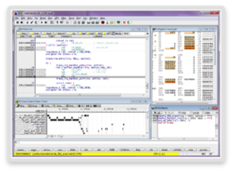


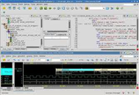
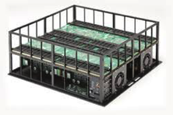
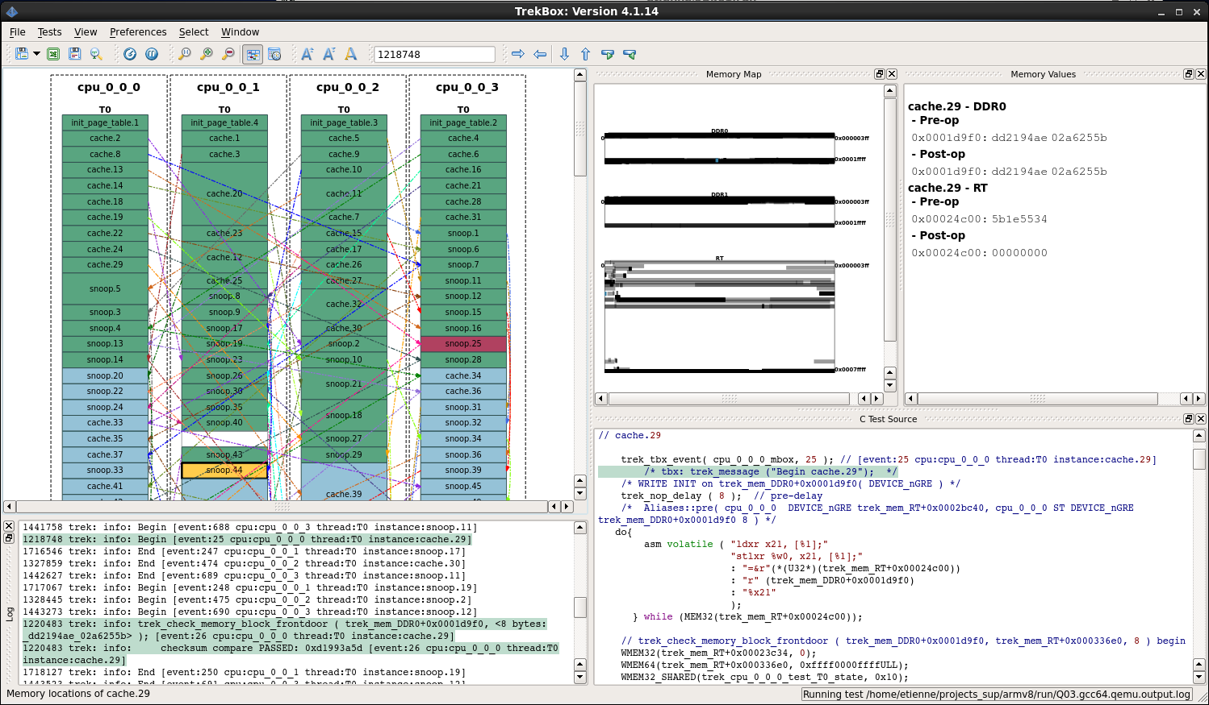
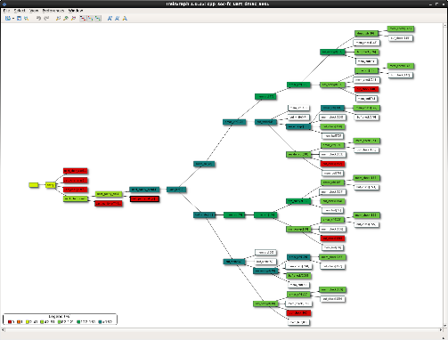
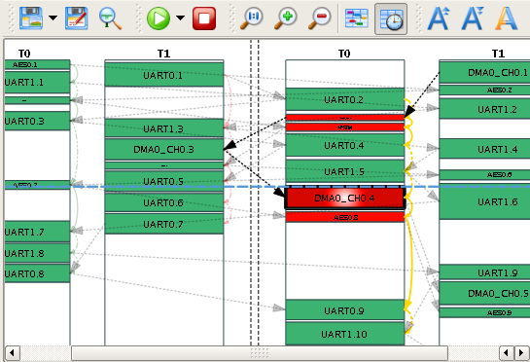
Single Source of Truth for all stages of Verification & Validation
SVIPs for IP Integrity
SVIPs for Core Integrity
SVIPs for SoC Integrity
SVIPs for FW Integrity
Mem2Mem (dma)
IO Offload (PCIE/Eth)
WQ Servicing
…
Register Hazards
Load/Store
Core Cache Coherency
Core Interrupts
…
SoC Cache Coherency
Memory Ordering
Power Management
System Interrupts
…
Mem2Mem (dma)
IO Offload (PCIE/Eth)
WQ Servicing
…
Test Suite Synthesis
SoC
VIP
VIP
SoC
CPU
CPU
Memory
System
and
Power
Control
SoC
RTL
Memory
System
and
Power
Control
CPU
CPU
Memory
System
and
Power
Control
Fabric
Fabric
Fabric
DMAC
Fabric
Fabric
DMAC
Fabric
AES
UART0
UART1
DMAC
AES
UART0
UART1
AES
UART0
UART1
UVM Testbench
VIP
VIP
UART1
AES
UVM Testbench
VIP
VIP
UVM Testbench
VIP
VIP
VIP
Virtual Platform Environment
Simulation Acceleration
Hybrid Emulation Environment
Silicon / Prototyping Environment
UVM Block Environment
High Level Debug
Coverage Analysis
Performance Profiling

Slide 12
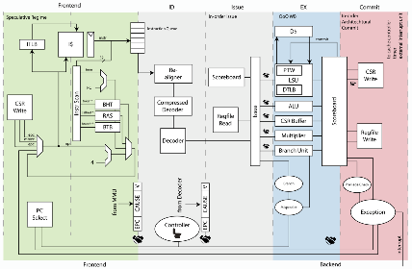
Different Challenges for Core vs SoC Verification
RISC-V SoC Verification Challenges
RISC-V Core Verification Challenges
System Coherency | Cover all cache transitions, evictions, snoops
System Paging/IOMMU | System memory virtualization
System Security | Register and Memory protection across system
Power Management | System wide sleep/wakeup and voltage/freq scaling
Packet Generation | Generating networking packets for I/O testing
Interface Testing | Analyzing coherent interfaces including CXL & UCIe
Random Instructions | Do instructions yield correct results
Register/Register Hazards | Pipeline perturbations dues to register conflicts
Load/Store Integrity | Memory conflict patterns
Conditionals and Branches | Pipeline perturbations from synchronous PC change
Exceptions | Jumping to and returning from ISR
Asynchronous Interrupts | Pipeline perturbations from asynchronous PC change
Privilege Level Switching | Context switching
Core Security | Register and Memory protection by privilege level
Core Paging/MMU | Memory virtualization and TLB operation
Sleep/Wakeup | State retention across WFI
Voltage/Freq Scaling | Operation at different clock ratios
Core Coherency | Caches, evictions and snoops
Random Memory Tests | Test Cores/Fabrics/Memory controllers across DDR, OCRAM, FLASH etc
Random Register Tests | Read/write test to all uncore registers
System Interrupts | Randomized interrupts through CLINT
Multi-core Execution | Concurrent operations on fabric and memory
Memory Ordering | For weakly order memory protocols
Atomic Operation | Across all memory types

Slide 13
Agenda
Test Suite Synthesis and SystemVIP
RISC-V Core Verification SystemVIP
RISC-V SoC Verification SystemVIP

Slide 14

RISC-V Core Testbench Integration
Scenario
Model
Virtualized OS Services
test.c
test.c
test.c
Compiler
CPU
test.tbx
test.c
test.c
TrekBox
L1
Memory
Model
Snoop
VIP
Interrupt
VIP

Slide 15
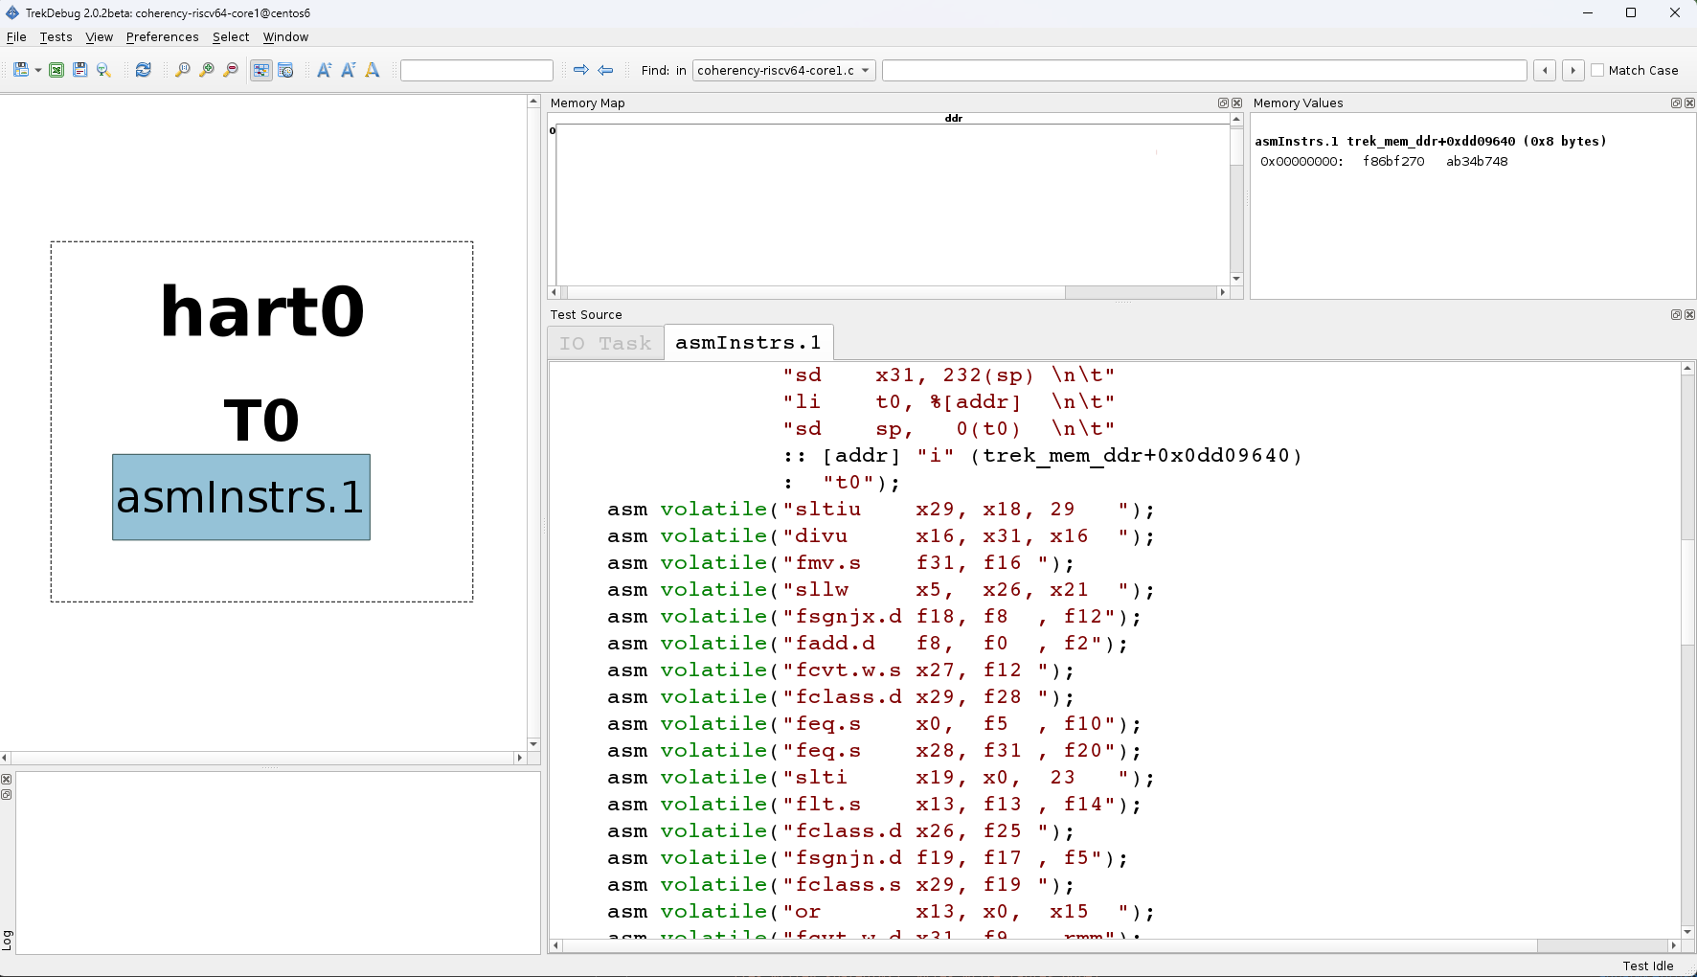
RV64 Core Instruction Generation
Random register instructions

Slide 16
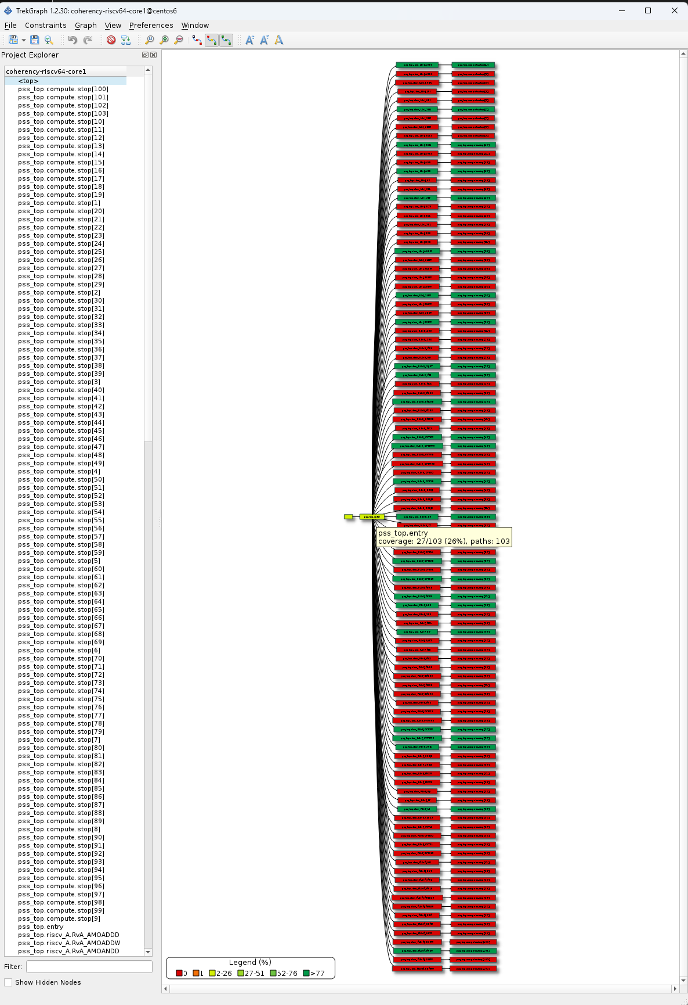
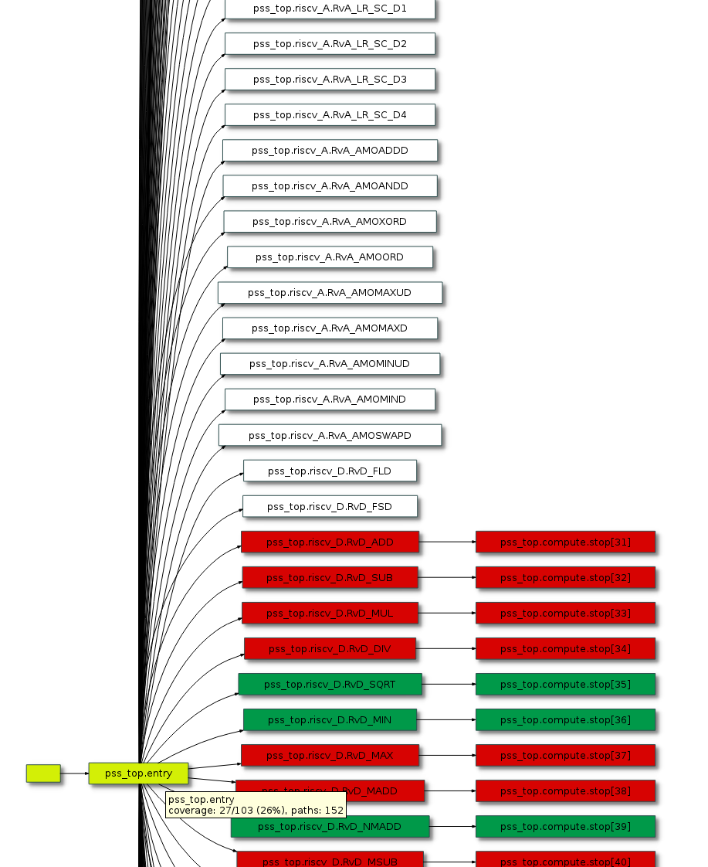
Instruction Coverage Analysis
27/103 reachable opcode have been exercised
Atomics, loads and stores not reachable in register only test

Slide 17
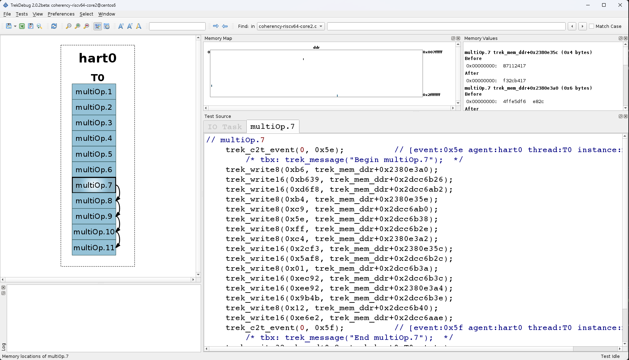
RV64 Core Load/Store
Locality of write addrs

Slide 18
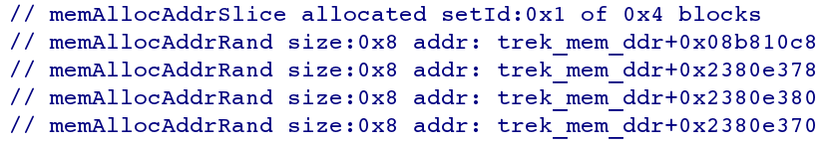
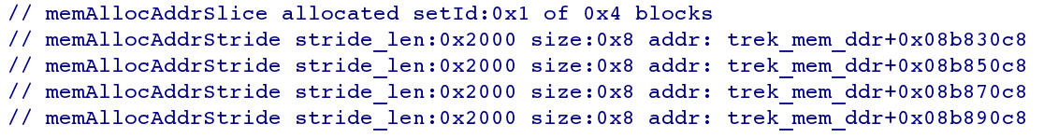
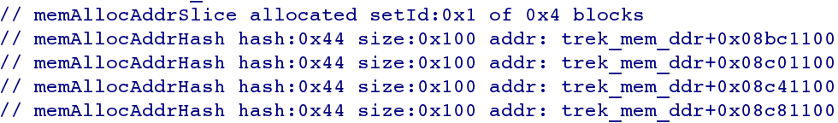
Example Address Allocation Patterns
Random Clusters with locality of reference
Stride Patterns across fixed address distances
Sequential Addresses matching a specific Hash

Slide 19
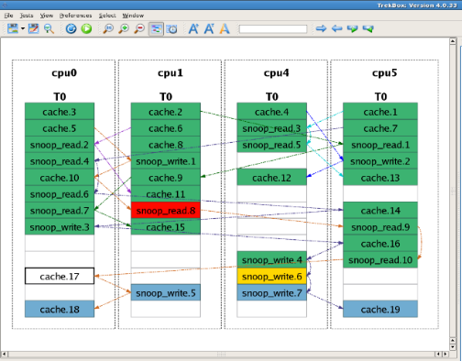
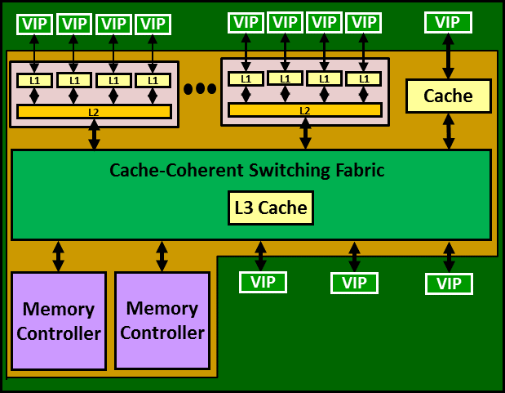
Application to Unit Bench and Sub-System Bench
NOC/Cache Unit Testbench
VIP
VIP
NOC/L2
VIP
VIP
VIP
NOC/Coherency Sub-Subsystem
Testbench

Slide 20
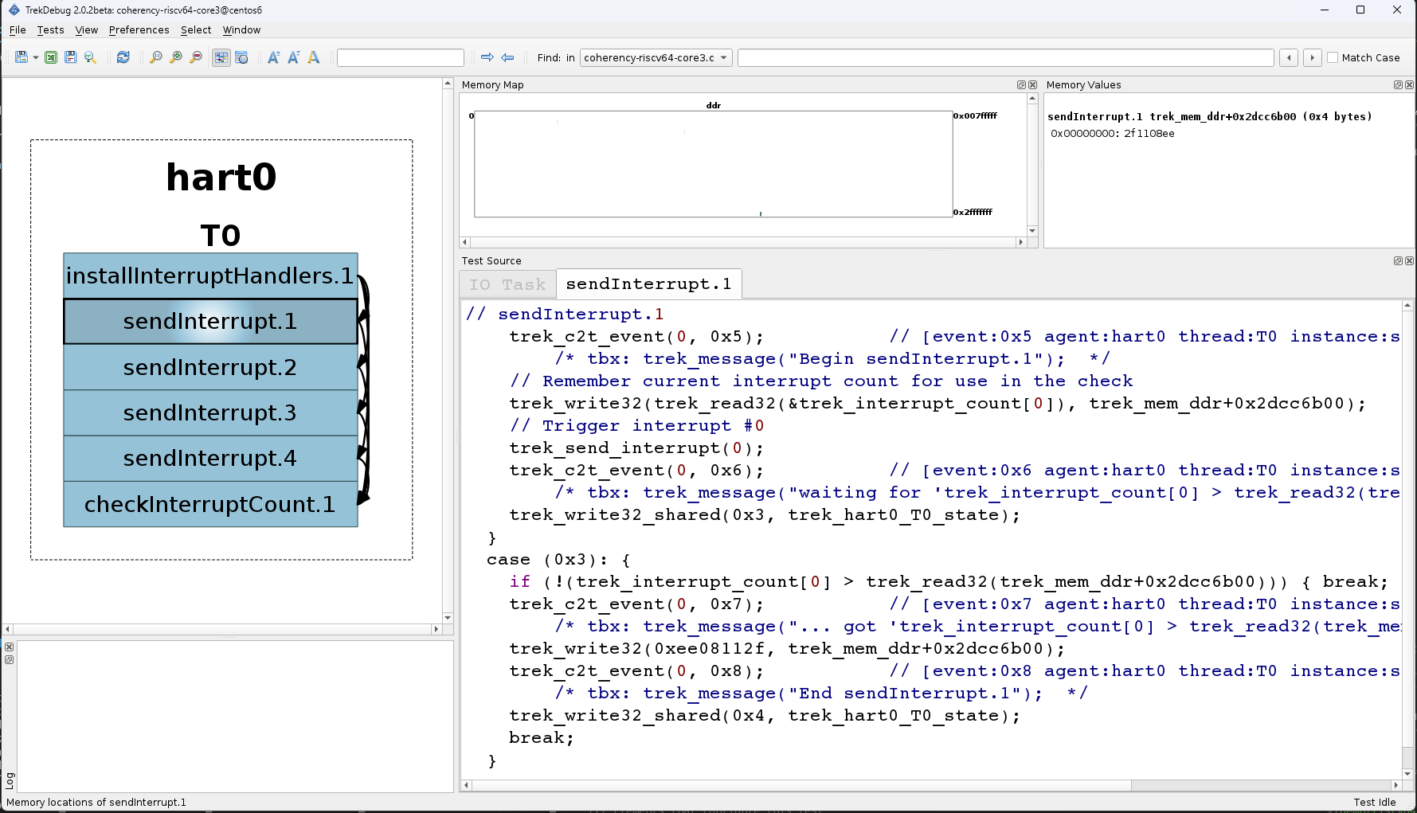
RV64 Core Exception Testing
Generates for example,
asm("UNIMP");
Check exception counts

Slide 21
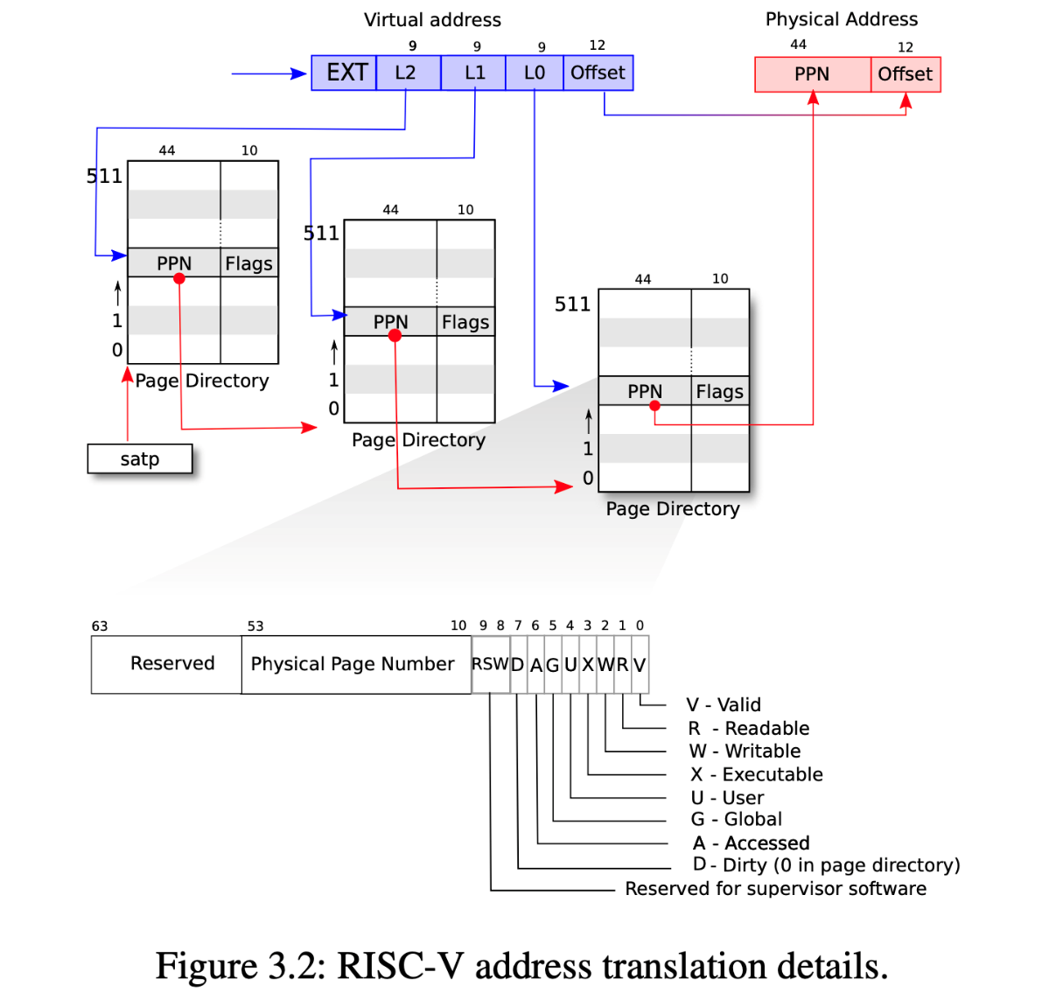
Page Based Virtual Memory Tests

Slide 22
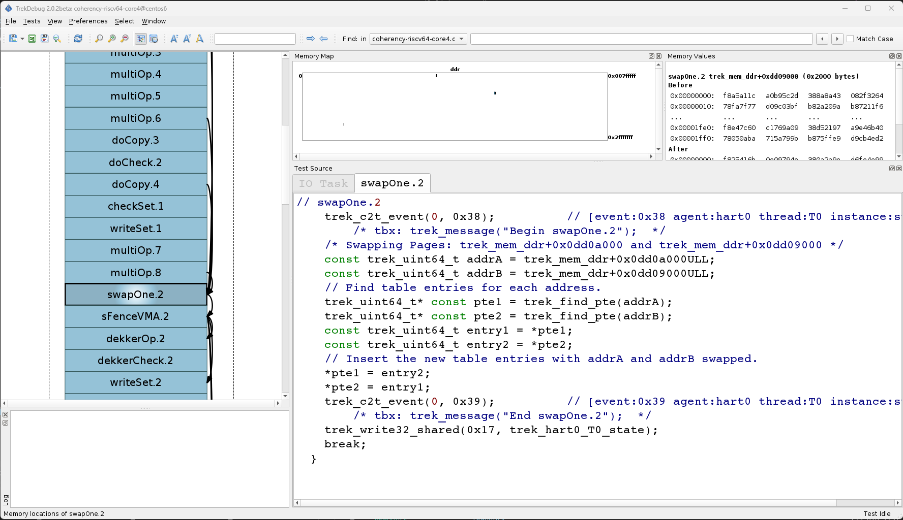
RV64 Core Page Based MMU Tests
Swap MMU PTE’s and
Check memory access

Slide 23
Agenda
Test Suite Synthesis and SystemVIP
RISC-V Core Verification SystemVIP
RISC-V SoC Verification SystemVIP

Slide 24
RISC-V SoC Testbench Integration
Scenario
Model
Virtualized OS Services
test.c
test.c
test.c
Compiler
CPU
CPU
CPU
CPU
CPU
CPU
CPU
CPU
test.tbx
…
test.c
test.c
L1
L1
L1
L1
L1
L1
L1
L1
L2
L2
TrekBox
Cache-Coherent Switching Fabric
L3 Cache / Snoop Filter
Memory
Controller
Memory
Controller
PCIE
Ethernet
Offload
PCIE
VIP
Ethernet
VIP

Slide 25
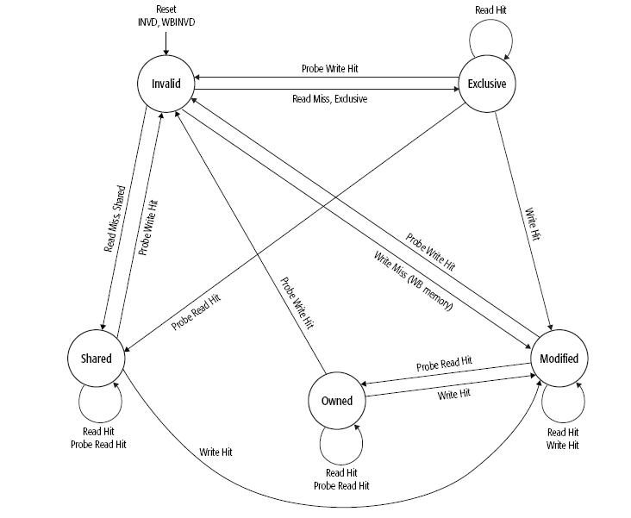
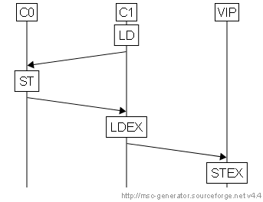

Multi-Agent Scheduling Plans: Overview
True Sharing within scenario
False Sharing across scenarios
N Transition Scenarios
N Transition Sequences
Concurrent Scenario Test Case
Schedule Memory
Interleave & Pack
Resolve Dependencies

Slide 26
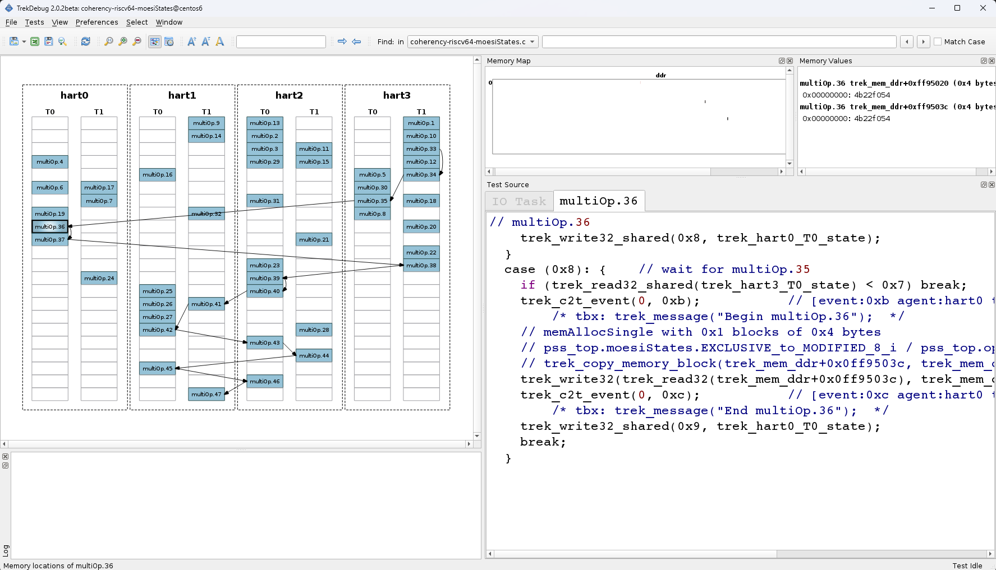
RV64 MultiCore MoesiStates
Planned Cache State
Transitions

Slide 27
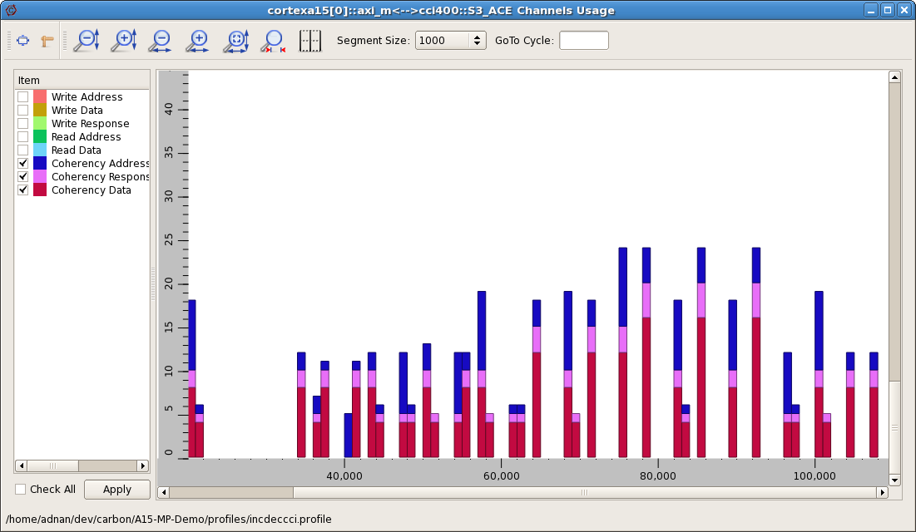
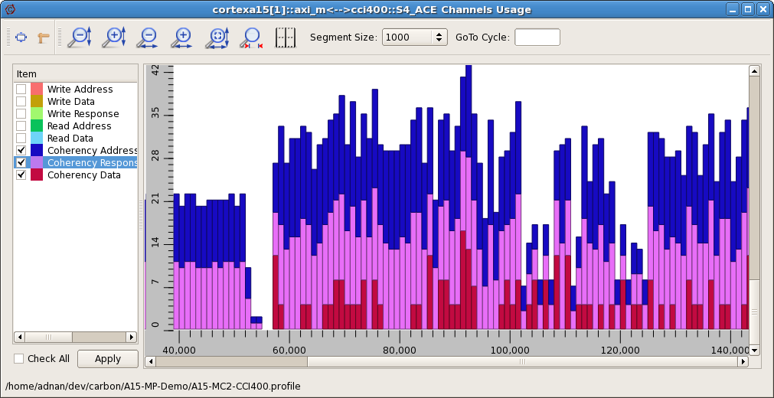
Efficacy of System-Integrity Testing using the RISC-V TrekApp
Typical directed coherency test …
… vs. RISC-V TrekApp
automated Sys-Integrity tests

Slide 28
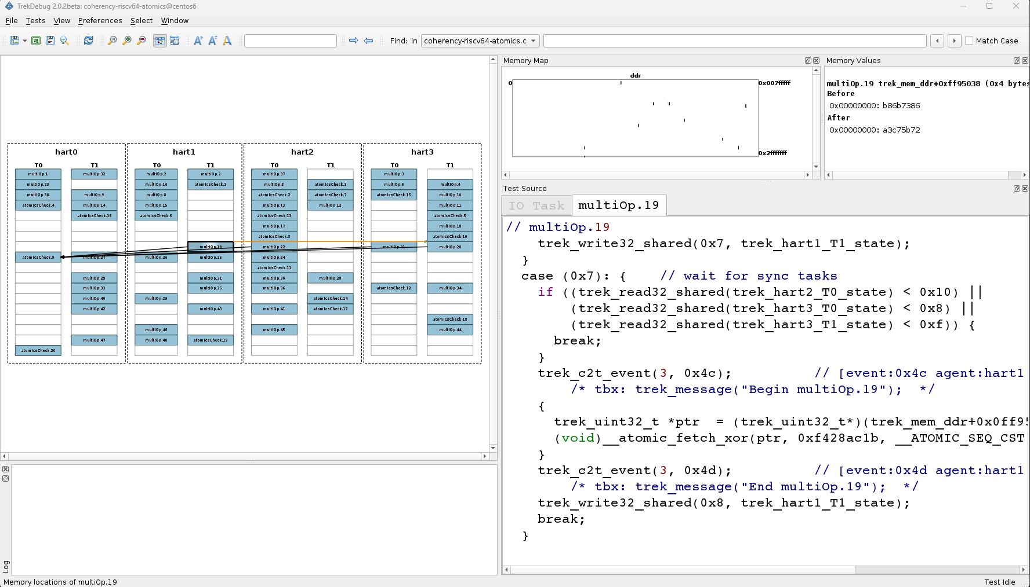
Atomics Testing
Check result is aggregate of synchronized atomic operations

Slide 29
RISC-V SoC Memory Ordering: Dekker Algorithm
Assume initial state A=0 , B=0
The Dekker Algorithm States
  core 0: ST A, 1; MEM_BARRIER; LD B
  core 1: ST B, 1; MEM_BARRIER; LD A
  error iff ( A == 0 && B == 0 )
This is a test for a weakly ordered memory system
  Such a system must preserve the property that a LD may not reorder ahead of a previous ST from the same agent

Slide 30
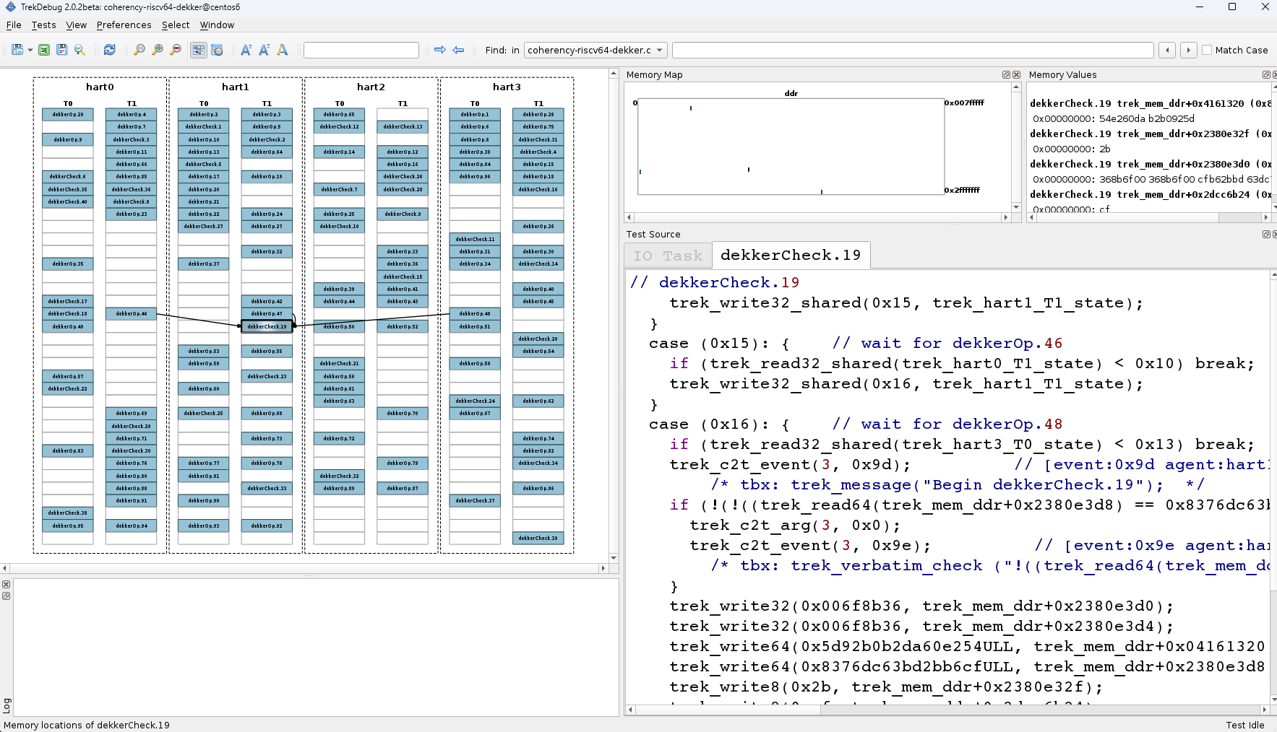
Dekker Memory Ordering
Check ordering across synchronized Dekker scenarios

Slide 31
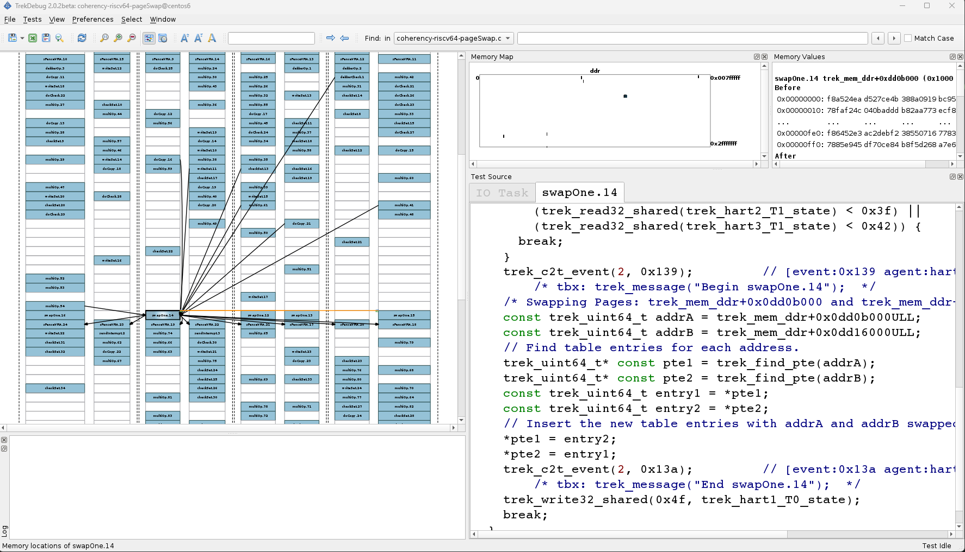
MultiCore MMU Tests
All cores Swap MMU PTE’s and check memory access

Slide 32
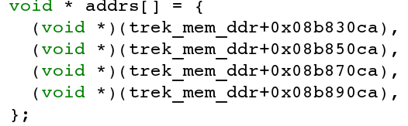
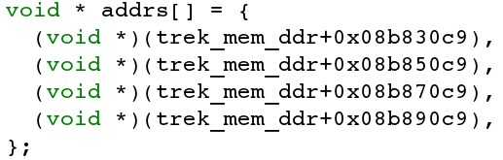
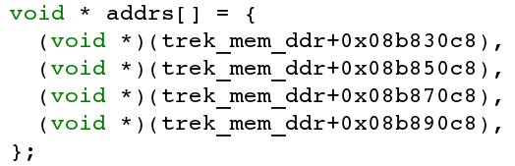
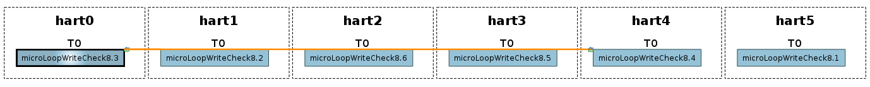
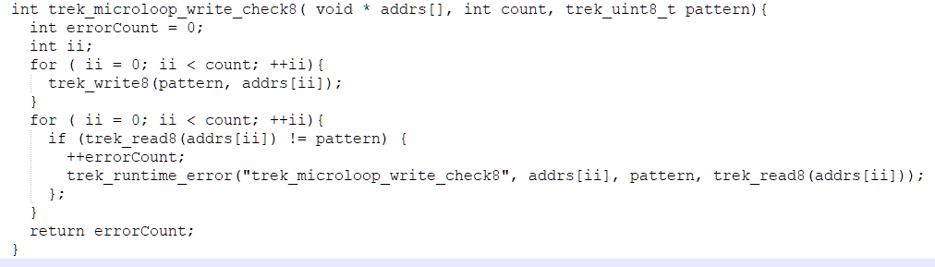

False-Share Memory Stress Tests
Allocate set of memory blocks
Byte 5
Byte 4
Byte 3
Byte 2
Byte 1
Byte 0
Each core operates on a “slice” of memory
Random cores with synchronized start
Each core has free running loop

Slide 33
Thanks for Listening!
Any Questions?

