Slide 1
Python empowered GLS Bringup Vehicle
(PEGV)
Debarati Banerjee Nikhil Singla Shantha B Pandithurai Sangaiyah

Slide 2
Agenda
Motivation
PEGV solution
TB integration
User inputs
Pros
Scope
Results

Slide 3
Motivation
Incompatible collaterals
NRFs
Syncflops
Libs and std cells
Functional DV/TB not matured
Hardcoded paths
Inexperienced GLS resource
Lack of standardization
Simulator switches
Defines
No methodology for collaterals reuse
Std cells and lib files
Common infra for reusability

Slide 4
PEGV
PEGV is a python based automated solution that sanitises all the collaterals provided by PD team without waiting for functional TB to be compatible with GLS flow
Supports all the GLS variants (no timing, PG and SDF simulations)
Push button flow that generates all the TB collaterals required for GLS runs
Standardization and reuse across the projects and platforms
Single source of user input which mainly contains the following information :
Connection sheet
Clk resets
Trace
PD collaterals(i.e. Netlist, sync flops, NRFs etc)

Slide 5
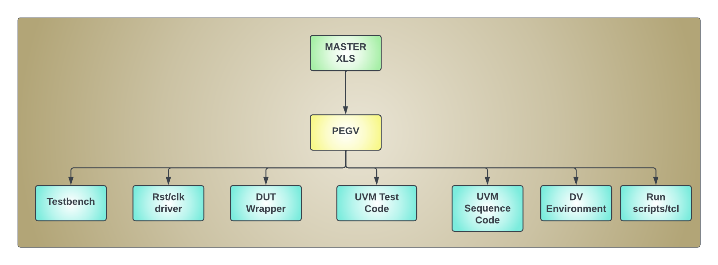
Empowering through python

Slide 6
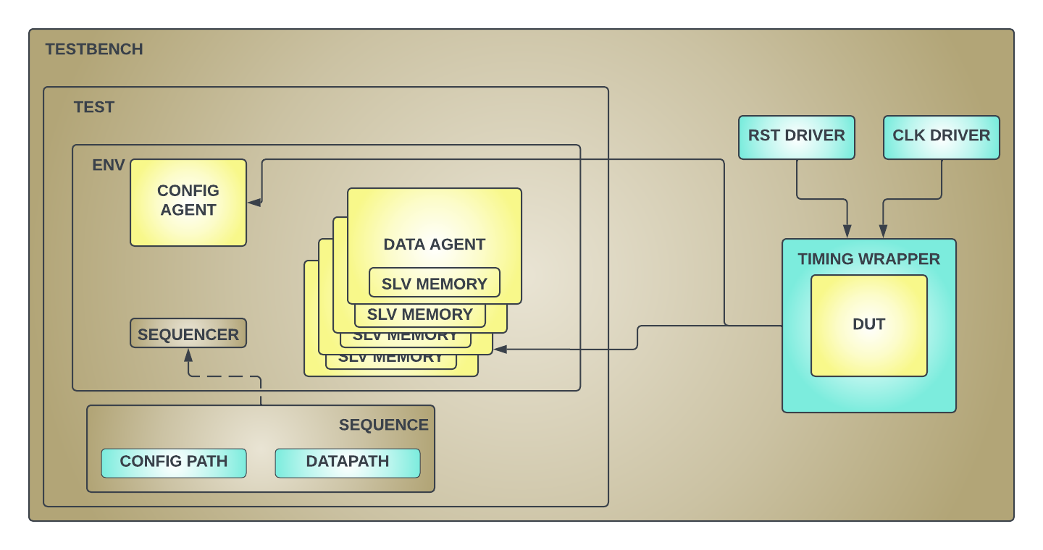
PEGV Testbench

Slide 7
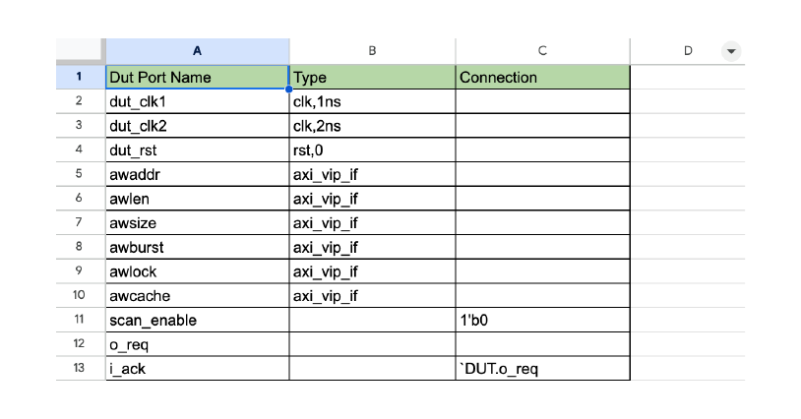
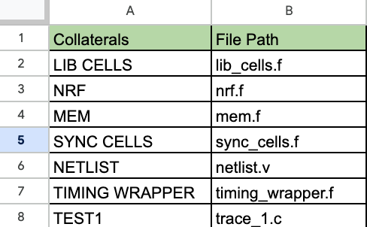
USER Inputs

Slide 8
Trace Layer
Trace methodology is a protocol agnostic layer built to decouple the protocol specific traffic from generic testbench. User is required to provide the trace in granularity of register rd/wr and memory rd/wr. Currently trace supports
config accesses( rd,wr, poll, compare with configurable width)
read_reg(addr)
Slave memory accesses ( load, store from/to file)
load_mem(addr_offset, mem.hex)
Delay
delay(1000)
Prints
print(“user message”)

Slide 9
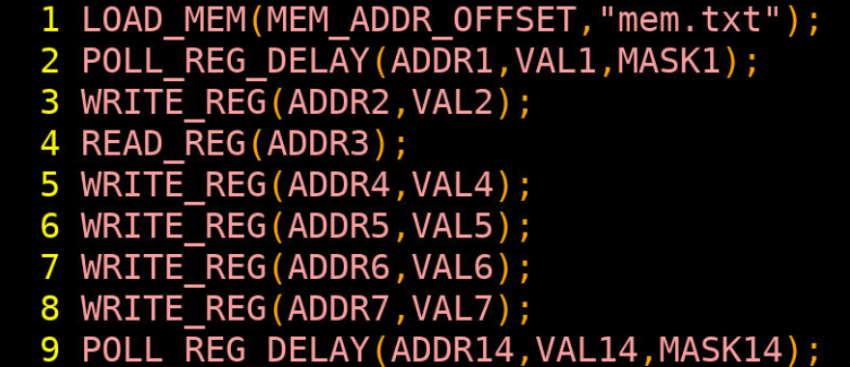
Execution flow
Notes:
Add trace example on the left
AXI agent to be moved down and make it multiple with memory box
Rename agents as config and data agent
Remove interface

Slide 10
Pros
Protocol and methodology agnostic
Standardization across platforms
Fully automated solution
Defines and simulator switches provided are standard across projects
All GLS variations (No timing, PG and SDF) can be closed with PEGV
XLS based solution for all the inputs
Whole testbench is configurable and able to sanitize any netlist
Trace flow provides a protocol agnostic layer for data traffic
No protocol expertise required to bring up the flow
No dependency on UVM/SV methodology
Notes:
Add trace example on the left
AXI agent to be moved down and make it multiple with memory box
Rename agents as config and data agent
Remove interface

Slide 11
Scope
PEGV can be extended to handle interrupts to complete interrupts verification as part of GLS
Custom parallel running sequence handle to user for any custom handshakes with DUT.

Slide 12
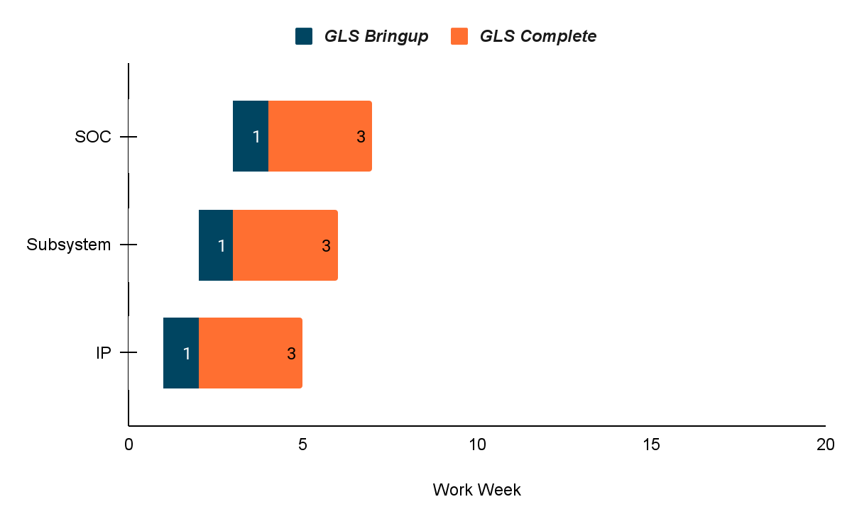
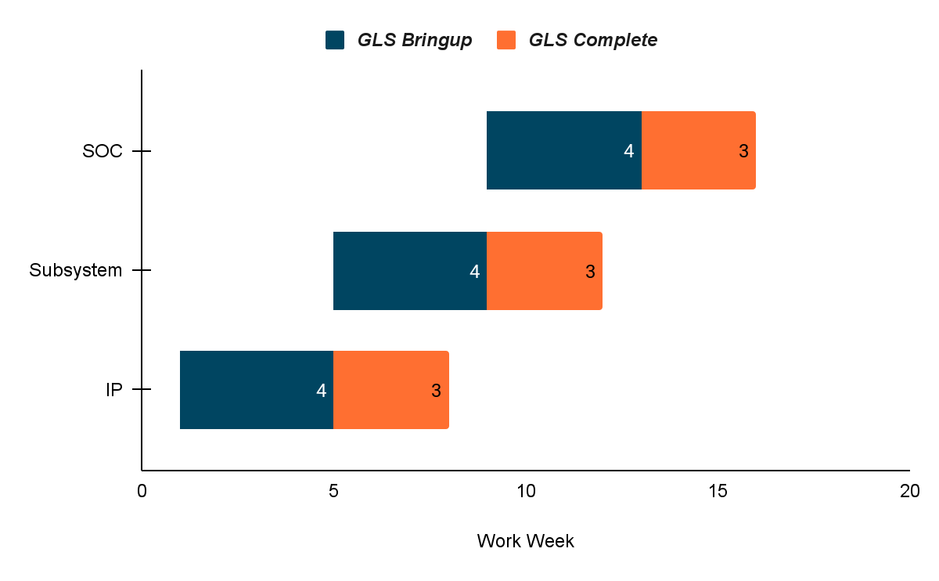
Results(1/3)
Conventional Approach
PEGV Approach

Slide 13
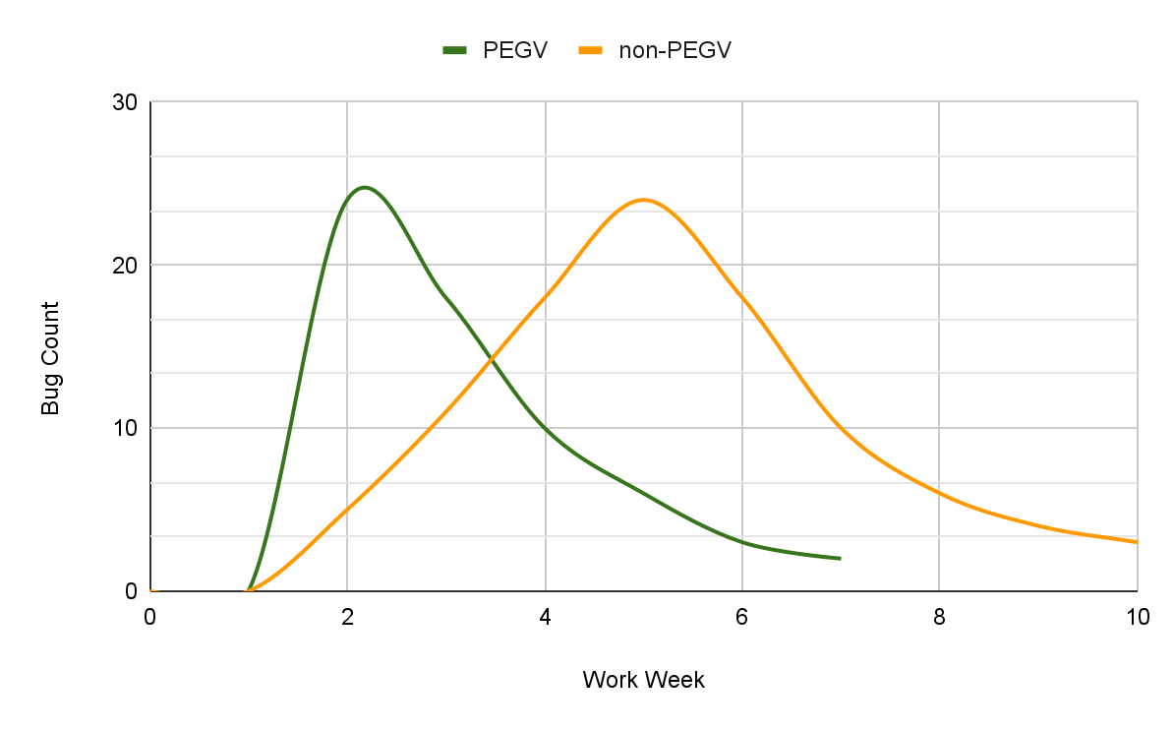
Results(2/3)
Bug Chart comparison between PEGV and Conventional Approach

Slide 14
Results(3/3)
It has reduced the basic bringup time from 4 weeks to 3-4 days.
With PEGV, teams have found multiple issues related to wrong/missing NRFs, coldboot not working due to power switch connections very early in DV cycle.
With every new release the DV setup overhead has been minimal as the only change required is in the master xls file.

Slide 15
Questions

