Slide 1
Efficient Verification of Arbitration Design with a Generic Model
Kevin Kotadiya, Ishita Agrawal
eInfochips An Arrow Company

Slide 2
Agenda
Introduction
Arbitration Model Architecture
Approach to Integrate Arbitration Model
Coverage Model and Results
Summary

Slide 3
Agenda
Introduction
Arbitration Model Architecture
Approach to Integrate Arbitration Model
Coverage Model and Results
Summary

Slide 4
Introduction
Generic SystemVerilog-based Weighted Round Robin arbitration model
Challenges - Why this model?
Multiple Arbitration – High redundancy
High maintenance
Complex functional coverage
Above leads to human errors

Slide 5
Agenda
Introduction
Arbitration Model Architecture
Approach to Integrate Arbitration Model
Coverage Model and Results
Summary

Slide 6
Arbitration Model Architecture
Two approaches for arbitration :
Get immediate result
Built-in result checking
Arbitration Model
Channel 0
 |  |  |  | q0
set_weight
> { ID, n }
Channel 1
push_packet
> { ID, CI }
 |  |  |  | q1
Channel *
Core Logic
 |  |  |  | q*
Expected Packet
get_expected_packet
{ ID } >
Channel N
 |  |  |  | qN
Actual Packet
check_actual_packet
> { ID, CI }
Checker
Coverage
Config

Slide 7
Features
N Number of Input Channels
Integrated APIs
set_weight : Setting weightage for each arbitration input channel
push_input : Feeding input to arbitration channel where input is encoded channel ID
get_expected_packet : Get expected arbitration result, where output is encoded channel ID
check_actual_packet : Fetch actual arbitration result and compare it with expected

Slide 8
Features (Cont.)
In-built Coverage Model
Channel Information
Custom information passed with channel ID (string, enum, class, etc.)
a1-ci0
A1
a1-ci0
a1-ci1
b1-ci0
B1
Input
b1-ci1
Output
a2-ci0
A2
b1-ci1
a2-ci1
a2-ci1

Slide 9
Agenda
Introduction
Arbitration Model Architecture
Approach to Integrate Arbitration Model
Coverage Model and Results
Summary

Slide 10
Approach to Integrate Arbitration Model
Design
Active Agent
Passive Agent
Processing Input Signal
Arbitration
Model
Processing Output Signal and Comparison
Reference Model
Environment
Top

Slide 11
Approach to Integrate Arbitration Model (Cont.)
Single Level
Design
Block Reference Model
Channel 0
Logic 0
Ch 0
Channel 1
Logic 1
Ch 1
Expected Packet
Arbitration Model
Actual Packet
Channel 2
Logic 2
Ch 2
Actual Packet
Logic 3

Slide 12
Approach to Integrate Arbitration Model (Cont.)
Multi Level
Design
Actual Packet
Block Reference Model
Channel 0
Logic 0
Ch 0
Logic 8
Logic 6
Channel 1
Logic 1
Ch 1
Arbitration Model 1
Output 0
Checking
Channel 2
Logic 2
Ch 2
Ch 0
Actual Pkt
Logic 9
Ch 1
Arbitration Model 3
Output 2
Channel 3
Logic 3
Ch 0
Ch 2
Channel 4
Logic 4
Ch 1
Actual Pkt
Arbitration Model 2
Output 1
Channel 5
Logic 5
Ch 2
Actual Pkt
Logic 7

Slide 13
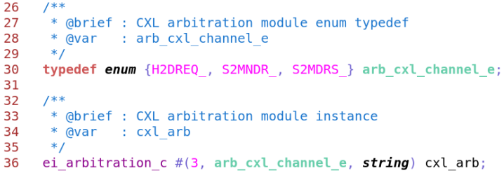
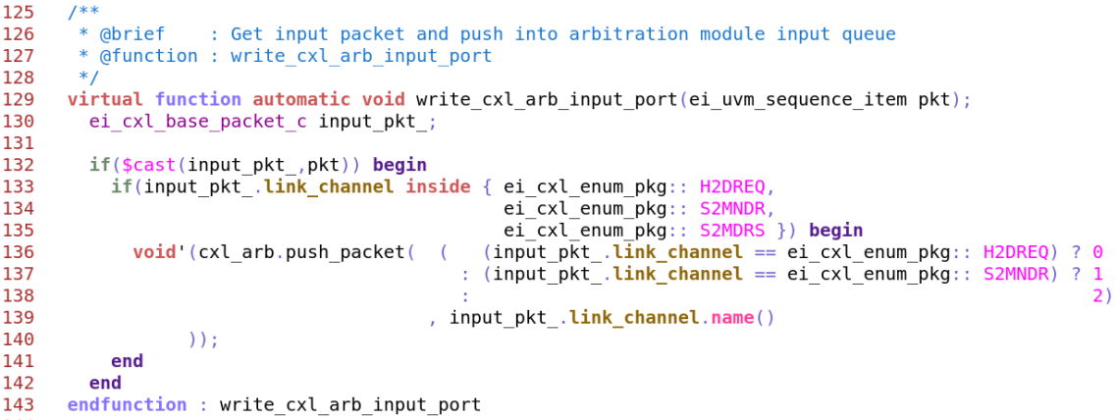
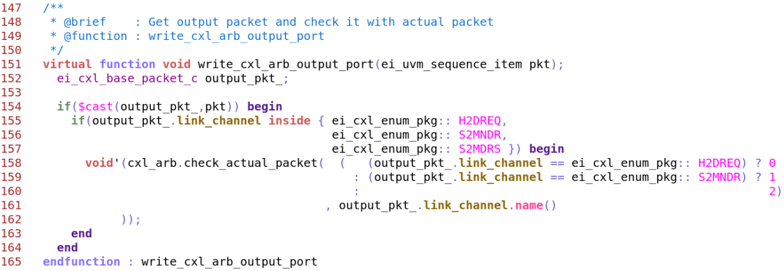
Integration Steps
Instantiate and construct
Feed input packets
Feed actual packet to compare with expected packet
Configure weightage
13

Slide 14
Agenda
Introduction
Arbitration Model Architecture
Approach to Integrate Arbitration Model
Coverage Model and Results
Summary

Slide 15
Coverage Model
Sr. No. | Name | Bin | Description
1 | <name>_arb_cg | - | Arbitration Cover group.
1.01 | arb_input_cp | auto[1] | Cover point for sampling all possible input combinations. N = number of input channels Ignore Bin = auto[0]
 |  | auto[2]
 |  | ...
 |  | auto[2^N -1]
1.02 | arb_cycle_start_cp | auto[CH 0] | Cover point for sampling channel from where one arbitration cycle started.
 |  | auto[CH 1]
 |  | …
 |  | auto[CH (N -1)]
1.03 | arb_output_transition_cp | CH 0 => CH 1 | Cover point for sampling all possible output transitions.
 |  | CH 0 => CH 2
 |  | …
 |  | CH (N -2) => CH (N -1)
1.04 | arb_output_transition_reason_cp | NO_INPUT | Cover point for sampling all output transitions reason.
 |  | NO_WEIGHT
 |  | NO_INPUT_NO_WEIGHT
1.05 | arb_output_transition_cp_X_arb_output_transition_reason_cp | - | Cross of output transition with its transition reason.

Slide 16
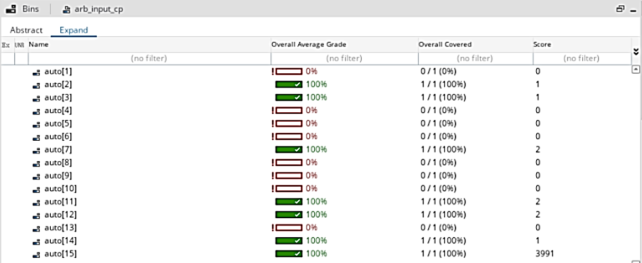
Results

Slide 17
Agenda
Introduction
Arbitration Model Architecture
Approach to Integrate Arbitration Model
Coverage Model and Results
Summary

Slide 18
Summary
Used in a complex SoC project
Multi-Level arbitration
Reduce coding effort (~91%)
1 arbiter - ~400 code lines
12 arbiters - ~4800 code lines
Reduce code errors and simplifies maintenance
Reusable, organized and adaptable
Includes built-in coverage
Quicker and efficient reference model development

Slide 19
Questions

