Slide 1
Coverage Acceleration and Testcase Pruning using Smart Stimuli Generator in SOC Verification
Rahul Laxkar, Naveen Srivastava & Sekhar Dangudubbiyam
SAMSUNG Semiconductor India Research

Slide 2
Agenda
Introduction
Importance and Challenges of Functional Coverage
Standard Practice for Functional Coverage
Conventional Methodology and Limitations
Smart Stimuli Generator Approach
How it works?
Implementation and Practical Considerations
Impact on Verification Productivity
Application of Smart Stimuli Generator in SoC
Results
Conclusion

Slide 3
Introduction(1/2)
Importance of Functional Coverage:
1.
Design Quality Assurance
Confirms that the design meets its intended functionality and specification
Reducing the probability of functional issues in final product
2.
Critical Feature Checks
Ensures all the corner cases of the design has been covered
Undercovered or un-covered scenarios are flagged, allowing timely debugging
3.
Verification Closure
Functional Coverage provides a measurable and quantifiable metric for verification completeness
Achieving the desired coverage goals signifies that the design has been thoroughly tested

Slide 4
Introduction(2/2)
Challenges of Functional Coverage:
Time-consuming and resource-intensive
May not always yield optimal results due to design complexity
Limited turnaround time
Reaching 100% coverage involves iterative testcase development, regression testing and subsequent analysis

Slide 5
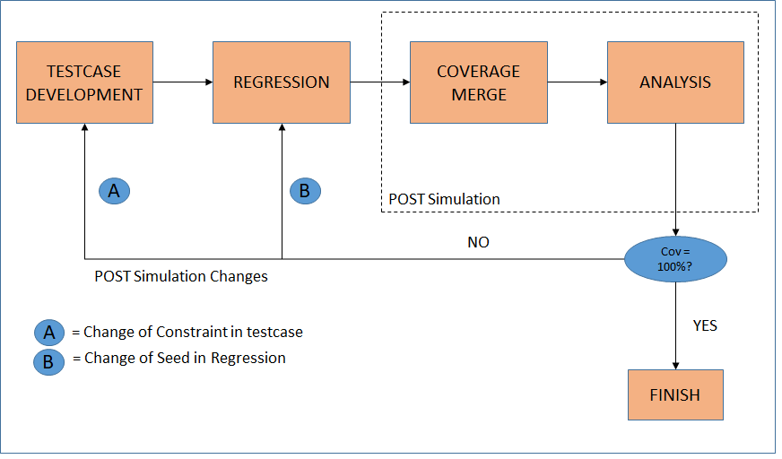
Standard Practice For Functional Coverage(1/2)
Conventional Methodology:
Generating testcase according to coverage bins
Merging of coverage database to generate final result
Post simulation changes in testcase to improve coverage

Slide 6
Standard Practice For Functional Coverage(2/2)
Limitations:
1.
: Creating Testcases, analyzing results and modifying seed values or constraints in post-sims
Time-consuming
2.
:Requires multiple post sim iterations until the coverage goal is achieved
Repetitive
3.
:The conventional approach may not provide complete coverage for all possible scenarios
Limited Coverage
4.
:When dealing with complex designs and tight deadlines, this approach can become even more challenging for a verification engineer
Rising Complexity

Slide 7
Smart Stimuli Generator Approach(1/2)
The proposed method leverages a single testcase with smart stimuli generator to eliminate the need for multiple testcases
Auto repetitive process of running datapath with new constraints until 100% coverage achieved in a single simulation
Eliminate the need for post-simulation coverage merging, results analysis and testcase modification
Enables addition of more scenarios in verification plan, expanding coverage of design

Slide 8
Smart Stimuli Generator Approach(2/2)
How it works?
Randomization of coverage variables in each iteration
Functional scenario runs with the randomized coverage variables
Collects coverage information using get_coverage();
Print the final report once achieved the coverage goal
Datapath Run
Finish
Collect COVERAGE
Cov=100%?
RANDOMIZE Cov Variables
No
Yes
Print Report & Finish

Slide 9
Implementation and Practical Considerations(1/2)
The successful implementation of the smart stimuli generator approach involves several key consideration and steps:
Dynamic Constraint Generation
Guides the generator in generating the constraints of the coverage variable for each iteration.
The generator uses the techniques such as constrained-random testing, directed testing or a combination of both to generate diverse and comprehensive values
AWLEN Bin Info.
AWLEN Randomization without repetition of bins

Slide 10
Implementation and Practical Considerations(2/2)
Coverage Goal
Specifies the desired coverage level that needs to be achieved for the given design or functional requirements.
Generator will continuously run the datapath until it accomplishes the coverage goal
Datapath Information
Functional Scenario to target the cover bins
Generator will provide the constraints for the datapath and ensuring the appropriate coverage is achieved
Dynamic Constraints
Coverage Goal
SMART STIMULI Generator
Datapath Info

Slide 11
Impact on Verification Productivity
Reduction in Turnaround Time: Achieves coverage goal with a single simulation
Enhanced Functional Coverage: Exercise all the critical functional requirements or features, leaving no gaps in coverage
Proactive Bug Hunting: Potential issues are addressed early, preventing them from causing more significant problems downstream in the development process
Streamlined Verification flow: Streamlines the verification flow by eliminating the need for post-simulation coverage mixing, results analysis and extensive testcase modification

Slide 12
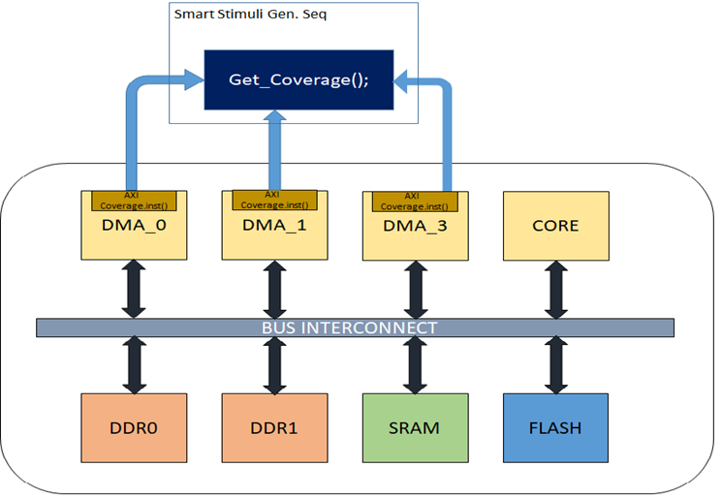
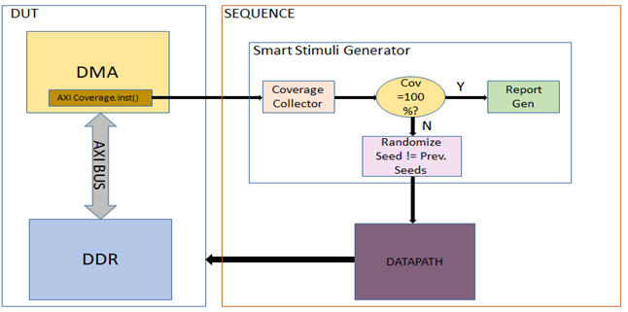
Application of Smart Stimuli Generator in SoC
DMA

Slide 13
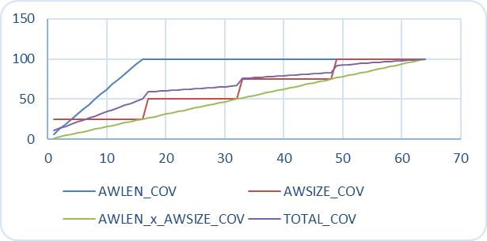
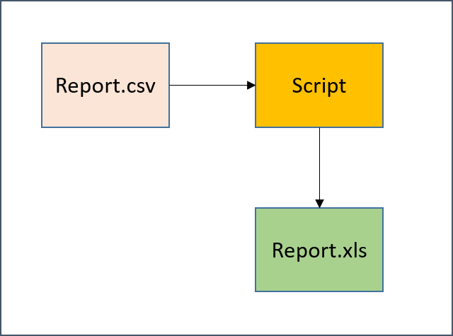
Results(1/2)
Report Generation flow
Coverage vs Iteration graph in Report.xls

Slide 14
Results(2/2)
No. of Iterations
AWLEN=100%
AWSIZE=100%
AWLENxAWSIZE=100%
TOTAL COV=100%

Slide 15
Conclusion(1/2)
The Smart Stimuli Generator approach is a powerful tool for engineer working in the design and verification of complex electronic systems.
Time-saving benefits like simulation time, automatic constraint generation, one simulation for complete coverage, less machine cycle used etc.
Improves the overall quality of the design by enabling the coverage expansion through addition of more scenarios, which can identify and address any issue in the design.

Slide 16
Conclusion(2/2)
Comparison of Conventional Approach and Smart Stimuli Approach
Tasks | Convention approach | Using Smart Stimuli Generator
Testcase volume | 36 Blocks x 6 DMAs ➔ 288 Tests | One testcase per block. Overall only 36 tests (~88% Testcases pruned)
Machine time | Average runtime per test – 8hrs 288 x 8 ➔ 2304hrs Max 72 Simulator licenses needed to complete all tests in a day | Average runtime with Smart Stimuli generator is 12hrs. Overall machine time 36 x 12 ➔ 432 hrs Max 18 licenses required to complete all tests in a day

Slide 17
Questions

