Slide 1
Accelerating SoC Sensor Network Verification Sign-off through Dynamic and Formal Synergy
Vinod Usha, Shreeram Hegde, Prasad Reddy
QUALCOMM India Private Limited

Slide 2
Introduction
Sophistication of on-chip sensor networks
Sensors sprinkled across the SoC
Different types of chains/networks
Distributed power sensor networks
High impact on power
Effects Overall functionality of SoC
One of the last items to be closed in verification cycle
Time consuming Verification Target
Highly bug prone implementation

Slide 3
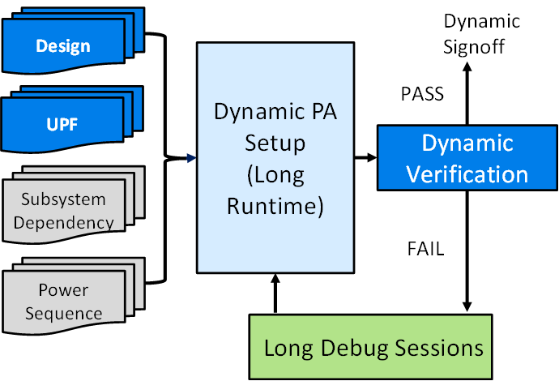
Dynamic Verification Challenges
Dependency on multiple sub-systems
Incorrect Sensor Network Specification
Sensor Power Rail Logic and Connectivity

Slide 4
Formal Verification Leverage
Dependency on multiple sub-systems
RTL, UPF & Spec , no other collaterals
Only sensors, controller and routing are required
Incorrect Sensor Network Specification
Bring up of Formal setup from specification can flag inaccuracy in it
Flexible to automate with logic
Sensor Power Rail Logic and Connectivity
LPCC (Low Power Connectivity Check) in Formal is leveraged

Slide 5
Formal Verification Challenges
Verification space: SoC RTL + Power Intent
Power State and Intent Constraints
End to End Verification

Slide 6
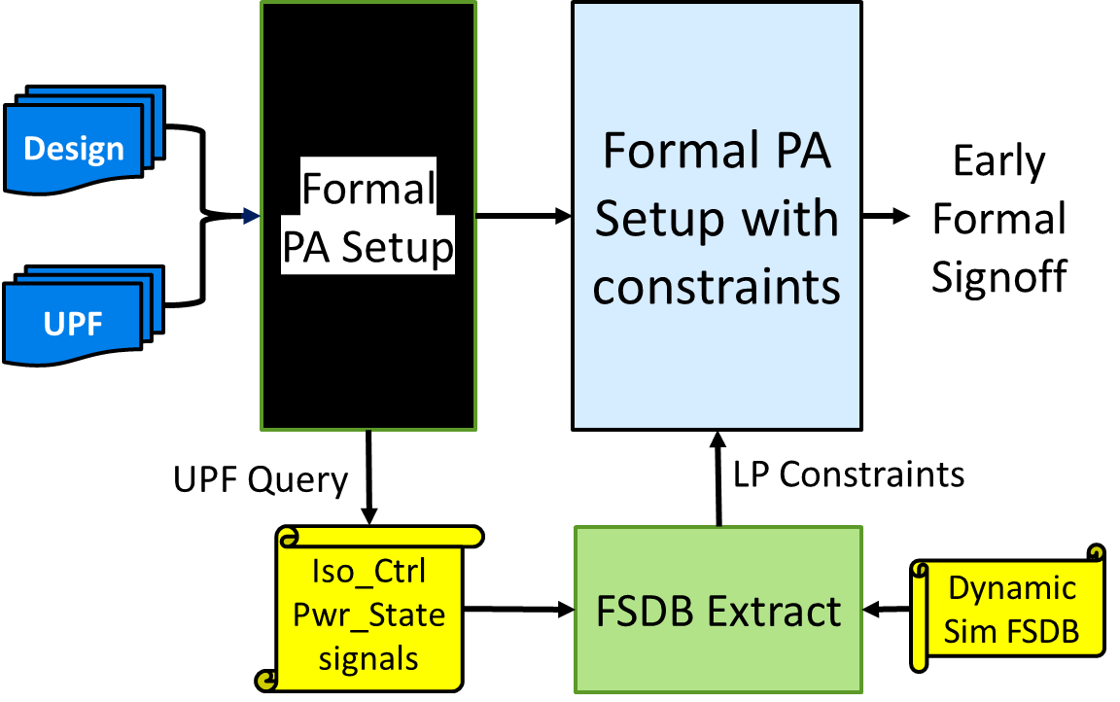
Dynamic Verification Leverage
Verification space: SoC RTL + Power Intent
Conscious “Un-Blackboxing”
Power State and Intent Constraints
UPF Query
Fsdb extraction
End to End Verification
Simulation Sign-off

Slide 7
Glimpse of Bugs Caught
Bugs caught early through Formal Verification
Power rail connectivity to Sensors and Controller
Caught Multiple broken links in a Daisy Chain connection early in verification cycle
Point to Point connectivity between Controller, Sensors and Subsystems
Isolation and Clamping issues
Incorrect Specification
Bugs caught through Dynamic Verification
Polarity and Logic mismatch of signals originating from deep inside a subsystem
Controller, Sensor & subsystem PA Bring up, and complete functionality

Slide 8
Results
Reduction in No. of Dynamic Tests
Timeline of Dynamic alone
vs Dynamic + Formal Approach

Slide 9
Conclusion
Apart from early verification sign-off, there are few more advantages of the hybrid approach:
Provides comprehensive structural analysis of the sensor chain as compared to traditional dynamic simulations.
Auto generation of assertions based on the Spec, RTL & UPF.
Eliminates expensive iterations of long running PA-RTL dynamic simulations.
Test plan optimization, which would help in saving compute power as well as NRE.
Optimal convergence time for proving PA Formal properties.

Slide 10
Questions

