Slide 1
Raising the Bar: Achieving Formal Verification Sign-Off for Complex Algorithmic Designs, with a Dot Product Accumulate Case Study
Shravya Jampana, Madhurima Eranki, Disha Puri

Slide 2
Agenda
Traditional C2RTL Formal Verification
Proposed E2E methodology
Limitations of Traditional Approach
Conclusion
Detailed Case Study
Future Direction and Adoption
Notes:
Recording

Slide 3
Traditional Datapath C2RTL Verification
Validation of RTL implementation against the C++ model
under specific constraints for one transaction of data
Valid state space
defined through constraints
Map inputs of C++ with RTL
C++ model development
RTL implementation
Perform equivalence checking
M Achutha KiranKumar V, Disha Puri, Mohit Choradia, Paras Gupta, “Novel Paradigm in Formally Verifying Complex Algorithms”, DVCON US 2021.
M Achutha KiranKumar V, Disha Puri, Shriya Dharade, “Bringing DataPath Formal to Designers’ Footsteps”, DVCON India 2019
Notes:
Backbone of ensuring design correctness
Explain flow
Well-established and paper published
But works on 3 assumptions: Cmodel golden, constraints golden and single instruction allowed

Slide 4
Pre-Formal Sign-Off Considerations
Is the entire range of legal values being tested?
Is the reference model golden?
Is verifying a single transaction of data enough for formal sign-off?
Where do design constraints come from? How to validate these constraints?
Notes:
Owing to its limitations, is conventional approach sufficient for signing off
Which are 4 main challenges that need to be addressed
New designs cannot be considered golden
Single stage done so far since huge complexity makes convergence impossible for tool engines
Spec cannot be considered golden
Setup might not be covering all scenarios

Slide 5
DPAS Case Study
A0 | B0 | C0
A1 | B1 | C1
…. | …. | ….
AN | BN | CN
α0 | α1 | α2
β0 | β1 | β2
…. | …. | ….
γ0 | γ1 | γ2
a0 | a1 | …. | aN
b0 | b1 | .... | bN
c0 | c1 | …. | cN
Result: (α0 + a0*A0 + a1*A1 + a2*A2 + .. aN*AN)
MAC
Final Accumulator
SrcA (n x N)
SrcB (N x m)
SrcC (n x m)
A0
A1
AN
α0
a0
x
a1
x
aN
x
+
1 channel
+
+
Notes:
Feedback:
Explain why DPAS is important operation
Take the advantage of explaining what AI algorithms need and DPAS is an important operation
Ideas:
Use an example: like a recommendation system that uses DPAS to predict user preferences
Then mention how matrix multiplications make a difference

Slide 6
Refine reference model: C-FPV
Architectural requirements converted to C++ assertions and included in the reference model to ensure that the algorithm itself operates accurately
Traditional C2RTL validation
Is reference model golden
C++ Model
RTL
C-FPV
C++ Model
Golden
C++ Model
C-FPV on DPAS unit:
Prove assertions included in C++ model
Notes:
FPV is well know, can this be applied on Cmodel
Never been done before because of tool restrictions, but would give impactful results if utilized properly
Introduce C-FPV
2 outcomes: underconstrained env and needs more assumptions or early bug detection
Feedback:
Explain that there are many checkers we incorporated apart from these properties and C-FPV gives higher confidence in the specification
Claim larger names instead of ‘initiative’

Slide 7
C++ Model bug found through C-FPV
assert ((a.exp>=MIN_EXP) && (a.exp<=MAX_EXP))
Assertion checks if the exponent is within the legal range
Failure Reason
Bug Fix
Fails despite constraining the design and allowing only legal exponent values
Incorrect values given to minimum and maximum parameters in C++ model
Parameters later modified with the expected values by the architect
Assert Failure

Slide 8
Validating pipeline
Single-stage
What are the potential risks of relying solely on single-instruction testing for pipeline validation?
DV/Enable signal
Cmodel output
RTL output
Is verifying single transaction sufficient
Multi-stage
Control Path + Data Path
Multiple instructions allowed in the pipeline
Notes:
Feedback:
Talk about clock gating, where inputs are not gated/ungated before the arrival of DV etc..
Should capture why data+control was not done before
Should say we created a great methodology multiplying/marrying the best practices of FPV and datapath

Slide 9
Uncovering interaction bugs
Data Integrity Violations: Data corruption, data loss/truncation
Timing Dependencies: Presence of feedback loops, timing constraints violated when a transaction arrives too early or too late
Control and Data Interaction: Interactions between different types of instructions

Slide 10
Implementation of SVA properties
How to validate FV constraints?
Implementation of Legal Assumptions:
Architectural requirements implemented as System Verilog Assertions (SVA)
Integrate these SVAs into the Dynamic Verification (DV)
Benefits and Appreciation:
Effectively utilizing existing DV environment for proving FV properties
Makes the flow tool agnostic
//maximum and minimum values for exponent
Assert_for_valid_input_exp : assert property (
@(posedge clock) disable iff(reset)
instr_valid |-> input_data.exp <=9'h1fe && input_data.exp>=9'h1
);
Notes:
2 tools:
SVAs are compatible with both FV and DV (universal language of property verif)
Existing DV env can be efficiently utilized to verify FV assumptions

Slide 11
Functional Covers
Covers to check the reachability of input scenarios/internal signals
Can detect any over-constraints or any unreachable logic in the design
Bounded proof + Cover points -> confidence factor
A favorable feature, made designers to dedicate bandwidth and provide multiple such covers that can be included in formal setup
Is entire range being tested?
//cover for denormal input
COV_for_input_data : cover property (
@(posedge clock) disable iff(reset)
instr_valid && (input_data.exp== 8'd0) && (input_data.mnt != 23'b0)
);
Notes:
How can we claim full coverage with traditional approach?
2 outcomes: overconstraints that must be addressed quickly, unreachable logic has to be reported to designers to reduce design complexity, enhance performance and avoid unnecessary bugs
Overflow buffer example

Slide 12
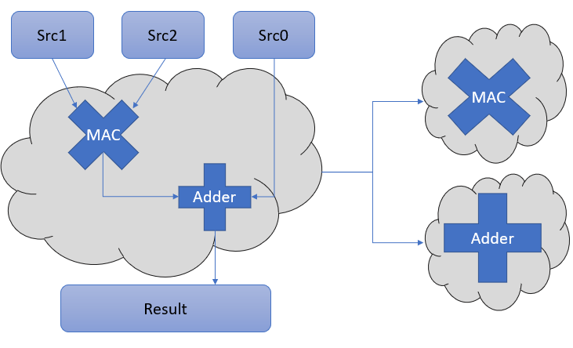
C2RTL Methodology
Bit level operations
Pipelined architecture
Large data widths
DPAS Design Complexity
Complexity reduction: DUT partitioning
Notes:
Bit level operation: state space explosion due to large number of combinations and state transitions
Large data width: leads to exponential growth in FV complexity
Pipelined arch: DPAS has multiple dedicated pipelines for every floating-point formats
Feedback:
When problem divided into 2, the question comes how are we sure it is complete. Should say we implement assume guarantee.

Slide 13
Convergence Techniques
Single-stage
Multi-stage
Constrain DV to take various patterns
Multiple DV patterns
Equivalent to performing equivalence check at a random cycle in pipeline
DV made high for a certain cycle and made symbolic for the rest
Reset abstraction
Proof decomposition
Use of helper lemmas
Prove internal nodes
Assume the proven nodes to check the output nodes
Incremental C2RTL Verification: Perform C2RTL at a lower design hierarchy and verify the equivalence of 2 hierarchy levels
C++ Model
Version-2
Input interface
Version-1
RTL
Output interface
Notes:
Why is complete convergence in multistage not possible (because of the nonlinear behavior)
Proof decomposition, no convergence then reset abstraction, no convergence then bounded proof for multiple DV patterns

Slide 14
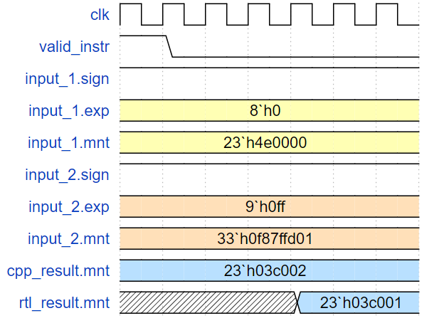
C++ Model Corner Case Bug
Description: False round up by the final accumulator when input is negative, and its exponent is small
Root Cause: Carry-add logic
Assertions to check equivalence between RTL design and C++ model outputs
Missed in simulation-level testing
carry-add logic mismatch:
RTL represents in 2's complement
C++ represents in 1’s complement
Notes:
32 bit and 43 bit inputs, impossible to be found in DV

Slide 15
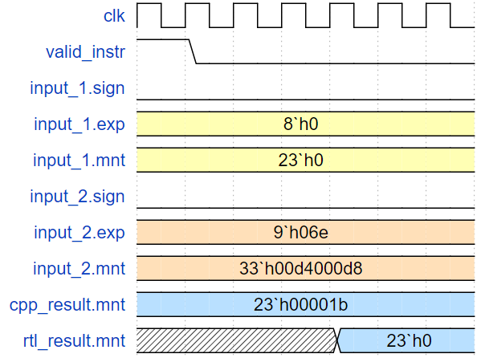
RTL Corner Case Bug
Description: Renormalization clamping data with end exponents to zero
Root Cause: No support for denormal right shift case
Input_1 is zero
Input_2 has exponent value less than the minimum
RTL design lacked denormal handling
Flushed small values to zero instead of preserving the denormal representation

Slide 16
Conclusion
Over 4 generations of DPAS design verified
20+ bugs detected with formal testbench and hence increased design robustness
Regressions enabled and significant reduction in turn-around time
Enhanced verification
coverage
Positive feedback and adoption
Huge shift-left
Notes:
Summarize the flow
Mention no bug escapes found over 4 generations
Mention turn around time was less than a week
Shift left because of bugs found from the beginning of the flow

Slide 17
Future Direction and Adoption
Integrate machine learning techniques into the verification flow
Address scalability challenges to handle larger designs
Incorporate more advanced formal verification techniques
Tool Ecosystem Enhancement

Slide 18
Questions

