Slide 1
When Last Minute FV Strikes Gold: A Case Study on Finding Starvations & Deadlocks in a Project Nearing Tape-in
Abhishek Potdar, Sachin Kumawat,
Sudhanshu Srivastava, Anshul Jain
Intel Corporation

Slide 2
1
Introduction & Problem Statement
2
Proposed Solution – ABC Formal
(Amplify, Build & Concentrate)
Agenda
3
Results & Future Scope
4
Conclusions

Slide 3
Introduction
Complex mesh to memory bridge
State-of-the-art features to support high-bandwidth memory
Complicated interactions and parallelism in Tracker FSMs
Multiple design modes, transactions and flows
Impractical to simulate all scenarios

Slide 4
Problem Statement
Sporadic but continuous bugs found in DV regressions
Many bug-prone design features/area left untested
In-exhaustive validation of late-stage fixes
Low design confidence
High probability of bug-escapes
Solution – Formal Verification!!!

Slide 5
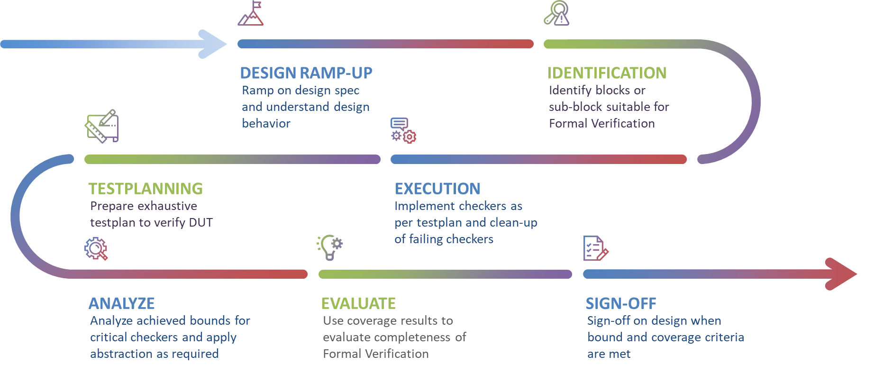
Traditional Formal Verification Flow
Specification
Architecture
RTL Design
Verification
Physical Design
Tape-in
Start
End

Slide 6
Challenge
Specification
Architecture
RTL Design
Verification
Physical Design
Tape-in
Start
End
Notes:
Challenges in applying traditional FV at late-stage in a DUT verification:
Time-consuming
Effort-intensive
Expertise dependent

Slide 7
ABC Formal
Amplify
The impact of available RTL embedded assertions
Concentrate
Build
End-to-end checkers to capture high-level intent of the design
Build
Amplify
Concentrate
On bug-prone microarchitectures for bug-hunting
Notes:
In this case study, we will present the successful utilization of last-minute formal verification techniques near tape-in date. Through clever bug hunting strategies involving existing RTL assertions and high-level end-to-end checkers,we identified and resolved showstopper starvation and hang issues that could have caused significant delays if undetected

Slide 8
Amplify
Enable
Through good design practice, our design incorporates numerous detailed RTL assertions – Enable them
Run
RTL assertions to explore exhaustive input space through FV, contrasted with DV where it limited by test vectors
Measure
The impact of these RTL assertions through formal coverage metrics, guiding/suggesting further improvements
Leverage
RTL assertions debugs to understand design better, identify constraints and tackle proof complexity (assume-guarantee)
Notes:
Amplify : RTL assertion, Which can be measured by coverage. Triaging evaluation of RTL asserts revealed that out of. To avoid any unintentional over-constraints source code of assumptions was integrated in dynamic simulation environment and validated in simulation regression runs
approximately 300 assertions failures, around 40 distinct failures were present
In dynamic simulation alone, RTL assertion's ability of finding bugs was limited by the test vectors run in dynamic simulations. To amplify their impact in bug finding bugs, we setup the DUT in FV and ran the same RTL embedded assertion with exhaustive input state space

Slide 9
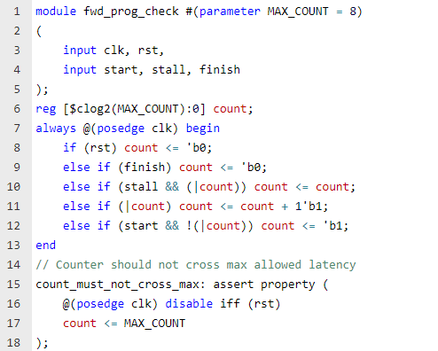
Build
Forward progress checkers are crucial for verifying a design, especially when addressing deadlock and starvation issues
Our DUT utilizes multiple parallel FSMs, increasing the likelihood of deadlock and starvation issues due to complex interactions and dependencies
High level forward progress checkers can be implemented without an in-depth understanding of the design
Notes:
Our DUT involved multiple Finite State Machines (FSMs) interacting with each other in parallel. In such complex systems, the potential for deadlocks and starvation issues increases due to the numerous interactions and dependencies between the FSMs

Slide 10
Concentrate
FV supports a wide variety of bug-hunting techniques to explore design state space beyond what is normally reached by BMC engines
Due to substantial size of our design, approximately 40% of our RTL assertions faced convergence issues
To uncover deep issues, deployed multiple bug-hunting techniques on RTL assertions to uncover deep scenarios
Till Cycle n
Till Cycle n
Cycle 0
Cycle 0
Cycle 1
Cycle 1
Cycle 2
Cycle 2
Cycle 3
Cycle 3
Formal Proof Checking
Formal Bug Hunting
Notes:
Specify which type of bug hunting we are using or describe a generic but-hunting technique.
Concentrate – previously known buggy areas, complexity hotspots,

Slide 11
Results – Statistics
Type | Statistics | Status
RTL Embedded Assertions | 6,019 | 60% Proven; 40% Bounded
RTL Embedded Covers | 7,892 | 100% Covered
Forward Progress Checkers | 9 | 100% Bounded
FV Assumptions | 791 | 100% Validated in Dynamic Simulation
Stimuli Coverage | 55.62% | Only critical modes were prioritized
Checker Coverage | 40.34% | 70% of total checker coverage is due to RTL assertions alone
Notes:
The above Coverage results are achieved through just using RTL assertions

Slide 12
Results – Starvation Bug (Scenario)
A corner case starvation scenario was caught by an RTL assertion
Due to an RTL bug, the anti-starvation timer for entry 0 in the 'transaction tracker' never times out
This starvation issue could trigger a system-wide reset, resulting in significant losses in performance and power efficiency

Slide 13
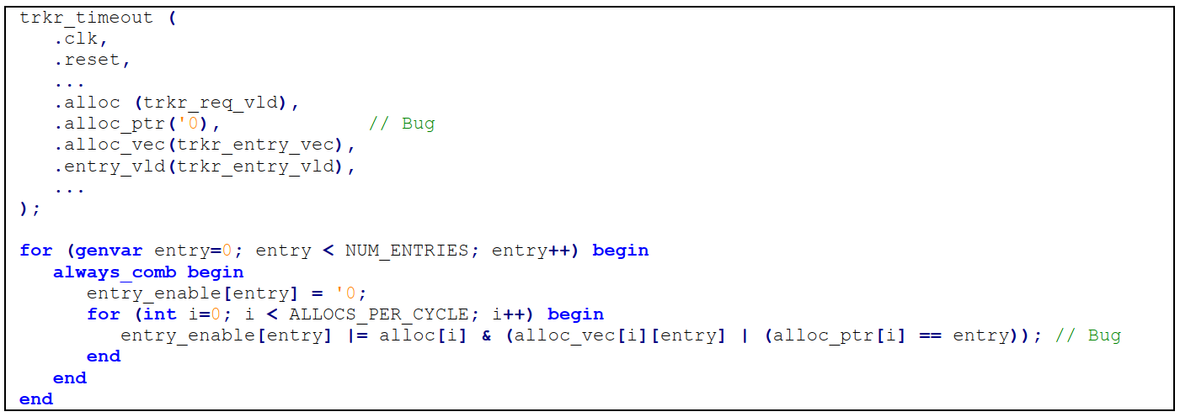
Results – Starvation Bug (Localization)
Following code snippet contains the buggy logic

Slide 14
Results – Deadlock Bug
Corner-case deadlock scenario
Found by forward progress checker
‘block_ingress_req’ expects ‘block_ingress_ack’ from bridge
‘force_bridge_to_idle’ expects ‘bridge_is_idle’ from bridge
Two requests conflict with each other (if received in proximity) leading to deadlock
This deadlock can only be resolved by a system-wide reset
Impact – hamper performance and power efficiency significantly
Fabric
block_ingress_req
block_ingress_ack
Bridge
Conflicting Requests
bridge_is_idle
force_bridge_to_idle
Memory Interface
Notes:
Other enhancements were also suggested for future generations

Slide 15
Future Scope
OBJECTIVES
TACTICAL (Current Work)
Known opportunities
RTL Assertions
High-level Checks
Proof of concept
ROI justification
VALUE OPTIMIZATION (Future Work)
Expand footprint (features, area)
Invest in design ramp
Invest in Sign-off
STRATEGIC (Beyond)
Establish Architectural proofs
Architectural FV
Leverage
best practices
Exhaustive / Sign-off FV
End-to-end FV
Bug-hunting FV
Improve process efficiency
Full-potential of FV
Specific Functions
Core Behavior
Complete Analysis
Achieve Shift-left

Slide 16
Conclusions
Snowball into Next Gen
Gave a good head start for exploring more design features/areas in the next generation of IP
Inspiring Results
Highlight the importance of FV and the benefits of formal bug-hunting to engineers and managers involved in critical projects
Right Strategy – ABC Formal
Show-cased how bug hunting using RTL assertions and E2E checkers helped find showstopper bugs with limited design ramp-up and verification effort
Never too late to apply formal
Presented comprehensive guide to apply FV in projects nearing tape-in date
Notes:
We presented a comprehensive guide for improving design quality through formal verification, even when starting near the tape-in date with impactful results highlighted in the case study
Here we show-cased how bug hunting techniques using existing RTL assertions and end-to-end checkers can be done without much design ramp-up time.
In this case study, showstopper issues were discovered just in time that saved substantial time and money by preventing re-spins.
This case study emphasizes the importance of formal verification and the benefits of formal bug-hunting techniques in the late stages of a project for engineers and managers involved in critical projects.
This last minute FV approach helped us in getting a good head start in the next generation of design

Slide 17
Questions

Slide 18
Backup Slides

Slide 19
Traditional Formal Verification Flow
DESIGN RAMP-UP
IDENTIFICATION
Ramp on design spec and understand design behavior
Identify blocks or sub-block suitable for Formal Verification
TESTPLANNING
EXECUTION
Prepare exhaustive testplan to verify DUT
Implement checkers as per testplan and clean-up of failing checkers
ANALYZE
EVALUATE
SIGN-OFF
Analyze achieved bounds for critical checkers and apply abstraction as required
Use coverage results to evaluate completeness of Formal Verification
Sign-off on design when bound and coverage criteria are met

