Slide 1
Covering All the bases: Coverage-driven Formal Verification Sign-off of Pipelined Error Detection Filter
Harbaksh Gupta, Anshul Jain
Intel Corporation

Slide 2
Agenda
Introduction
Why Formal?
Design Overview
Problem Statement
Solution
Results
Conclusion
Questions

Slide 3
Introduction
Erratic bit failure phenomenon : common issue in advanced flash memories for on-chip cache.
Modern SoCs invests great efforts in logging, correcting, and recovering from these failures.
These failures can occur due to factors such as aging, environmental conditions, and manufacturing variations.
Simulating all possible combinations and sequences of errors is practically impossible.
Dynamic Simulation needs numerous test vectors and sizeable compute.
Limited confidence in verification effort using Dynamic Simulation.
Notes:
Erratic bit failure phenomenon is one of the widely reported issue in advanced flash memories used for implementing on-chip cache memory. Modern SoCs invest great efforts in logging, correcting, and recovering from such bit failures. These failures can occur due to various factors such as aging, environmental conditions, and variations in manufacturing processes. As the word “erratic” suggest, simulating all possible combinations and sequence of errors is practically impossible. Dynamic Simulation would not only require many test vectors and sizeable compute to simulate errors, but it will also fall short of providing absolute confidence in verification effort.

Slide 4
Why Formal?
Dynamic Simulation challenges
Expensive in uncovering all the control logic flaws
Hard to generate enough stimuli to witness timed, unlikely sequence of events that can cause hardware to malfunction
Potential RTL bug escapes for uncovered input state spaces with existing test cases.
Does not guarantee absence of bugs
Formal Verification advantages
Exhaustive, breadth first analysis
Provides complete coverage equivalent to simulating all possible scenarios
Helps find issue in early stage of development, avoiding re-spins
FV can ensure that no bugs are left undetected.

Slide 5
Design Overview
The Error Detection Filter is a specialized memory structure designed to manage and track errors in high volume manufacturing environments. This is particularly useful for detecting and managing errors in L3 cache memory, where "erratic bit failures" can cause correctable ECC errors.
Key features of an Error Detection Filter include:
N entry CAM array: The filter has an N entry CAM array to log errors for unique addresses, providing an efficient way to track and manage correctable errors in the L3 cache.
Tracking correctable errors (CE): The Error Detection Filter tracks ECC errors that can be corrected, allowing for more efficient error management and prevention of further issues.

Slide 6
Design Overview
Logging defects in DFT (Design for Test) mode: The filter logs defects found during DFT mode, which is used in high volume manufacturing to detect and prevent potential issues before they arise in the final product.
Managing errors on a per set and way basis: The Error Detection Filter logs errors for unique addresses within the L3 cache, allowing for better analysis and understanding of the issues that arise.
Filtering unique correctable errors: The Error Detection Filter is designed to filter up to N unique correctable errors that may occur due to erratic bit failures, helping to maintain the integrity and performance of the L3 cache memory.

Slide 7
Statistical details of DUT
Design Statistics for Hardware Configuration with 32 CAM entries (N=32)
Flops | 1,367
Latches | 11
Gates | 47,739
Nets | 50,778
Ports | 36
RTL Lines | 2,989

Slide 8
Problem Statement
Error detection filter design has been a challenging area for several generations because of the repeated bug-escapes from IP and SOC DV environments to Silicon. Thorough analysis of bugs found in the past pointed towards following two main contributing factors:
Handling multiple types of incoming errors: In complex systems, various types of errors can occur simultaneously or at different points in time. These errors can arrive at different pipeline stages, which adds complexity to the error detection filter design.
Variable latencies: In some cases, the time taken to process and log the errors is not constant. This variability can be attributed to dependencies between different errors, which can make it challenging to design a robust error detection filter.

Slide 9
Implementation Complexities and FV Solutions
Multiple input streams of errors spread across different pipe stages:
DUT handles multiple types of errors from different stream of inputs and at different pipeline stages.
Misaligned pipeline stages hinder efficient error processing.
Misalignment can cause incorrect error detection and handling.
Negative impact on system performance and reliability.
Accurate reference model vital for proper error detection and handling.
Sampling the data at correct time and pipeline stage crucial to make well- informed decisions.

Slide 10
Implementation Complexities and FV Solutions
Aligning pipeline stages at a common point before feeding data to FV reference model.
Synchronizing data from different stages to a single reference point or stage.
Ensuring consistent and accurate processing of incoming errors.
Aligned stages allow comprehensive error analysis and detection by FV reference model.
Reduced misalignment issues, leading to precise error detection.
Simplified reference model creation due to consistent and organized data processing.
Streamlined approach to error management achieved.
always @(posedge fv_clk) begin
if (en_err_log && en_clk) begin
// error info received @stage x18
fv_tag_err_x19 <= tag_err_x18;
fv_tag_err_x20 <= fv_tag_err_x19;
fv_tag_err_x21 <= fv_tag_err_x20;
fv_tag_err_x22 <= fv_tag_err_x21;
fv_tag_err_x23 <= fv_tag_err_x22;
fv_tag_err_x24 <= fv_tag_err_x23;
fv_tag_err_x25 <= fv_tag_err_x24;
end
end
always @(posedge fv_clk) begin
// opcode info received @stage x20
if (pkt_x20.vld && en_clk) fv_pkt_x21.op <= pkt_x20.op;
if (fv_pkt_x21.vld && en_clk) fv_pkt_x22.op <= fv_pkt_x21.op;
if (fv_pkt_x22.vld && en_clk) fv_pkt_x23.op <= fv_pkt_x22.op;
if (fv_pkt_x23.vld && en_clk) fv_pkt_x24.op <= fv_pkt_x23.op;
if (fv_pkt_x24.vld && en_clk) fv_pkt_x25.op <= fv_pkt_x24.op;
end

Slide 11
Implementation Complexities and FV Solutions
Multiple CAM entries:
There were Multiple entries in the CAM .
Reference model for each individual entry is time-consuming .
Every entry in the CAM is symmetric in nature.
Symmetry utilized for simplifying reference model creation.
Symbolic variable tracks transactions on symbolic CAM address.
Symbolic variables can take on any legal value, enhancing utility.
Single reference model covers transactions for all CAM addresses.
This approach exploits CAM entry symmetry and reduces need for multiple models.
Streamlines design and verification process and ensures coverage for all possible addresses.

Slide 12
Implementation Complexities and FV Solutions
Variable output latencies:
Variable latencies pose a challenge in accurate system behavior verification.
One technique to address this issue is the use of quiesce checking.
It halts incoming traffic randomly, compares outputs after waiting for specified duration.
A Floating pulse temporarily pauses incoming traffic.
System stabilizes during quiescent period for precise output comparison.
Quiesce checking simplifies formal reference modeling.
This helps in identifying any discrepancies in the design .
Guarantees accurate and reliable resultswithout being affected by variable latencies .

Slide 13
Quiesce Checking
Floating Pulse:
A pseudo-random variable asserted only once at an arbitrary time after reset
FV tool can do something special on that pulse
Special thing can be used to tag a certain transaction, inserting a barrier, switching modes etc.
Quiesce Checking:
Quiesce checking halts incoming traffic randomly, compares outputs after waiting for specified duration.
Floating pulse temporarily pauses incoming traffic.
Quiesce checking technique mitigates latency challenges.
Achieves cycle independence in deeply pipelined design.
Cycle independence ensures evaluation without latency effects.
wire pulse;
reg pulse_seen;
always@(posedge clk) begin
if(rst)
pulse_seen <= 1'b0;
else if (pulse)
pulse_seen <= 1'b1;
end
pulse_high_only_once: assert property(
@(posedge clk) disable iff(rst)
pulse_seen |-> !pulse
);

Slide 14
Results
Formal verification analysis helped find four new bugs in a simulation clean design, most importantly the “last bug” of the design.
A couple of bugs were identified to be existing in previous generations of the IP as well.
These bugs were extremely complex to uncover due to the nature of sequence of the events required to activate them. Using this approach, we were able to suggest two enhancements which simplified the design implementation and made it more efficient w.r.t area and performance.

Slide 15
Bug Description
In one of the design bugs found through formal verification, “error flow” state machine did not transition correctly from “soft error” to “replace” state when “write operation” arrives immediately (in the next cycle) after “read error” for same address(represented by set and way).
The root-cause of the bug lies in erroneous way of matching pipeline latencies. In the waveform shown in figure above, even though “write operation” and “read error” was received for the same address (set 0x09, way 0x04), design pipeline captured the “write operation” before the address (set, way) for the write operation be updated. This led to mapping the “write operation” to incorrect address and corrupting the “error flow” state of address (set=0x09, way=0x04).

Slide 16
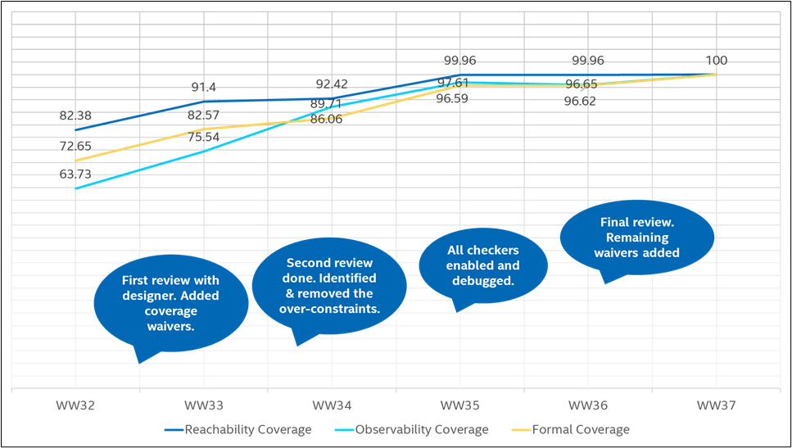
Formal Coverage
Collected formal coverage numbers during FV testplan implementation on weekly basis.
Active tracking of execution progress and waiver identification.
Increased confidence in discovering all design bugs.
Consistent enhancement of coverage metrics visible in figure.
Design state space covered systematically.
Well-defined process helped us to achieve exhaustive proofs and high-quality formal sign-off.

Slide 17
Conclusion
Found 4 bugs in a Simulation-clean design.
2 Design enhancements leading to more efficiency w.r.t performance and area.
Coverage-driven Formal Property Verification on error detection filter enabled the guarantee of “0 bugs left” on a simulation clean design which had a history of repeated bug escapes from pre-silicon IP & SOC DV analysis.
The decision to deploy formal verification on a complex design involving erratic bit errors and deep pipeline proved to be a successful strategy to gain full confidence on the quality of implementation.
High-quality formal sign-off of error detection filter design not only helped prevent re-spins and save costs, but also paved way for novel methods for verifying similar class of designs and defined a sound strategy for formal sign-off.

Slide 18
Questions
Finalize slide set with questions slide

