Slide 1
Paradigm Shift In Power Aware Simulation Using Formal Techniques
Sachin Bansal, Girish Marudwar, Sandeep Jana, Kamalesh Ghosh, Yogananda Mesa

Slide 2
Motivation
Exhaustive verification of power aware connectivity and functional properties using formal verification tools is required to shift left the simulation-based power verification flow
Traditional power aware simulation tools can be used but require additional power sequence tests in testbench which is expensive, and do NOT guarantee exhaustive verification
Thus, power aware formal verification is the need of the hour to shift left the functional verification flow to significantly reduce the overall TAT
In given diagram, connectivity of path (FF1 to FF2) will be proven by Formal tool
Supply VDDO (OFF) makes the connection broken which is caught later in simulation-based flow
Power Aware Formal Verification will exhaustively verify such scenarios earlier in the design cycle

Slide 3
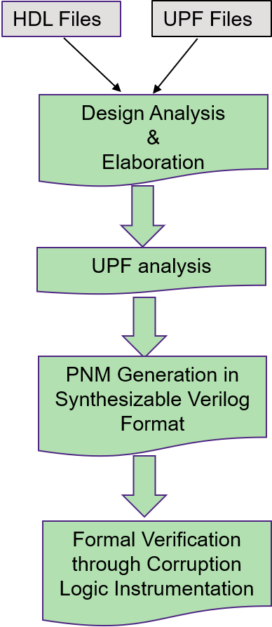
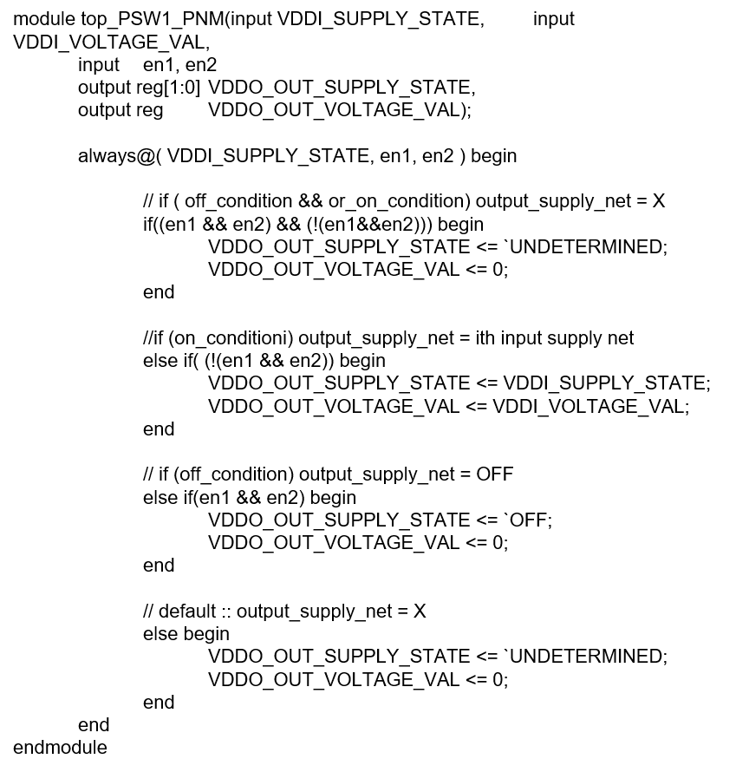
Main Idea
Power aware formal property describes a connection in which verification flow uses power network model (PNM) from VC LP and exhaustive analysis engines of VC-Formal to prove correctness of properties
This solution introduces a lightweight PNM which is dumped in a Synthesizable Verilog format which generates functional model of UPF supplies considering
Power Switches , Fine grain macros, Power Down Functions (PDF) , Power states (add_power_state), Resolution functions etc.
PNM helps to capture the FULL_ON/OFF state modeling for different supplies specified in the UPF
PNM is directly consumed by the formal tool to verify the power aware properties through corruption MUXes and minimal instrumentation
FLOW CHART
UPF Construct
Synthesizable PNM
create_power_switch PSW1
-domain PD1
-output_supply_port {VDDO VDDO}
-input_supply_port {VDDI VDDI}
-control_port {EN1 en1}
-control_port {EN2 en2}
-ack_port {ACK1 ack1}
-off_state {off {en1&&en2}}
-on_state {on VDDI {!(en1&&en2))}}

Slide 4
Main Idea
To verify the connectivity between IP1/FF1/Q and IP2/FF2/D, Formal tool needs to prove that whenever IP1/FF1/Q and IP2/FF2/D are in NORMAL (i.e. ON) state, BUF should not be in CORRUPT (i.e. off) state
Formal Testbench
VDDII_SUPPLY_STATE
Hierarchical PNM Module
VDDTOP_SUPPLY_STATE (CORRUPT/NORMAL)
VDDI_SUPPLY_STATE
VDD1_SUPPLY_STATE (CORRUPT/NORMAL)
This is dumped by VC LP in Verilog Format.
IP1
Enable condition for MUX
Enable condition for MUX
IP2
FF1
(VDD1)
FF2
(VDD2)
VDDTOP
BUF
MUX
MUX
Open Input
Open Input
1
2
Formal instrumented Mux for X Injection

Slide 5
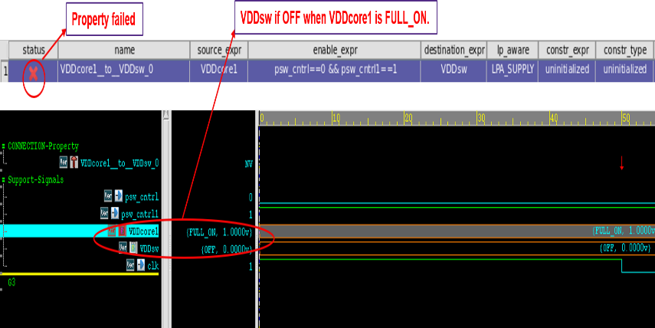
Results
The results on customer and in-house designs have established the shift-left notion by significantly reducing the TAT of overall low power functional verification by catching bugs very early in the verification flow
Examples:
Formal verification verifying if two supplies connected through Power Switch in UPF have the same state when enable expression is true
add_cc -dest VDDsw -src VDDcore1 -enable { psw_cntrl==0 && psw_cntrl1==1}
As shown in Figure, VDDsw supply state is OFF when VDDCore1 supply is FULL_ON. The enable condition is also true as shown in timing diagram
The supplies are not functionally connected even they can be structurally connected
PG PIN Connectivity property falsified between supplies VDDCore1 and VDDsw which are connected through power switches due to resolution function.
add_cc -dest VDDsw -src VDDcore1 -enable { psw_cntrl==0 && psw_cntrl1==1} -lpa_type LPA_SUPPLY
UPF
VDDCore1
Parallel Resolution
VDDsw

Slide 6
Results & Summary
Multiple SOC level designs have used this flow for validating
PG Pin connectivity
PA Functional connectivity
Handled many types of UPF use models
Handled macros, lib cells, RTL vs inferred power elements.
Teams were able iterate multiple times in a single day
Memory required is 150Gb to 350GB (depends on design size and no of connections to check)
Productivity improvements
Left shift of 3-4 weeks
Effort reduction to 60% for low power checks at subsystem level
Left shift in Power Aware Verification with quality UPF release for simulation
Potential reduced no of ECOs
Has potential for full low power signoff in future

Slide 7
Questions

