Slide 1
FV: A Robust Solution for Tackling Design Complexities – A Case Study on In-Band ECC
Yash Sachin Pawar, Aarti Gupta, Disha Puri
Intel Corporation

Slide 2
Agenda
Design Complexities
Case Study – In Band ECC
Comprehensive Verification Technique
Results
Next Steps

Slide 3
Design complexities

Slide 4
Design Complexities
Sequential Complexity
Spatial Complexity
Computational Complexity
Spanning multiple cycles
Initialization
Timeout
FIFO’s …
State Space Exploration
Memories
Large Data Bus
Arithmetic Algorithms
FP
Hashing
ECC

Slide 5
CASE STUDY – IN BAND ECC

Slide 6
In Band ECC : Design Overview
Region Reserved for ECC
ECC
Initialization
Module
Rd req
Wr req + Data
Recent Syndrome Buffer
ECC
Computation
Rd Data
Memory
Notes:
ECC bits have to be done and write is done using xor, so they need to be initialized to 0 initially to avoid x prop later. If performance is of paramount importance, the sideband (extra bits in the bus between the processor and external memory) scheme is helpful because the ECC computation and checks can be carried out in parallel with the main data transfer. However, using sideband signals is not only wasteful of board real estate and component sizes, but also imposes power and cost penalties.
In space-constrained systems and other applications where sacrificing a bit of performance is an acceptable trade-off for memory protection, architects have come up with the concept of in-band ECC.
'In-Band' refers to the fact that the ECC is stored within the same memory space as the main data (by reserving an address range, and disallowing its use by the memory clients inside the SoC / processor). In simple terms, whenever data is written out to the external memory, the ECC corresponding to it is also written out to a corresponding reserved address. Whenever data is read from the external memory, the corresponding ECC is also read back, and the memory controller inside the SoC / processor does the data integrity check as required. This scheme is not performance-friendly if operated with the same 64-bit data / 8-bit ECC granularity used in sideband configurations, as the effective memory bandwidth would get cut down by more than a factor of two.
Instead, most in-band ECC schemes operate with data block sizes equivalent to the burst size of the external memory. DRAM is accessed in sets of cycles (termed as the burst length - BL). With BL8, and a 64-bit memory bus, each access set would be to 64 bytes (512-bits). I am hugely oversimplifying things here, but readers should be able to catch the drift.
Now, SECDED for 512 bits can be achieved with 16 ECC bits. There is an additional complication here because accessing the external memory for reading and writing 2 bytes is highly wasteful (remember the BL8 / 64-byte access set). To improve memory bandwidth utilization for ECC accesses, the memory controller includes an 'ECC cache' where these ECC values are stored (and preferably flushed out only if they can be bunched together in a single write burst). Similar to any caching scheme, this can improve bandwidth utilization but can't always be guaranteed to avoid inefficiencies. Sometimes, it may be necessary to perform read-modify-writes to the external memory, and this can bring down overall memory bandwidth utilization. Intel's 2019 patent filing provides more detailed technical insights into the likely architecture of the in-band ECC block in the memory controller.

Slide 7
FV VERIFICATION STRATEGY

Slide 8
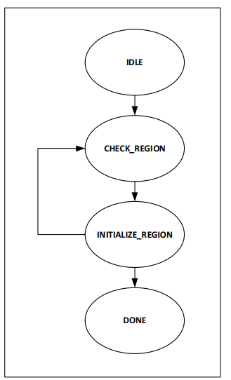
ECC Initialization Module: Challenges
Spatial
Computational
Sequential
FSM to block regular read and write to protected regions
Even minimum address space (32x32 MB) -> ~10⁶ clock cycles.
Impossible to verify in FV without abstractions.
IDLE
Initialize Region#1
Initialize Region#N
DONE
ECC Initialization Sequence
Out of Reset State
Millions of Clock cycles

Slide 9
ECC Initialization Module: Verification Strategy
Apply cut-points on state-elements
First cycle constraint: Any valid state in ECC initialization sequence can be taken
Prove next state is always a legal state
Prove any symbolic protected address is initialized
IDLE
Initialize Region#1
Initialize Region#N
DONE
ECC Initialization Sequence
Out of Reset State
With Abstraction:
Multiple initial states allow shorter path to buggy state
Without Abstraction:
Breadthwise FV search from reset state may not reach buggy state
Notes:
Prove:
Always start from legal state : initial constraints (symbolic
Next state is always valid state (converted to assertions)
If I choose a protected symbolic address, then is it initialized

Slide 10
ECC Datapath Block: Challenges
Spatial
Computational
Sequential
Configurable Protection Levels :
SECDED: Single Error Correction, Double Error Detection
ZECTED: Zero Error Correction, Triple Error Detection
Granularity (Dynamic, per Xaction): 32B/64B
Complexity:
Computation:
Max-corner: Detect 3 errors in 512b -> (512 choose 3) combinations of corruption
Control+Data Mix:
Per transaction configurations, like granularity selection, data-chunk masks, data-chunk counting, makes datapath verification complex
DUT:
Writer module: generates ECC (check) bits (before data gets stored in memory)
Reader module: detects & corrects soft-errors (random-bit flips while data was stored in memory)
Notes:
ECC Datapath – 2 separate modules – EE writer and reader module. Writer takes data and generates ECC or check bits, redundant bits which can be used to recover data in case of soft errors. This data plus checkbits makes write code word. This code word is data stored in memory. In memory, it can be corrupted. Some bits can flip (on data or check bits). When we read data, it may not be equivalent to write data. Read code word goes through reader module which checks and tries to correct. It gives out dout and some error signals which indicates if error was indeed present. 0 – no error, CE – correctable error, DUE – detecteable but uncorrectable error. ECC have diff protection levels. In this module, we had 2 configurable protection levels: SECDED: Single Error Correction, Double Error Detection (if single bit flip, corrected; double bit is detected but not corrected); ZECTED: Zero Error Correction, Triple Error Detection (no correction but upto 3 bits signalled)
Reader;s output is as per ECC scheme is job of verif.
Complexity – max corner case : 512 choose 3 combinations of corruption, 22million combinations. Apart from this, there was mix of control due to multiple granularity.

Slide 11
ECC Datapath Block: Verification Strategy
Specialized FV Technique: Symbolic Simulation; Toolset: Forte (Intel Internal)
Input and Output BDDs analyzed to guarantee correctness of ECC algorithm
[“D[i]”,…,“D[0]”]
CodeWord CW_{w}
[“C[j]”,…,“C[0]”]
D_{IN}
Writer
Corruption C
D_{OUT}
Reader
Err (NE/CE/DUE)
Read CodeWord
Generic properties
n Correction
n+1 Detection
CW_{R}
(Countbits(C) = 0) ⇒ NE and D_{OUT} = D_{IN}
0 < Countbits(C) <= n ⇒ CE and D_{OUT} = D_{IN}
(Countbits(C) = n + 1) ⇒ DUE
Notes:
Use symbols, symbols on each bit of inputs – data and corruption. Writes symbols across circuits and generates Boolean equations called BDD’s for each internal nodes. Boolean expron dout and error signals. Prove above properties based on scheme. SECDED scheme above, no error and 1 bit flips. Symbolic indexing. 534 bits of corruption, 534 corruption variables, only 1 bit is problem…make symbolic vector… 10 bits (corruption index) tells which bit is high. If variable is all 0, bit 0 in corrupted.

Slide 12
Recent Syndrome Buffer: Challenges
Spatial
Computational
Sequential
Fully Associative Cache
The tag width for this cache is 34-bit address.
Each new read can hit and miss with the cache, to know the result, the incoming read address serving as a tag needs to be matched with all valid addresses (tags).

Slide 13
Recent Syndrome Buffer: Verification Strategy
Create Abstraction model with two states of memory, one where symbolic tag exists in buffer, and one where it is absent
Prove that the symbolically chosen tag provides correct hit/miss response and does not get evicted till it has no pending consumers
(tag == sym_tag) OR (tag != sym_tag)
Memory Abstraction:
Height of memory replaced with one line of memory representing the transaction that is tracked

Slide 14
Replacement of the RTL modules with Abstract Models
The properties that are proved earlier are used as constraints to drive outputs of Initialization-Module/RSB.
Helps in convergence of end-to-end properties
Black-boxed module
Abstract Model

Slide 15
RESULTS

Slide 16
Results
The approaches discussed above drastically decreased design complexity and helped uncover 20 bugs.
14 of these were discovered in the control and data-transport logic with the help of the ECC initialization sequence abstraction.
The abstraction of the cache memory and tracker caught three bugs.
Each of these three were caught within 10-20 cycles in the abstracted formal environment, which would have otherwise required at least 400 cycles to be caught.
Three critical datapath bugs were discovered using the ECC verification approach.
One of these had an incidence rate of 0.000002% and would have probably gone undetected by all other forms of verification, had this verification strategy not been applied.

Slide 17
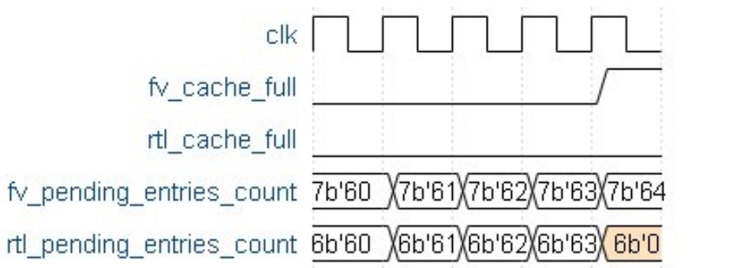
Example of an uncovered bug
While Verifying the RSB cache controller separately with IVA, we found a mismatch in full indications between RTL and FV model.
The cause was found in RTL counter being 6 bits, not sufficient to hold value 64, which is size of cache. This scenario is difficult to achieve if the design starts empty(rtl_pending_entries_count=0).
After Applying Initial Value Abstraction, we have this scenario where we start from advanced state where (rtl_pending_entries_count=60).
Thus, using Initial Value Abstraction we can uncover bugs which are at deeper bounds and difficult to be proved without use of complexity reduction methods

Slide 18
NEXT STEPS

Slide 19
Recap and Next Steps
Sequential Complexity
ECC Initialization Module
Interesting Cases at Deeper Bounds
Spatial Complexity
Recent Syndrome Buffer
Input Combinations Unmanageable
Computational Complexity
ECC Computation Block
Complex Arithmetic Manipulations
ECC
Initialization
Module
Rd req
Wr req + Data
Recent Syndrome Buffer
ECC
Computation
Rd Data

Slide 20
Acknowledgements
We would like to acknowledge other FV engineers, designers and management who have played a key role in success of this project.

Slide 21
Questions

