Slide 1
Quiescent Formal Checks (QFC) for Detecting Deep Design Bugs – Sooner and Faster
Somesh Mishra, Mayank Kumar, Ketan Mishra, Anshul Jain, Bharath Varma Gottumukkala

Slide 2
Agenda
Introduction
Concept of Quiesce State in Software domain
Concept of Quiesce State in Formal domain
Problem statement
Proposed Solution
Use Cases
Our Implementation Experience
Conclusion

Slide 3
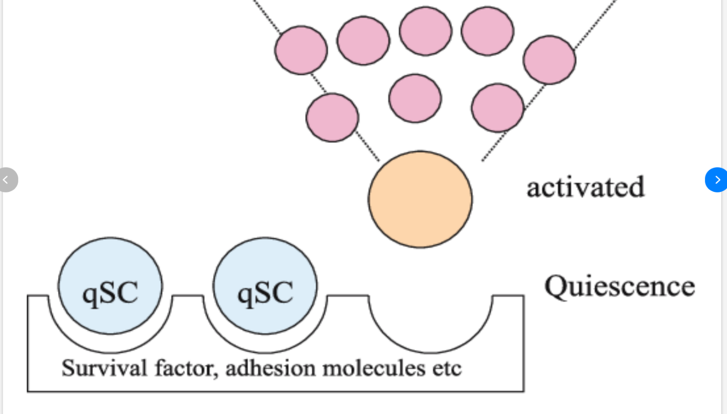
Introduction
Quiesce State - A silent system state
Quiesce Command
Force block all Incoming transactions
QUIESCE COMMAND

Slide 4
Agenda
Introduction
Concept of Quiesce State in Software domain
Concept of Quiesce State in Formal domain
Problem statement
Proposed Solution
Use Cases
Our Implementation Experience
Conclusion

Slide 5
Quiesce – Software Edition
Quiesce State in DBMS
A state in which the database is set into a read-only mode
All modifications to the data are halted
Applications of Quiesce State in DBMS
Schema changes
Database Replication
Backup and Recovery
Notes:
In Quiesce state, normal transactional activities and modifications are halted

Slide 6
Quiesce – Software Edition
Quiesce State in Networking
A state in which certain network functions are temporarily suspended
Applications of Quiesce State in Networking
Network Redundancy
Load Balancer Maintenance
Virtualization and Migration
Notes:
In Quiesce state, normal transactional activities and modifications are halted

Slide 7
Agenda
Introduction
Concept of Quiesce State in Software domain
Concept of Quiesce State in Formal domain
Problem statement
Proposed Solution
Use Cases
Our Implementation Experience
Conclusion

Slide 8
Quiesce – Formal Edition
What is Formal?
A technique to ensure correctness of complex designs using mathematical proofs
How is Quiesce Command achieved in this context?
A floating pulse is used to block incoming transactions
Quiesce command

Slide 9
Quiesce – Formal Edition
What is our view of Quiesce State in Formal?
There are no input transactions
Outside dependencies are resolved
The state formed will be Quiescent State.

Slide 10
Agenda
Introduction
Concept of Quiesce State in Software domain
Concept of Quiesce State in Formal domain
Problem statement
Proposed Solution
Use Cases
Our Implementation Experience
Conclusion

Slide 11
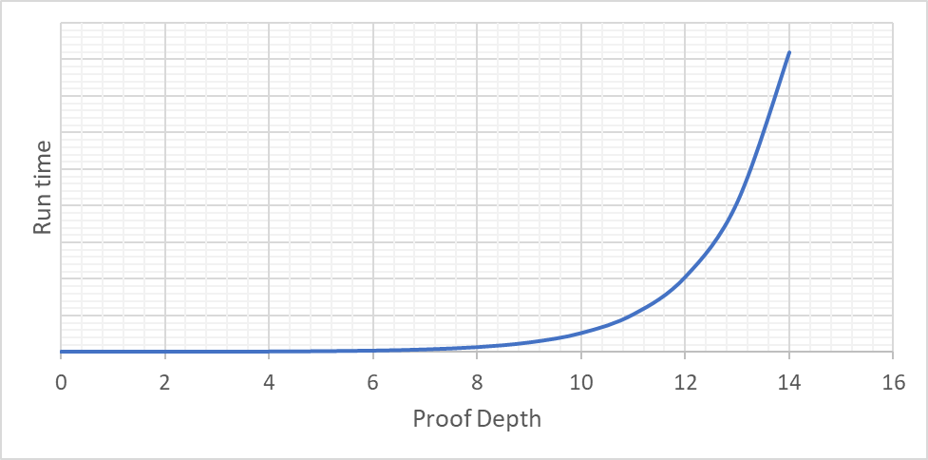
Problem Statement
Formal Complexity
Formal tries to explore all possible states and transitions
However, the same attribute introduces challenges – State Space Explosion
As a result, Formal tools reach a point where they cannot continue to explore further states

Slide 12
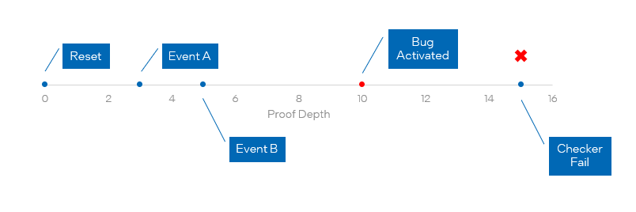
Problem Statement
Bug Activation-Detection Gap
Sophisticated bugs often exhibit a “warm-up” period before causing issues
Bugs with such “warm-up” period can be challenging to identify and are often missed due to high complexity

Slide 13
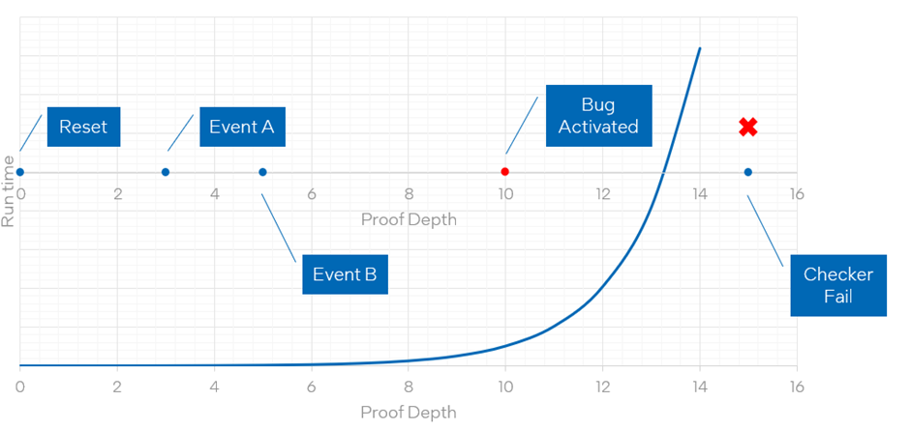
Problem Statement
Undetected Bugs
The combination of formal complexity and bug activation-detection gap can result in undetected bugs
We often require additional techniques to tackle these challenges

Slide 14
Agenda
Introduction
Concept of Quiesce State in Software domain
Concept of Quiesce State in Formal domain
Problem statement
Proposed Solution
Use Cases
Our Implementation Experience
Conclusion

Slide 15
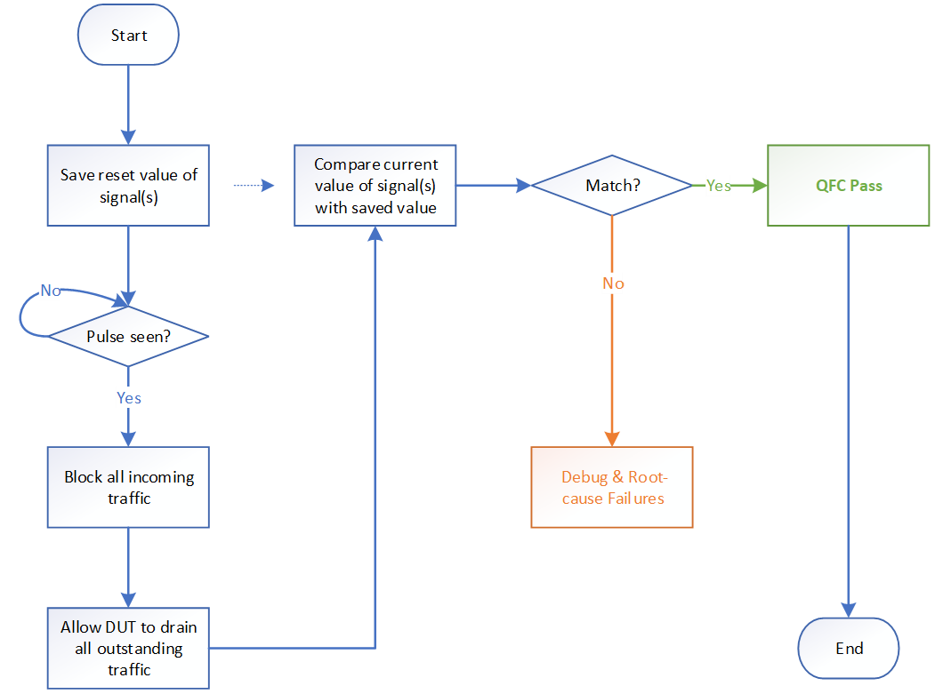
Proposed Solution – Quiesce Formal Checks
QFC Methodology

Slide 16
Proposed Solution – Quiesce Formal Checks
Identifying Hotspots
When applied to specific parts of a design can yield highly beneficial results
Common Hotspots are
FSM
Counter
Validator Signals
Furthermore, Quiesce Formal Checks can be applied to signals that are expected to stabilize when design has entered a Quiesce state

Slide 17
Agenda
Introduction
Concept of Quiesce State in Software domain
Concept of Quiesce State in Formal domain
Problem statement
Proposed Solution
Use Cases
Our Implementation Experience
Conclusion

Slide 18
Use Cases
Resource Leakage
Often occurs when there is an implementation error while capturing or releasing a resource
In corner-case scenarios, these error can become more apparent
Adverse Effects of Resource Leakage
Performance degradation
Starvation
Deadlocks

Slide 19
Agenda
Introduction
Concept of Quiesce State in Software domain
Concept of Quiesce State in Formal domain
Problem statement
Proposed Solution
Use Cases
Our Implementation Experience
Conclusion

Slide 20
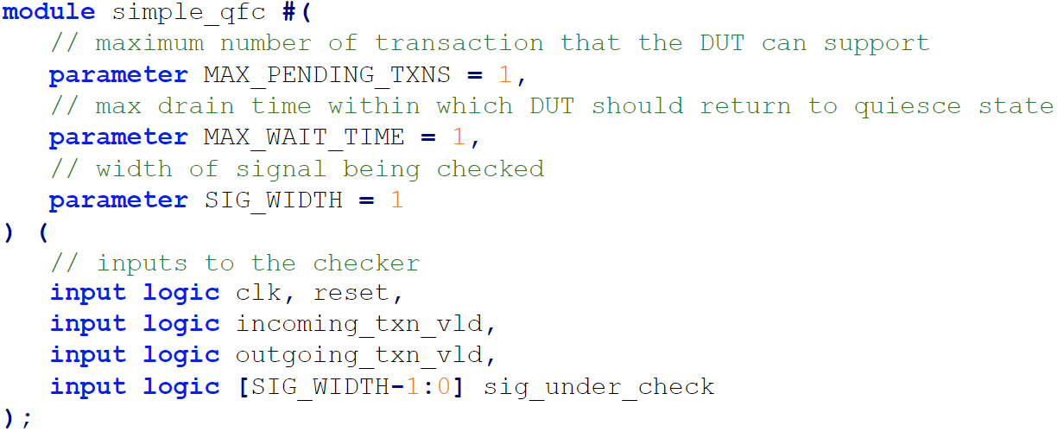
Our Implementation Experience
Our module simple_qfc provides checkers for testing the behavior of a DUT at Quiesce state
The module supports several parameters
MAX_PENDING_TXNS
MAX_WAIT_TIME
SIG_WIDTH
The module has three main inputs
incoming_txn_valid
outcoming_txn_valid
sig_under_check

Slide 21
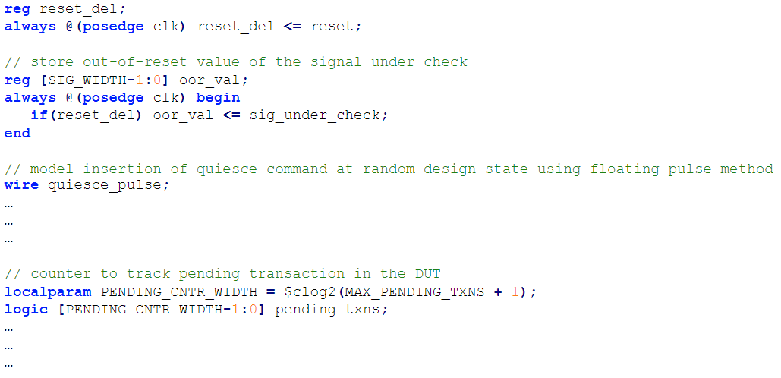
Our Implementation Experience

Slide 22
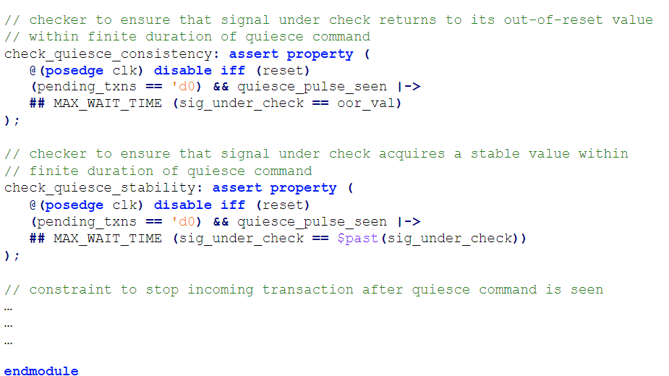
Our Implementation Experience
The two main assertions at Quiesce state would be
check_quiesce_consistency
check_quiesce_stability
Additionally, there is an assumption that ensures that no new incoming transactions are allowed after the quiesce command has been seen
input_stop_at_quiesce_indication

Slide 23
Conclusion
QFC is an innovative approach aiming to improve efficiency and effectiveness of Formal verification for complex designs.
QFC offers a promising bug-hunting strategy that can overcome some of the limitations faced by conventional FV techniques.
We encourage adoption of Quiesce check technique to unlock its full potential in optimizing design verification in various scenarios.
Further research and development in this area could lead to even more powerful and practical verification methods for large-scale industrial designs.

Slide 24
Questions

