Slide 1
Revolutionizing Proof Convergence for Algorithmic Designs: Combining Multiple Formal Verification Tools
Suraj Kamble, Rajib Lochan Jana, Disha Puri

Slide 2
Agenda
Floating point Arithmetic and Design Overview
Traditional Formal Verification and its Challenges
Introduction to Tool Agnostic Flow
Overall Proof Strategy
Interesting Corner case scenarios
Optimizing the next generation FV
Conclusion
Future Work

Slide 3
Real life & FV
FV Tool 1
FV Tool 2
FV Eng
FV Tool 3
Let's Start with the childhood story (nostalgic?)
FV Tool n
Moral of the story
Unity is strength
Is it true for FV?
FV problem
Image Courtesy:- https://kathakids.com/folktales/unity-is-strength
Let’s explore SPFMA/DPFMA design

Slide 4
Why FMA Design?
Integral part of any execution unit
Hard problem for Formal Verification
Can optimized uses of multiple tools help here to ease this problem?
Let’s explore 😊

Slide 5
Floating point SP/DP Multiply Add: Case Study
A
B
C
MUL
(A.s ^ B.s) (A.e + B.e) (A.m * B.m)
A * B
ADD
(P.e != C.e |->
shift P.m)
Image Courtesy:- https://en.wikipedia.org/wiki/IEEE_754-1985#Single_precision
A, B, C, OUT can be single precision (SP MAD) or Double precision (DP MAD)
Sign = A.s, B.s
Exponent = A.e,B.e,C.e,P.e
Mantissa (Fraction) =A.m,B.m,P.m
OUT =A * B + C

Slide 6
Design Overview
A
Preprocessing
(source modification function)
A’
Data computation
(A’ * B’ + C’)
A”
Postprocessing (saturation output )
B
B’
B”
Output
C
C'
C”
mant C’
Align
Invert
Adder
Complement
mant A’
Normalize
Rounding
Mul Block
LZA
mant B’
sign, exp result

Slide 7
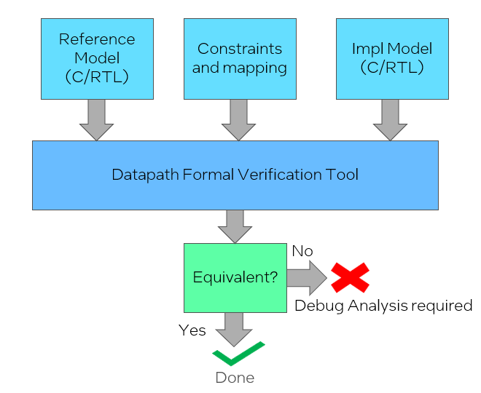
Datapath Formal Verification (SPFMA/DPFMA Design)
Untimed C/C++ Model
Pipelined RTL
Input space is huge
Focus is on proving single transaction
Run E2E setup for ~48 hours
Equivalent?

Slide 8
Complexity Reduction: Standard case split on inputs
A | B | C
N | N | N
N | N | D
N | D | N
N | D | D
D | N | N
D | N | D
D | D | N
D | D | D
Inf/Nan | Inf/Nan | Inf/Nan
Single Precision |  | Double Precision |  | Number Represented
Exp [30:23] | Mantissa [22:0] | Exp [62:52] | Mantissa [51:0]
!= 0xFF | Any value | != 0x7FF | Any value | Normal Number
= 0 | != 0 | = 0 | !=0 | Denormal Number
= 0xFF | =0 | = 0x7FF | =0 | Infinity
= 0xFF | !=0 | = 0x7FF | !=0 | Not a Number(Nan)
Nan
Denorms
Nan
-∞ max- -1.0 min- ±0 min+ +1.0 max+ +∞
N : Normal Number
D : Denormal Number
Infinity
Zero
Infinity
Normal numbers
Normal numbers

Slide 9
So far……
Pure Datapath Check
No more FV setup issues
Complexity reduction technique
Aimed Single transaction
Proof ran for 48 hours
Standard case split on Inputs
Still facing convergence issue
Created C2RTL setup
Step-by-step Approach:
Impact of Deep Drive:
More Time & Resource investment
Need Design expertise
Chance to missing deadline
Un-convergence may lead to the escape of bug
Problem
Level 0
Multiple tools available, can I use them
SP-1
SP-2
SP-n
Level 1
Tool Agnostic
Flow
SP-2.1
SP-2.n
Level 2

Slide 10
Tool Agnostic Flow: Challenges & Approaches
Setup
SVA
Creating Multiple Verification Setups
Handling Design Constraints
Compilation
Design Constraints
Design Constraints
Approaches:
Checkers
Compilation
Creating Multiple Verification Setups
Design compilation, mapping and Checkers are in tool specific format
Assume SVA of Design Constraints
Handling Design Constraints
Coded Design Constraints as SVA (portable/reusable)
Reduce setup time
DV integration gives confidence on FV Setup
Assume SVA
Checkers
Setup
FV SETUP
Compilation & Checkers -> 20%
Design Constraints -> 80%

Slide 11
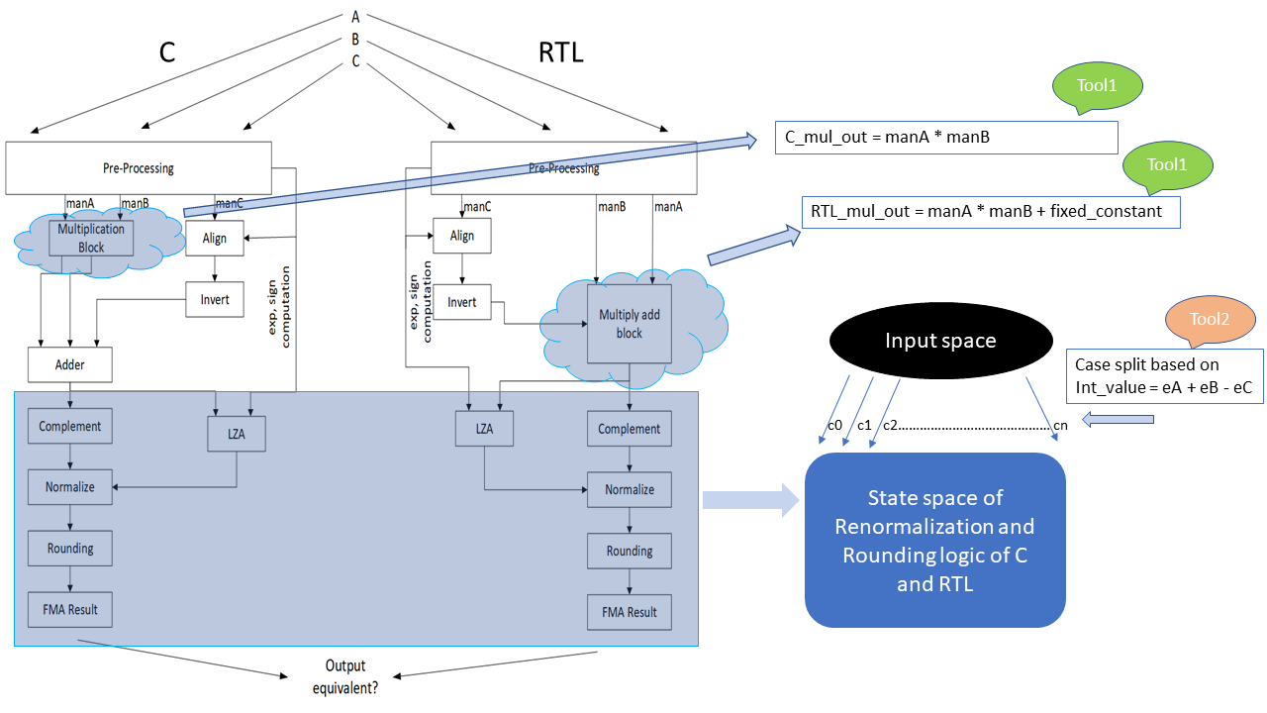
SPFMA/DPFMA: Level-1 Subproblems

Slide 12
Overall Proof Strategy: SPFMA
Standard case split
Assume guarantee
Tool Agnostic flow
Primary inputs
A,B,C
NNN
DDD
Standard Casesplit
NND
DDN
NDN
DND
NDD
DNN
Multiplier Assume Guarantee
Proved and Assumed Multiplier Block
 | Gen 1(C vs RTL)
 | SPFMA | DPFMA
E2E setup | Unconverged | Unconverged
Standard case split | Unconverged | Unconverged
Tool Agnostic flow | Proved (~15h) | Proved (~25h)
Each Casesplit result
out_cs0 out_cs1 out_cs2 out_cs3 out_cs4 out_cs5 out_cs6 out_cs7
Final output
OUT

Slide 13
Overall Proof Strategy: DPFMA
Standard case split
Assume guarantee
Tool Agnostic flow
Primary inputs
A,B,C
Input constraint: spec limitation(POC)
NNN
Proved and Assumed Multiplier Block
Multiplier Assume Guarantee
Casesplit (level1)
0 1 ………...7…………12………….…….24………....31
Level 2 casesplit for unconverged cases
 | Gen 1(C vs RTL)
 | SPFMA | DPFMA
E2E setup | Unconverged | Unconverged
Standard case split | Unconverged | Unconverged
Tool Agnostic flow | Proved (~15h) | Proved (~25h)
Casesplit (level2)
0 1 2……………………………….126 127
Final output
OUT

Slide 14
Bug Revealed: SPFMA
Bug Scenario:
Denorm mode is off and intermediate value before round up is Max Denorm, then the RTL output is zero.
RTL flushes intermediate value (Max Denorm) to zero before round up.
Denorms
Scenario
-∞ max- -1.0 min- ±0 min+ +1.0 max+ +∞
A | 0x0B381E20
B | 0x2DF2067E
C | 0x808002B8
Expected output | 0x80800000
Impl output | 0x0
Zero
Min- Normal
0x80800000
Max- Denorm
0x807FFFFF
Criticality:
Corner case bug; One in billion cases($2^{32}$ possible values for Internal signal)
Some few input combinations from $2^{96}$possible values

Slide 15
Bug Revealed: DPFMA
Bug Scenario:
Denorm mode is off and intermediate value before round up is Max Denorm, then the RTL output is mismatched with expected value.
RTL flushes intermediate value (Max Denorm) to zero before round up.
Not revealed even after running the setup for 50hrs.
Denorms
Scenario
-∞ max- -1.0 min- ±0 min+ +1.0 max+ +∞
A | 0xA3E59B1BB76CF3A6
B | 0x1F39C4CE02FEB9A5
C | 0x0331660EC998B4B7
Expected output | 0x8010000000000000
Impl output | 0x8000000000000000
Zero
Min- Normal
0x8010000000000000
Max- Denorm
0x800FFFFFFFFFFFFF
Criticality:
Corner case bug; One in billion cases($2^{64}$ possible values)
Some few input combinations from $2^{192}$possible values

Slide 16
Optimizing the next generation FV
Now 1st Gen RTL became Golden
Easy Setup bringing up
Easy debug
Less abstraction difference
Low effort high ROI
 | Next Gen (RTL vs RTL)
 | SPFMA | DPFMA
E2E setup | Unconverged | Proved (~5h)
Standard case split | Unconverged | NA
Tool Agnostic flow | Proved (~3h) | NA

Slide 17
Conclusion
FV is primary vehicle for Execution Unit instructions.
Reported 10+ bugs including more than 2 corner cases
Automated weekly regressions to catch early bugs without manual efforts
Tool agnostic approach is used to get complete convergence.
100% convergence on unit much before deadlines
Huge shift left achieved
Integration of Design constraints (SVA) with DV gives confidence on FV Setup.
Simulation + SVA to prevent over-constraint env
Vendor collaboration to improve engines for complex blocks

Slide 18
Future work
Spec
Compilation
Input Mapping
Output checkers
Design Constraints
(SVA creation Env)
Setup Database
E2E Setup
Impl
Tool Info
Generation Env
Convergence Techniques
Updating setup with Convergence Techniques
No
Convergence Env
Converge ?
Yes
End
Proof
Setup with Convergence Technique
E2E Setup
FV Tool Execution Env
In-House Tool for TAF
TAF Architecture

Slide 19
Questions

