Slide 1

A Generic Verification Methodology for Chip to Chip Interrupt Handling in a Multi-Chip SoC (3DIC)
Vignesh Adiththan, Padma Vutukuru, Lalithraj Mailappa, Sekhar Dangudubiyyam
Samsung Semiconductor India Research (SSIR)

Slide 2
Agenda
Introduction
Overview of GIC 600 and configuration in SoC
Applications
-Inter chip interrupt routing
-Inter chip low power wake request generation
-Dynamic interrupt off loading
-Co Simulation based interrupt verification environment
Results
Conclusion

Slide 3
Introduction
Complex Logic
Interrupt Priority
More Gates-> More Area
Interrupt Routine
3DIC
More Area In smaller Form Factor
Interrupt Routing Sequence
Multiple SoC- Multiple CPU – Multiple GIC
Low Power Wake Request
Inter GIC – Inter CPU Routing improves Interrupt Handling Performance
Notes:
With the advent in Information Technology, emergence of Internet of Things, AI gadgetry, the need for VLSI in chip manufacturing has become inescapable.
This demand and growing sophistication of applications have been continuously pushing the design and manufacturing of integrated circuits and electronic systems to unimaginable levels of complexity.
Verification of this sophisticated complex design is also a challenge.
It is well known that verification is a major time and effort drain in today’s design process.
Assertion based verification is one among the various widely used verification methods of these complex design.
Based on the design complexity the assertion failures may vary from 1K to 100k.
It is practically impossible to manually debug these huge failures.
This in turn will delay the verification closure and hence the time to market.
Debugging also requires the domain knowledge.
We all know the famous Statement made by Gordon Moore, that “Number of transistor in an Ic doubles every eighteen months”
What is driving this law?
The “innovation engine”, that fuels Moore’s law is the semiconductor process technology.
Semiconductor technology is growing day by day , with the advent in the semiconductor technology, we were able to develop complex systems.
All these comes with a cost.

Slide 4
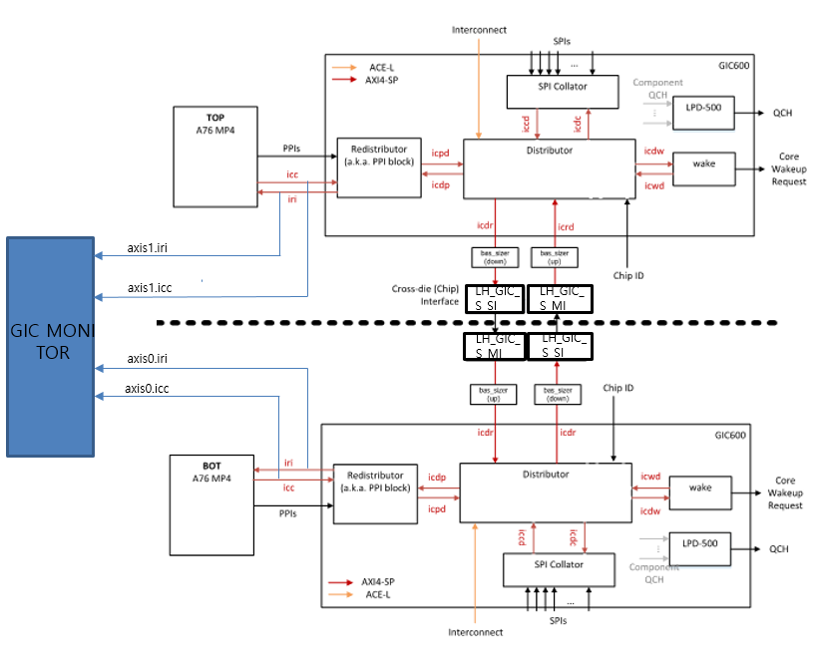
Overview of GIC600 and Configuration in SoC
Unexpected Interrupt checker
Interrupt type checker
Interrupt task checker
Interrupt process checker
Interrupt rising before enable checker
Interrupt rising checker
Interrupt Level keeping checker
Interrupt drop checker

Slide 5
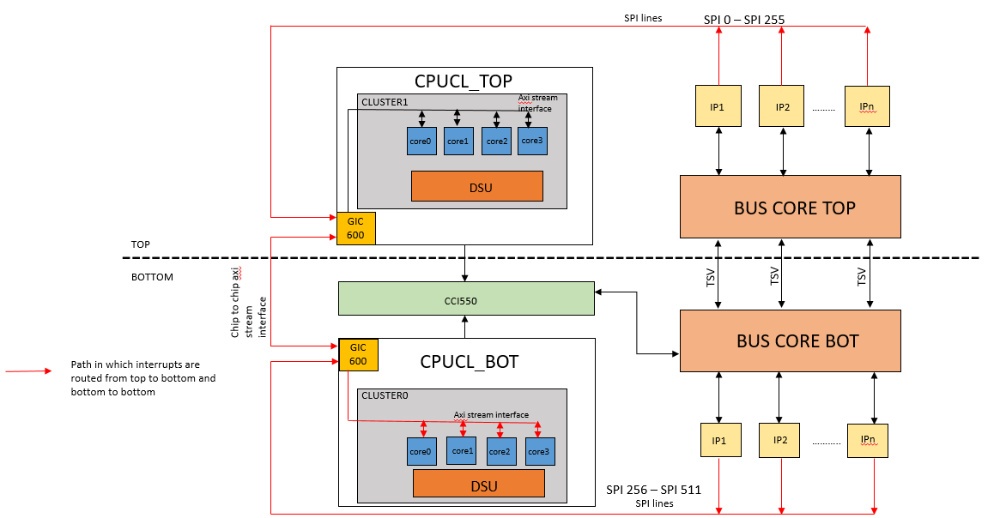
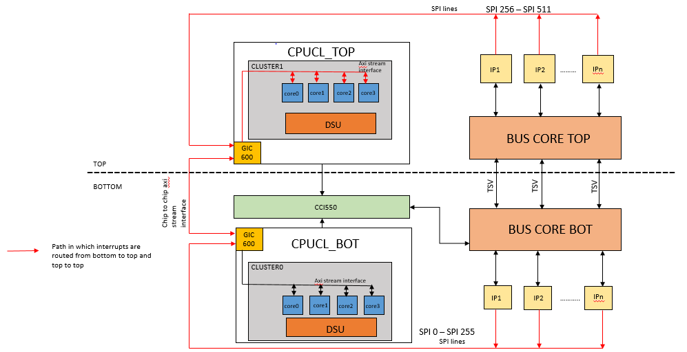
Applications-Inter chip Interrupt Routing

Slide 6
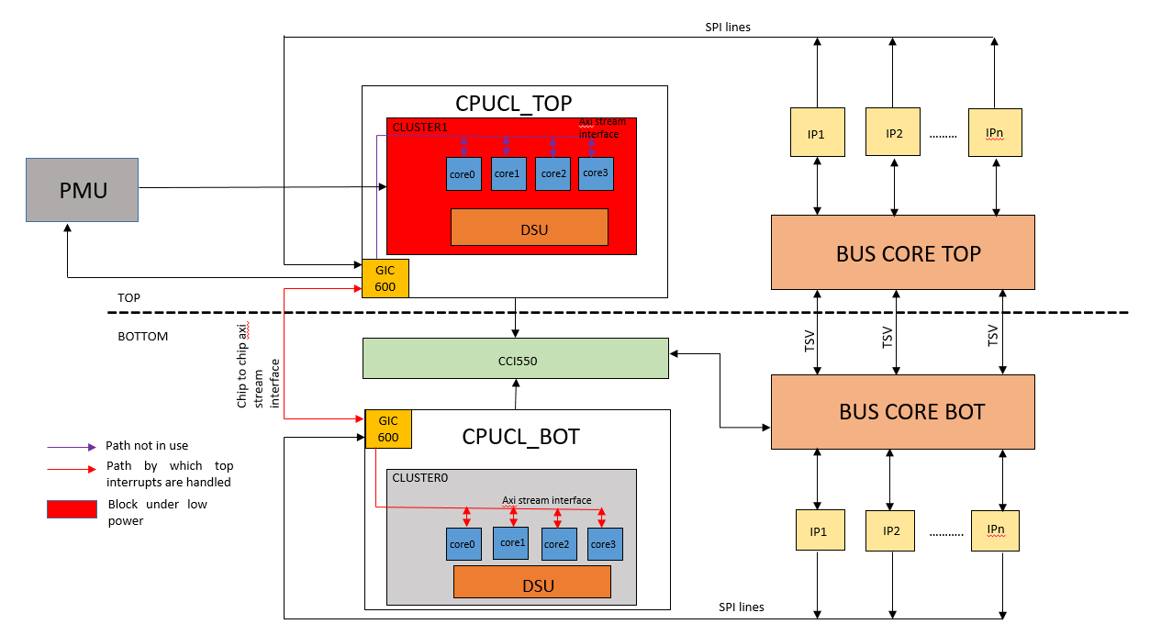
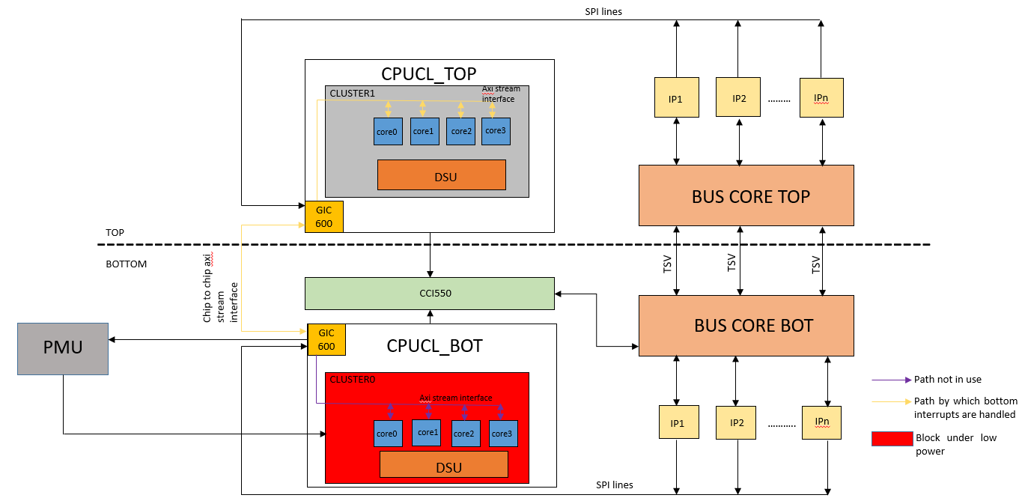
Inter Chip Low Power Wake Request Generation
(Interrupt Routing Mode)
Auto Route
User defined routing
Wake request to low power core
Wait for cores to be free to process
Dynamic Interrupt Off Loading

Slide 7
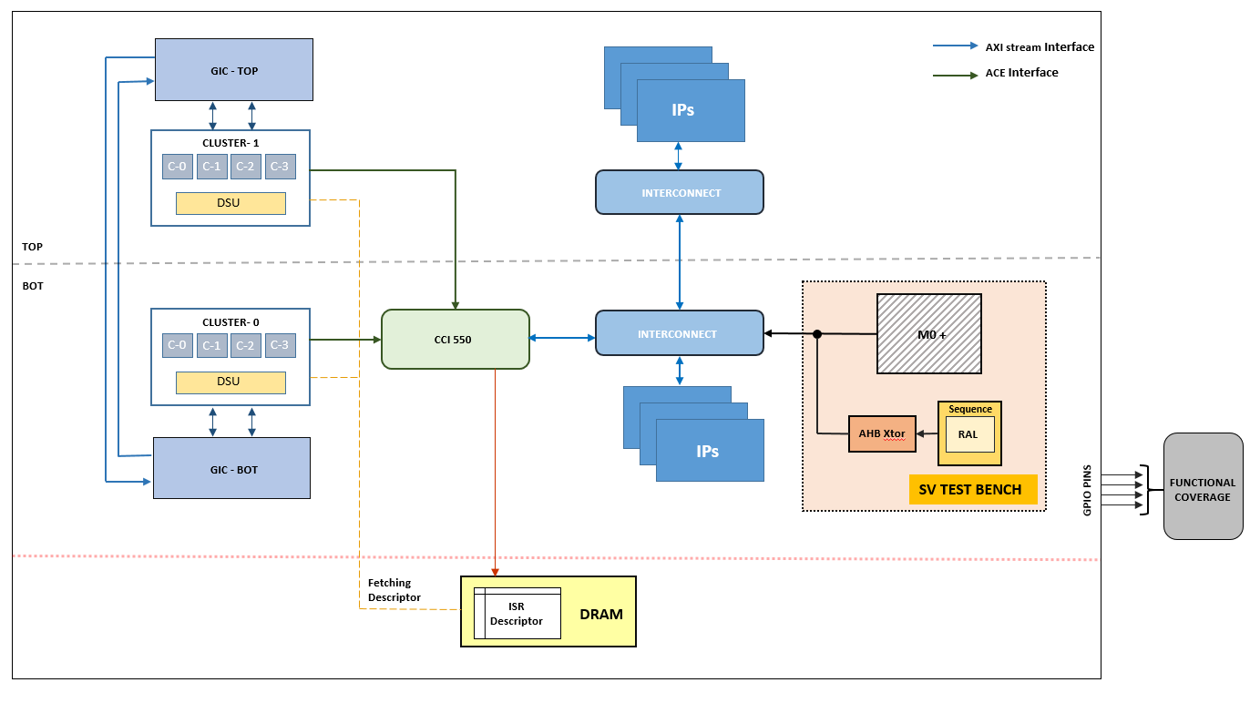
Co Simulation Based Interrupt Verification Environment
SV and C based verification environment with static ISR image.
Components
  Interrupt generator
  Interrupt monitor
  ISR Descriptor
  Interrupt status checker
  Interrupt clear
  GPIO based interrupt functional coverage

Slide 8
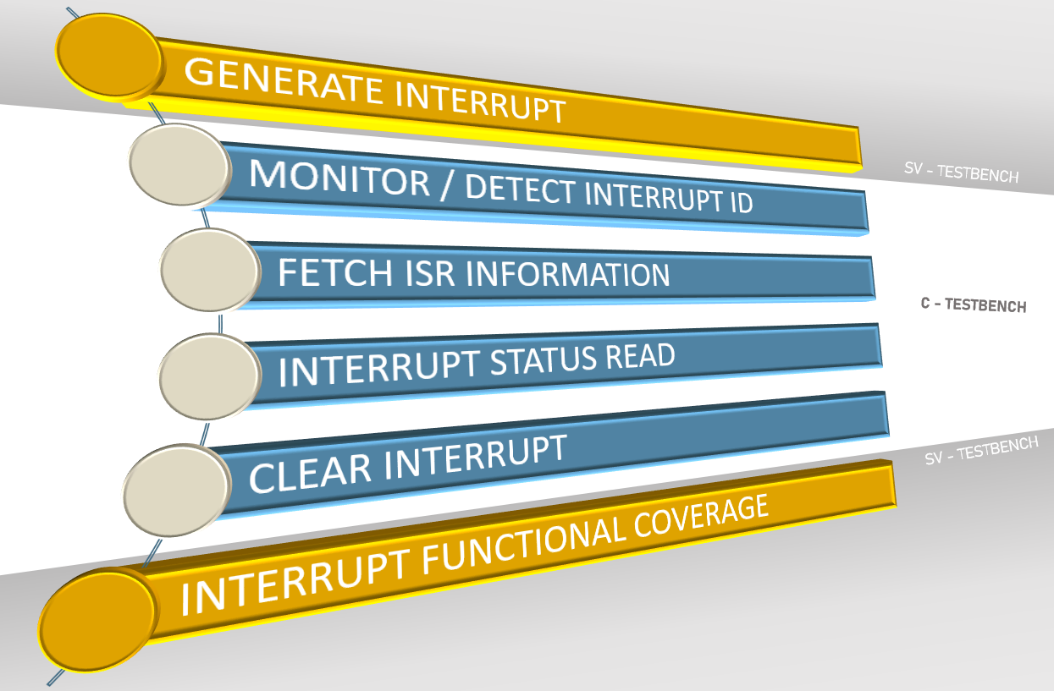
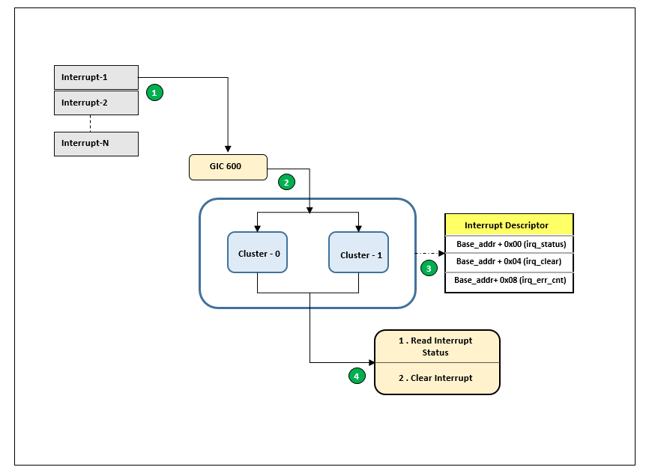
Co Simulation Process Flow

Slide 9
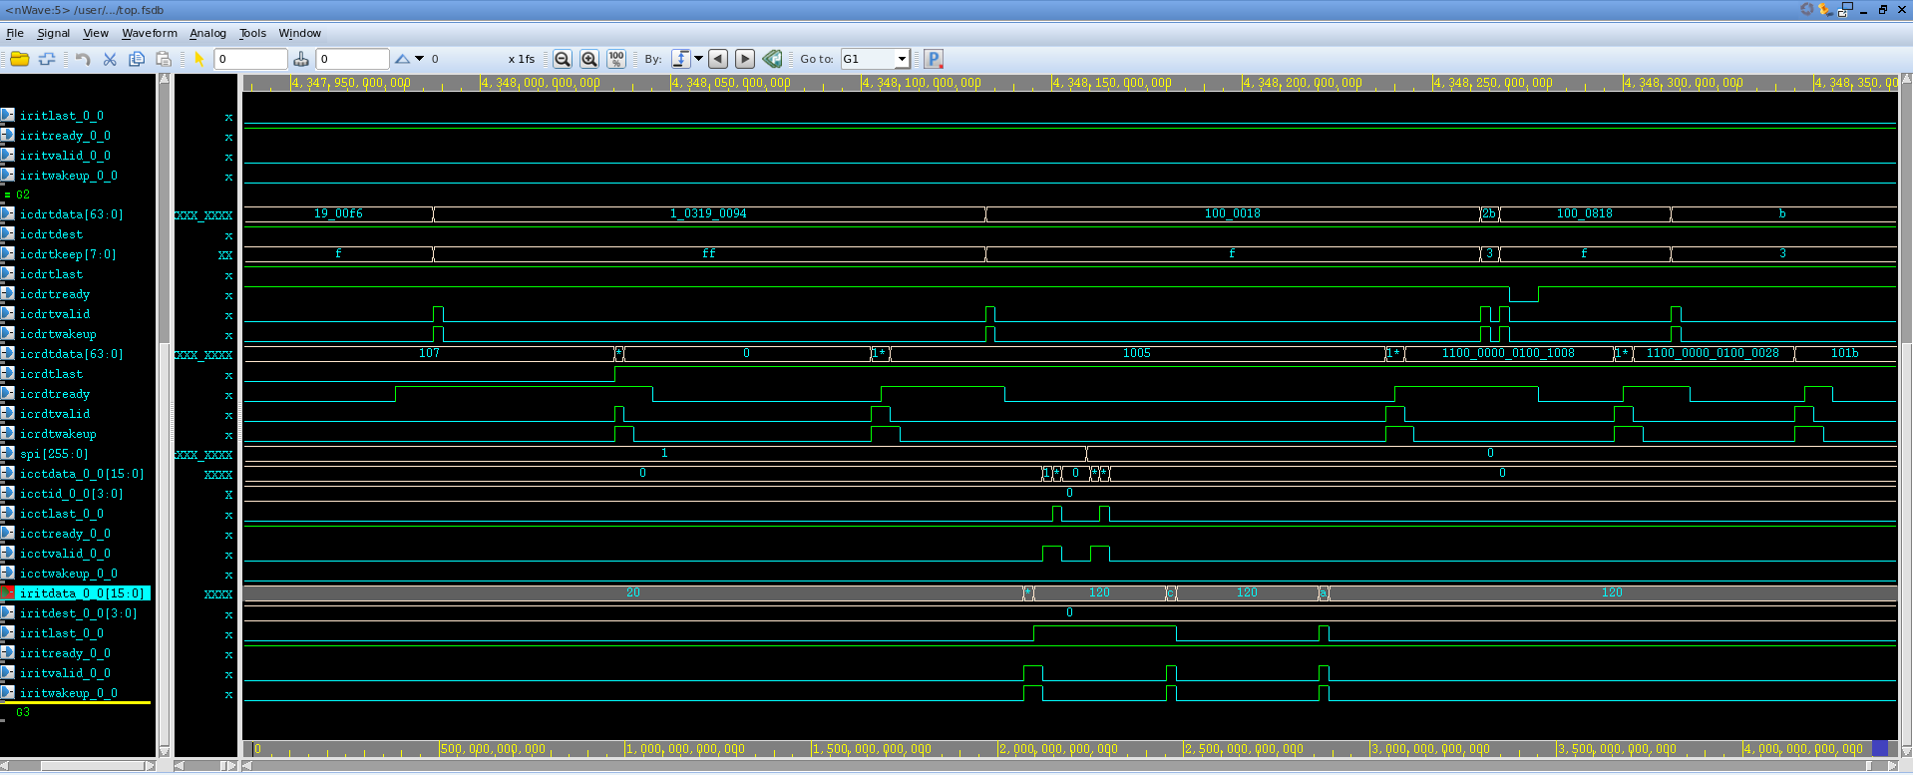
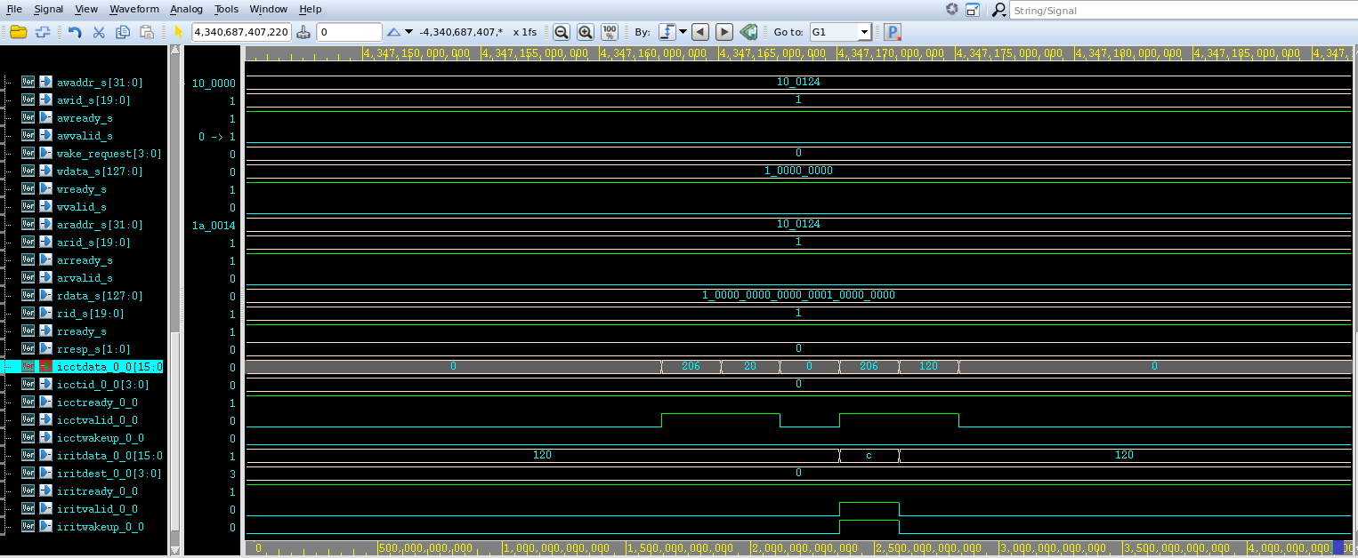
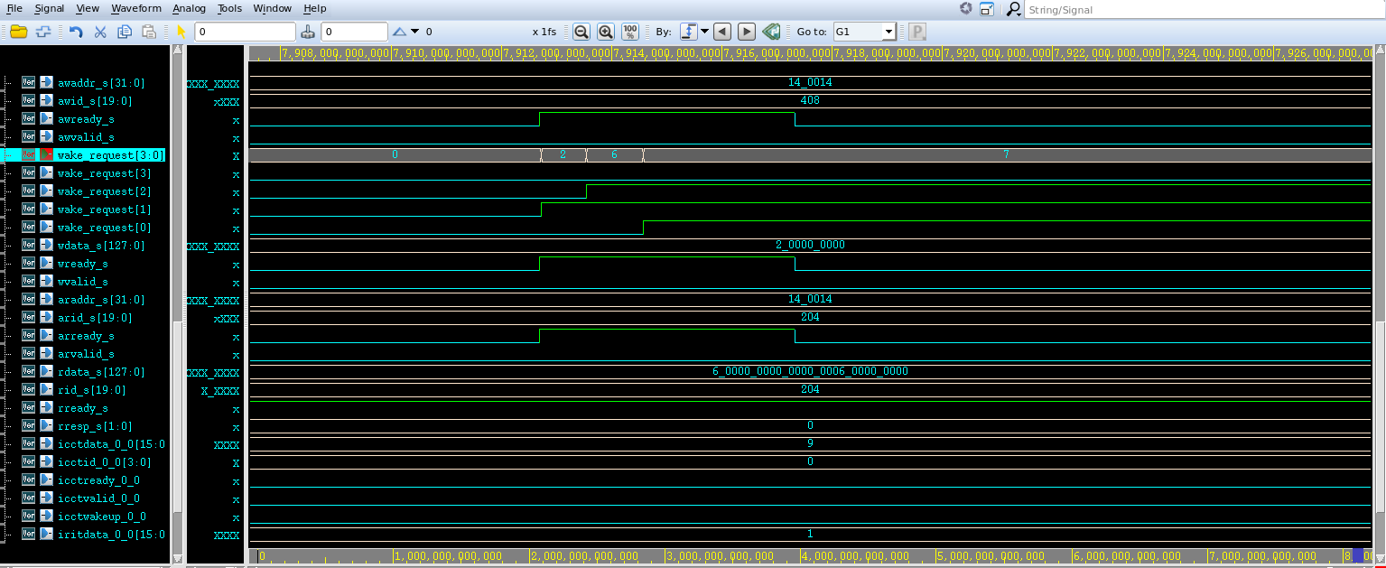
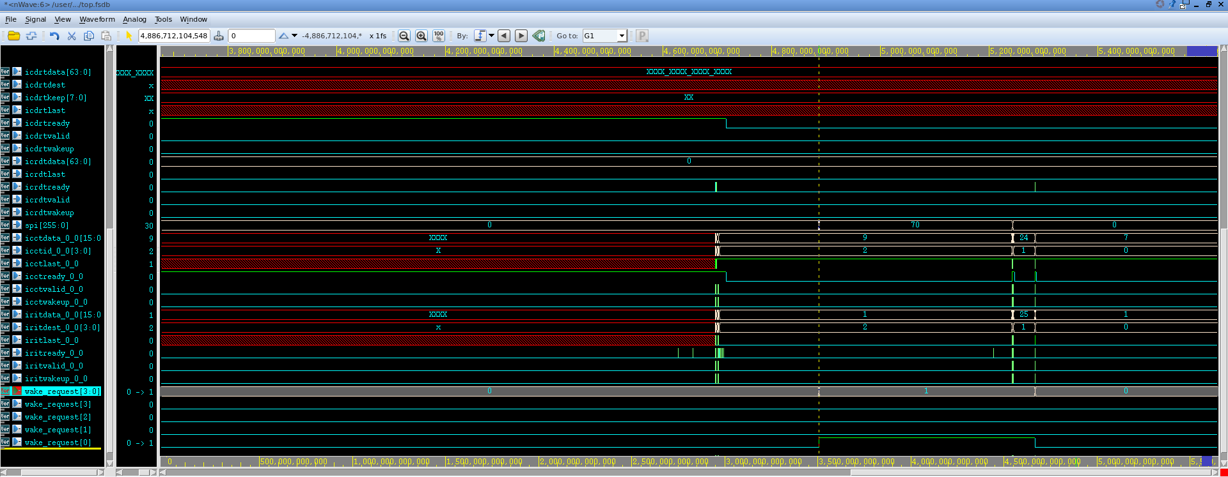
Results
1) Inter chip interrupt routing with unique interrupt id
2) Low power wake request generation to off core

Slide 10
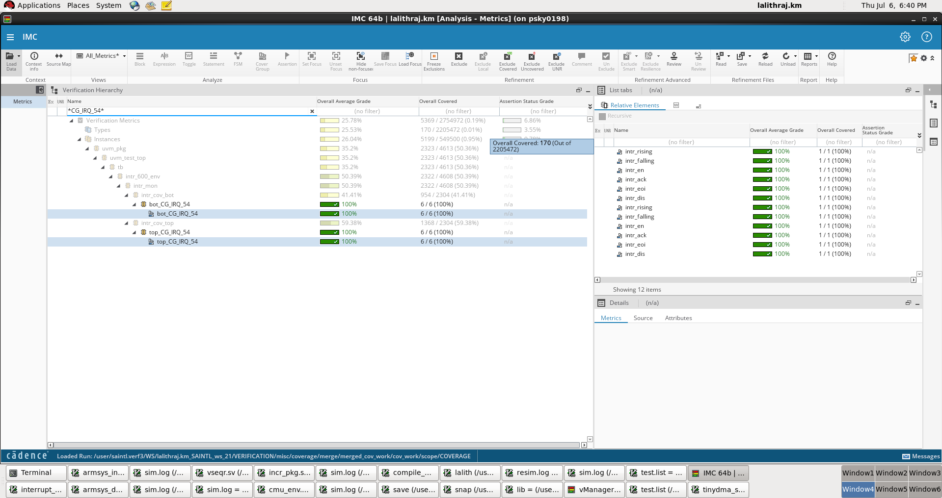
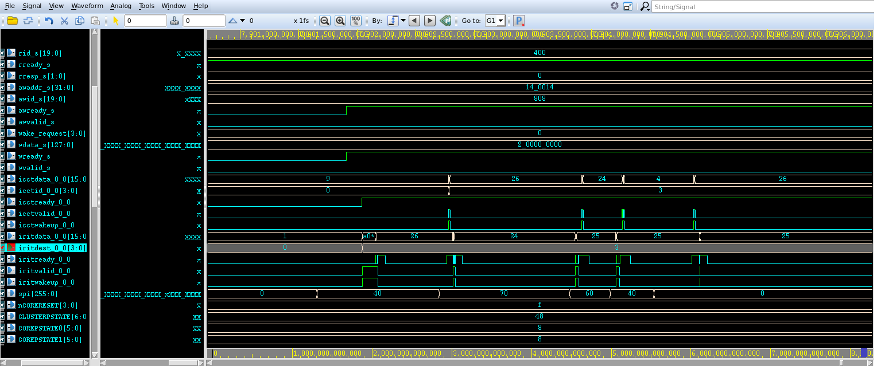
Results
4) Functional coverage
3) Dynamic off loading of interrupts
Intr_set_checker
Intr_rising_checker
Intr_falling_checker
Intr_ack_checker
Intr_disable_checker
Intr_eoi_checker

Slide 11
Conclusion
Robust framework – extended to multiple chips with ease
Functional coverage using a single ISR image
Power use case scenarios and core wakeup priority verification
Direct porting to emulation environment
Co Simulation
  Interrupt coverage for hybrid C-SV environment
  Components are environment independent
  No sequence change required for interrupt coverage dump
  Reduced turn around time

Slide 12
Questions

