Slide 1

Tabled Data Into Query Able Data “key” Concepts Demonstrated Using DDR5 Example
Rahil K Jha, Joseph Bauer
Cadence

Slide 2




Agenda
General Challenge
Effectiveness of STM APIs
7
1
2
DDR5 Challenge
Outside DDR5
8
3
Solution – Executable Table
Customer Testimonial
and Ease of Use
9
4
The Basic Building Block
Application Steps
10
End-to-End
Implementation Flow
5
Simulation Performance Aware
11
6
An API Example
Key Takeaways
12

Slide 3





General Challenge
Data: Encapsulated Potential
  Across files, versions, applications, groups, management systems
    [ AI, ML, SQL, DBMS or Verification Intellectual Property (VIP), etc.
  Rough tabular packed labeled form [Version x Section|Title x Row x Column]
Usable: Target/Clean/Re-pack -> structured keys access
  params [Version] [Topic] [Param] [Condition]
Extract: Manual Association – Tedious, Repetitive, Error-prone
Data:
  Files,
  Versions,
  Tables
  Format:
  Derived [Hefty/Complex/Shifting]
  Value:
  Gold = Optimal Structure

Slide 4
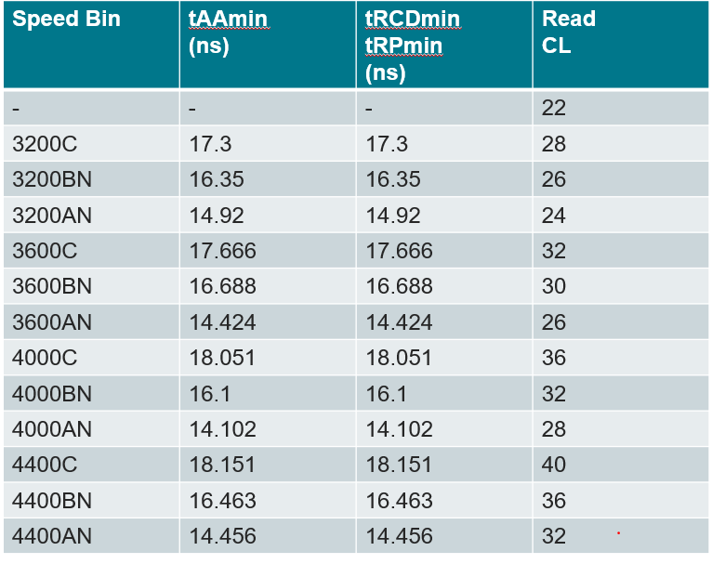
DDR5 Challenge: Speed Bins
Characteristics summary – [ operating speeds, widths, bins, modes, timings]
Bandwidth [Slow($) : Fast($$$$)] – Speed[3200:6400MT/s] x Width[4,8,16] or DIMM64
Latency [Low($$$$) : High($)] -
*29 speed bin tables in DDR5
Increase[CL, tRCD, tRP] with [A,B,C] bin stepdown
Table: Rows(speed x bin) ∩ columns(Param)
Valid value of Speed dependent timing
Operating speed
Bin
Param
*Not shown,
  Additional dimensional complexity:
  (speed x bin) values
    reserved by bin-type parts
  Planar vs 3DS
  Redacted for NDA
4
4

Slide 5







Solution – Executable Table
Speed –to- Mode|Timings APIs [SMT]:
Executable: Access, Query, Iterate, Join/Modify
  Associative indexed data structure
SMT APIS:
Purpose:
Speed Bin Information
Access: Run-time Match [DV HVL]
Timings + Modes @ Bin x Speed
Cover:
Approach:
Automate: Target, express format, extract, transform
Advantage:
Repeated Manual Reading of specification
  REPEAT: look, interpret, extract, ....
5

Slide 6
The Basic building block
Core – Data Extraction
Solution: Make tabled data executable
Concept: ‘n-key’ dimensional aggregation
      matrix[key1][key2], n=2:
      key1 - row label = ‘bin’,
      key2 - column label = ‘speed’
Result: set/get Data = function(@keys[])
      return matrix[bin][speed];
6

Slide 7
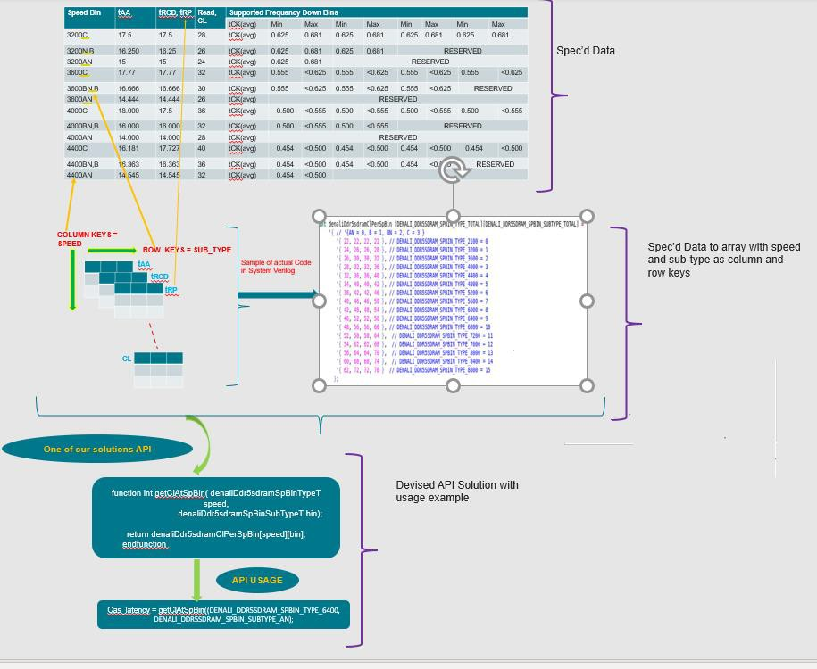

End-to-End Implementation Flow
Parse PDF table ~structures~
Representation[3]
Format:
Firm Intermediate META DATA
Representation[2]
Representation[1]
System Verilog Packed array
API + Usage
7

Slide 8




End-to-End Implementation Flow
PDF
Data
Access
Extract
Source:
DDR5_revX.pdf,
Tables=”Table*Speed Bins*”
Maintain:
Unpack - Automate, Evolve
Format -
  [ parser,structure,
  metadata,generator ]
Cells of ‘Speed Bin’
x ‘Parameter’
x ‘min’ ..
STM API:
Pval = getSTM(p paramT, s speedT, b binT):
return stm[p][s][b]
Input: @keys = [ param, speed, bin ]
Return: scalar integer
Usage:
cl = getSTM(CL, 3200, AN)
cl = getClPerSpBin(3200, AN)
foreach(getClPerSpBin[i,j])
$display("cl @ [%0d][%0d] = %0d",
i,j, getClPerSpBin[i][j]);
8

Slide 9
Same Table, Another Representative Format
Internal working of API: getValidsInSpBinAtSpeed
User Inputs:
Enum variable like: ‘SPBIN_TYPE_3200’
2) Speed bin string like : ‘clSpBinString’
String Input
ModesAtSpeedEndPos = find_string_pos_within_string(SpBinString.substr(ModesAtSpeedStartPos,SpBinString.len()-1), "," );
Spd2spdstr = ‘{
SPBIN_TYPE_2100 : “[.952 ns – 1.010 ns ]”,
SPBIN_TYPE_3200 : “[.625 ns – .681 ns ]”,
SPBIN_TYPE_3600 : “[.555 ns – .625 ns ]”,
SPBIN_TYPE_4000 : “[.500 ns – .555 ns ]”,
SPBIN_TYPE_4400 : “[.454 ns – .500 ns ]”,
SPBIN_TYPE_4800 : “[.416 ns – .454 ns ]”,
SPBIN_TYPE_5200 : “[.384 ns – .416 ns ]”,
SPBIN_TYPE_5600 : “[.357 ns – .384 ns ]”,
SPBIN_TYPE_6000 : “[.333 ns – .357 ns ]”,
SPBIN_TYPE_6400 : “[.312 ns – .333 ns ]”,
SPBIN_TYPE_6800 : “[.294 ns – .312 ns ]”,
SPBIN_TYPE_7200 : “[.277 ns – .294 ns ]”,
SPBIN_TYPE_7600 : “[.263 ns – .277 ns ]”,
SPBIN_TYPE_8000 : “[.250 ns – .263 ns ]”,
SPBIN_TYPE_8400 : “[.238 ns – .250 ns ]”,
SPBIN_TYPE_8800 : “[.227 ns – .238 ns )”
};
Enum Input
ModesAtSpeedStartPos = find_string_pos_within_string( SpBinString, spd2spdstr[speed] );
Determining end position of string
Determining start position of string
cwlSpBin "[.416 ns - .454 ns) 38 40, [.454 ns - .500 ns) 34 38, ……., [.952 ns - 1.010 ns] 20“
clSpBin "[.416 ns - .454 ns) 40 42, [.454 ns - .500 ns) 36 40,……… ,[.625 ns - .681 ns] 26 28, [.952 ns - 1.010 ns] 22“
taaSpBin "[.416 ns - .454 ns) 16666 17500, [.454 ns - .500 ns) 16363 18181 ,……..,[.625 ns - .681 ns] 16250 17500, [.952 ns - 1.010 ns] 20952“
wrPstSpBin "[.416 ns - .454 ns) 1 3, [.454 ns - .500 ns) 1 3,……., [.952 ns - 1.010 ns] 1"
“[.625 ns - .681 ns]”
END RESULT
‘{32, 34,28, 36}
From the entire string obtained using start and end position function, extracting the set of integer values and storing them in a queue. API function returns the queue of valid values
9

Slide 10
Usage Example of “getValidsInSpBinAtSpeed”
Variable declaration in testbench:
string clSpBinString = Sve0.myUvmEnv.activeDevice.config.clSpBin; valids_t valCLs ;
SpBinTypeT speed;
Testbench API call:
speed = SPBIN_TYPE_4800;
valCLs = getValidsInSpBinAtSpeed( clSpBinString, speed );
`uvm_info("USER_TEST",$psprintf("\t Printing all possible valid values of CL for 4800 Operating Frequency %0p",valCLs),UVM_LOW);
Simulation Output:
uvm_test_top [USER_TEST] Printing all possible valid values of CL for 4800 Operating Frequency '{34,40,42}
Practical Usage
While testing the randomization scenario, users may want to randomly pick the value from this queue of valid values to test valid spacing scenarios.
10

Slide 11


Effectiveness of STM APIs on a Larger Scale
Glimpses of the magnitude of verification scope:
~15 operating speed ranges ~12 speed bin 4 sub-parts planar/3DS
This turns out to ~1,400+ combinations
Maintenance despite huge combinations: Only 1 table needs alignment per the latest spec
STM APIs Use can
Parallelize across multiple CPU farms
Huge combinations of test scenarios
Execution Time
Execution Speed
11

Slide 12
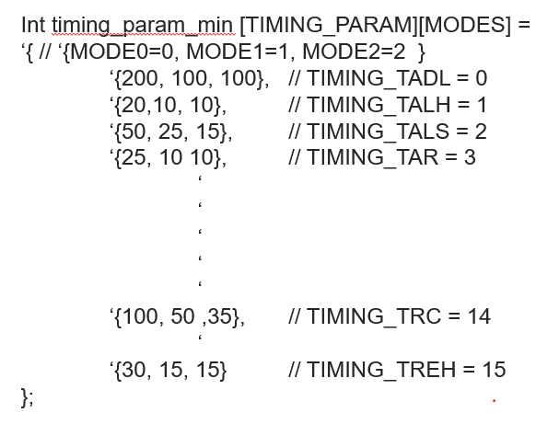
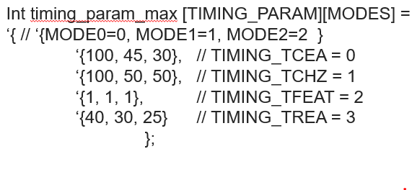
Outside DDR5
Extracted tabular data in 2D packed array
Valid value of any of the timing parameters is a function of Mode, min-max:
t𝐷𝑆, t𝐹𝐸𝐴𝑇, t𝐴𝐷𝐿, t𝐶𝐸𝐴 … … . = 𝑓𝑢𝑛𝑐𝑡𝑖𝑜𝑛( 𝑀𝑜𝑑𝑒[0, 1, 2], 𝑖𝑠𝑀𝑖𝑛[𝑇|𝐹] )
Applying the same steps as STM API then onwards, time to mode API can be developed, which returns valid value of the desired timing parameter
12

Slide 13
Outside Engineering Domain
“Executable Table” concept is applicable outside of the engineering domain too
Tabulated Census data for 3 localities carried out every 5 years
Population density = function(row “keys,” column “keys”)
= function(year, locality).
Extracting → storing to aggregated matrix/array → applying same steps as STM API → automated solution
13

Slide 14
Customer Testimonial and Ease of Use
Used Speed to Modes and Timings solution to access the valid value of timing parameters based on operating speed and sub-part in the DRAM, which allowed us ease of access. Using these valid values, we were able to correctly describe the spacing between valid commands, which saved our effort from running into command spacing-related violations
Ease of Use:
  Can work easily with HVLs such as SV, UVM, SystemC
  Readily available in the release product package
  No switch to enable API usage
  Required packages are already imported, there is no user overhead.
  Consumes 0 simulation time, all APIs are functions
  An example demonstrating ease-of-use and how APIs can help to select appropriate command spacing w.r.t operating speed
14

Slide 15
Application Steps
Determine required APIs arguments and their types with the possibility of clubbing them in structure form, etc.
Identify targeted sub-section, table, row, column from spec. for conversion.
Check automation possibility: reading spec’d table and converting to HVL data aggregation (using tools like python panda, tableau)
Identify type of indexer(string, int, etc.) required for atomic access.
Can we convert existing DV Env. variables to APIs data structure indexer type
Make API reusable: importable package, embed in already imported trans. class
Determine the aggregate storage element type (queue, array, fixed-size array. etc.), it’s dimension, etc.
Capture API function prototype resembling its return type, input argument type, etc.
e.g., period-to-freq, Enums-to-Valid IDs
15

Slide 16
Simulation Performance Aware.
Dynamic, Assoc. arrays, Queues
When and What:
Unpack arrays, When and What:
Run time changing size
Mutable data
Sparse allocation
Table cell order preservation not required
Frequent access/call can impact simulation
Fixed Size
Immutable data
Build time allotment
Minimal simulation impact
16
16

Slide 17
Key Takeaways
Spec’d tabled data: Nothing but executable tables giving freedom from the need to access specification
Easily maintainable because of end-to-end automation: from extracting spec’d table to HVL aggregation structure to devising STM APIs for accessing aggregated structure information
Customer testimonial
DV user reduction in time and efforts + higher coverage
Easy to use. No imports/inclusion is needed. As simple as calling a function
Advantageousness increases with an increase in “Scenarios of Interest.”
All APIs are functions, consume 0 simulation time
Can we tweak to modify the return type as desirable
Not a space-confined solution; it can be extended outside DDR5 and even outside the engineering domain
17

Slide 18
References
[1] JEDEC STANDARD DDR5 SDRAM, Revision “JESD79-5A”, October 2021 (Revision of JESD79-5, JULY 2020)
[2] ONFI Specification v1.0: (https://www.onfi.org/specifications)
[3] google.com
18

Slide 19

Questions
Thank You

