Slide 1
Netlist Enabled Emulation Platform for Accelerated Gate Level Verification
Samhith Pottem, Vasudeva Reddy, Rahul S S, Sarang Kalbande, Garima Srivastava, Hyundon Kim

Slide 2
A
G
E
N
D
A
6
HYBRID GLE
1
INTRODUCTION
2
MOTIVATION
7
STUBBED GLE
3
GLE
Implementation
8
APPLICATIONS
4
9
RESULTS
GLE
CHALLENGES
5
GLE in Action
10
Conclusions & Future Ahead

Slide 3
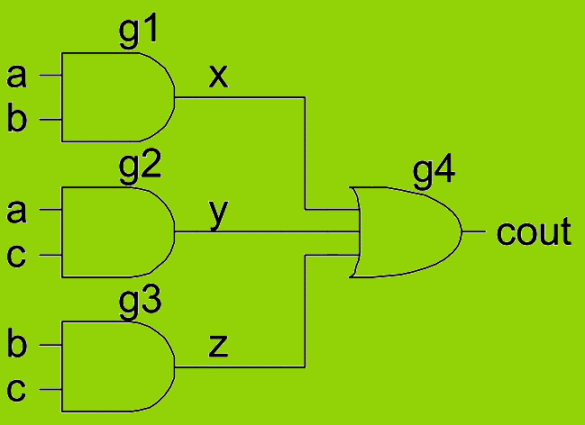
Introduction
Netlist as an Input
module carry(input a, b, c, output cout)
wire x, y, z;
and g1(x, a, b);
and g2(y, a, c);
and g3(z, b, c);
or g4(cout, x, y, z);
endmodule
Register
Level
D Q
Gate Level
Transistor Level
Significance
Accuracy
Correctness & Functionality
Incremental Verification
Regulatory Compliance
Power Analysis

Slide 4
Motivation
Widely Employed Across all the industry standard for Verification at Gate Level.
GLS
Cover most of our Verification by adopting to GLE methodology for early Tape-out.
Conventional Process with good coverage over RTL
Yet, have some constraints
Short Run Time
Real time Debugging
Supports Complex Designs
GLE
Gate Level Emulation:
Advance
Methodology
Huge Run Time
More Resource Requirements
Not Feasible for Complex Designs
Needs Less Resources
System Level Verification
Regression Testing
GLS – Gate Level Simulation GLE – Gate Level Emulation

Slide 5
GLE Implementation – Prerequisites
Design Netlist
Cell Libraries
Test Bench
Memory Models
Analog Models
Pre defined Cells
Cell Instantiations and of different Cell Types
Functionality of Memory Elements
Technology Node Dependent
Behavioral and connectivity representation of a circuit
Verilog or VHDL Format
Zero Delay
Necessary Transactor Models
Compile time Hacks
Clock Modelling
Synthesizable models of Voltage Monitors

Slide 6
GLE Implementation – Front End
COMPILE
1
ELABORATION
2
Front End
Front End
OPTIMIZATION
3
SYNTHESIS
4
MAPPING
5

Slide 7
GLE Implementation – Back End
CLOCKS
1
MEMORY MODELLING
2
Back End
Front End
PARTITIONING
3
PLACE & ROUTE
4

Slide 8
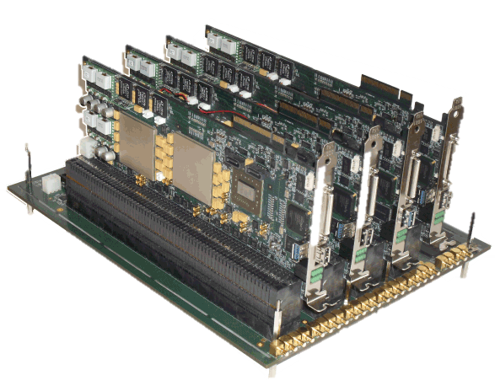
GLE Implementation
Cell Libraries
Design Netlist
Test Bench
EDIF NETLIST
Front End
FPGA Modules
Memory Models
Back End
Analog Models

Slide 9
GLE Challenges – Compile Time
Issue
Analysis
Solution
High Compile Time
Design Size and Complexity Increases
More Resource Requirements
Multi Core and Multi Threads Approach
Parallel Processing of the Tasks

Slide 10
GLE Challenges – Run Time
Solution
Inserting D Flops in the SCC path -> Performance Improvement
Analysis
Scan Logics Added
Test Mode Signals Enabled
Long Timing Paths
Issue
Less Driver Clock
SCC – Strong Connected Components

Slide 11
GLE in Action (Full SoC)
3B Gates

Slide 12
Smarter Solution – Hybrid GLE
Design Inputs
Full Net Model
SoC
IP₁ IP₂
IP₃ IP₄
IP₅
Netlist
Netlist
Emulation Compiler
Full Net GLE
IP₆
Netlist
Netlist
Hybrid Model
RTL
SoC
IP₁ IP₂
IP₃ IP₄
Netlist
IP₅
RTL
Netlist
Emulation Compiler
Hybrid GLE
IP₆
Netlist
RTL

Slide 13
Smarter Solution – Stubbed GLE
Design Inputs
Hybrid Model
Stubbed Model
SoC
SoC
IP₁ IP₂
IP₃ IP₄
IP₁ IP₂
IP₃ IP₄
IP₁ IP₂
IP₃ IP₄
IP₅
IP₅
RTL
Netlist
IP₆
IP₆
Netlist
RTL
FAKE
RTL
Emulation Compiler
Emulation Compiler
Netlist
Hybrid
GLE
Stubbed
GLE

Slide 14
GLE in Action (Stubbed GLE)
Full SoC GLE – 3B Gates Stubbed GLE - ~1.8B Gates

Slide 15
Applications
APPLICATIONS
SoC Boot
1
SoC Snap Shot
2
SAIF based Power Estimation
3

Slide 16
Results
GLS vs GLE Execution Time Comparison
Applications | GLS (Hrs) | GLE (Hrs)
SoC Boot | 12 | 0.25
SoC Snapshot | High Run Time | 0.9
Power Estimation | High Run Time | 2.2

Slide 17
Results (Contd..)
HIGH RUN TIME

Slide 18
Results
Functional Mode
TARGET
IP
Test Mode
MC0
Tx.
Tx.
PHY
CONTENTS CORRUPT
MEMORY
TEST
EN
=0
Resolution
TEST
EN
=1
MC0
MC1
MC – Memory Controller
PHY
MEMORY

Slide 19
Conclusions & Future Ahead …
Future Scope
Full SoC Netlist files integrated Emulation Platform
Hybrid GLE
Stubbed GLE
Validate the long running and System level scenarios effectively in GLE
UPF Integration with GLE
Power Estimation and Analysis
DFT BIST scenarios
Conclusions
19

