Slide 1
Efficacious Verification of Irreproachable and Steady Data Transfer Protocol for high-speed die-to-die communication on a 3DIC Chip
Varun Kumar C, Jyoti Verma, Sekhar Dangudubiyyam
Samsung Semiconductor India Research (SSIR)

Slide 2
AGENDA
Introduction
D2D Interface
Stack Level Verification
SOC Level Verification
Issues and Bugs
Result
Future work
Conclusion

Slide 3
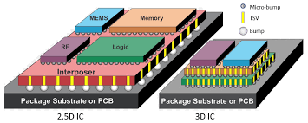
Introduction – 3DIC Technology
Limitations on the Moore’s Law
2.5D technology (Interposer technology) integrates several electronic devices inside a single package by assembling them side-by-side on a shared interposer
3DIC technology consists of multiple tiers of active devices stacked above each other

Slide 4
Guidelines (3)
Introduction – Advantages of 3DIC
1
2
5
Reduction in wire-length
Efficient power consumption
Improved packing density
Noise immunity
Superior performance
5
3
4
3
1
4
5
3
5
3
2

Slide 5
Introduction – Motivation for D2D protocol
TSVs enable 3DIC technology and are still experimental
Higher operating temperature
High temperature differences between the layers
Conventional data transfer through AXI interface across the dies poses challenges
Lack of reliability
Data loss
Higher pin count (450 pins)
High latency
Complex die to die NOC timeout

Slide 6
D2D Interface
TSV based interface
CRC Error checks and data retry
Reduced number of inputs and outputs
ECC Error detection and correction (QEDTEC)
AXI transactions monitoring
D2D Interface
Bus maintenance and cleany operation
Supports transfers up to 100 GBps
SDR and DDR modes
20 unique interrupts
Center aligned and Delay alligned

Slide 7
Levels of Verification
Stack Level Verification
Master VIPs for traffic generation and configuration
Back to back IP wrap with TSV IO modules
Functional verification
Code coverage and functional coverage
SOC Level Verification
Real time masters for traffic
Low power verification
Performance verification
System level tests for ATE
Cross die interrupt handling

Slide 8
Stack Level Verification
INTERFACE MONITOR
COVERAGE MODULE
COVERAGE MODULE
AXI_CH_ARBITER
D2D_FIFO SI
SDRCLK, DDRCLK1, DDRCLK1, INITN
D2D_FIFO MI
AXI_CH_DEMUX
SI_IOCTRL
AR, AW, W
49
PAYLOAD
ERROR INJECTION
PAYLOAD
49
AR, AW, W
MI_IOCTRL
9
RESPONSE
RESPONSE
9
AXI4 MASTER VIP
AXI4 I/F
AXI4 I/F
AXI4 SLAVE VIP
INTERFACE MONITOR
B, R
AXI_CH_DEMUX
D2D_FIFO MI
SDRCLK, DDRCLK1, DDRCLK1, INITN
D2D_FIFO SI
AXI_CH_ARBITER
B, R
49
PAYLOAD
ERROR INJECTION
PAYLOAD
49
APB MASTER VIP
APB I/F
SPECIAL
FUNCTIONREGISTERS
9
RESPONSE
RESPONSE
9
SPECIAL
FUNCTIONREGISTERS
APB I/F
APB MASTER VIP
D2D_Slave_interface
SCOREBOARD
D2D_Master_interface
VERIFICATION COMPONENTS
CORECLK DOMAIN(4GHz)
ACLK DOMAIN(1 GHz)
PCLK DOMAIN(250MHz)

Slide 9
SOC Level Verification
TOP DIE
Master
Master
. . .
Master
NOC
AXI Performance Monitor
CPU Cores
D2D Slave Interface
D2D Master Interface
Clock Skewer/Jitter Inducing
TSV IOs
Error Injection Module
CPU Cores
D2D Master Interface
D2D Slave Interface
AXI Performance Monitor
LPDDR5
NOC
Master
Master
Master
PCie4
BOTTOM DIE
EP
Testbench Components

Slide 10
SOC Level Verification
Real Time Application Scenarios
Multiple masters in top and bottom die
Concurrent traffic generation from all the CPU cores, traffic generator and PCIE master
Clock jitter and skew introduction
Different crystal oscillators in top and bottom die
Tuning of coarse grain and fine grain delays
Variable clock ratios with traffic stress
Independent operational clocks of D2D_master_interface and D2D_slave_interface
Confirmation on robustness of flow control
Clock skewer and jitter inducing testbench component

Slide 11
SOC Level Verification
System level tests for ATE
Verification in a single IP environment
Internal loopback, external loopback and remote loopback
Cross die interrupt handling
Support for 20 unique interrupts
Two GIC600s present in top and bottom die
Low power verification
Dies operate at different voltages
Various power aware verification checks
Testing on various pattern generation modes
Communication between GIC 600s happen through AXI stream interface
Different voltage rails for PLLs, D2D core, TSV_TX_IO and TSV_RX_IO

Slide 12
SOC Level Verification – Link reliability and bus maintenance
Injection enable, number of CRC error, CRC error bit position, ECC error, ECC error type(single, double, uncorrectable), Payload type(AW, AR, W, B, R),…
Multiple instances of D2D interface, hence error injection through force is not feasible
Development of error injection module which can be scaled up to any payload based protocol
Error condition behavior was monitored in the sequences through registers, counters and interface signals
D2D_Slave_Interface
Payload
D2D_Master_Interface
49
49
CRC Error Injection
ECC Error Injection
9
9
Response
Error scenario monitoring in the sequences

Slide 13
Issues and bugs
Protocol violations for various configurable AXI parameters
Transactions hang during multi-master D2D interface access
Improper payload formation due to clock skew and jitter
Issues in P and Q channel handshakes for Low power verification
Issues in reliability features like ECC and CRC errors

Slide 14
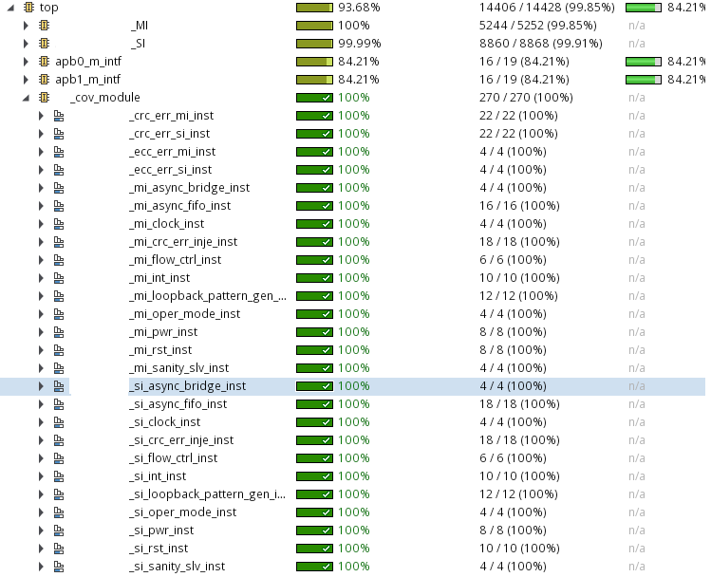
Results – Code coverage

Slide 15
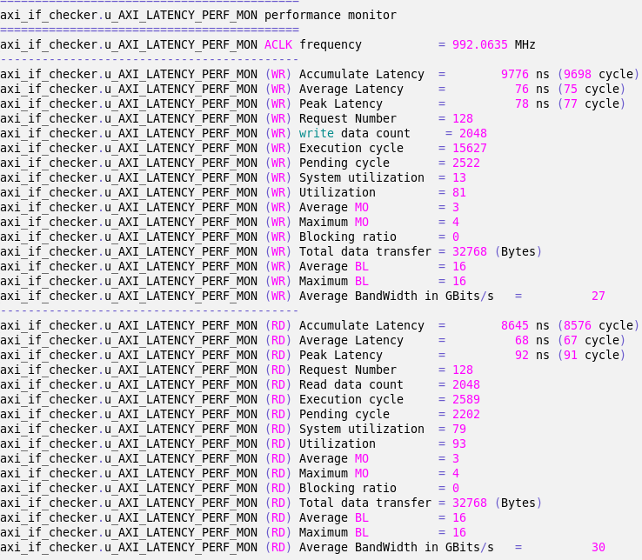
Results – Performance verification
BLK_D2D_TOP
WRITE ONLY PERFORMANCE Source :: BLK_D2D TOP ---------> Destination :: BLK_D2D BOT RAM Traffic = 8k MO = 04 awlen = f WR Bandwidth from 1st WVALID posedge to last WLAST negedge = 8192/614.88 = 13.32 GBs => 106.968 Gbits per sec
BLK_D2D BOT
READ ONLY PERFORMANCE Traffic = 8k MO = 04 arlen = f RD Bandwidth from 1st RVALID posedge to last RLAST negedge = 8192/547.344 = 14.96 GBs => 119.968 Gbits per sec
WRITE ONLY PERFORMANCE Source :: BLK_D2D BOT ---------> Destination :: BLK_D2D TOP RAM Traffic = 32k MO = 04 awlen = f WR Bandwidth from 1st WVALID posedge to last WLAST negedge = 32768/2501.856 = 13.09 GBs => 104.77 Gbits per sec
READ ONLY PERFORMANCE Traffic = 32k MO = 04 arlen = f RD Bandwidth from 1st RVALID posedge to last RLAST negedge = 32768/2192.4 = 14.94 GBs => 119.56 Gbits per sec

Slide 16
Future work
Dynamic CDC verification using metastability injection (CDC jitter) mechanism during simulation
Utilization of emulation for accelerating the functional verification closure

Slide 17
Conclusion
Die-to-die interfaces provide major use cases for targeting applications
Presented D2D protocol offers plenty of features and hence better die to die communication
Functionality, timing, power, energy consumption and reliability impacted the complexity of verification
Master like VIPs used for stack level verification
Reuse of sequences at SOC level verification
New methods in clock scenarios verification, loopback verification, performance verification, CRC and ECC error verification and functional verification

Slide 18
Questions

