Slide 1
Code-Test-Verify all for free - SystemVerilog Assertions + Verilator
Hemamalini Sundaram
Kasthuri Srinivas, Supriya Ummadisetty

Slide 2
Agenda
Semiconductor growth, talent building
Why focus on Design Verification?
What did we work on?
Our Approach
AHB-Lite Assertions – list, sample assertion and Unit tests for AHB assertion
AXI Assertions – list, sample assertion and Unit tests for AXI assertion
APB Assertions – list, sample assertion and Unit tests for APB assertio
Results Table
Advantages
Opensource – reflecting from Poetic world

Slide 3
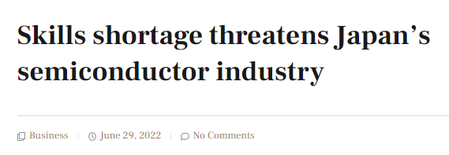
Semiconductor growth, talent building
Notes:
https://semiengineering.com/engineering-talent-shortage-now-top-risk-factor/
https://www.mckinsey.com/industries/semiconductors/our-insights/the-semiconductor-decade-a-trillion-dollar-industry
* The semiconductor industry's growth is driven by automotive, computation, and wireless sectors. Automotive is projected to triple demand due
to autonomous driving and e-mobility. Computation and data storage will grow 4 to 6 percent with AI and cloud computing demand. Wireless expansion
will be led by smartphones and 5G. Despite short-term volatility, the industry outlook is bright. Industry leaders should focus on R&D, factories,
and sourcing for growth opportunities.
* The IC industry is facing a growing demand for engineers and technical professionals, particularly in hot markets like AI and 5G. However,
companies are struggling to find enough skilled talent, especially in STEM fields. This shortage affects their ability to fill key positions,
renew their workforce, and innovate with new products. A survey by Deloitte and SEMI reveals that 82% of executives reported a shortage of qualified
technical candidates. Electrical engineering jobs are the hardest to fill (60%), followed by computer sciences/software engineering (35%), and mechanical engineering (35%), among others.

Slide 4
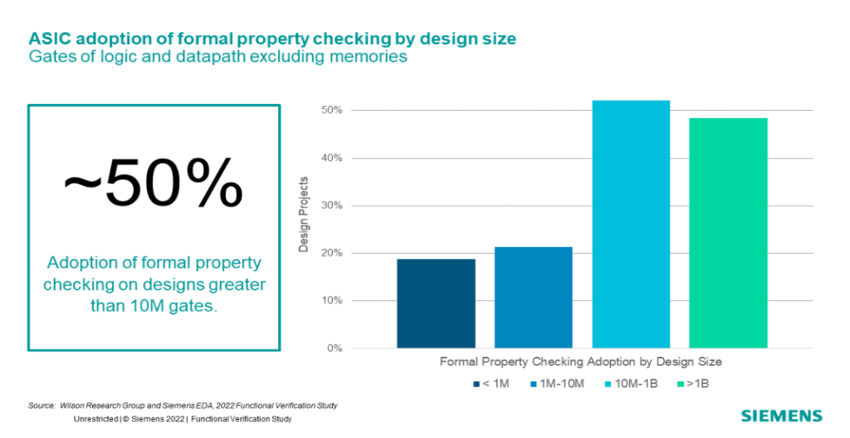
Why focus on Design Verification?
Notes:
The study identifies design flaws leading to IC/ASIC respins, with "logic or functional flaws" being the primary cause. Flaws associated with safety and security features showed a downward trend. Analog circuit tuning issues were prevalent across various nodes, impacting designs of all sizes, with almost 50% of designs under 1M gates experiencing respins due to analog issues.
The ASIC market experienced challenges with verification complexity due to SoC-class designs in the mid-2000s. While overall dynamic verification technique adoption remained flat from 2007 to 2022, ASIC projects' processes matured to address growing pains.
we see that there is significantly more adoption of formal property checking on designs over 10M gates.

Slide 5
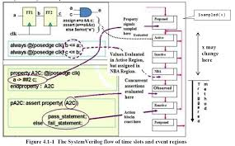
What did we work on?
Notes:
• SystemVerilog Assertions (SVA) are excellent candidates to capture these protocol requirements in concise, unambiguous, executable specification.
• Lack of Open source tools supporting concurrent assertions has been a significant hindrance to widespread use of SVA and checkers in general.
• Presenting a verification methodology for protocol checkers using SVA developed completely using open-source simulator – Verilator.
• Also presenting Unit testing as the way of testing each assertion in isolation for correctness. The entire code base will be made available online for free.

Slide 6
Our approach
Code SVA
Subset for Verilator
Write Unit test per assertion
Much easier to “test”
PASS and FAIL tests
Use SVUnit
Run, debug, fix
VCD + GTKWave
sv_wateterm – log-based wave tracing

Slide 7
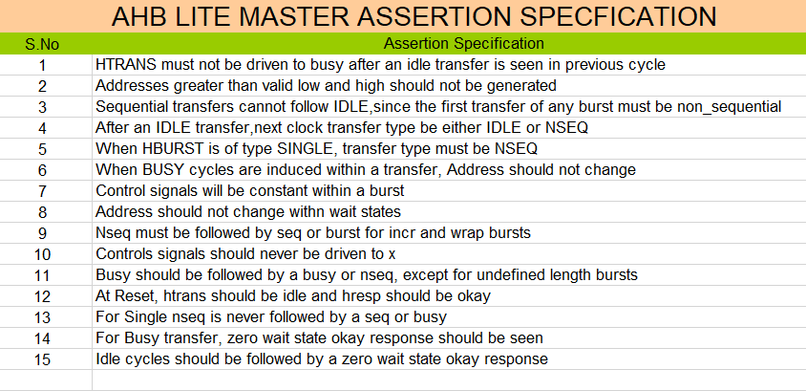
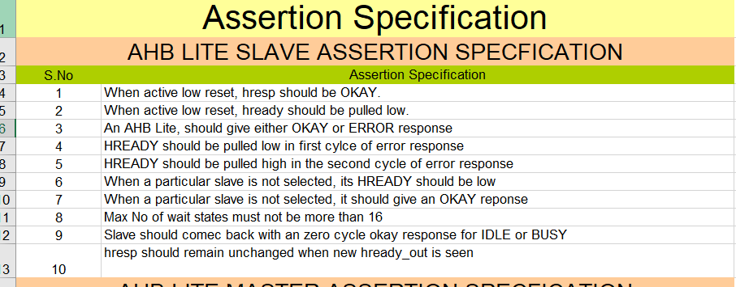
AHB-Lite Assertions - list

Slide 8
Sample AHB assertion
Antecedent
Fail action block
Consequent

Slide 9
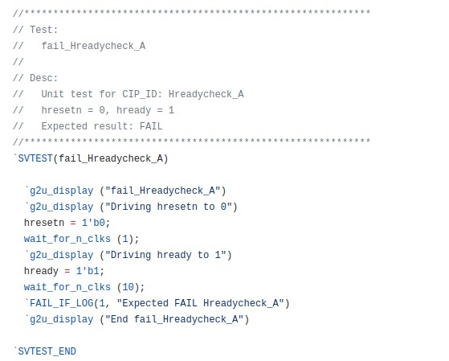
Unit Tests for AHB assertion

Slide 10
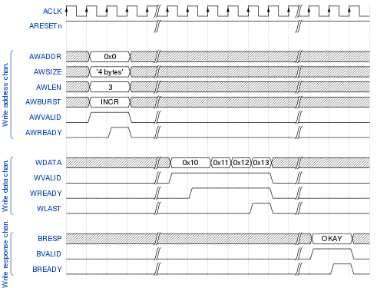
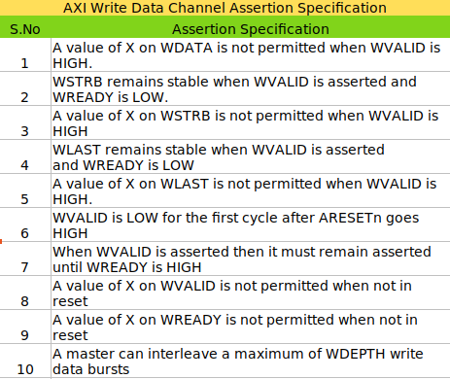
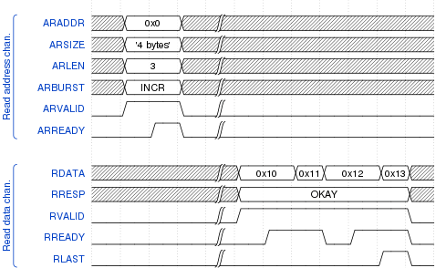
AXI Assertions - list

Slide 11
Sample AXI assertion
Antecedent
Fail action block
Consequent

Slide 12
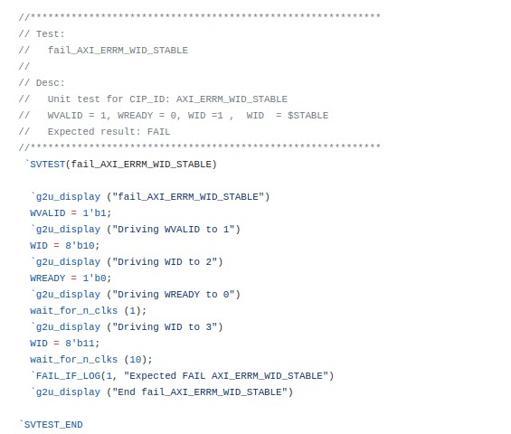
Unit Tests for AXI assertion

Slide 13
APB Assertions - list

Slide 14
Sample APB assertion
Abort cond
Antecedent
Fail action block
Consequent

Slide 15
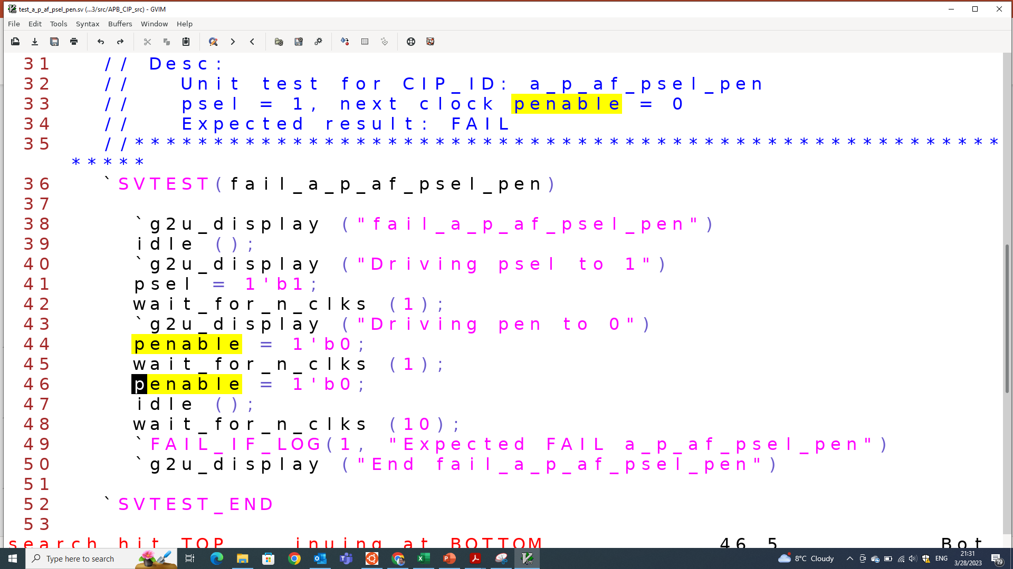
Unit Tests for APB assertion
psel && !penable
|=> pen
Notes:
Unit test shown simulates/triggers a known FAILure as pen = 0 after psel

Slide 16
Unit tests – testsuite, PASS/FAIL

Slide 17
GitHub repos/projects - references
Used many opensource projects
Verilator
SVUnit
Verible
sv_waveterm
Ported CIP to Verilator
Workarounds added
Reported 10+ issues
Fixed one inside Verilator source
Ported SVUnit to Verilator
4+ issues, branch PR
Ported sv_waveterm to Verilator
Fixes provided

Slide 18
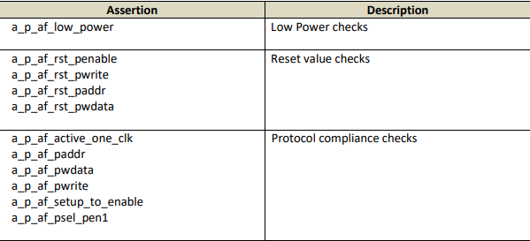
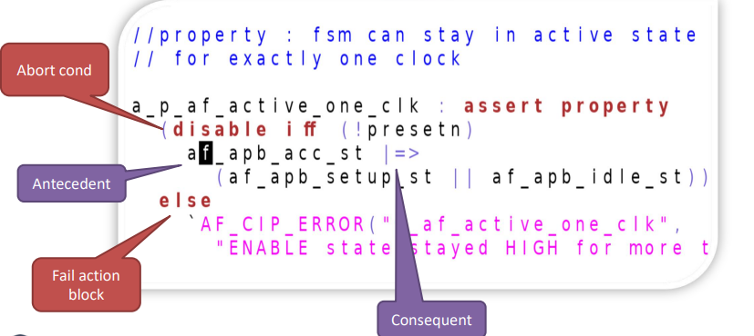
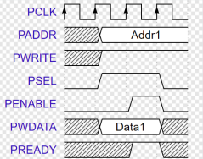
Results Table
Table below shows checks developed for APB:

Slide 19
Advantages
Enabling industry to explore open-source simulators such as Verilator along with advanced verification technologies such as Assertion Based Verification, Unit Testing, Debug automation etc
One good application of this work can be the academia that can now learn SVA for free using opensource tools

Slide 20
Opensource – reflecting from Poetic world
Notes:
We want to close this talk with a quote from the great poet, freedom fighter, social reformer Mahakavi Bharatiyaar (TamilNadu, India). In one his songs he prays to Goddess Shakti to give him power/strength to be of some use to the society at large. He was very short lived (38 years), his work is even today referred to and praised in India and abroad. We believe FOSSi has similar goals – to be of use to wider community across the globe.

