Slide 1
Adopting Register Change Dump Methodology for RISC-V
Processor functional Verification
Damandeep Saini, Chethan AS, Anil Deshpande, Raviteja Gopagiri, Somasundar, Niharika Sachdeva

Slide 2
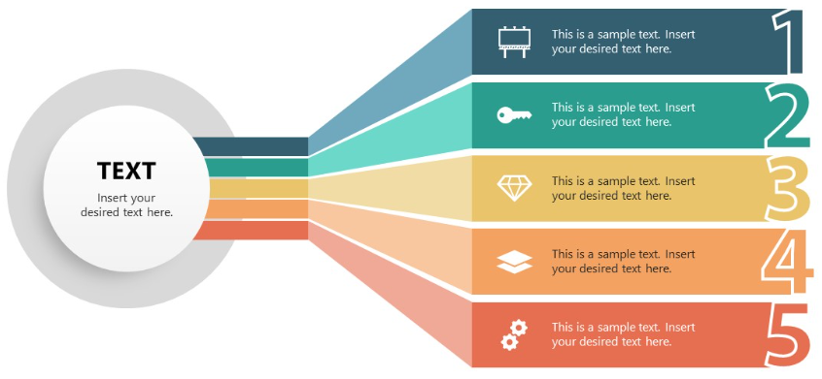
AGENDA
INTRODUCTION
TRADITONAL METHODS
PROPOSED WORK
RESULTS
CONCLUSION

Slide 3
Introduction
Traditional Methods
Proposed Work
Results
Conclusions & QnA
Open
Source
73%
Time to
Market
Acquisition
Growth
Processor

Slide 4
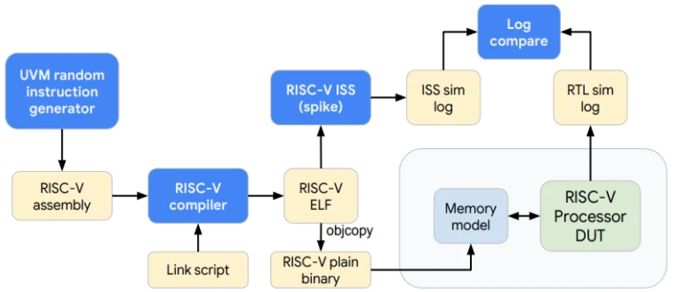
Introduction
Traditional Methods
Proposed Work
Results
Conclusions & QnA
Highly Expensive 3rd Party Simulators
Encrypted design and flow
Patented IP’s and associated Royalty
Limited Access on to Performance Tools

Slide 5
Introduction
Traditional Methods
Proposed Work
Results
Conclusions & QnA
components needed to do the End-to-End Processor verification of RISC-V
Boot Code or Instruction Binary Test Vector
ROM Code
Information of any change in Processor's Register values along with external data transfer.
.RCD File
RTL Code
An open-source RTL (Verilog) code for
RISC-V Processors.
UVM Script
System-Verilog or any other UVM script which converts the .RCD to RISC-V register models

Slide 6
Introduction
Traditional Methods
Proposed Work
Results
Conclusions & QnA
components needed to do the End-to-End Processor verification of RISC-V
Boot Code or Instruction Binary Test Vector
ROM Code
Information of any change in Processor's Register values along with external data transfer.
.RCD File
RTL Code
An open-source RTL (Verilog) code for
RISC-V Processors.
UVM Script
System-Verilog or any other UVM script which converts the .RCD to RISC-V register models

Slide 7
Introduction
Traditional Methods
Proposed Work
Results
Conclusions & QnA
components needed to do the End-to-End Processor verification of RISC-V
Boot Code or Instruction Binary Test Vector
ROM Code
Information of any change in Processor's Register values along with external data transfer.
.RCD File
RTL Code
An open-source RTL (Verilog) code for
RISC-V Processors.
UVM Script
System-Verilog or any other UVM script which converts the .RCD to RISC-V register models

Slide 8
Introduction
Traditional Methods
Proposed Work
Results
Conclusions & QnA
components needed to do the End-to-End Processor verification of RISC-V
Boot Code or Instruction Binary Test Vector
ROM Code
Information of any change in Processor's Register values along with external data transfer.
.RCD File
RTL Code
An open-source RTL (Verilog) code for
RISC-V Processors.
UVM Script
System-Verilog or any other UVM script which converts the .RCD to RISC-V register models

Slide 9
Introduction
Traditional Methods
Proposed Work
Results
Conclusions & QnA
components needed to do the End-to-End Processor verification of RISC-V
Boot Code or Instruction Binary Test Vector
ROM Code
Information of any change in Processor's Register values along with external data transfer.
.RCD File
RTL Code
An open-source RTL (Verilog) code for
RISC-V Processors.
UVM Script
System-Verilog or any other UVM script which converts the .RCD to RISC-V register models

Slide 10
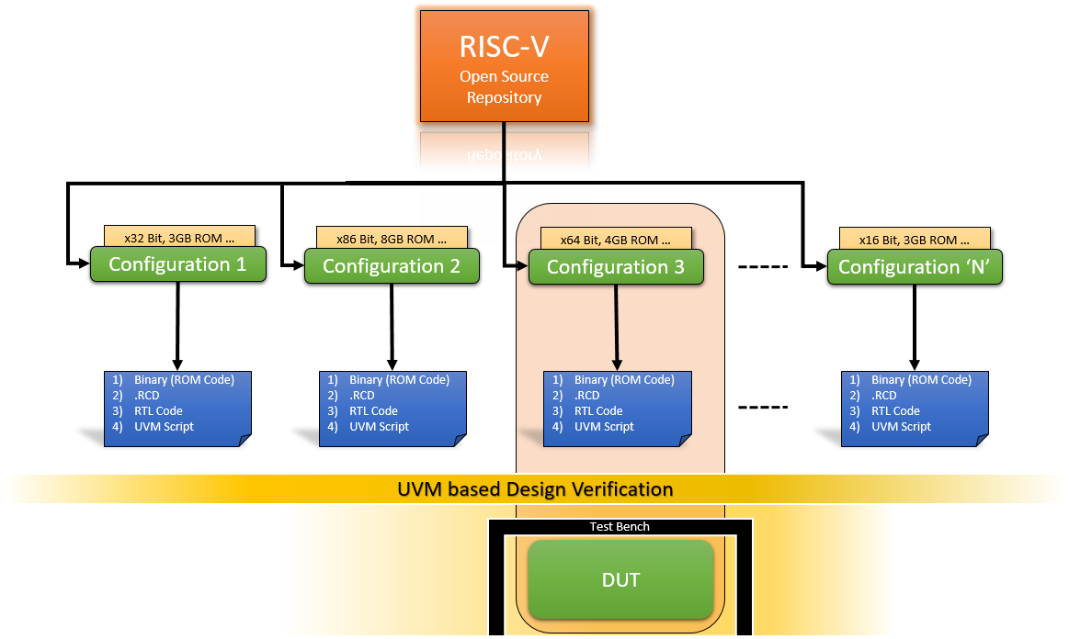
Introduction
Traditional Methods
Proposed Work
Results
Conclusions & QnA
FRAMEWORK

Slide 11
Introduction
Traditional Methods
Proposed Work
Results
Conclusions & QnA
Competitive Analysis
30
= Traditional Methodology
= Proposed Methodology
20
Number of Days
10
0
RTL Code
DV Verification
Retesting Bug / Issue
Coverage Closure

Slide 12
Introduction
Traditional Methods
Proposed Work
Results
Conclusions & QnA
1
5
2
4
3
Unbiased
Multi-Processor
Architecture
Time to Market
Power
Consumption
From Small Scale to Billion Dollar Company.
Collaboration
Extend verification concept on RISC-V for multi processor architecture.
The basic ecosystem for development & verification is reduced.
Workflow for measuring Power Consumption using .RCD File.
Being an open-source, it would benefit worldwide developers

Slide 13
Introduction
Traditional Methods
Proposed Work
Results
Conclusions & QnA
QnA

