Slide 1
A Novel Approach for faster diagnostic coverage closure aided by STL of CPU Cores
Naveen Srivastava, Amresh Kumar Lenka, Varun Kumar C, Subramanian, Sekhar Dangudubiyyam
Design Verification, FDSHW Samsung Semiconductor India Research Bangalore, India

Slide 2
Outline
Introduction
VC Z01X with STL for functional safety
STL Capabilities
Proof of concept
FMEDA
References
Questions

Slide 3
Introduction
What is fault simulation ?
Fault simulation is an execution of test stimulus on a good machine and a faulty machine (identical copy of good machine but with systematically injected faults) and check whether the test stimulus resulted in a difference at the required observation points.
Detecting a difference is expected as it indicates the visibility of faults in the circuit. Failure to produce the difference indicates the need for change in the internal logic so that missed faults are now detectable.
Good Machine
Compare Results
Difference ?
Stimulus
Faulty Machine
No Difference ?

Slide 4
Need for fault simulation
Fault simulation can be used in two contexts:
1. To catch bad parts or manufacturing defects.
2. Functional safety verification.
Fault simulation is required in safety critical applications like space stations and automotive vehicles.
Space has harsh environment with ionizing radiations. These high energy particles can cause permanent stuck at faults in the circuits. The chips in automotive vehicles are continuously subjected to various stresses from supply, frequency and temperature. This causes faults being generated resulting in unexpected behavior of vehicles.
Simulating these real life fault scenarios is paramount. Functional safety verification gives the overview about a design’s capability to recognize the faults.

Slide 5
VC Z01X with STL for functional safety
STL libraries enable us to simulate the full range of logical functionalities in the core. Since the STL exercises critical processor pathways, the injected faults are more meaningful by providing valuable faulty machines.
Developing STL
Logical simulation of STL
Fault simulation with VC-Z01X using STL
Fault sim report
A processor function missed ?

Slide 6
Scope of STL in functional safety
STL stands for software test library, Which contain assembly + C written test cases to target/test individual functions and registers of the processing core.
In the scope of functional Safety, STL is considered as “Safety element out of context”, for ISO26262 standard[2][3]. And a “Complaint item”, for IEC 61508 standard.
Development of STL
Testing it on DUT
Integrating DUT in the end application
During development of STL, We have no info on end application of DUT

Slide 7
Why STL is required ?
In a typical testing procedures, there is adherence to standard processor tests employing the Dhrystone benchmark or executing cache hit/miss scenarios.
However, these scenario-based tests may not comprehensively cover all logical functionalities, leaving potential safety gaps.
Transitioning to Software Test Libraries (STL), can liberate us from scenario-centric testing and address each function of the design individually.

Slide 8
As STL reports the status of the test outside of the DUT, to a pseudo register, strobing becomes really easy and makes the setup reusable for both RTL and GLS simulation.
Testing of CRC instruction
Testing of multiplication instruction
Testing of division instruction
STL
Testbench
External main Memory
External Pseudo Register
Automotive Processor
L3
Snoop Controller
Core-Pair-n
L2
Instruction Processing Logic
VC-Z01X Strobe File

Slide 9
STL Capabilities
Feature List | Description
Feature 1 | Testing of logical instructions AND, EOR and ORR
Feature 2 | Testing of multiplication instructions
Feature 3 | Testing of branch and addition instructions
Feature 4 | Testing of GPR registers
Feature 5 | Testing of CRC instructions
Feature 6 | Testing of load/store instruction
Feature 7 | Testing of bit operation instructions
Feature 8 | Testing of subtraction instructions
Feature 9 | Testing of shift instructions
Feature 10 | Testing of conditional select instructions
Feature 11 | Testing of division instructions
Feature 12 | Testing operand arithmetic with carry instructions

Slide 10
Proof of Concept
Execution Flow
Image loaded into the memory
Logic simulation result
Testbench
External main Memory
External Pseudo Register
Automotive Processor
L3
Snoop Controller
Core-Pair-n
L2
Instruction Processing Logic

Slide 11
The test case can be generated for required instruction, like for testing multiplication, division and addition instructions.
After the build, compiled hex and elf files are loaded into external main memory.
Logical simulation is run, to check the credibility of test case.
Once the logical simulation confirms “TEST PASSED” status, Next we proceed for fault simulation using VC-Z01X.

Slide 12
Preparation of .SFF file for status definition and fault injection location.
TCL script preparation

Slide 13
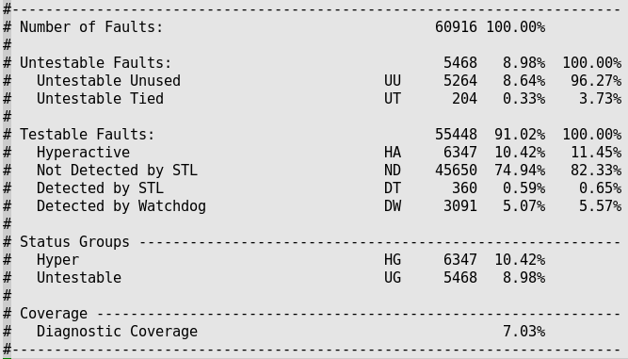
Results
After the successful execution of faultsim, below diagnostic coverage report is generated. This particular report is with testing just load and store instruction.

Slide 14
VC-Z01X also facilitates the fault simulation status per hierarchy, hence the complete picture of DC status for all hierarchies from top to bottom is obtained.

Slide 15
FMEDA
𝜆_{𝑝} : Raw Failure rate in FIT. S_{𝑝}%: Safe fault fraction. 𝜆_{𝑝d}: Dangerous fault fraction. 𝜆_{𝑝} % : Failure rate distribution for the Failure mode as a percentage of whole design's failure rate. 𝐷𝐶%: Diagnostic coverage. 𝜆_{RF} : Residual Faults.
Part | Failure mode | Tech node | Safety related | Failure mode type | No of unit design elements | 𝜆_{𝑝} | S_{𝑝}% | 𝜆_{𝑝d} | 𝜆_{𝑝} % | 𝐷𝐶% | 𝜆_{RF}
u_instruction_execute | Incorrect operation | 3nm | YES | MISSION | 350 | 350 | 8.89% | 318.885 | 0.00% | 0.733% | 316.54
Part | Failure mode | Tech node | Safety related | Failure mode type | No of unit design elements | 𝜆_{𝑝} | S_{𝑝}% | 𝜆_{𝑝d} | 𝜆_{𝑝} % | 𝐷𝐶% | 𝜆_{RF}
u_instruction_execute | Livelock | 3nm | YES | MISSION | 350 | 350 | 8.89% | 318.885 | 0.02% | 6.295% | 298.81

Slide 16
Questions

