Slide 1
Future Proofing Power Intent Specification through Unified Power Format (UPF) 4.0 for Evolving Advanced State Retention Strategies
Lakshmanan Balasubramanian¹, Amit Srivastava², Raguvaran Easwaran³, John Decker⁴, Rick Koster⁵, Progyna Khondkar⁴, Paul Bailey⁶, Barry Pangrle⁷, Shreedhar Ramachandra², Phil Giangarra⁴, John Biggs^{8,9} and David Cheng⁴
1 2 3 4 5 6 7 8 9

Slide 2
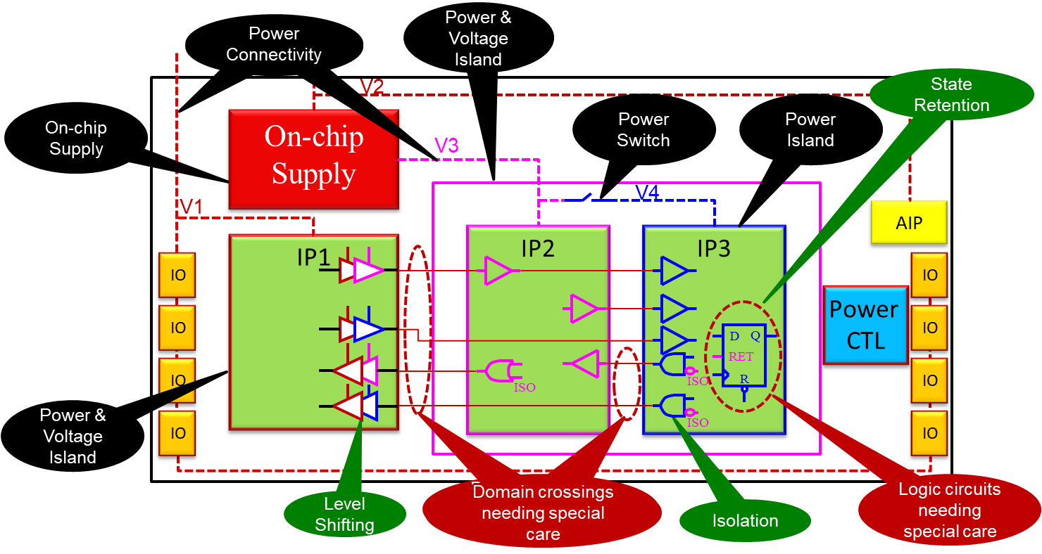
Background| Typical Low Power System
Electronic systems evolve
Increasing demands for energy efficiency, esp. mobile, embedded and autonomous applications
Low power (LP) design techniques for dynamic and static power reduction
Functionally and electrically consistent LP design → User-controllable power-versus-performance trade-off
Choice of devices/components used
Adaptive and static body biasing
Clock frequency reduction for periods of low performance
Adaptive voltage and frequency scaling
Power gating
Techniques for avoiding functional and power consumption issues
Isolation of signals from switchable i.e., power gated domains to clearly define safe states
Level shifting for signals crossing between domains of incompatible supply voltage levels
State retention (SR) of memory elements → Focus of this paper
Clock and reset domain crossing (CDC & RDC) techniques
Clock and reset synchronization → Handled functionally

Slide 3
Motivation
Standardised power intent (PI) specifications like Common Power Format (CPF) and Unified Power Format (UPF)
Support the power gating, voltage scaling and related aspects
Challenge: Maintaining data integrity during power-down events viz. power shutdown and various gradations of sleep modes
State retention (SR) strategies → Preserving critical state information even when the power supply is turned off
This presentation explores, in the context of complex low power System-on-Chip (SoC)
Various SR techniques, including the design and implementation of SR registers
Optimising power consumption, system recovery times & overhead during power state transitions
Utilising UPF (IEEE 1801 standard) for effective & coherent SR specification, modelling, verification, and implementation
Ensuring functional and electrical correctness under a wide range of operating conditions
Verification strategies → Power state analysis, data integrity check & seamless power state transition

Slide 4
A Typical Power-Aware Verification Setup
Vijayakumar Sankaran, et al, Modern Recipes for Brewing the Inevitable Methodology for Today’s ICs: Low-Power Mixed-Signal Design Verification, Tutorial, DAC 2019
Lakshmanan B, et al, A holistic approach to low power mixed-signal design verification using power intent: CPF-Based Interface Elements, Methods, and Guidelines, DVCON 2016

Slide 5
A Typical Low Power System & Behaviour
Legend:
V1, V2: Primary power supplies
V3, V4: On-chip switched power supplies
CLK: Clock signal
RSTZ: Active low reset signal
RET: Active high state retention control signal
ISO: Active high isolation control signal
D: Input data to a state retention cell
Q: Output of a state retention cell
RSTZ_V4: Reset for the power domain V4
Vijayakumar Sankaran, et al, Modern Recipes for Brewing the Inevitable Methodology for Today’s ICs: Low-Power Mixed-Signal Design Verification, Tutorial, DAC 2019

Slide 6
Typical LP System| UPF 3.1 Abstraction & Signal-Level Behaviour
(1 of 2)
upf_version 3.1
set_retention ret -domain PD_V4 \
-save_signal {RET posedge}
-restore_signal {RET negedge} ...
define_retention_cell -cells SR1 -clock_pin CLK \
-save_function {RET posedge} -restore_function {RET negedge} \
-power_switchable VDD -power VDD_RET -ground VSS
Clock Free
Vijayakumar Sankaran, et al, Modern Recipes for Brewing the Inevitable Methodology for Today’s ICs: Low-Power Mixed-Signal Design Verification, Tutorial, DAC 2019

Slide 7
Typical LP System| UPF 3.1 Abstraction & Signal-Level Behaviour
(2 of 2)
upf_version 3.1
set_retention ret -domain PD_V4 -save_signal {RET posedge} \ -restore_signal {RET negedge} \
-save_condition {!CLK} -restore_condition {!CLK} …

Slide 8
Evolving SR Strategies
Conventional SR techniques
Sub-optimal implementation for evolving technologies and end applications
Evolving SR strategies
Area and power efficient SR elements utilising lower i.e., device-level optimisations
May impose additional functional and electrical boundary conditions
Lakshmanan Balasubramanian, et al, Advanced Low Power Retention Simulation Framework, Designer Track, DAC 2019

Slide 9
Power Intent Standard Limitations
Handling additional boundary conditions imposed by the evolving advanced SR strategies
Not supported in the current versions of PI standards
Most of the electrical and behavioural constraints are not specifiable in the current PI specification standards
On reset (CLRZ), preset, clock (CLK) signals of such SR elements & SR strategies
Across different states of the related power domains (both primary and backup power domains)
Across different states of the retention control signal (RET)
This state-of-the-art causes
Late finding of or miss basic architectural and infrastructural specification violations
Inappropriate (both inaccurate and incorrect) implementation details
Evolution until very late in the design cycle → Cannot be comprehended in RTL stage, PI limitations, specification and verification gaps
Existing synthesis and implementation methods/tools don’t comprehend
Such functional behaviours can only be comprehended at a mature design stage post Gate Level abstraction
Only with power-aware simulations
Some electrical behaviours require even transistor-level simulation like Analog and Mixed-Signal (AMS) co-simulation
Can be prohibitively costly
Impractical due to the complexity and computational costs for simulations especially at late stages of design
Potentially resulting in escaped design issues and silicon bugs
IEEE Standard 1801-2024, “IEEE Standard for Design and Verification of LP, Energy-Aware Electronic Systems,” 2024

Slide 10
Proposed Solution
Extensions and enhancements in the new version UPF 4.0
Propose to add additional syntactical features supporting scalable semantics of evolving advanced SR requirements and techniques for
Comprehensive power intent specification
Consistent and coherent comprehension
Seamless handling across EDA tools and flows
These features include semantic and syntactical extensions to existing retention related commands
define_retention_cell, map_retention_cell, set_retention, & use_interface_cell
Additional set of predefined options (conditions) to identify system states save_event_condition, restore_event_condition, restore_period_condition, power_down_period_condition, & async_set_reset_effect

Slide 11
Extensions in UPF 4.0
upf_version 4.0
set_retention retention_name -domain domain_... \
[-save_signal {logic_net <high | low | posedge | negedge>} \
[-restore_signal {logic_net <high | low | posedge | negedge >}] \
[-save_event_condition {boolean_expression}] \
[-restore_event_condition {boolean_expression}] \
[-powerdown_period_condition {boolean expression}] \
[-restore_period_condition {boolean expression}] \
[-async_set_reset_effect <ignored | retained_value | output_value>] \
[-applies_to <flop | latch | any>] \
… [-save_condition {boolean_expression}] \
[-restore_condition {boolean_expression}] \
[-retention_condition {boolean_expression}]
New Semantic Features
New Filter
Declared Legacy for Backward Compatibility → Cannot Co-Exist with New Features

Slide 12
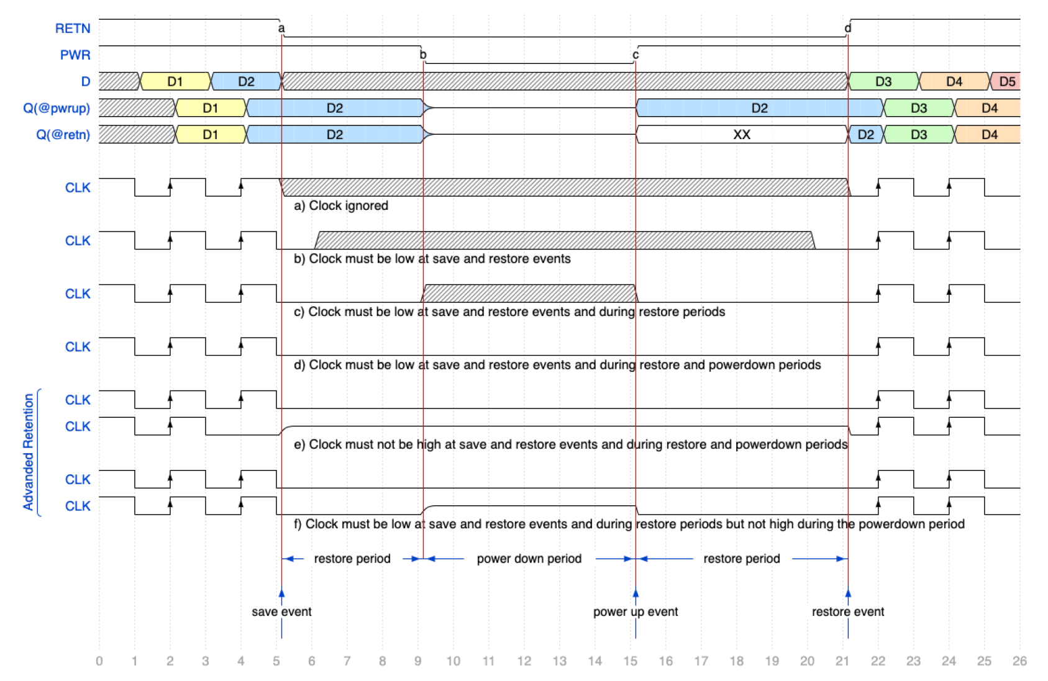
Single-Control Retention| Clock State Dependency
Clock ignored during RETN active → Default behaviour
Clock must be low at save and restore events -save_event_condition {!UPF_GENERIC_CLOCK} -restore_event_condition {!UPF_GENERIC_CLOCK}
Clock must be low at save and restore events, & during restore period -save_event_condition {!UPF_GENERIC_CLOCK} -restore_period_condition {!UPF_GENERIC_CLOCK}
Clock must be low at save and restore events, & during restore and power-down periods -save_event_condition {!UPF_GENERIC_CLOCK} -restore_period_condition {!UPF_GENERIC_CLOCK} -powerdown_period_condition {!UPF_GENERIC_CLOCK}
e) Clock must not be high during save and restore events, & during restore and power-down periods -save_event_condition {UPF_GENERIC_CLOCK==0 || UPF_GENERIC_CLOCK==Z} -restore_period_condition {UPF_GENERIC_CLOCK==0 || UPF_GENERIC_CLOCK==Z} -powerdown_period_condition {UPF_GENERIC_CLOCK==0 || UPF_GENERIC_CLOCK==Z}
Clock must be low at save and restore events, & during restore periods, but not high during power-down period -save_event_condition {!UPF_GENERIC_CLOCK} -restore_period_condition {!UPF_GENERIC_CLOCK} -powerdown_period_condition {UPF_GENERIC_CLOCK==0 || UPF_GENERIC_CLOCK==Z}

Slide 13
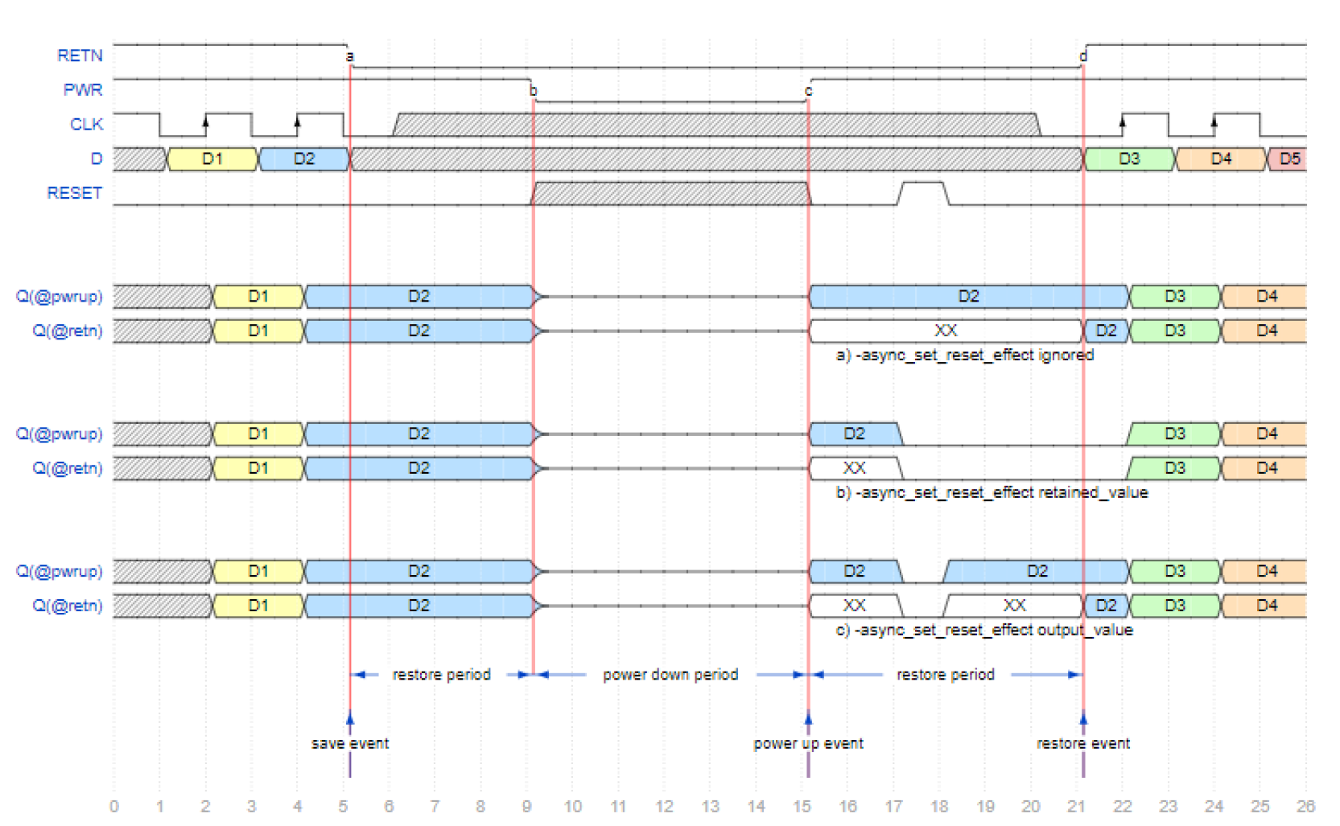
Single-Control Retention| Reset State Dependency
Reset is ignored during the restore period -async_set_reset_effect ignored
Reset affects the retained value and therefore the output value during the restore period -async_set_reset_effect retained_value
Reset affects the output value during the restore period -async_set_reset_effect output_value
a)
b)
c)

Slide 14
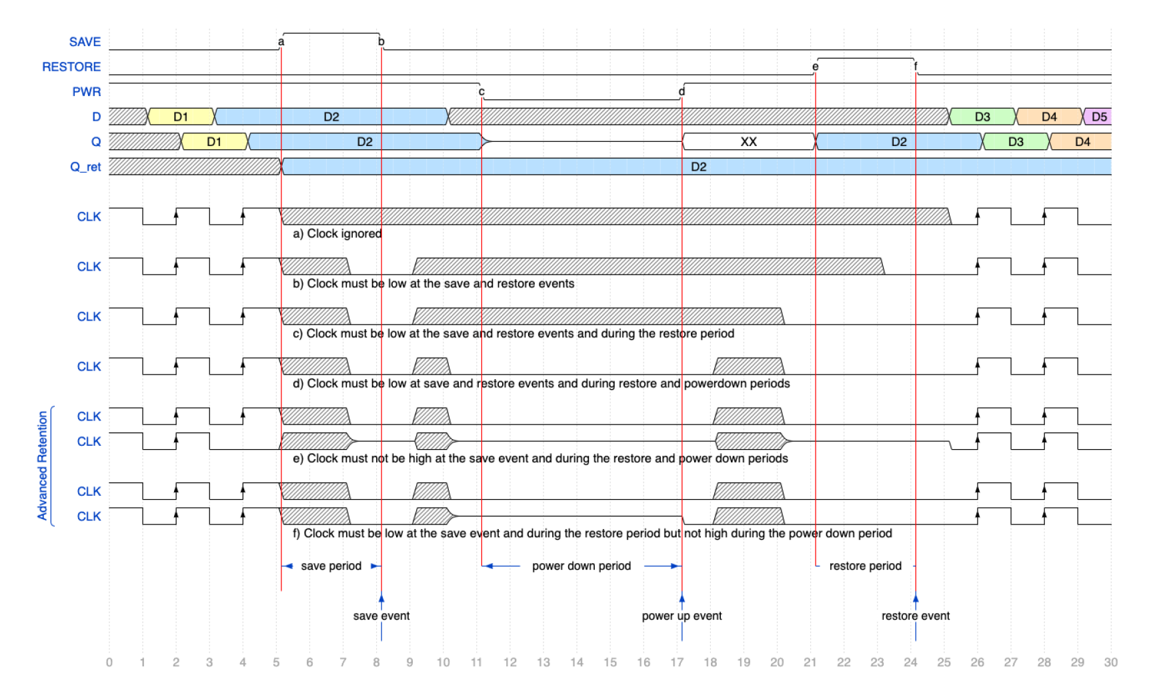
Dual-Control Retention| Clock State Dependency
Clock ignored during RETN active → Default behaviour
Clock must be low at save and restore events -save_event_condition {!UPF_GENERIC_CLOCK} -restore_event_condition {!UPF_GENERIC_CLOCK}
Clock must be low at save and restore events, & during restore period -save_event_condition {!UPF_GENERIC_CLOCK} -restore_period_condition {!UPF_GENERIC_CLOCK}
Clock must be low at save and restore events, & during restore and power-down periods -save_event_condition {!UPF_GENERIC_CLOCK} -restore_period_condition {!UPF_GENERIC_CLOCK} -powerdown_period_condition {!UPF_GENERIC_CLOCK}
e) Clock must not be high during save and restore events, & during restore and power-down periods -save_event_condition {UPF_GENERIC_CLOCK==0 || UPF_GENERIC_CLOCK==Z} -restore_period_condition {UPF_GENERIC_CLOCK==0 || UPF_GENERIC_CLOCK==Z} -powerdown_period_condition {UPF_GENERIC_CLOCK==0 || UPF_GENERIC_CLOCK==Z}
Clock must be low at save and restore events, & during restore periods, but not high during power-down period -save_event_condition {!UPF_GENERIC_CLOCK} -restore_period_condition {!UPF_GENERIC_CLOCK} -powerdown_period_condition {UPF_GENERIC_CLOCK==0 || UPF_GENERIC_CLOCK==Z}

Slide 15
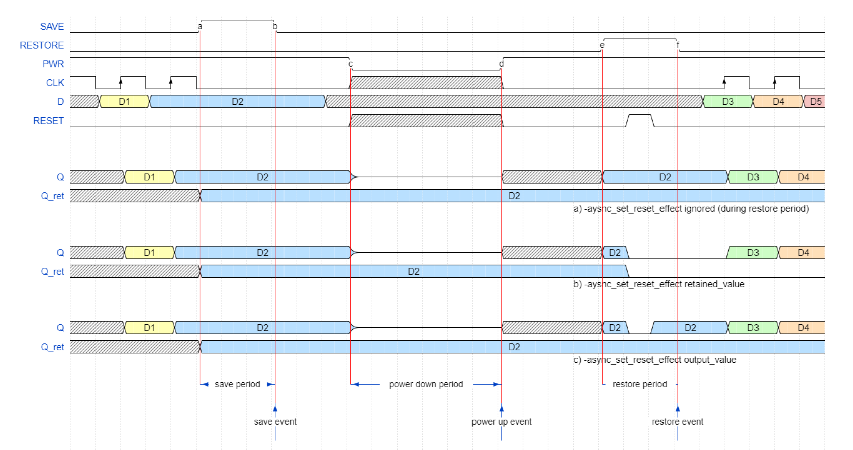
Dual-Control Retention| Reset State Dependency
Reset is ignored during the restore period -async_set_reset_effect ignored
Reset affects the retained value and therefore the output value during the restore period -async_set_reset_effect retained_value
Reset affects the output value during the restore period -async_set_reset_effect output_value
a)
b)
c)

Slide 16
Novelty Elements & Evidence
Comprehensive support to specify the electrical and functional boundary conditions of evolving and advanced state retention (SR) mechanisms
Syntactical and semantical support to specify conditions on clock, reset, present, related power domain
Trade-off between area (cost of build) versus power consumption
Power trade-off: Clock tree versus state retention element, active versus standby power & dynamic versus leakage power
Complexity trade-off: System level versus state retention element level
Need for local and/or global clock gating & entire clock tree to remain powered-on, etc.
Case study demonstrated practical applications of SR strategies in LP designs highlighting design trade-offs

Slide 17
Summary
Presented syntactic and semantic enhancements to existing UPF commands to support evolving advanced SR strategies
Shared insights on how such SR strategies can be effectively implemented to balance energy efficiency, system performance, and data integrity → As an essential component of modern LP design flows
Presented recommendations on best practices for designing and verifying SR strategies in the current, continuously evolving and future energy-aware electronic systems

Slide 18
Acknowledgements
Colleagues of IEEE P1801 Working Group, for creativity in devising many of the design scenarios discussed & contributions driving the standard
Special gratitude is due to Marcelo Glusman of Cadence Design Systems for thorough and critical review of the manuscript & presentation
Thanks all of you for kind attention, time, and interest
Welcome Questions & Interaction

