Slide 1
A Low-cost yet effective coverage model for fast functional coverage closure
Koushik Ramakrishnan, Roshan Paul, Suresh M K, Ajay Rupanagudi, Tathagato Bose, Guru Venkatesh K, Vaidyanathan Sambasivan, Subodh Prabhu
Nvidia Corporation

Slide 2
Agenda
Problem statement
Proposed coverage model
Applications of the proposed model
Performance metrics
Future work

Slide 3
Problem statement
Traditional functional coverage is slow in large IP/cluster testbenches
Covergroup count grows exponentially with the number of IPs and their instances
Design and verification IPs add extensive new coverage code
Consequently,
This leads to high compilation and run time
Coverage report generation may take many days to converge
Coverage analysis gets de-prioritized at the start of the project

Slide 4
Problem statement - continued
Efficiency issues
Lack of automated coverage checks
Silent drops in coverage
Coverage goals aren’t part of submission criteria
Farm usage
Functional coverage enabled simulations consume lots of farm time
Testcases that don’t contribute to coverage waste farm time

Slide 5
Proposing LWC (“Low Weight Coverage”)
Why is it “low weight”?
Zero impact on compile time
Low runtime impact
Instant coverage report generation
Doesn’t provide all the features that function coverage gives
This makes LWC a lightweight model

Slide 6
LWC overview - 1
‘Stat counters’ form the foundation of LWC.
What is a ‘stat counter’ ?
Corresponds to a ‘coverage item’
Incremented when a coverage event occurs
Can be declared in the testbench or RTL

Slide 7
LWC overview - 2
What does the LWC flow look like ?
Stat counters are incremented during the simulation
At end-of-test, the stat counter names and values are printed to a file
LWC post-regression parser reads the counter values from the entire regression’s test results
The parser computes average of each counter across the regression
Compares the computed average against expectations

Slide 8
LWC overview - 3
Why use a counter?
Consider a “valid” signal as your coverpoint.
Some tests may not generate any ‘valid’ transactions which can be acceptable.
However, we still expect a reasonable number of ‘valid’ transactions across a regression.
Measures real stimulus quality rather than indicating what is covered or not.
Assess whether a regression meets its aggregate coverage goals.

Slide 9
LWC overview - 4

Slide 10
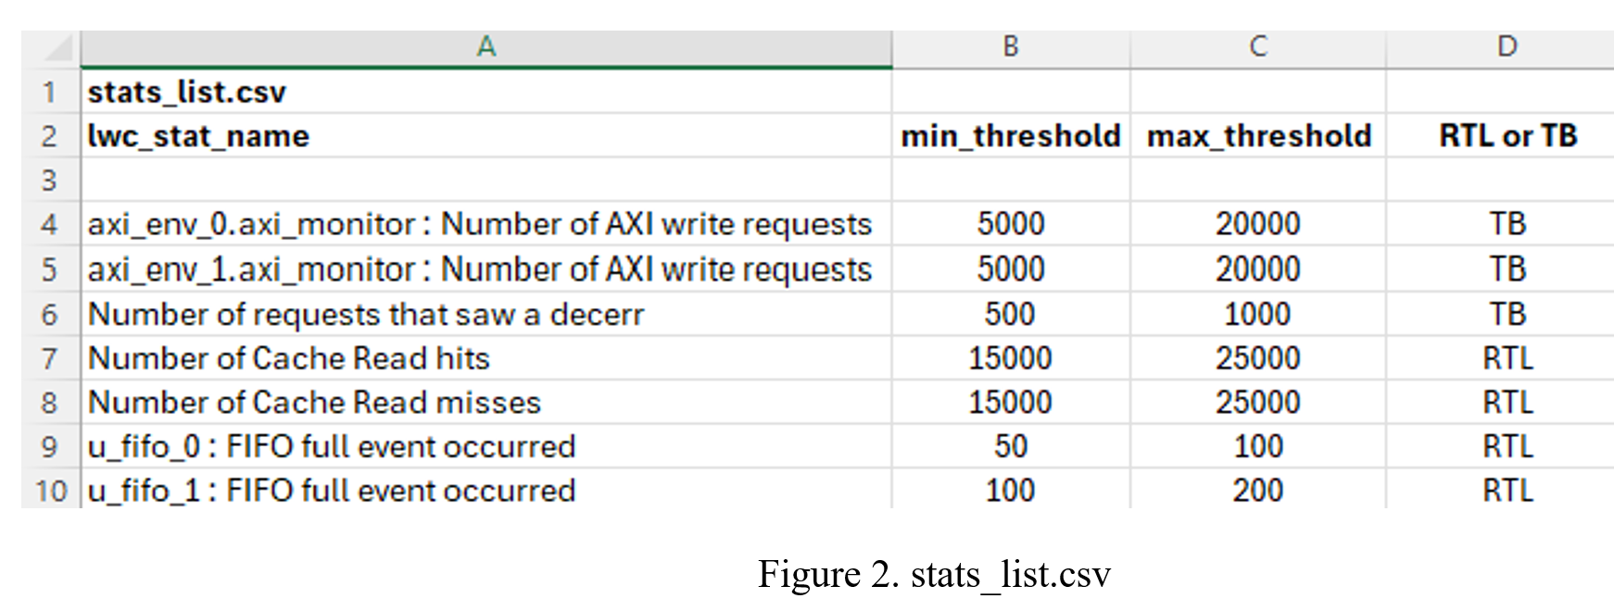
Example coverage scenarios and thresholds

Slide 11
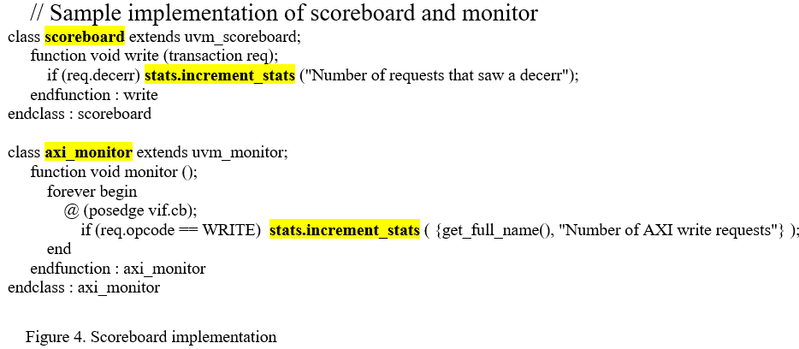
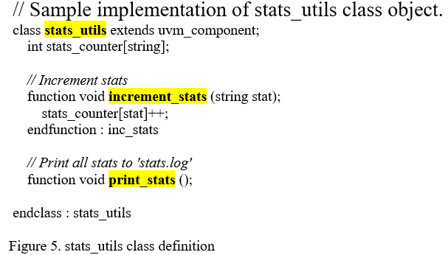
LWC counters TB implementation

Slide 12
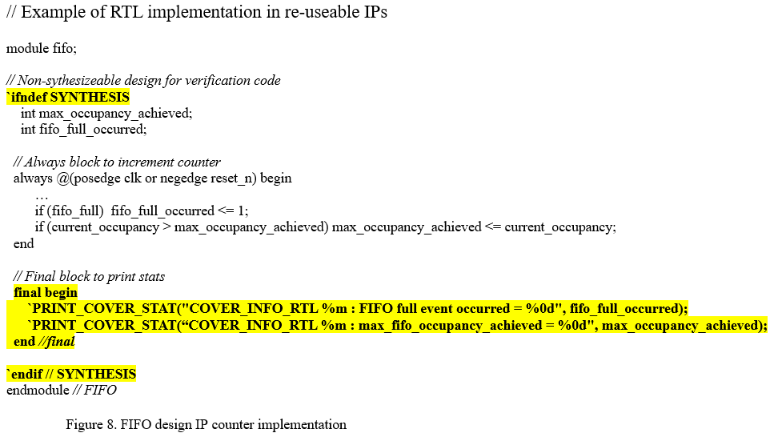
LWC counters RTL implemented

Slide 13
LWC Post-Regression Parser
Too many decerrs
In a regression of 100 tests, we expect ‘u_fifo_1’ to be full at least 100 times

Slide 14
How are min and max thresholds arrived at ?
Depends on multiple factors
How do you define your regression ?
Directed or randoms
Volume of traffic
Features being tested

Slide 15
Improving efficiency using LWC - 1
Reused LWC counters at higher level testbenches
Implemented stat counters in re-usable design IPs and VIPs
Wrote in-simulation and post-simulation checks
To make sure directed tests meet their intent
This is much harder to do with covergroups
Reactive stimulus based on feedback from the testbench counters

Slide 16
Improving efficiency using LWC - 2
Enabled LWC methodology across all IP, sub-IP, cluster testbenches
LWC is our primary source of coverage closure for feature verification
Used LWC coverage results to qualify changes before submission
Used stat counters to report metrics
Track static and dynamic latency per IP over the lifetime of the project

Slide 17
Improving efficiency using testcase ranking
Used LWC to do testcase tuning i.e., identifying inefficient testcases that don’t contribute to coverage
Allowed project-to-project / milestone-to-milestone / IP-to-IP “score” comparisons
Use “anomaly detection” to keep track of any drops in week-to-week coverage scores and notify the user

Slide 18
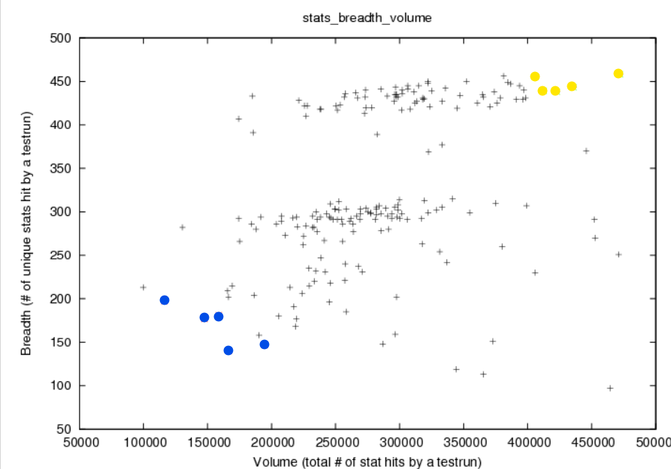
Testcase ranking
Testcase ranking metrics used by LWC based on [1] –
Breadth – Tests hitting variety of coverage i.e., unique stats
Volume – Tests hitting bulk of coverage i.e., number of all stat hits
Score – how valuable a test is for bulk verification.
Score = (Volume² + Rarity_Factor * Breadth² – Time Factor – Time²)^{Power_Factor}
Rarity – how crucial a test is for rare scenario verification.
SPF (score per farm cycle) – how efficient a test is for bulk verification (for a given farm time).
SPF=(Score∗TimeFactor)/cpuTime
RPF (rare score per farm cycle) – how efficient a test is for rare scenario verification (for a given farm time).
RPF=(RareScore∗TimeFactor)/cpuTime

Slide 19
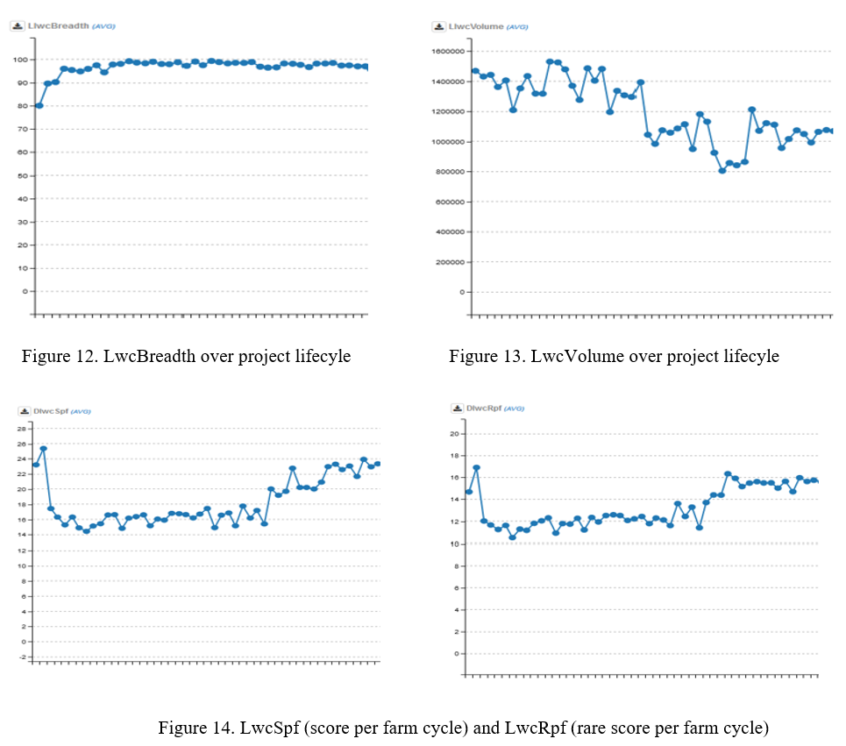
Testcase tuning
Breadth remains same
But volume reduces
SPF/RPF increases over time
Testcases are becoming more efficient!

Slide 20
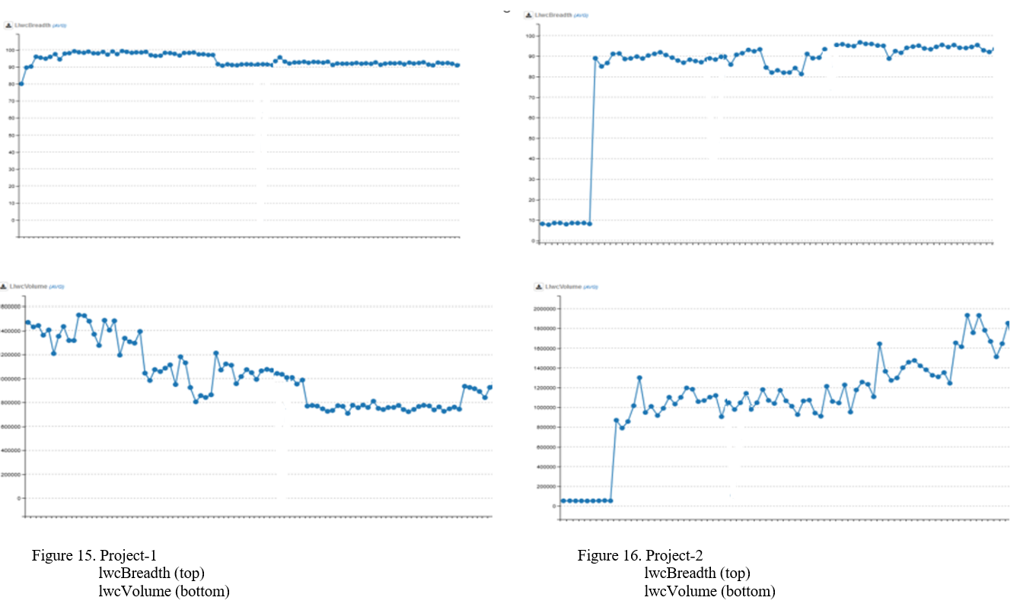
Project-to-project comparisons
Project-1 is more mature
Project-2 is newer and less stable
Breadth is stable
Volume has reduced
Breadth and volume are increasing

Slide 21
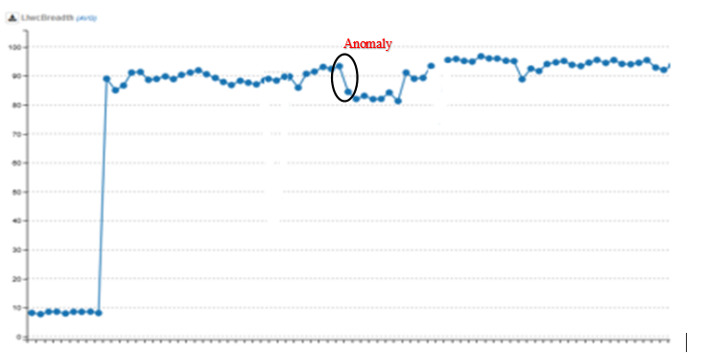
Anomaly detection
Notify the user !

Slide 22
Limitations of LWC
LWC doesn’t have many features that functional coverage provides
Scenarios that would have required too many functional coverage bins may not scale with LWC
LWC needs to be used in conjunction with functional coverage!

Slide 23
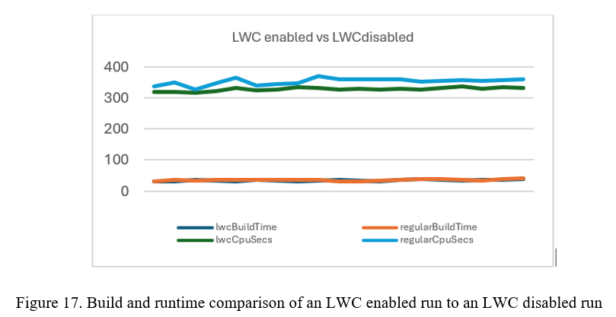
Performance metrics - 1
10,000 lwc stat counters were used
No build time impact
Lwc enabled run had a runtime overhead of 4%

Slide 24
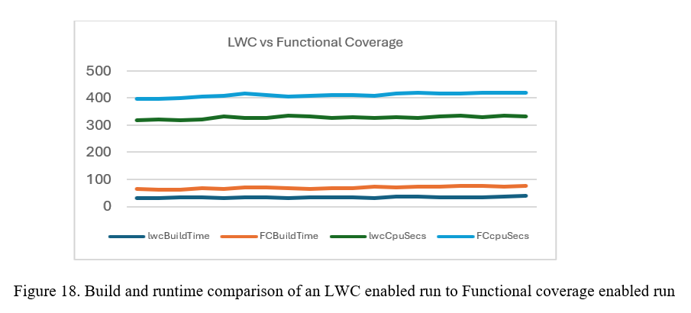
Performance metrics - 2
10,000 lwc stat counters vs 10,000 coverpoints
Lwc provides build time savings of 40-50% and runtime savings of 20%

Slide 25
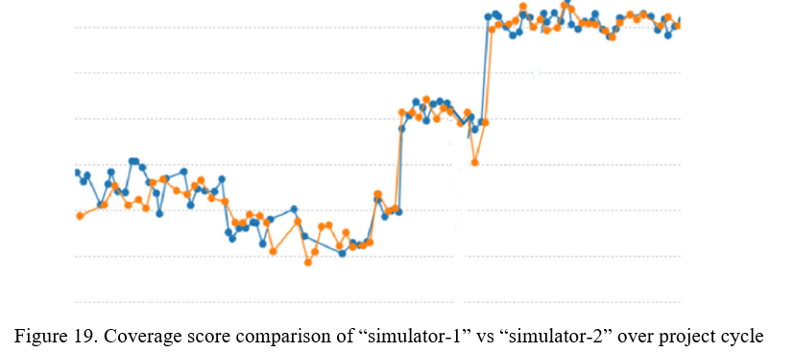
Performance metrics - 3
Coverage scores identical across two simulators over time.
This validates LWC as a reliable methodology

Slide 26
Future work
Future work focusses on integrating LWC with LLM.
Auto-tune a regression by injecting or removing test-cases until a specific coverage goal and efficiency is met.
This is a manual process today

Slide 27
References
[1] “Optimizing Random Test Constraints Using Machine Learning Algorithms”, ARM.
https://dvcon-proceedings.org/wp-content/uploads/optimizing-random-test-constraints-using-machine-learning-algorithms-presentation.pdf
[2] “Testbench coverage”, Synopsys, https://www.synopsys.com/verification/simulation/vcs.html

Slide 28
Questions ?

Slide 29
We plan to make low_weight_coverage available open source under this link. https://github.com/koush3119/low_weight_coverage

