Slide 1

A Novel AI-ML Regression Flow for
SoC Verification
Presenters:
Sunil Shrirangrao Kashide(Head of part, SoC DV)
Co-Authors:
Narasimha Rao Chinni (Senior Manager, SoC DV)
Garima Srivastava ( Group Head, SoC DV)

Slide 2
Agenda
Introduction
Verification Flow
Concept
Phased execution Flow
Use Cases
Results
Conclusion

Slide 3
Introduction – Verification Flow
Document Manager
Design Spec
Interpretation
vManager
vManager vplan
Manual !
Run & Debug
Test Plan
Verification flow – Tools
Understand Design – Manual !
Test plan – vManager / XLS
Understand Testbench – Specador/DVT
Develop New features – DVT VSCode
Run regression – vManager
Debug simulation failures – Manual !
DVT VSCode
Specador
DVT
Code Development
TB Understanding

Slide 4
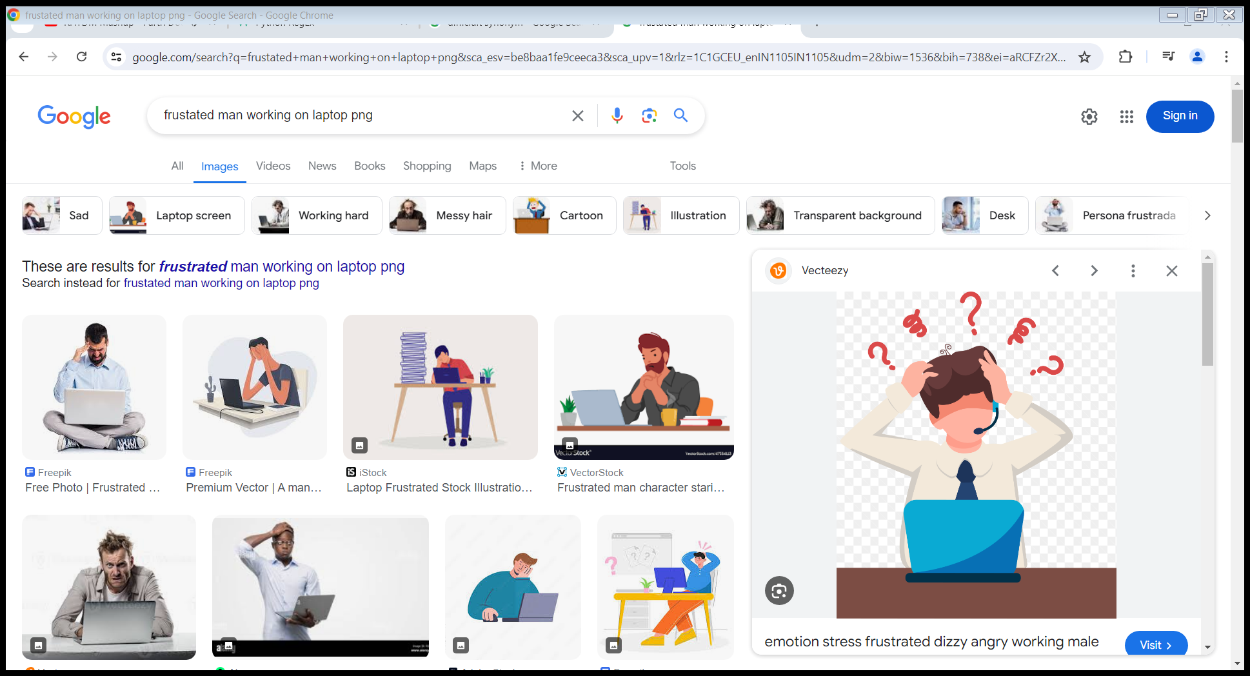
Introduction-Debug
Run Regressions Periodically
To Confirm all Tests marked PASS are still passing !
Any Change may Break already passing test
Common reasons
Design update/integration
Debug Turnaround time
Due to manual effort in debug and rerun the simulations
Test bench modification
Week of time
Simulation Environment
Debug
Manual
Effort

Slide 5


What is that we are looking for !
An intelligent and scalable acceleration flow/solution which can address following motivations
Reduce/Avoid manual effort in debug
Provide possible root cause analysis
Reduce overall Turn Around Time
Scalable flow which is easily adaptable at various platform

Slide 6
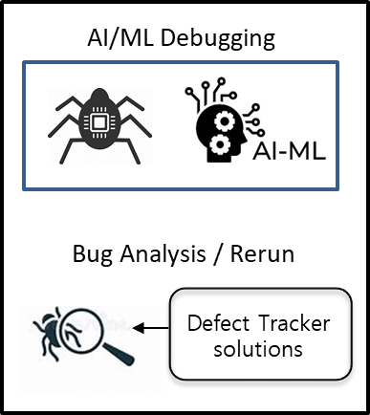
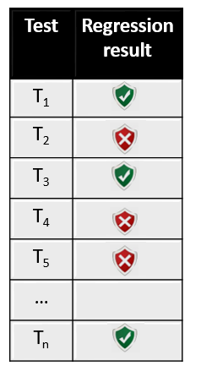
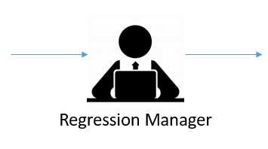

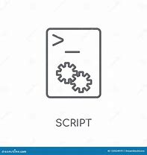

Phased execution flow [1/2]
Planning
Execution
Label : Tag N+1
Test Plan
Test | Status | Tag
T₁ | PASS | Tag N
T₂ | PASS | Tag N-1
T₃ | PASS | Tag N
T₄ | FAIL | Tag N-1
T₅ | FAIL | Tag N-1
…
T_{n} | PASS | Tag N
Regression
Passing Dump
Update “Tag” in
Test plan
Debug
ML DB

Slide 7

Phased execution flow [2/2]
Regression manager launches the regression of tag (N+1)
AI-ML Flow analyse the failure using ML DB (data base)
(Defect Tracking Tool) will provide fix if its known failure
Otherwise, failure is going to be debugged by AI-ML Debugger
AI-ML Debugger is going to generate the snapshot of last Pass
CodeMiner analyses both Pass and Fail snapshot and sort list the root cause in ranking basis. (RTL, TB or both)
WaveMiner will compare wave dump of passing and failing simulation
Once the fix is submitted, the same is stored in ML DB and updated for later reference
Latest passing Tag will be updated in Test plan
by referring the past database (ML DB) where that particular test had passed
Regression
Analysis
Yes
ML DB
Pass
Update Tag
No
ML Flow
Old Failure
Yes
Defect Tracker
No
Apply Fix
Re-run
New test
Yes
AI-ML
CodeMiner
No
RTL Diff
User Debug
AI-ML
Ranking of Root Cause
WaveMiner
Waveform Diff
Ranking of Root Cause

Slide 8
Use cases
Known failure
(Defect Tracking tool)
In house tool
Newly added feature (CodeMiner)
Prev fix is already registered(Jira, file sync)
CDN tool
First time failure. Compare RTL snapshot
New failure
(WaveMiner)
CDN tool
Failure occurred in latest Tag. Compare against last PASS tag
Notes:
AI-ML can be applied to debug the following cases

Slide 9
Results
TAT Metric | Gain over Traditional approach
Debug time of simple test (Register access) | 2-10x improvement
Over all TAT of simple test (debug + re-run + multiple iterations) | 2-5x improvement
Debug time of a complex test | 2-5x improvement
Over all TAT of Complex (debug + re-run + multiple iterations) | 2-20x improvement
Regression TAT | 2-20x improvement

Slide 10
Conclusion
Debug multiple failures simultaneously
Scalable to IP/SoC/sub-system level
Easy deployment
Save debug time by many fold

Slide 11
Thank you
Queries !

Slide 12
Guidelines (1)
Please keep the default font size for main lines at 28pt (or 26pt)
  And use 24pt (or 22pt) font size for the sub bullets
Use the default bullet style and color scheme supplied by this template
Limited the number of bullets per page.
Use keywords, not full sentences
Please do not overlay Accellera or DVCon logo’s
Check the page numbering

Slide 13
Guidelines (2)
Your company name and/or logo are only allowed to appear on the title page.
Minimize the use of product trademarks
Page setup should follow on-screen-show (4:3)
Do not use recurring text in headers and/or footers
Do not use any sound effects
Disable dynamic slide transitions
Limit use of animations (not available in PDF export)

Slide 14
Guidelines (3)
Use clip-art only if it helps to state the point more effectively (no generic clip-art)
Use contrasting brightness levels, e.g., light-on-dark or dark-on-light. Keep the background color white
Avoid red text or red lines
Use the MS equation editor or MathType to embed formulas
Embed pictures in vector format (e.g. Enhanced or Window Metafile format)

Slide 15
Questions
Finalize slide set with questions slide

