Slide 1



Expedite multi-die coherency verification through adaptive VIP subsystem
Sunil Shrirangrao Kashide (Samsung-India)
Jainender Kumar (Samsung-India)
Garima Srivastava (Samsung-India)
Dimitry Pavlovsky (Cadence-USA)
Anunay Bajaj (Cadence-India)

Slide 2
Presentation Outline
Understanding Multi-Die Systems
Key Verification Differences from SoC
Overcoming Verification Challenges
Strategies for Effective Verification
Proposed Methods-Adoptive VIP subsystem
Advantages
Results and Summary
QnA

Slide 3

Understanding Multi-Die Systems
The complexity of modern SoC architecture is continuing to increase
To address the yield and scalability the design getting split in Chips and/or Chiplets
Multi-die systems involve assembling multiple smaller chiplets or tiles, onto a single package [SIP]-2D, 2.5D & 3D
The modularity of chiplets offers several advantages, such as boosting production yield, shortening time to market, and providing greater flexibility in system design.
Interconnect between chiplets is crucial: Efficient interconnects ensure fast data transfer between chiplets, minimizing latency and power consumption
This has given birth to new protocols and specification –UCIe, CHIg,CXL,CXS…..

Slide 4
Key Verification Differences from SoC
Inter-Die Communication: Unlike monolithic SoCs, multi-die systems require verification of chip-to-chip communication based on specific protocols, such as UCIe, adding a new layer of complexity
Physical Verification Challenges: The physical verification of individual pieces and checking the interconnect between them as a system introduces unique challenges in multi-die systems.
Integration Testing: Verification processes must consider every step from a single die perspective while also ensuring seamless integration at the system level
Interconnect Verification Complexity
Protocol Compliance: Verifying chip-to-chip communication based on specific protocols, such as UCIe, introduces complexities related to protocol compliance and interoperability.
Signal Integrity: Ensuring signal integrity across the interconnects is crucial, requiring thorough verification to mitigate issues related to noise, crosstalk, and signal degradation.
Clock Domain Crossing: Verification must address challenges associated with clock domain crossing between different chiplets, ensuring synchronization and minimizing timing violations

Slide 5
Strategies for Effective Verification (D2D)
CPU
GPU
NPU
DMA
CPU
GPU
NPU
DMA
Legends
Coherent interconnect
Streaming
CXS/CXL/PCIe(6)
Coherent interconnect
Streaming
CXS/CXL/PCIe(6)
PERIPHERAL Interconnect
Coherent traffic
DDR0
………
……….
UCIe
UCIe
Non-Coherent traffic
DDR1
Coherent interconnect
DDR2
Non-Coherent interconnect
DDR4
CHI
Custom
Stream
UCIe
CHIPLET#0
CHIPLET#1
Faster identification of issues
System Level Coherency Assurance
Efficient resource utilization
Deterministic Run Time
Reusability of the stimulus

Slide 6
Multi Die Topologies
DUT
DUT
DUT
DUT
DUT
DUT
DUT
DUT
Topology-1
Topology-2

Slide 7
Challenges
“TestBench”
Development
and
Bring up time
“Exponentially Growing”
Simulation
run time
“Exponentially Growing”
Resource
Requirement
Higher
Boot-up
time
Higher
TestBench
maintenance
For multiple
Variants
Reusability
Across platform

Slide 8
Multi-Die Sub-System Topology
DUT
VIPSS
DUT
VIPSS
DUT
VIPSS
VIPSS
VIPSS
Topology-1
Topology-2

Slide 9

Proposed Approach [1/6]
Need a subsystem that is/can:
UCIE compliant
VIP
VIP
VIP
VIP
CPU
GPU
NPU
DMA
Manage the streaming protocol embedded inside UCIE payload.
Coherent interconnect
Streaming
CXS/CXL/PCIe(6)
PERIPHERAL Interconnect
DDR0
………
……….
UCIe
Custom Packetize/De-packetize information
Flow Control Support
DDR1
DDR2
DDR4
CHIPLET#0
Vendor specific protocol Responder/Transmitter

Slide 10
Proposed Approach [2/6]
Need a subsystem that is/can:
UCIeVIP
UCIE compliant
VIP
VIP
VIP
VIP
CPU
GPU
NPU
DMA
Manage the streaming protocol embedded inside UCIE payload.
Streaming
VIP
Coherent interconnect
Streaming
CXS/CXL/PCIe(6)
PERIPHERAL Interconnect
DDR0
………
……….
UCIe
Custom Packetize/De-packetize information
Flow Control Support
DDR1
Adopter
Layer
DDR2
DDR4
CHIPLET#0
CPU BUS VIP
Vendor specific protocol Responder/Transmitter

Slide 11
Proposed Approach [3/6]
TB
UCIe VIP
Streaming VIP
(Vendor Specific)
Responder/Transmitter
Adapter Layer
VIP
VIP
VIP
VIP
CPU
GPU
NPU
DMA
Coherent interconnect
Streaming
CXS/CXL/PCIe(6)
PERIPHERAL Interconnect
DDR0
………
……….
UCIe
DDR1
DDR2
DDR4
CHIPLET#0
VIP Subsystem

Slide 12
Proposed Approach [4/6]
TB
UCIe VIP
Streaming VIP
(Vendor Specific)
Responder/Transmitter
Adapter Layer
SB
VIP
VIP
VIP
VIP
CPU
GPU
NPU
DMA
Coherent interconnect
Streaming
CXS/CXL/PCIe(6)
PERIPHERAL Interconnect
DDR0
………
……….
UCIe
Comparator
DDR1
DDR2
DDR4
CHIPLET#0
Translator
VIP Subsystem

Slide 13
Proposed Approach [5/6]
TB
UCIe VIP
Streaming VIP
Responder/Transmitter
Adapter Layer
SB
VIP
VIP
VIP
VIP
CPU
GPU
NPU
DMA
Coherent interconnect
Streaming
CXS/CXL/PCIe(6)
PERIPHERAL Interconnect
DDR0
………
……….
UCIe
Comparator
DDR1
DDR2
DDR4
CHIPLET#0
VIP Subsystem

Slide 14
Proposed Approach [6/6]
TB
UCIe VIP
Streaming VIP
Responder/Transmitter
Adapter Layer
SB
VIP
VIP
VIP
VIP
CPU
GPU
NPU
DMA
Coherent interconnect
Streaming
CXS/CXL/PCIe(6)
PERIPHERAL Interconnect
API
DDR0
………
……….
UCIe
Comparator
DDR1
DDR2
DDR4
CHIPLET#0
VIP Subsystem

Slide 15
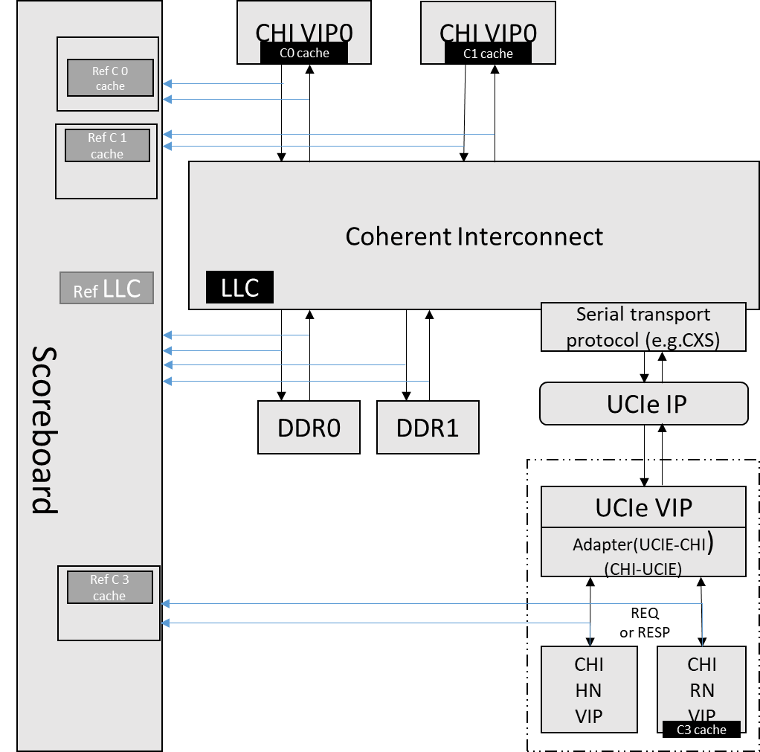
Advantages
Sequences
CHI Sequences can be reused
Scoreboard
End to End Data integrity
Time
Coherency Checks / LLC hit miss scenario
Reduced simulation time
Lesser Tb maintenance
Scalable
Protocol checking
Error Injection
Payload corruption
Back pressure
Retry/re-train
Timeout ……

Slide 16
Multi-Die Coherency Test Scenarios
Test Case Scenario
Non-Coherent Data Path:
  North to South: ReadNoSnp and WriteNoSnp* from CHI Master to CHI_HN VIP subsystem.
  South to North: ReadNoSnp and WriteNoSnp* from CHI_RN in VIP subsystem following Targets in local Die:
    DRAM
    SFR
    IRAM/IROM Memories
  Cross-die access check(SFR reserved/unmapped region, Reserved/Unmapped region in Memory map)
Coherent Data Path (CHI Masters):
Error Injection
  READ allocating
  ReadClean
  ReadNotSharedDirty
  ReadShared
  ReadUnique
  ReadPreferUnique MakeReadUnique
  READ non-allocating
  ReadOnce
  ReadOnceCleanInvalid
  ReadOnceMakeInvalid
  WRITE writezero
  WritenoSnpZero
  WriteUniqueZero
  WRITE Immediate write
  WriteNoSnpPtl
  WriteNoSnpFull
  WriteUniquePtl
  WriteUniqueFull
  WriteUniquePtlStash
  WriteUniqueFullStash
  WRITE copybackwrite
  WriteBackPtl
  WriteBackFull
  WriteCleanFull
  WriteEvictFull
  WriteEvictOrEvict
  Combined: Immediate Write & Persist CMO
  WriteNoSnpPtlCleanShPerSep
  WriteNoSnpFullCleanShPerSep
  WriteUniquePtlCleanShPerSep
  WriteUniqueFullCleanShPerSep
  Combined CopyBack Write & CMO
  WriteBackFullCleanInv
  WriteBackFullCleanSh
  WriteCleanFullCleanSh
  WriteBackFullCleanShPerSep
  WriteCleanFullCleanShPerSep
  Atomic Tx
  AotmicStore
  AtomicLoad
  AtomicSwap
  AtomicCompare
  Stash Transaction
  WriteUniquePtlStash
  WriteUniqueFullStash
  StashOnceUnique
  StashOnceShared
  StashOnceSepUnique
  StashOnceSepShared

Slide 17
Results (2-DIE)
Simulation Time
Topology | Boot + Link Up Time (in Hrs) | Simulation RunTime (in Hrs) | Total Time (in Hrs)
Multi Die | 37 | 1 | 38 hours
MD-VIPSS | 7 | 1 | 08 hours
Defect detect penetration | #
SFR PATH | 10
IP Design | 5
System Level | 7
Error Injection Scenario | 10
Defects Found
Early Design Issues

Slide 18
Summary
Faster identification of issues
√
Early deployment of TB
System Level Coherency Assurance
√
Exhaustive Coherent Opcode scenarios
Efficient resource utilization
√
No additional compute and memory (servers)
Deterministic Run Time
√
38x8
Reusability/Portability
√
CHI Sequences, SB, Checks promoted across platforms

Slide 19
Thank you

