Slide 1



AI - accelerating coverage closure using intelligent stimulus generation
Jainender Kumar, Ronak Bhatt, Garima Srivastava, Ashutosh Sinha, Prashant Teotia

Slide 2
Agenda
System on Chip (SoC)
Coverage and its Challenges in SoC NOC Interconnect
Proposed AI/ML Solution with SimAI
How SimAI Helps in Coverage Closure
Result and Key Metrics
Conclusion

Slide 3
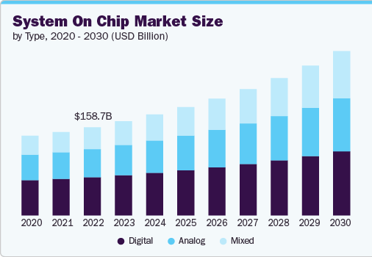
SOC
With a growing consumer market in AI, IOT & mobile applications, the design of SOC is becoming more complex than ever
Source: www.grandviewresearch.com

Slide 4
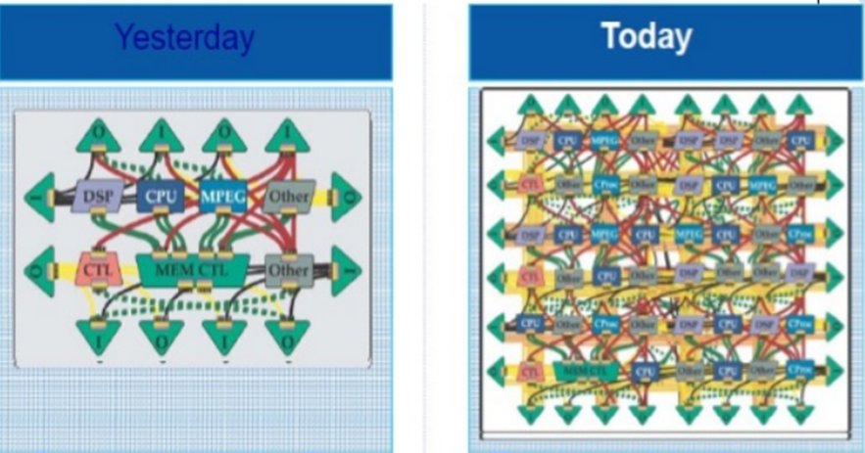
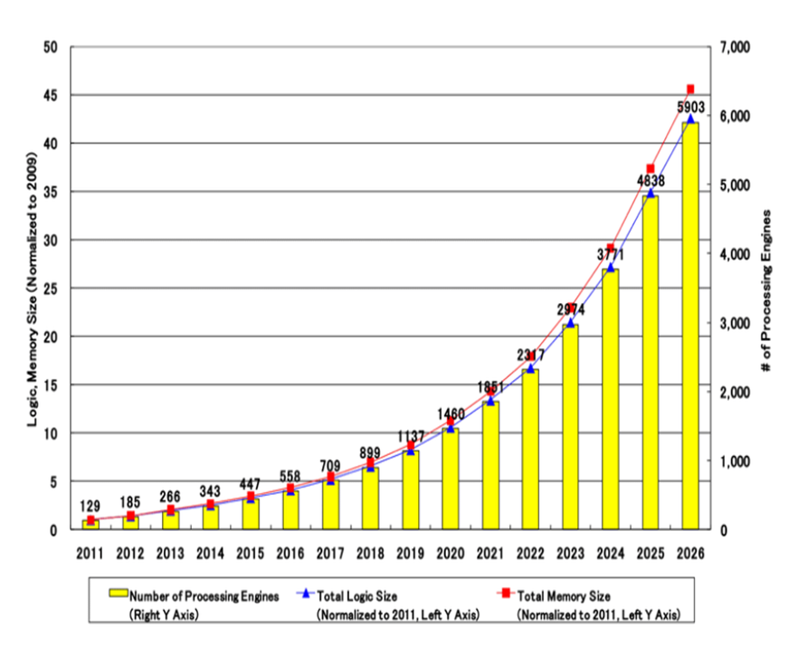
Complex SOC System
The customers have come to experience sophisticated applications, which is possible with the advent of complex SOC
Source: slideshare

Slide 5
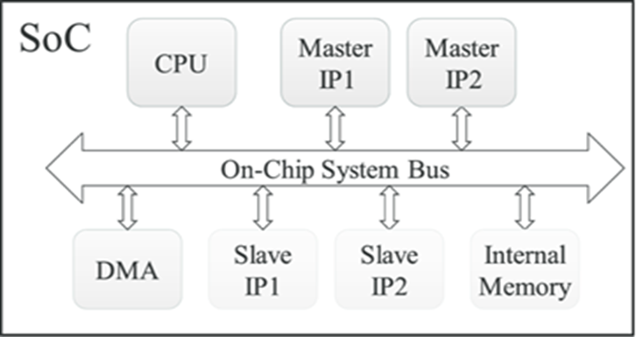
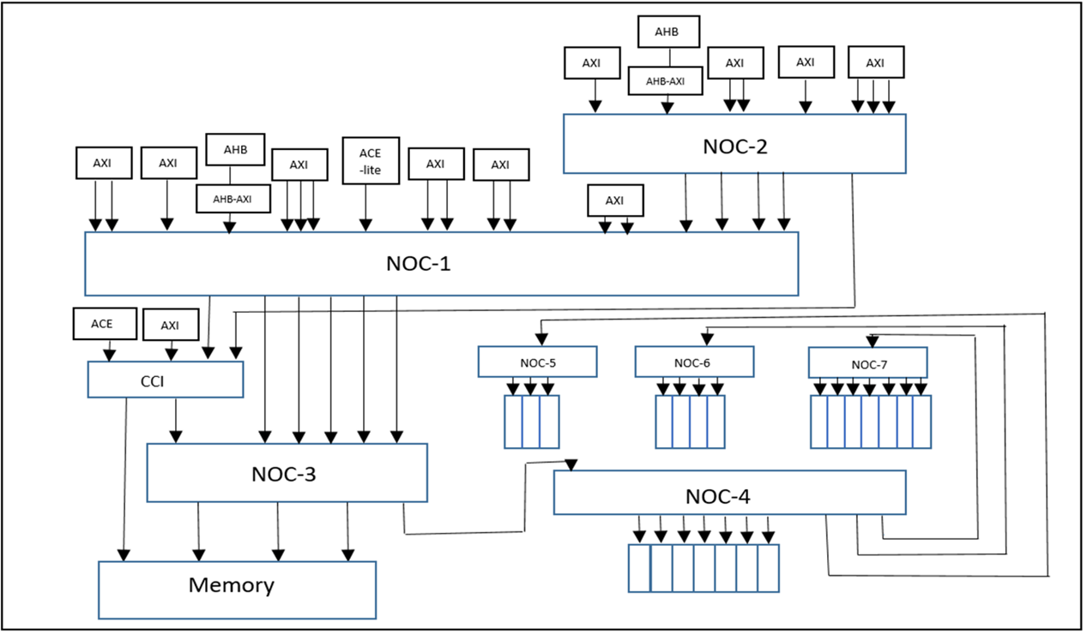
NOC
The Interconnects allows for the connection and communication between all the IPs in the SOC
Simplified NOC
METRICS
Reliability
Performance
Power
Cost
SOCs have evolved from single processors connected to a few IP blocks to multimode networks that connect to hundreds of IP blocks
Nested NOC
There can be 100s of masters and ~1000 slaves in the real system.

Slide 6



Verification Challenges
Complex interconnects
Explosion in Coverage Parameters
Massive number of bins
Impact on Time to Market
Ineffective coverage closure
Extensive functional coverage
Extended timeliness and increased consumption
Complicate verification efforts
Demand advanced solutions.
NOC Verification
Coverage is crucial for verification as it ensures all scenarios, edge cases, and requirements are exercised for comprehensive validation.

Slide 7

NOC Coverage Challenges
Coverage Complexity
Massive numbers of parameters and cross-products create over a million bins in SOC verification.
AXI
(Master)
READ
ID 1
Len 1
Size 1
Kind 1
Slave-1
Cover group -1
WRITE
ID 2
Len 2
Size 2
Kind 2
Slave-2
Cover group -2
Resource
Bottlenecks
Len N
Size N
Kind-N
Slave-N
Cover group -N
Simulation demands exceed available computational and memory resources.
Coverage
Saturation
Random stimulus reaches a plateau, leading to diminishing returns in verification progress.

Slide 8
NOC Coverage Traditional Approach
Test bench Fixes
Constraint Fixes
Bug Fixes
Test/vPlan
Execute regression suite
Measure the metrics
Randomized
Huge time
Stimulus
Large resources
More iteration/cycle
Less improvement
Need Directed test case
Manual intervention
Directed
Stimulus
Identify closure strategies
Coverage closure
No
Yes
Done

Slide 9

Proposed Solution
Constraints
Coverage Model
Reachability
Execute regression suite
Measure the metrics
Devise
Test Plan
Automation
SimAI input Bias config
Randomized
Stimulus
Address Space
Coverage closure
Done
2-6x seed
reduction
Maximized
coverage
Yes
No
AI generated test suite
SimAI

Slide 10
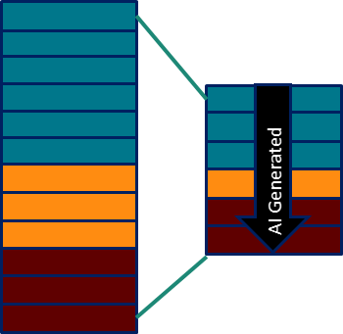
SimAI Introduction
Regression
Efficiency
AI Optimized Randomization
Coverage Hit Ratio
Verisium
SimAI
Hole
Jasper Formal
Jasper Formal
Jasper Formal
Xcelium
Stimulus
Jasper Formal
Xcelium
Coverage
Related hits to target

Slide 11
simAI - Input Bias
Input Bias maximizes coverage by stressing user-specified random variables.
  It fills efficiency gap of the autonomous coverage maximization of SimAI.
  It targets “hard-to-hit” coverage bins that have strong correlations to random variables
Input Bias Flow
Variable File
Reads the Variable File as additional input in SimAI
Evaluates how the variables in Variable File are assigned in user’s tests in the user’s regression
Generates a SimAI regression:
  Constrains so that the variables and values in Variable File are assigned effectively in user’s tests.
Users specify random variables and value ranges to stress
Users may specify groups of variables and values that should be assigned together.
Constraints
Variable File
Random
points
SimAI
Input Bias
Coverage
Test
Randomization
Trace

Slide 12
Proposed Solution
Constraints
Coverage Model
Reachability
Execute regression suite
Measure the metrics
Devise
Test Plan
Automation
SimAI input Bias config
Randomized
Stimulus
Address Space
Coverage closure
Done
2-6x seed
reduction
Maximized
coverage
Yes
No
AI generated test suite
SimAI

Slide 13
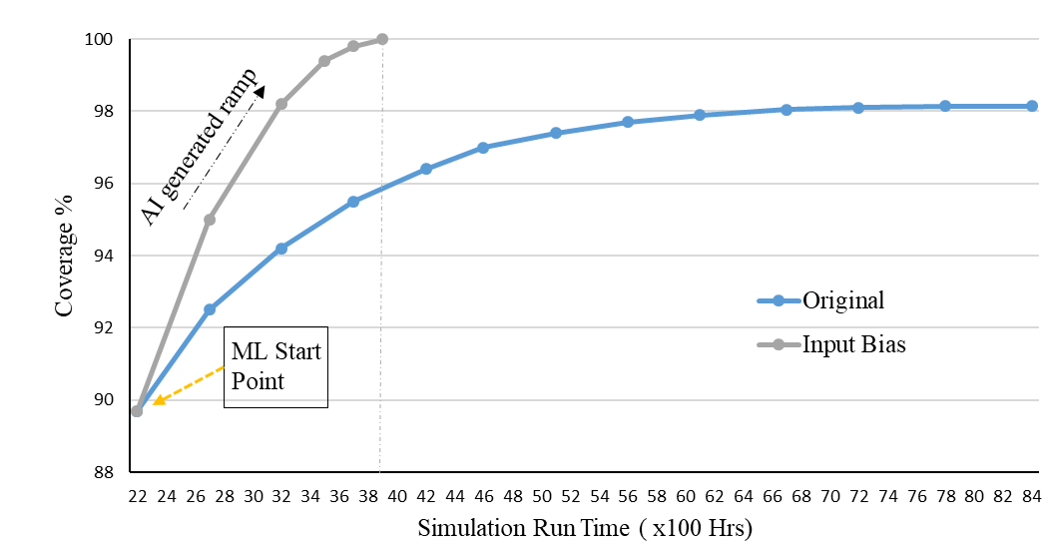
Result and Key Metrics
Impact of AI on coverage efficiency
Significant time reduction
Higher coverage achieved
Improved resource utilization
Without input-bias
With input bias
Figure 6. simAI tool generated coverage vs normal regression coverage after applying ML at 88%.

Slide 14
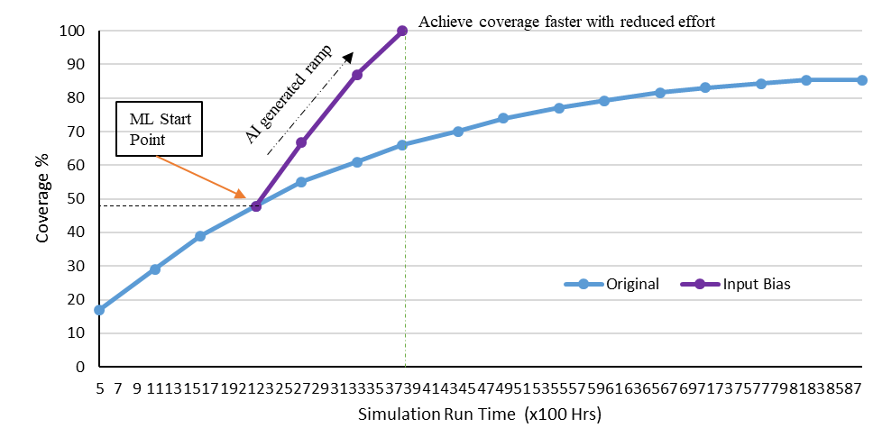
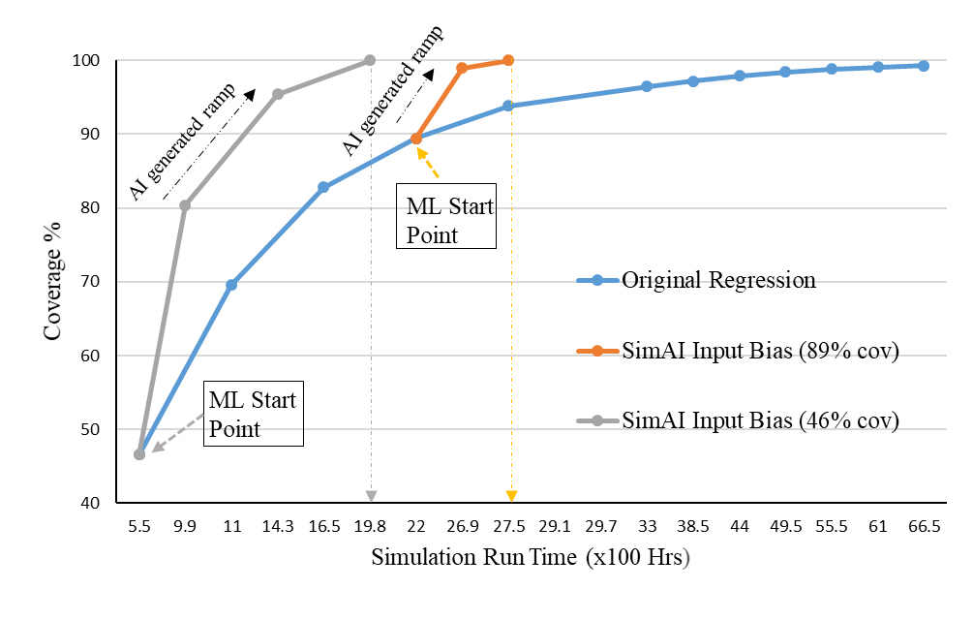
Result and Key Metrics
Without input-bias
Without input-bias
With input-bias
Figure 6. simAI tool generated coverage vs normal regression coverage after applying ML at 46%.
Figure 7. AI-generated coverage vs normal regression coverage applied on the same regression with different base regression

Slide 15
Advantages and Features
Why AI/ML in NOC Coverage Closure Stands Out ?
Dynamic Stimulus Adjustment
Easy Integration
Scalability and Efficiency

Slide 16
Conclusion
Leveraging AI/ML for Enhanced Functional Coverage
Efficient Coverage Closure without coverage saturation
Resource Optimization
Highly Scalable
Reduced coverage complexity with use of automation

Slide 17
Thank you

