Slide 1
Register Access by Intent: Towards Generative RAL based Algorithms
Ahmed M. Allam
AMS Verification Consultant, ICpedia

Slide 2
Outline
UVM Testcases challenges : RAL Perspective
UVM RAL Access by Intent : META-RAL
UVM MV-RAL
Generic RAL Algorithm
Applications

Slide 3
RAL challenges
Fields are moving around registers especially at early verification cycle.
Testcases has to adapt these changes rapidly.
Building RAL model as one inseparable unit
In large SoC, this impact simulation performance.
RAL sequences are always tied to DUT physical info.
Register sequences has to adapt to these changes.
Cannot be generic with different IPs and RTL releases.

Slide 4
META-RAL Framework
META-RAL consists of three sub frameworks to solve previous challenges
Flexible RAL
Multi-View RAL
Generic Event

Slide 5
Flexible RAL

Slide 6
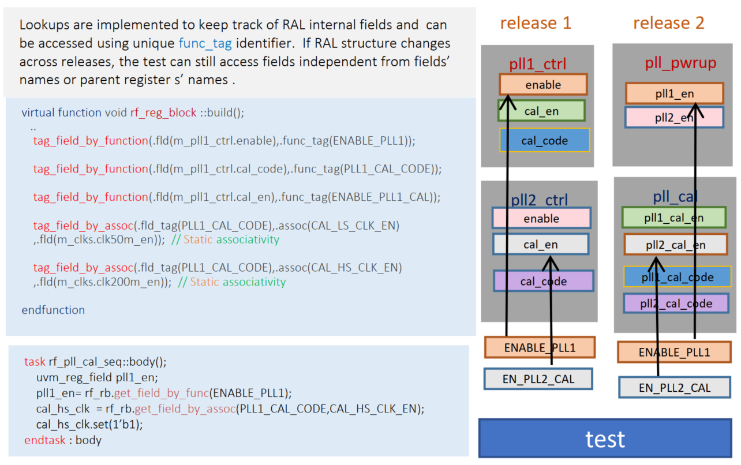
Flexible RAL

Slide 7
META-RAL: class implementation
class uvm_meta_reg_block extends uvm_reg_block;
uvm_reg m_reg_scopes_registry[scope_e][$];
uvm_reg_field m_reg_field_scopes_registry[scope_e][$];
uvm_reg_field m_reg_field_func_registry[tag_e];
uvm_reg_field m_reg_field_assoc_registry[tag_e][assoc_e];
uvm_reg m_reg_assoc_registry[string][assoc_e];
scope_e m_reg_field_name_scopes_registry[tag_e][$];
scope_e m_reg_name_scopes_registry[string][$];
scope_e ral_view_scopes[ral_view_e][$];
ral_view_e ral_view;
//////////////////////////////////////////////////////////////////////////////////////////
function tag_field_by_function(uvm_reg_field fld, tag_e func_tag);
m_reg_field_func_registry[func_tag] = fld;
endfunction
//////////////////////////////////////////////////////////////////////////////////////////
function uvm_reg_field get_field_by_func(tag_e func_tag);
return m_reg_field_func_registry[func_tag];
endfunction
//////////////////////////////////////////////////////////////////////////////////////////
function add_field_scope(scope_e scope, tag_e func_tag);
uvm_reg_field fld;
fld = m_reg_field_func_registry[func_tag];
m_reg_field_scopes_registry[scope].push_front(fld);
m_reg_field_name_scopes_registry[func_tag].push_front(scope);
endfunction
///////////////////////////////////////////////////////////////////
function bit check_reg_build(ral_view_e ral_view, string reg_name);
foreach(m_reg_name_scopes_registry[reg_name][i]) begin
if(m_reg_name_scopes_registry[reg_name][i] inside {ral_view_scopes[ral_view]})
return 1;
end
return 0;
endfunction
function add_reg_name_scope(scope_e scope, string reg_name);
m_reg_name_scopes_registry[reg_name].push_front(scope);
endfunction
/////////////////////////////////////////////////////////////////////////
function get_regs_by_scope(scope_e scope, ref uvm_reg regs[$]);
foreach(m_reg_scopes_registry[scope,i])begin
regs.push_front(m_reg_scopes_registry[scope][i]);
end
endfunction
/////////////////////////////////////////////////////////////////////////
function get_fields_by_scope(scope_e scope,ref uvm_reg_field flds[$]);
foreach(m_reg_field_scopes_registry[scope,i])begin
flds.push_front(m_reg_field_scopes_registry[scope][i]);
end
endfunction
//////////////////////////////////////////////////////////////////////////////////////////////////

Slide 8
META-RAL class implementation Cont’d
function tag_field_by_assoc(tag_e fld_tag, assoc_e assoc, uvm_reg_field fld);
if(fld != null)begin
if(m_reg_field_func_registry[fld_tag] != null)begin
m_reg_field_assoc_registry[fld_tag][assoc] = fld;
end
end
endfunction
///////////////////////////////////////////////////////////////////////////////////////////////
function uvm_reg_field get_field_by_assoc(tag_e fld_tag, assoc_e assoc);
return m_reg_field_assoc_registry[fld_tag][assoc];
endfunction
/////////////////////////////////////////////////////////////////////////
function set_ral_view_scopes(ral_view_e ral_view, ref scope_e view_scopes[$]);
ral_view_scopes[ral_view] = view_scopes;
endfunction
/////////////////////////////////////////////////////////////////////////
function set_ral_view (ral_view_e ral_view);
this.ral_view = ral_view;
endfunction
/////////////////////////////////////////////////////////////////////////
endclass : uvm_meta_reg_block

Slide 9
META-RAL: Use Case
class rf_reg_block extends uvm_meta_reg_block;
`uvm_object_utils(rf_reg_block)
rand reg_status_general m_reg_status_general;
rand reg_control m_reg_control;
virtual function void build();
m_reg_control = reg_control::type_id::create("m_reg_control");
m_reg_status_general = reg_status_general::type_id::create("m_reg_status_general");
m_reg_status_general.configure(this, null, "");
m_reg_control.configure(this, null, "");
m_reg_control.build();
m_reg_status_general.build();
tag_field_by_function(.fld(m_reg_control.irtry_to_send),.func_tag(TRY_SEND));
tag_field_by_function(.fld(m_reg_status_general.sleep_mode),.func_tag(SLEEP_STATUS));
tag_field_by_function(.fld(m_reg_control.set_hmc_sleep), .func_tag(SLEEP_CONTROL));
tag_field_by_assoc(.fld_tag(SLEEP_CONTROL),.assoc(STATUS),.fld(m_reg_status_general.sleep_mode));
add_field_scope(.scope(SLEEP), .func_tag(SLEEP_CONTROL));
add_field_scope(.scope (SLEEP),.func_tag(SLEEP_STATUS));
endfunction
endclass

Slide 10
META-RAL: RAL Access by Intent

Slide 11
META-RAL simulation

Slide 12
Multi-View RAL

Slide 13
MV-RAL Architecture
RAL model is always one unit.
All registers and fields are built regardless each test utilization.
This wastes memory resources and results in performance degradation.
The Multi-View RAL framework solves this problem by building registers on test purpose.
RAL hierarchical architecture is decomposed into ral_view and ral_scope.
Here we have 3 ral_views (powerup, basic_cal, adv_cal) and 4 ral_scopes (control, startup_cal, pvt_cal, vreg_cal).
Then each ral_scope can select which registers and fields to build.
In this case, memory can only be allocated to the test accessed registers and fields.
powerup | basic_cal | adv_cal
scope/reg | pll_pwrup | vreg_pwrup | pll_cal | pll_fsm
control
startup_cal
pvt_cal
vreg_cal

Slide 14
MV-RAL implementation
class rf_reg_block extends uvm_meta_reg_block;
`uvm_object_utils(rf_reg_block)
string reg_name;
ral_view_e ral_view;
rand pll_ctrl m_pll1_ctrl ;
virtual function void build();
rf_map = create_map("rf_map", 'h0, 8, UVM_LITTLE_ENDIAN, 0);
reg_name = " m_pll1_ctrl ";
if(check_reg_build(ral_view, reg_name) )begin //Meta-RAL code
/Meta-RAL functionality code
m_pll1_ctrl = reg_pll1_ctrl ::type_id::create(" m_pll1_ctrl ");
tag_field_by_function(m_mpll1_ctrl.enable,ENABLE_PLL1);
end
lock_model ();
endfunction
endclass

Slide 15
RAL-MV performance evaluation
 | UVM RAL | MV-RAL
# additional created registers | 10,000 | 10
Memory size during simulation (Mb) | 375-397 | 250-280
Simulation wall time (S) | 63.5 | 51.2

Slide 16
Generic RAL Algorithms

Slide 17
Generic META-RAL Algorithm
task meta_ral_pll_cal(serdes_ral_model ral_model);
uvm_reg_field pll_cal_flds[$];
uvm_reg_field fld;
uvm_status_e status;
uvm_event cal_event;
repeat(n) begin
fld = ral_model.get_field_by_func(PLL_CAL_CODE);
fld.write(status,pll_code);
fld = ral_model. get_field_by_assoc(PLL_CAL_CODE,TRIG_CLK);
trigger_clk(fld);
cal_event = uvm_event_pool::get_global(“pll_cal_code_updated");
cal_event.wait_trigger();
pll_code = next_pll_code();
end
endtask
class event_handler_ip1 extends meta_event_handler;
virtual event_if e_vif;
virtual task event_trigger;
fork
begin
@(posedge e_vif.pll_code_updated);
trig_event("pll_cal_code_updated");
end
// other events
join
endtask
endclass

Slide 18
Q & A

