Slide 1
Reset Sweep Verification for Elimination of Reset Domain Crossing Blind Spots in Design
Authors :- Nitika Gupta , Neha Srivastava, Vivek Yadav
NXP Semiconductors ,ACE

Slide 2
INTRODUCTION
A novel Design & verification strategy, targeted to stress design and architectures with plural reset and clock domains to shift left verification.

Slide 3
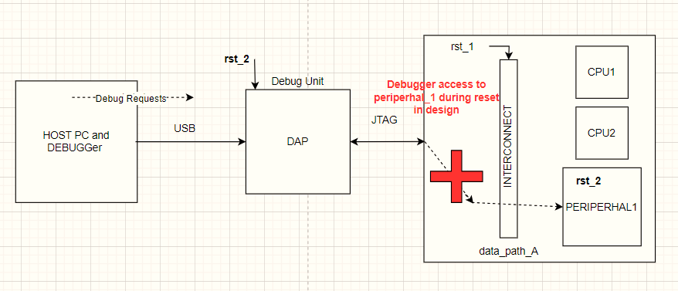
Problem Statement
Higher the complexity ,Higher the RDC crossing !!
Increase in Si IP in advanced multicore SoC/Chip-lets
Manual disposition of 1000000s of RDC violations
Probability of Improper constraints, assumptions by virtue of Human error.
SDV point arch implies multiple SW controllable reset domains 100s meaning increasing domain crossing between these SRD’s

Slide 4
Methodology -> Verification setup/generic

Slide 5
Details->

Slide 6
Functional Coverage <-> Types of issues
A
Back-to-Back resets propagation hang!
B
Protocol violation during quiescing stage
Bucket of Defects/Bugs Found!!
C
IP/SoC Integration bugs in HW handshake logic !
D
Debugger access hangs during reset in design
E
Safety x Reset

Slide 7
Thankyou !!

