Slide 1
A Comprehensive Safety Verification Solution for SEooC Automotive SoC
Gaurav Kumar Yadav
Debasis Mishra Pattan Farooq Khan
Aniruddha N Anavatti
PrashantKumar Sonavane
Garima Srivastava

Slide 2
Agenda
Safety Element out of Context
Unique Design Requirements of SEooC SoCs
Fault Manager(Fault in SoC)
Safety Controller (For maintaining the FFI)
Design Implementation
FM Design
SC Design
Verification Challenges
FM Verification
SC Verification
Comprehensive Solution
Verification framework
Solution implemented for the problems
FM VC
SC VC
Results - Data
Impact/Takeaway

Slide 3
Safety Element out of Context (SEooC)
SEooC: ISO 26262-10:2018, Clause 9
“Safety related elements which are not developed for a specific item (Not developed in the context of particular vehicle)”
Infotainment system
Drowsiness detection
Infotainment and Drowsiness detection
SoC
Notes:
The Windscreen Company
Drowisness Detection Systems | ADAS ...

Slide 4
Safety Element out of Context (SEooC)
SEooC: ISO 26262-10:2018, Clause 9
“Safety related elements which are not developed for a specific item (Not developed in the context of particular vehicle)”
Infotainment system
Drowsiness detection
Infotainment and Drowsiness detection
SoC
Display Processing Unit
DRAM1
IP_1
Image Signal Processing
IP_2
Neural Processing Unit
DRAM 2
.
SoC
Audio Processing Unit
IP_n
Notes:
The Windscreen Company
Drowisness Detection Systems | ADAS ...

Slide 5
Safety Element out of Context (SEooC)
SEooC: ISO 26262-10:2018, Clause 9
“Safety related elements which are not developed for a specific item (Not developed in the context of particular vehicle)”
Infotainment system
Drowsiness detection
Infotainment and Drowsiness detection
SoC
Display Processing Unit
DRAM1
IP_1
Image Signal Processing
IP_2
Neural Processing Unit
DRAM 2
.
SoC
Audio Processing Unit
IP_n
Notes:
The Windscreen Company
Drowisness Detection Systems | ADAS ...

Slide 6
Safety Element out of Context (SEooC)
SEooC: ISO 26262-10:2018, Clause 9
“Safety related elements which are not developed for a specific item (Not developed in the context of particular vehicle)”
Infotainment system
Drowsiness detection
Infotainment and Drowsiness detection
SoC
Display Processing Unit
DRAM1
IP_1
Image Signal Processing
IP_2
Neural Processing Unit
DRAM 2
.
SoC
Audio Processing Unit
IP_n
Notes:
The Windscreen Company
Drowisness Detection Systems | ADAS ...

Slide 7
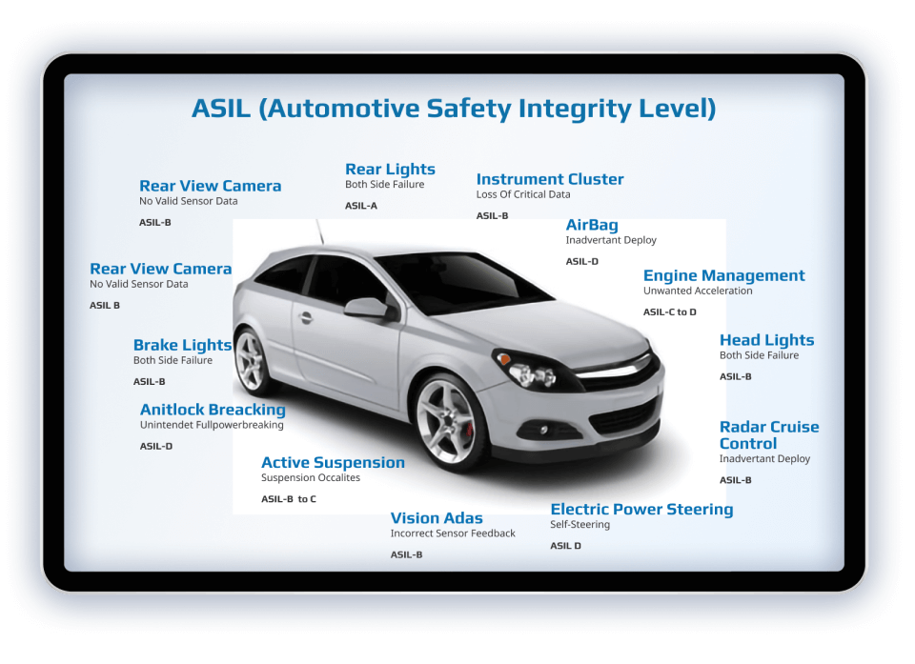
Safety Element out of Context
SEooC: ISO 26262-10:2018, Clause 9
“Safety related elements which are not developed for a specific item(Not developed in the context of particular vehicle)”
Freedom From Interference (FFI): ISO 26262-1:2018, Clause 3.65
“Absence of cascading failures between two or more elements that could lead to the violation of safety requirement”

Slide 8
Unique Design requirements for an SEooC design
Talk about the need of configurable design elements. 2 such CE’s are:
Fault Manager
Safety Controller

Slide 9
Unique Design requirements for an SEooC design
Talk about the need of configurable design elements. 2 such CE’s are:
Fault Manager
Safety Controller
Need of Fault Manager
A typical Automotive SoC can generate ~5k faults from various safety mechanisms.
The main task of Fault manager is to log the faults and take correct action for each fault.
Fault manager routes the faults considering the actual use case of the fault
Reset Request
Power Down
Interrupt
External Alarm
Every fault is unique and need unique approach to handle it
ADD FM diagram here

Slide 10
Unique Design requirements for an SEooC design
Talk about the need of configurable design elements. 2 such CE’s are:
Fault Manager
Safety Controller
Requirement of Safety Controller
Multi master Architectures: Safety Master, Security Master, DMA etc.
Safety and Security are 2 independent aspects to take care of in the SoC
Co-existence of ASILs and possibility of interference
Maintaining FFI
Safety Attribute controller (Configurable due to SEooC) Configuration at master side
Safety Controller at the block level for
Transaction monitoring
Reporting failures
Safety Controller Capabilities and configurations
Configuration of window access
Traffic monitoring once SC is enabled
Raising a flag if there are any un intended access
ADD SC DIAGRAM HERE

Slide 11
Unique Design requirements for an SEooC design
A typical SoC can generate ~5k faults from various safety mechanisms.
The main task of Fault manager is to log the faults and take correct action for each fault.
Fault manager routes the faults considering the actual use case of the fault
Reset Request
Power Down
Interrupt
External Alarm
Every fault is unique and need unique approach to handle it
SoC
SM 1
Fault_in[0]
FM
PMU
.
M1
.
..
M2
Reset
.
SM 2
Fault_in[1]
.
..
Power-down
External MCU
Mn
Alarm
.
Interrupt
.
..
Register 1
CPU
Register 2
Register n
SM n
Fault_in[n]

Slide 12
Safety Controller
Multi master Architectures: Safety Master, Security Master, DMA etc
Safety and Security are 2 independent aspects to take care of in the SoC
Co-existence of ASILs and possibility of interference
Maintaining FFI
Safety Attribute controller (Configurable due to SEooC) Configuration at master side
Safety Controller at the block level for
Transaction monitoring
Reporting failures
Safety Controller Capabilities and configurations
Configuration of window access
Traffic monitoring once SC is enabled
Raising a flag if there are any un intended access
Masters
Masters
SoC
Safe
Non-safe
Safe
Non-safe
Safe
Non-safe
Non-safe
Safe/non-safe attribute SC
Interconnect
SC
FM
SC
SC
External block

Slide 13
Trivial Solution and Challenges
Need to add about trivial verification methods here
Fault Manager verification
Typical SoC has 5000+ faults
Each DV engineer needs to understand and configure 30+ FM registers
Unintended Fault behaviour
Fault table change during design maturity
Scalability & Portability
Unverified fault might result in silicon bug/s
FM verification in Multi Die will pose a significant challenge for DV Engineers
Safety Controller verification
40+ blocks , 60+ instances
Verification of scenarios for all master slave pair
End to end verification SC-> FMU-> GIC
DV engineer needs a thorough understanding of SFRs of SC and FM
Human error might lead to silicon bug/s
Ensuring 100% functional coverage may not be possible
Functional coverage of 100% may not be guaranteed

Slide 14
Verification Challenges
Safety controller verification
40+ blocks , 60+ instances
Verification of scenarios for all master slave pair
End to end verification SC-> FMU-> GIC
DV engineer needs a thorough understanding of SFRs of SC and FM
Human Error-> Silicon bug
Ensuring 100% functional coverage

Slide 15
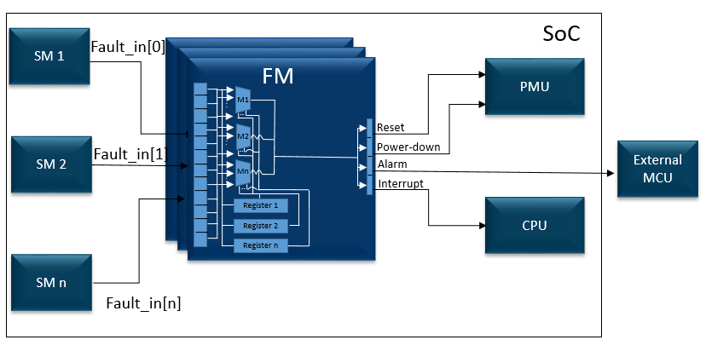
Proposed Solution

Slide 16
Examples of distributed SEooC IP’s

Slide 17
Common Verification Framework
Auto Test Generation
Start
Inline checks
SCVC Execution
Post Check
User Input
Pre-configuration checks
Functional Coverage
Slide looks dull. Need to enhance

Slide 18
Application of Framework in Exynos SEooC IP’s
FM Common Task
SC Common Task

Slide 19
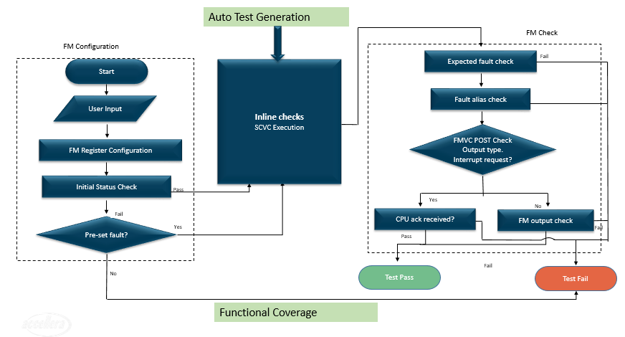
Application of Framework in Exynos SEooC IP’s
FM Common Task
SC Common Task

Slide 20
Application of Framework in Exynos SEooC IP’s
FM Common Task
SC Common Task
Insert SC flow diagram here

Slide 21
Auto Test Generation
FM Check
FM Configuration
Expected fault check
Fail
Start
Inline checks
SCVC Execution
Pass
Fault alias check
Fail
User Input
Pass
FMVC POST Check
Output type. Interrupt request?
FM Register Configuration
Initial Status Check
Pass
Yes
No
Fail
CPU ack received?
FM output check
Pre-set fault?
Yes
Fail
Pass
Test Pass
Fail
Test Fail
No
Functional Coverage

Slide 22
Proposed Solution (Delete if not required)
Proposed Solution Fault Manager
Auto generated test
Excel based checks.
Functional Checks
FM auto-configuration with minimalistic user inputs
Checkers for intended fault type, polarity, effect, etc. including spurious fault(s) detection
Fault reporting and SoC reaction check
Fault aliasing and connection check
Functional coverage for all the faults
Sanity checks for FM connections
Scalability to multichip solutions
Proposed Solution Safety Controller
Configurable safety attribute of the master as safe or non-safe
Allow or block transaction based on safety attribute
Check Safety Controller fault output to Fault Manager (FM) and GIC
Configuration of Safety Controller with minimalistic user inputs
Error logging of the blocked transaction
Functional Coverage for all the Safety Controllers in SoC
Automated test case generation
Different verification mode supported for user configuration
Scalable to other verification solutions to catch FFI issues in bus component

Slide 23
Proposed Solution Fault Manager
Auto generated test
Excel based checks.
Functional Checks
FM auto-configuration with minimalistic user inputs
Checkers for intended fault type, polarity, effect, etc. including spurious fault(s) detection
Fault reporting and SoC reaction check
Fault aliasing and connection check
Functional coverage for all the faults
Sanity checks for FM connections
Scalability to multichip solutions
Proposed Solution Safety Controller
Configurable safety attribute of the master as safe or non-safe
Allow or block transaction based on safety attribute
Check Safety Controller fault output to Fault Manager (FM) and GIC
Configuration of Safety Controller with minimalistic user inputs
Error logging of the blocked transaction
Functional Coverage for all the Safety Controllers in SoC
Automated test case generation
Different verification mode supported for user configuration
Scalable to other verification solutions to catch FFI issues in bus component

Slide 24
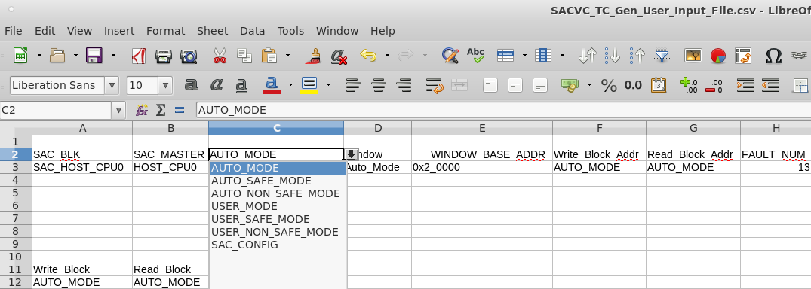
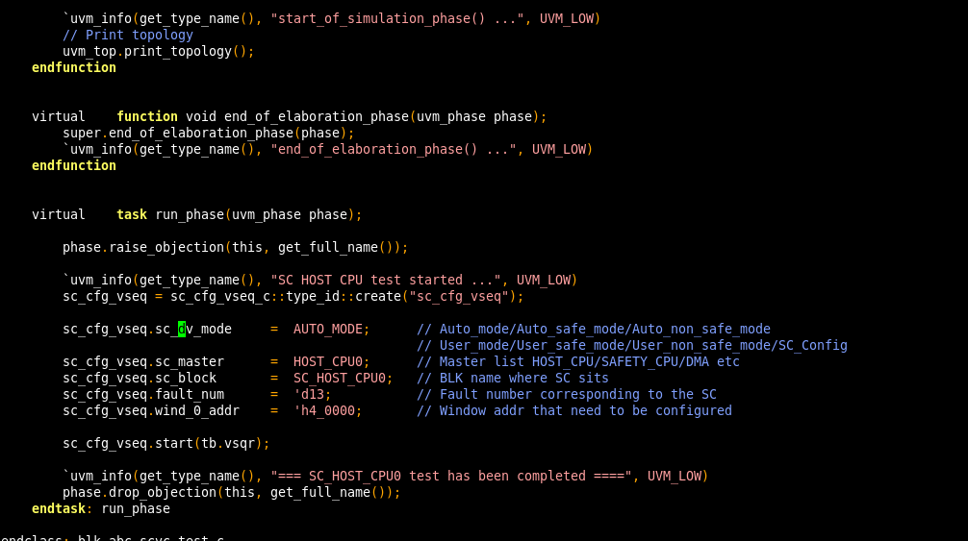
Proposed Solution Safety Controller
Configurable safety attribute of the master as safe or non-safe
Allow or block transaction based on safety attribute
Check Safety Controller fault output to Fault Manager (FM) and GIC
Configuration of Safety Controller with minimalistic user inputs
Error logging of the blocked transaction
Functional Coverage for all the Safety Controllers in SoC
Automated test case generation
Different verification mode supported for user configuration
Scalable to other verification solutions to catch FFI issues in bus component
Methodology

Slide 25
Results
Safety Controller Common Task
240+ tests added with a TAT of half day instead of 3weeks.
Overall 95+% DV effort reduction for Safety Access Control verification Component
100% Functional Coverage
Architectural Impact:-
Safe read transactions being overridden as non-safe transactions has resulted in IP change. RTL change in > 40 instances
Bugs found:-
Bug found for fault from SAC instance to Fault Manager > 20 instances
Fault Manager Common Task
Configurable by the user
Scalable and Portable
Functional coverage is ensured
Fault aliasing
Typical verification
Critical timelines
Verification will be quick and robust
Human efforts reduced to single person. Executables taken and can be run.
Automated test creation flow will add multiple tests in short time.

Slide 26
Conclusion
Plug and play Solution
Automated script based solution
Supports multiple modes
Functional Checkers and Error Logging feature
Systematic Coverage , Cross Functional Scenario
Scalability
Can be easily scalable to any safety SoC/Multi Chip, Multi Die, Cyber security SoC’s
Slide looks dull. Need to enhance

Slide 27
Thank you

Slide 28
Backup

