Slide 1
Stimulus Diversification and Coverage Closure of 3D NAND Flash with Artificial Intelligence
G. Pallela, P. Shi, S. Deshmukh, V. Venkatesh, B. Hughes, R. Suvarna, S. Srinivasan
Notes:
Good afternoon, everyone. My name is Srinivas, and today I'll be presenting on 'Stimulus Diversification and Coverage Closure of 3D NAND Flash with Artificial Intelligence.' This work is a collaborative effort by G. Pallela, P. Shi, S. Deshmukh, V. Venkatesh, B. Hughes, R. Suvarna, and S. Srinivasan. We are excited to share our findings and the innovative approach we have developed to address the challenges in design verification, specifically focusing on functional coverage closure. We hope that it inspires the audience to challenge the traditional roadblocks and improve the efficiency and quality of Design Verification.

Slide 2
Agenda
Objective
Proposed Approach
RL Agent
Reward Design
Results and Future work
Notes:
Here's the agenda for today's presentation. We'll start with the objective of our project, followed by the proposed approach. We'll then delve into the details about the Reinforcement Learning (RL) agent, the design of the reward system, and the results we achieved. Finally, we'll discuss future work and open the floor for questions

Slide 3
Objective
Coverage closure is mandatory and a serious time-consuming challenge for the tape-out.
It requires manual analysis in several iterations.
AI has become capable of handling many tasks that were once thought could only be handled by humans.
Idea is to use AI to direct the stimulus generation towards faster coverage closure.
Notes:
The main objective of this effort is to address the challenge of functional coverage closure, which is mandatory and is in the critical path in the execution for chip tape-out. Traditionally, this requires manual analysis in several iterations. Our idea is to use AI to direct stimulus generation towards faster coverage closure. By leveraging AI, we aim to reduce the time and effort required to achieve comprehensive coverage, ultimately accelerating the design verification process. We have seen in the past few years that AI has enabled us to challenge the thought that many tasks that can only be handled by humans.

Slide 4
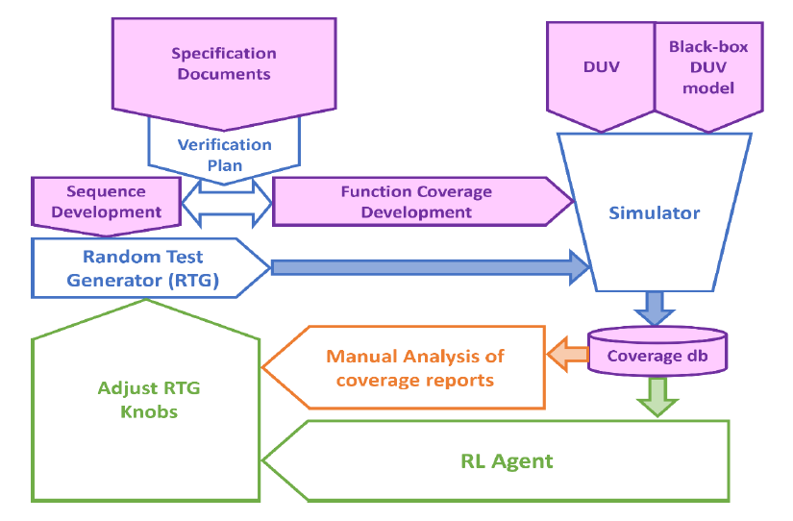
Proposed Approach - ML in DV Flow
Notes:
DV flow starts with reviewing and understanding NAND Design Specification documents and planning for verification. Later separate verification plans are drafted for each new feature. Sequences, Functional Coverage, and behavioral white-box checks are developed in System Verilog (SV) independently per the verification plan. After test-bench (TB) development, the DV team runs regressions, debugs failures, and analyzes coverage gaps using the coverage reports that are generated by the simulator tool which is predominantly a manual process. This cycle repeats till satisfactory Coverage goal is reached. The part highlighted in green is the focus of this presentation and will be explained in following slides.

Slide 5
Proposed Approach – Key requirements
Stimulus controllability
A black-box model of DUV
A Reinforcement Learning (RL) Agent
Feedback path from CovDB to RL agent
Notes:
Our proposed approach involves integrating machine learning into the design verification flow. The key requirements include stimulus controllability, a black-box model of the Design Under Verification (DUV), and a feedback path from the Coverage Database (CovDB) to the RL agent. This integration allows us to automate and optimize the stimulus generation process, making it more efficient and effective

Slide 6
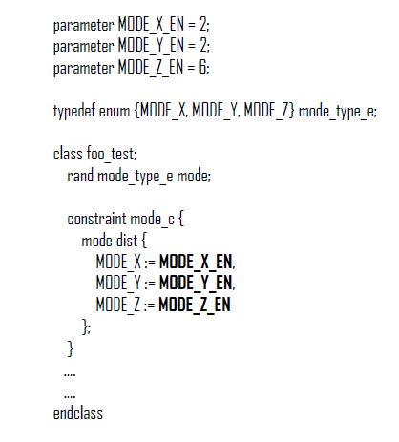
Proposed Approach – Stimulus controllability
Stimulus must be able to be controlled by RL agent.
There are multiple ways one can do this.
Examples: SV parameters, $test$plusargs or UVM CLP etc.
We control SV dist constraints in the sequences/tests using SV parameters which are called as “knobs.”
Notes:
Stimulus controllability is crucial. We need to ensure that the stimulus can be controlled by the RL agent. This can be achieved through various methods such as SV parameters, $test$plusargs, or UVM Command line processor which allows us to control the behavior of a UVM simulation using custom command line arguments. In our case, we control SV dist constraints to create weighted distributions for random variables in the sequences/tests using SV parameters, which we refer to as 'knobs.' These knobs allow the RL agent to adjust the stimulus generation dynamically based on the feedback it receives. An example of the knobs is shown in the slide.

Slide 7
Proposed Approach – Black-box model of DUV
TB and DUV change rapidly resulting in new training iterations.
ML training can be expensive in terms of time, licensing and compute resources.
The focus is only on the stimulus generation from TB, so black-box your DUV as much as you can or use a BFM for training.
Notes:
Given the rapid changes in the testbench and DUV, it's essential to black-box the DUV as much as possible or use a BFM for training. This helps in managing the time, licensing, and compute resources required for ML training. By treating the DUV as a black box, we can focus on optimizing the stimulus generation without being affected by the internal complexities of the DUV

Slide 8
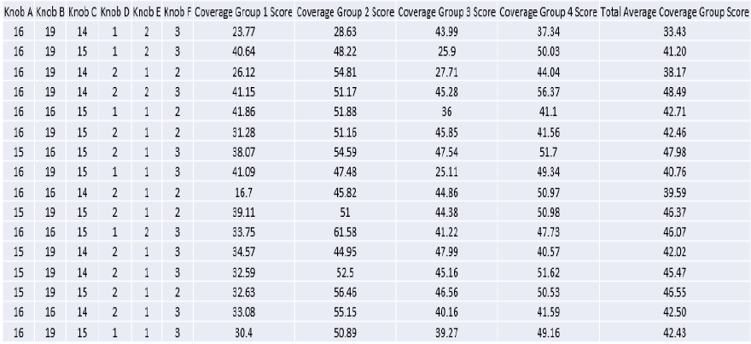
Proposed Approach – Feedback from CovDB to Stimulus generation via RL agent
Automate the flow
Parse through Coverage DB
Extract the required info
Map them back to knobs
Rank the results, if needed
File format is specific to RL agent
Ranking/Ordering is specific to the reward and ML algorithm that are being used
Notes:
We automate the flow by parsing through the Coverage DB, extracting the required information, mapping it back to the knobs, and ranking the results if needed. The file format and ranking are specific to the RL agent and the reward and ML algorithm being used. This feedback loop ensures that the RL agent continuously learns and improves its stimulus generation strategy based on the coverage data or the reward used

Slide 9
RL Agent
Initially Simulator is fed randomized knobs
The Simulator returns reward(s) - Coverage to the RL Agent
Agent generates the next set of knobs for the Simulator (DV-Env) based on the reward(s)
RL Agent is a DNN that learns to generate the best knob settings to optimize the reward(s) - Coverage in this case
DV
Env
Knob settings
- for next sims
Reward(s)
- Coverage
Simulation results
- knob settings
VerifAI-RL
AGENT
Reinforcement Learning Setup with DV Environment
Notes:
The RL agent is a Deep Neural Network (DNN) that learns to generate the best knob settings to optimize coverage. Initially, the simulator is fed randomized knobs, and the simulator returns rewards, which are the coverage metrics, to the RL agent. The agent then generates the next set of knobs based on these rewards. This iterative process allows the RL agent to refine its strategy and achieve better coverage over time.

Slide 10
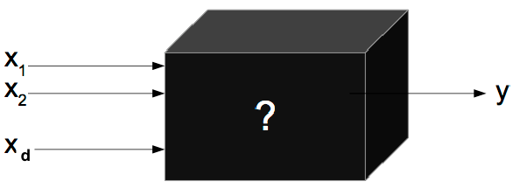
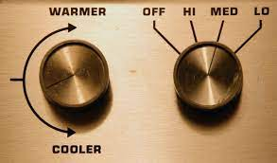
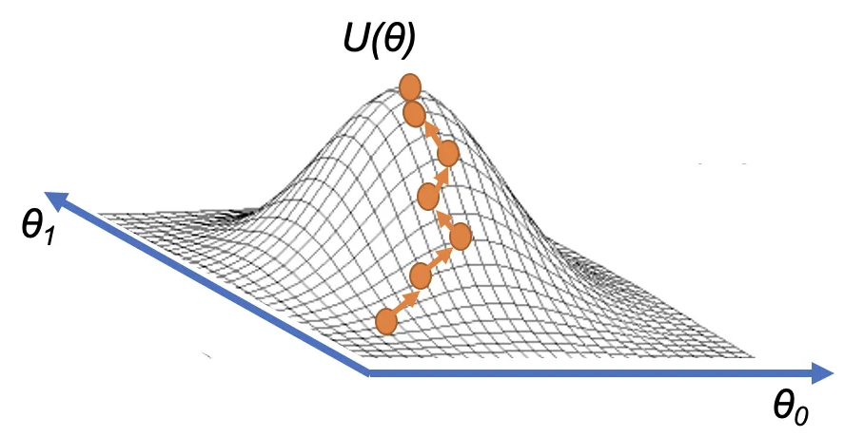
Black Box Optimization using Gradient Ascent
Input Knobs
Output (reward)
RL Agent fits a DNN to capture the relationship between Knobs (x’s) and output metric (y)
Then we use Gradient ascent on the output of the DNN (y) w.r.t. input features (x’s)
Goal is to find the best knob settings (x’s) to maximize the output of the DNN (y)
Gradient ascent updates input parameters iteratively in the direction of the steepest climb of the function that is captured by the DNN
Knobs - Action Space
Notes:
In our reinforcement learning setup, the RL agent fits a Deep Neural Network (DNN) to capture the relationship between knobs (input parameters) and the output metric (coverage). We use gradient ascent on the output of the DNN to find the best knob settings that maximize coverage. This approach allows us to systematically explore the parameter space and identify the optimal settings for achieving comprehensive coverage.

Slide 11
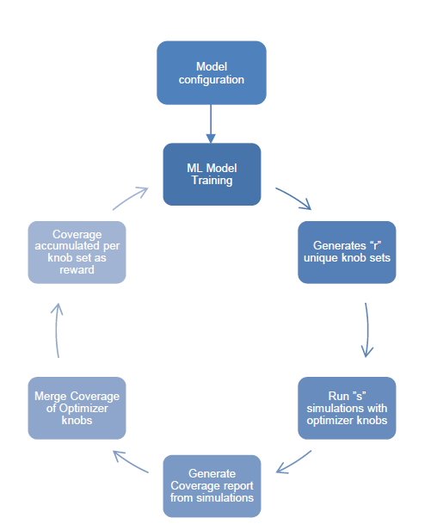
RL Agent - Training
Configure the model with input knobs and output rewards.
Training iteratively until rewards are satisfactory.
Keep human involved in training.
Notes:
Training the RL agent involves configuring the model with input knobs and output rewards and iteratively training until the rewards are satisfactory. It's important to keep human involvement in the training process. Human experts can provide valuable insights and guidance to ensure that the RL agent is learning effectively and efficiently

Slide 12
Designing the reward
Reward is just a ‘number’ to the RL agent that it aims to maximize by controlling the stimulus.
Use it wisely to meet your requirement.
Examples:
Functional/Code Coverage Scores
Relative Functional/Code Coverage wrt a reference score
Number of design bugs getting caught
Stress testing on the design
Notes:
Designing the reward is crucial as it guides the RL agent's learning process. The reward is just a 'number' that the RL agent aims to maximize by controlling the stimulus. Examples of rewards include functional/code coverage scores, relative coverage with respect to a reference score, the number of design bugs caught, and stress testing on the design. By carefully designing the reward system, we can ensure that the RL agent focuses on the most important aspects of coverage

Slide 13
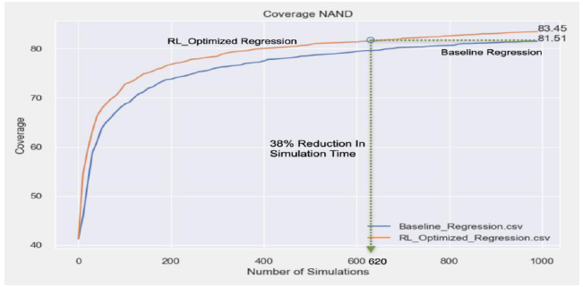
Results and Future work
Same amount of coverage was achieved in 38% fewer simulations.
Higher coverage of ~2% was reached with same number of 1000 simulations.
Given the manual efforts spent, these results are very encouraging in pursuing AI/ML to improve DV.
More experiments are being run by adjusting reward metrics, using different combinations of ‘r’ and ‘s’, and by using more advanced RL algorithms.
Notes:
Our approach achieved the same amount of coverage in 38% fewer simulations and reached higher coverage with the same number of simulations. These results are encouraging and demonstrate the potential of AI/ML in improving design verification. Future work involves more experiments with different reward metrics and advanced RL algorithms. We are excited to continue exploring the possibilities and pushing the boundaries of what AI can achieve in this field.

Slide 14
Questions
Notes:
Thank you for your attention. I'm happy to take any questions you may have. We look forward to your feedback and insights.

