Slide 1

Lessons Learned Using Formal for Functional Safety
Doug Smith
Notes:
Hi, my name is Doug Smith, and I'm a engineer and instructor at Doulos. I've been involved with automotive functional safety for a number of years, performing random fault campaigns on designs using formal, developing a formal functional safety app and fmeda creation tool, and combining formal results with other tool flows. While I don't claim to be an expert, I thought I could share a few lessons I've learned using formal with functional safety in hopes it might help you in your automotive functional safety project.

Slide 2
The role of formal within functional safety
Systematic failures
5. Product development at the hardware level
5-5 Initiation of product development at the hardware level
5-6 Specification of hardware safety requirements
5-7 Hardware design
5-8 Evaluation of the hardware architectural metrics
5-9 Evaluation of the safety goal violations due to random hardware failures
5-10 Hardware integration and testing
Random failures
Functional verification
Model checking
Equivalence checking
Super lint
Connectivity
X-propagation
Register checking
…
Random fault testing
Fault pruning
Fault injection
Fault propagation
(ISO26262-5)
Notes:
Hardware design for systematic failures (bugs)
Verifying the design
Verifying safety mechanisms
Use model checking
Use formal apps …
Random fault testing
Generating a reduced fault list
Injecting the fault in the design or safety mechanism
Propagating the fault to a safety output or alarm to see if it's detected

Slide 3
Functional verification of safety mechanisms
Model checking
Pseudo-code
memory
DUT
Safety mechanism insertion
cut data
DUT
DUT
// ECC implementation
wire logic p1 = 1 ^ data[0] ^ data[1] ^ data[3] ^ data[4] ^ data[6];
wire logic p2 = 1 ^ data[0] ^ data[2] ^ data[3] ^ data[5] ^ data[6];
wire logic p4 = 1 ^ data[1] ^ data[2] ^ data[3] ^ data[7];
wire logic p8 = 1 ^ data[4] ^ data[5] ^ data[6] ^ data[7];
logic [12:0] expected_ecc;
assign expected_ecc[11:0] == { data[7], data[6], data[5], data[4],
p8, data[3], data[2], data[1], p4,
data[0], p2, p1 };
assign expected_ecc[12] = ^expected_ecc[11:0]; // Overall parity
assert property ( ecc_from_dut == expected_ecc );
Safety
alarm
error
=
Sequential Equivalency

Slide 4
Sequential depth challenges
Combinational CRC – probably
Sequential CRC – formal friendly?
crc[30] = D[63] ^ D[61] ^ D[59] ^ D[58] ^ D[56] ^ D[53] ^
D[52] ^ D[51] ^ D[48] ^ D[46] ^ D[45] ^ D[43] ^
D[42] ^ D[35] ^ D[32] ^ D[30] ^ D[29] ^ D[28] ^
D[27] ^ D[26] ^ D[24] ^ D[23] ^ D[22] ^ D[14] ^
D[10] ^ D[8] ^ D[7] ^ D[4] ^ C[0] ^ C[3] ^
C[10] ^ C[11] ^ C[13] ^ C[14] ^ C[16] ^ C[19] ^
C[20] ^ C[21] ^ C[24] ^ C[26] ^ C[27] ^ C[29] ^
C[31];
crc[31] = D[62] ^ D[60] ^ D[59] ^ D[57] ^ D[54] ^ D[53] ^
D[52] ^ D[49] ^ D[47] ^ D[46] ^ D[44] ^ D[43] ^
D[36] ^ D[33] ^ D[31] ^ D[30] ^ D[29] ^ D[28] ^
D[27] ^ D[25] ^ D[24] ^ D[23] ^ D[15] ^ D[11] ^
D[9] ^ D[8] ^ D[5] ^ C[1] ^ C[4] ^ C[11] ^
C[12] ^ C[14] ^ C[15] ^ C[17] ^ C[20] ^ C[21] ^
C[22] ^ C[25] ^ C[27] ^ C[28] ^ C[30];
assign crc_next = data ^ crc[14];
assign crc_tmp = {crc[13:0], 1'b0};
always @ (posedge clk)
begin
if(initialize)
crc <= #Tp 15'h0;
else if (enable)
begin
if (crc_next)
crc <= #Tp crc_tmp ^ 15'h4599;
else
crc <= #Tp crc_tmp;
end
end
Lesson: C to RTL equivalency may work better for sequential CRC.

Slide 5
Fault list generation

Slide 6
Formal + random fault testing
Fault List Creation
Formal Synthesis
RTL
Synthesis
Simulation
Formal Fault List Pruning
Fault List Pruning
Emulation
Random Fault Testing
Formal
Analysis

Slide 7

How to identify safe faults
Safe faults
(cannot affect output)
cover property ( @(posedge clock) safety_output );
Fault list
(Cone-of-influence)
Pseudo-code
Formal FuSa app not required!
Safety Element
report coi <property>
Lesson: Identify safe faults using the formal cone-of-influence.

Slide 8
Do all faults need tested?
 | ASIL B | ASIL C | ASIL D
Single-Point Fault Metric (SPFM) (ISO 26262-5, Table 4) | >= 90% | >= 97% | >= 99%
Latent Fault Metric (LFM) (ISO 26262-5, Table 5) | >= 60% | >= 80% | >= 90%
Acceptable SPFMs with margin of error:
100% ± 10%
99% ± 9%
98% ± 8%
97% ± 7%
96% ± 6%
95% ± 5%
94% ± 4%
93% ± 3%
92% ± 2%
91% ± 1%
100% ± 3%
99% ± 2%
98% ± 1%
100% ± 1%
Margin of error

Slide 9
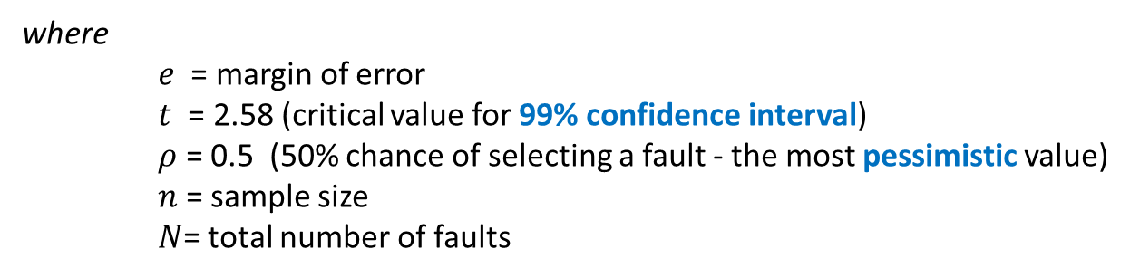
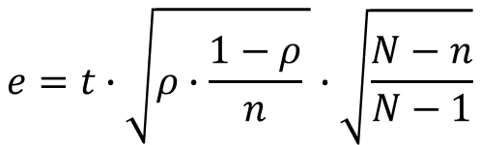
Calculating the margin of error
Population sampling from statistics
$$e=t∙\sqrt{ρ∙\frac{1−ρ}{n} }∙\sqrt{\frac{N−n}{N−1}}$$
where
$e$ = margin of error
$t$ = 2.58 (critical value for 99% confidence interval)
$ρ$ = 0.5 (50% chance of selecting a fault - the most pessimistic value)
$n$ = sample size
$N$= total number of faults
R. Leveugle, A. Calvez, P. Maistri and P. Vanhauwaert. "Statistical fault injection: Quantified error and confidence." Design, Automation & Test in Europe Conference & Exhibition. Nice, France, 2009 . 502-506.

Slide 10
A practical sample size
Margin of error

Slide 11
Margin of error

Slide 12
So are all faults necessary?
Probably not …
  ASIL B, ASIL C – 4000-5000 faults +/- margin of error may be sufficient
  ASIL D – ASIL decomposition or other techniques (e.g., lockstep, etc.)
Lesson: Testing around 4k random faults is usually sufficient.

Slide 13
Why not collapse faults?
Equivalent faults
Dominant faults
stuck-at 1
stuck-at 0
stuck-at 1
stuck-at 1
Output fault equivalent to input fault
?
?
Output fault dominates input fault
stuck-at 0
stuck-at 1
stuck-at 0
stuck-at 0
?
?
Only one fault needs tested
Ignore input when testing for output

Slide 14
Collapse or not collapse?
RTL not as easy to find equivalent and dominant faults
ISO26262 requires uniform random distribution and selection
  Does collapsing faults change the fault distribution?
Dominant faults collapsing requires the dominant fault to be tested
Why collapse if only 4000-5000 faults are needed?
c
if ( a > b )
q <= c;
else
q <= d;
cd
q
d
internal signals?
gates?
a
b
>
a_gt_b
Lesson: Fault collapsing probably violates the intent of random testing.

Slide 15
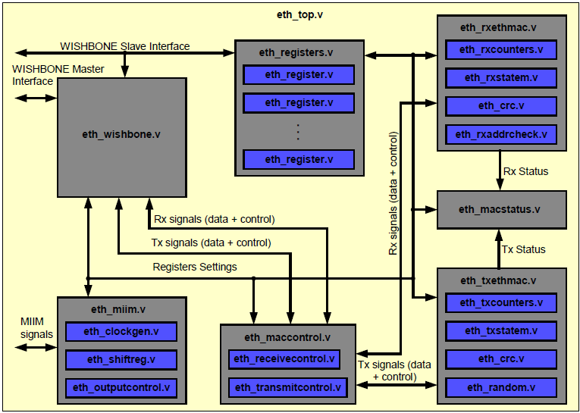
Formal proves independence
Design independence show by Fault Tree Analysis (FTA)
Formal COI proves data independence
OpenCores Ethernet MAC
cover property ( safety_output );
Lesson: COI can prove independence when partitioning a safety element.

Slide 16
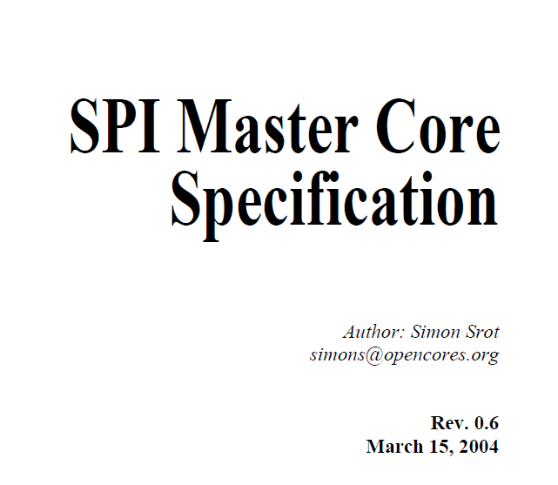
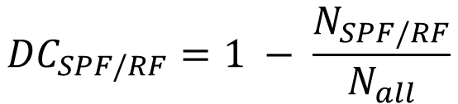
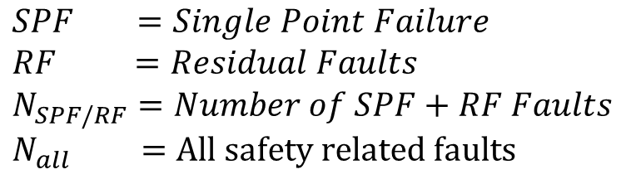
Fault campaign on RTL or gates?
$${DC}_{SPF/RF}=1 − \frac{N_{SPF/RF}}{N_{all}}$$
More faults → greater DC %
OpenCores SPI Example
$$SPF =Single Point Failure$$
$$RF =Residual Faults$$
$$N_{SPF/RF}=Number of SPF+RF Faults$$
$$N_{all} =All safety related faults$$
 | Fault Count
 | RTL | Gates
 | 2533 | 26789
Example: N_{RF}= 100 | DC = 1 - 100 faults = 96% 2533 | DC = 1 - 100 faults = 99.9% 26789
RTL more pessimistic
Lesson: RTL is more pessimistic than gates so just use RTL.

Slide 17
Is RTL okay?
Depending on the purpose, fault injection can be implemented at different abstraction levels (e.g., semiconductor component top-level, part or sub-part level, RTL, etc.) A rationale for the abstraction level is provided.
Selection of the abstraction level can also depend on the nature of the fault that is intended to be modelled by fault injection: the stuck-at fault can be injected at gate level netlist, whereas for bit-flips an RTL level abstraction is sufficient.
(ISO26262:2018-11, p.64)

Slide 18
Running a fault campaign with formal

Slide 19
Fault campaigns with formal
module fault_injector(...);
default clocking cb @($global_clock); endclocking
bit [$clog2(N)-1:0] fault = '0;
...
always @($global_clock)
if ( inject ) injected = 1;
asm_stable_sf_fault : assume property ( injected |-> $stable(fault) );
asm_delay_injection : assume property ( $fell(reset) |-> !inject[*START] );
always @($global_clock) begin
violated = injected && ( original.output != faulted.output );
detected = injected && ( !original.error && faulted.error );
end
// Find residual fault(s)
cov_res1: cover property (( fault == 1 ) && violated && !detected );
cov_res2: cover property (( fault == 2 ) && violated && !detected );
...
endmodule
Original
Faulted
FuSa app better!
DUT
DUT
Safety
alarm
Safety
alarm
=
Sequential
Equivalency
// Pseudo-code - Tool directive for conditional cut point (sa0 fault injection)
cut { impl.signal1 } –cond { injected && fault == 1 } –value 0

Slide 20
Keep it simple
ISO26262 requires testing "normal operating modes" and "conditions"
  Constraint formal to reduce state space complexity
  More likely to converge on results
Lesson: Constraint formal to normal modes and conditions.

Slide 21


Sampling formal friendly faults
Status | Node
 | dut.p_wbspi.wb_dat_o[0]
 | dut.p_wbspi.wb_dat_o[1]
 | dut.p_wbspi.wb_dat_o[1]
 | dut.p_wbspi.shift.data[0]
 | dut.p_wbspi.shift.data[1]
 | dut.p_wbspi.shift.data[2]
 | …
Sample formal
friendly faults
Introduces bias
Ignore
inconclusives
Violates uniform random distribution principle
Lesson: Never "cherry pick" formal friendly faults.

Slide 22
Latent fault analysis
Latent fault analysis
Typical latent fault analysis
Safety
element
Safety
alarm
Safety
alarm
detected?
detected?
Fault detected with a fault in alarm?
May have a secondary alarm
Too many permutations for 2 faults
LFM is negligible in PMHF

Slide 23
Latent analysis with multiple faults
// Allow formal to pick any safety element fault (free variable)
assume property { design_fault inside [1:max] }
Some faults won't propagate to the alarm → less undetected faults
LFM becomes more optimistic (and realistic)
// Latent fault analysis with 2 injected faults
cover property { alarm_fault == 1 && injected && violation && !detected }
Lesson: Formal has good capability for latent fault analysis.

Slide 24
Formal fault campaign results

Slide 25
Limitations of formal
Formal Synthesis
RTL
Synthesis
Formal only fault analysis possible, but …
  State space limits formal analysis
  Non-formal friendly blocks yield poor results
Simulation
Formal Fault List Pruning
Emulation
Formal
Analysis
Lesson: Formal FuSa best combined with other verification tools.

Slide 26
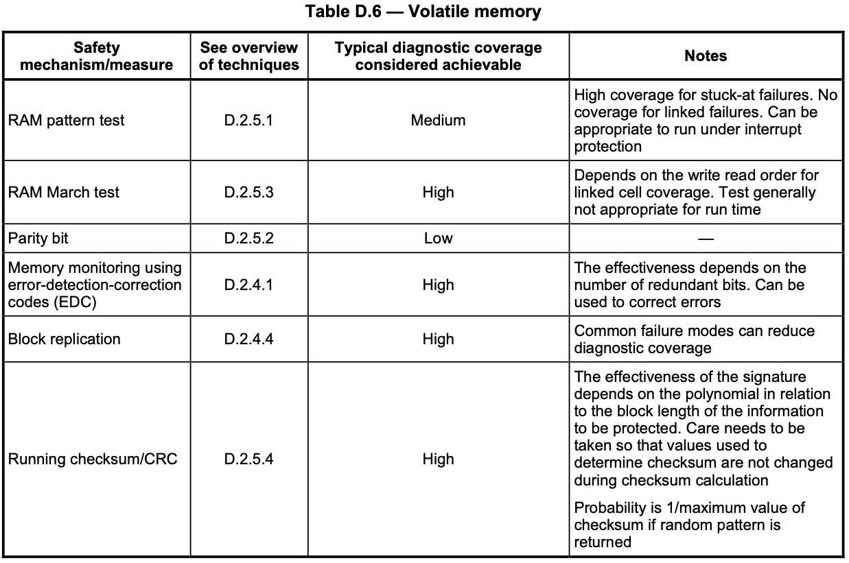
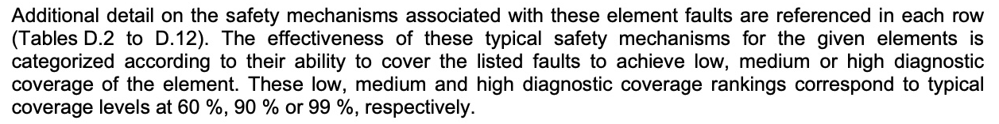
Typical diagnostic coverage levels
Ranking | DC
Low | 60%
Medium | 90%
High | 99%
ISO26262 Part 5, Appendix D
Lesson: Consider DC guideline instead of an unnecessary fault campaign.

Slide 27
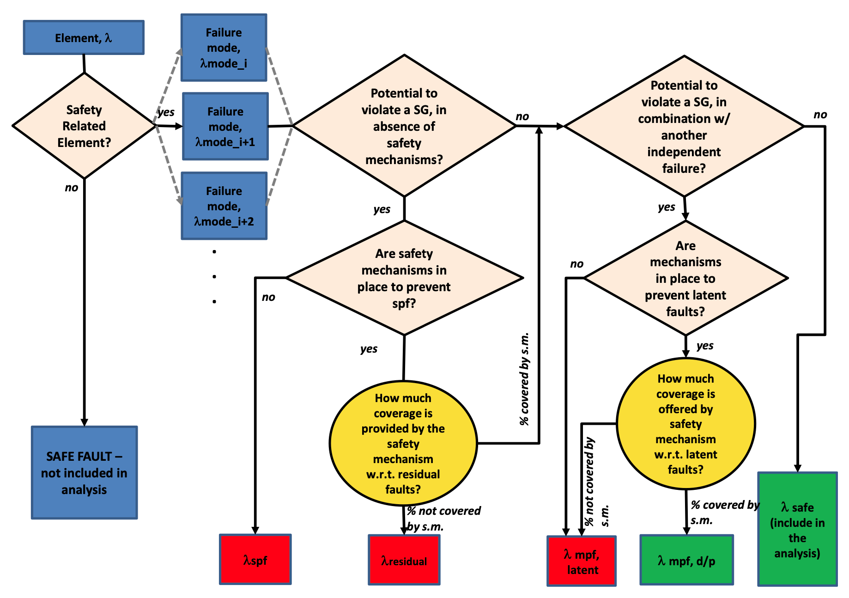
ISO Terminology
Term
SPF
Residual
MPF, latent
MPF, d/p
Safe
ISO26262, Part 5, Figure B.2

Slide 28

EDA tools
EDA Tools
Detected
Undetected
Activated
Non-propagated
Non-detected
Safe
ISO26262
SPF
Residual
MPF, latent
MPF, d/p
Safe
Lesson: Learn what vendor terminology means.

Slide 29
Conclusion

Slide 30
Lessons learned
Use formal for functional verification of safety elements and mechanism
Use formal's COI to prune out safe faults and provide a minimal set
Combine formal with simulation and emulation
Use formal for fault propagation testing via a FuSa or SEC app
Use a small fault sampling with a low margin of error and high level of confidence
Save effort using ISO DC guidelines instead of a fault campaign

Slide 31
Questions

