Slide 1
Addressing Advanced Mixed-Signal Verification Scenarios by Developing a UVM Framework for Analog Models
Simul Barua - Ulkasemi, Inc.
Shahriar Kabir - Ulkasemi, Inc.
Henry Chang - Designer’s Guide Consulting, Inc.

Slide 2
Agenda
Motivation and purpose of the AMSV utility framework
Structure of the framework
Case study: application of the framework
Framework implementation in models and testbench
Simulation results
Summary & future scopes

Slide 3
Increased Complexity in IC Verification
Modern applications outpaces design complexity
Declining verification success rates
Key factors include analog design issues and mixed-signal interface bugs.
Insights from our previous research
Integrating validated functional analog models enhances chip-level verification.
Improved bug detection at the system level
Remaining gap
Traditional methodologies still lack the robustness needed to address more complex system requirements

Slide 4
Evolving Verification Needs for the Digital Twin
Must include analog elements
System performance
Simulating temperature effects, parametric variations, and analog non-idealities
Ensuring real-world performance criteria are met
Safety Requirements
Modeling how analog blocks, subsystems, and systems can fail
Verifying fault tolerance and mitigation strategies
Conventional verification methodologies lack the support needed for these critical features

Slide 5
Limitations of Traditional Methodologies
Transistor-level simulations for real-world complex scenarios
Accurate, yet impractical for system-level verification
Environmental effects (e.g. temperature) demand prolonged runs
Verifying critical features using system-level testbenches
No direct control over environmental factors (e.g. temperature)
Difficult to observe system responses (e.g. thermal shutdowns)
Predictable failures require design modifications accommodating fault conditions
Need for a flexible and efficient approach
Designs must accommodate the verification of both environmental and safety features
System-level verification must efficiently handle complex, mixed-signal scenarios efficiently
Faster simulation time

Slide 6
Overcoming the Limitations
Leveraging analog models
Feasible simulation speeds compared to transistor-level
Straightforward incorporation of complex effects (e.g. environmental stress, parametric shifts)
Enables real-world scenario modeling (e.g. AI performance under analog degradation)
Enhancing the UVM Testbench
Enhanced monitoring and control for analog models
Bridging the gap
A dedicated mechanism is required to enhance both the analog model and the UVM testbench

Slide 7
The AMSV Utility Framework
Overview
Leverages SystemVerilog OOP constructs
Enhances analog models and system-level UVM testbench
Efficient communication between the models and the testbench
Simulates real-world conditions: temperature effects, parametric variations, and failures
Addressing limitations of traditional methodologies
Enables modeling of real-world scenarios
Faster, practical alternative to slow transistor-level simulations
Enables direct control and monitoring of environmental impacts
Key features
Introduces bidirectional data flow for advanced observation and control without compromising pin accuracy
Dynamic parameter adjustment from UVM testbench
Continuous fault detection and debugging via model-to-testbench reporting

Slide 8
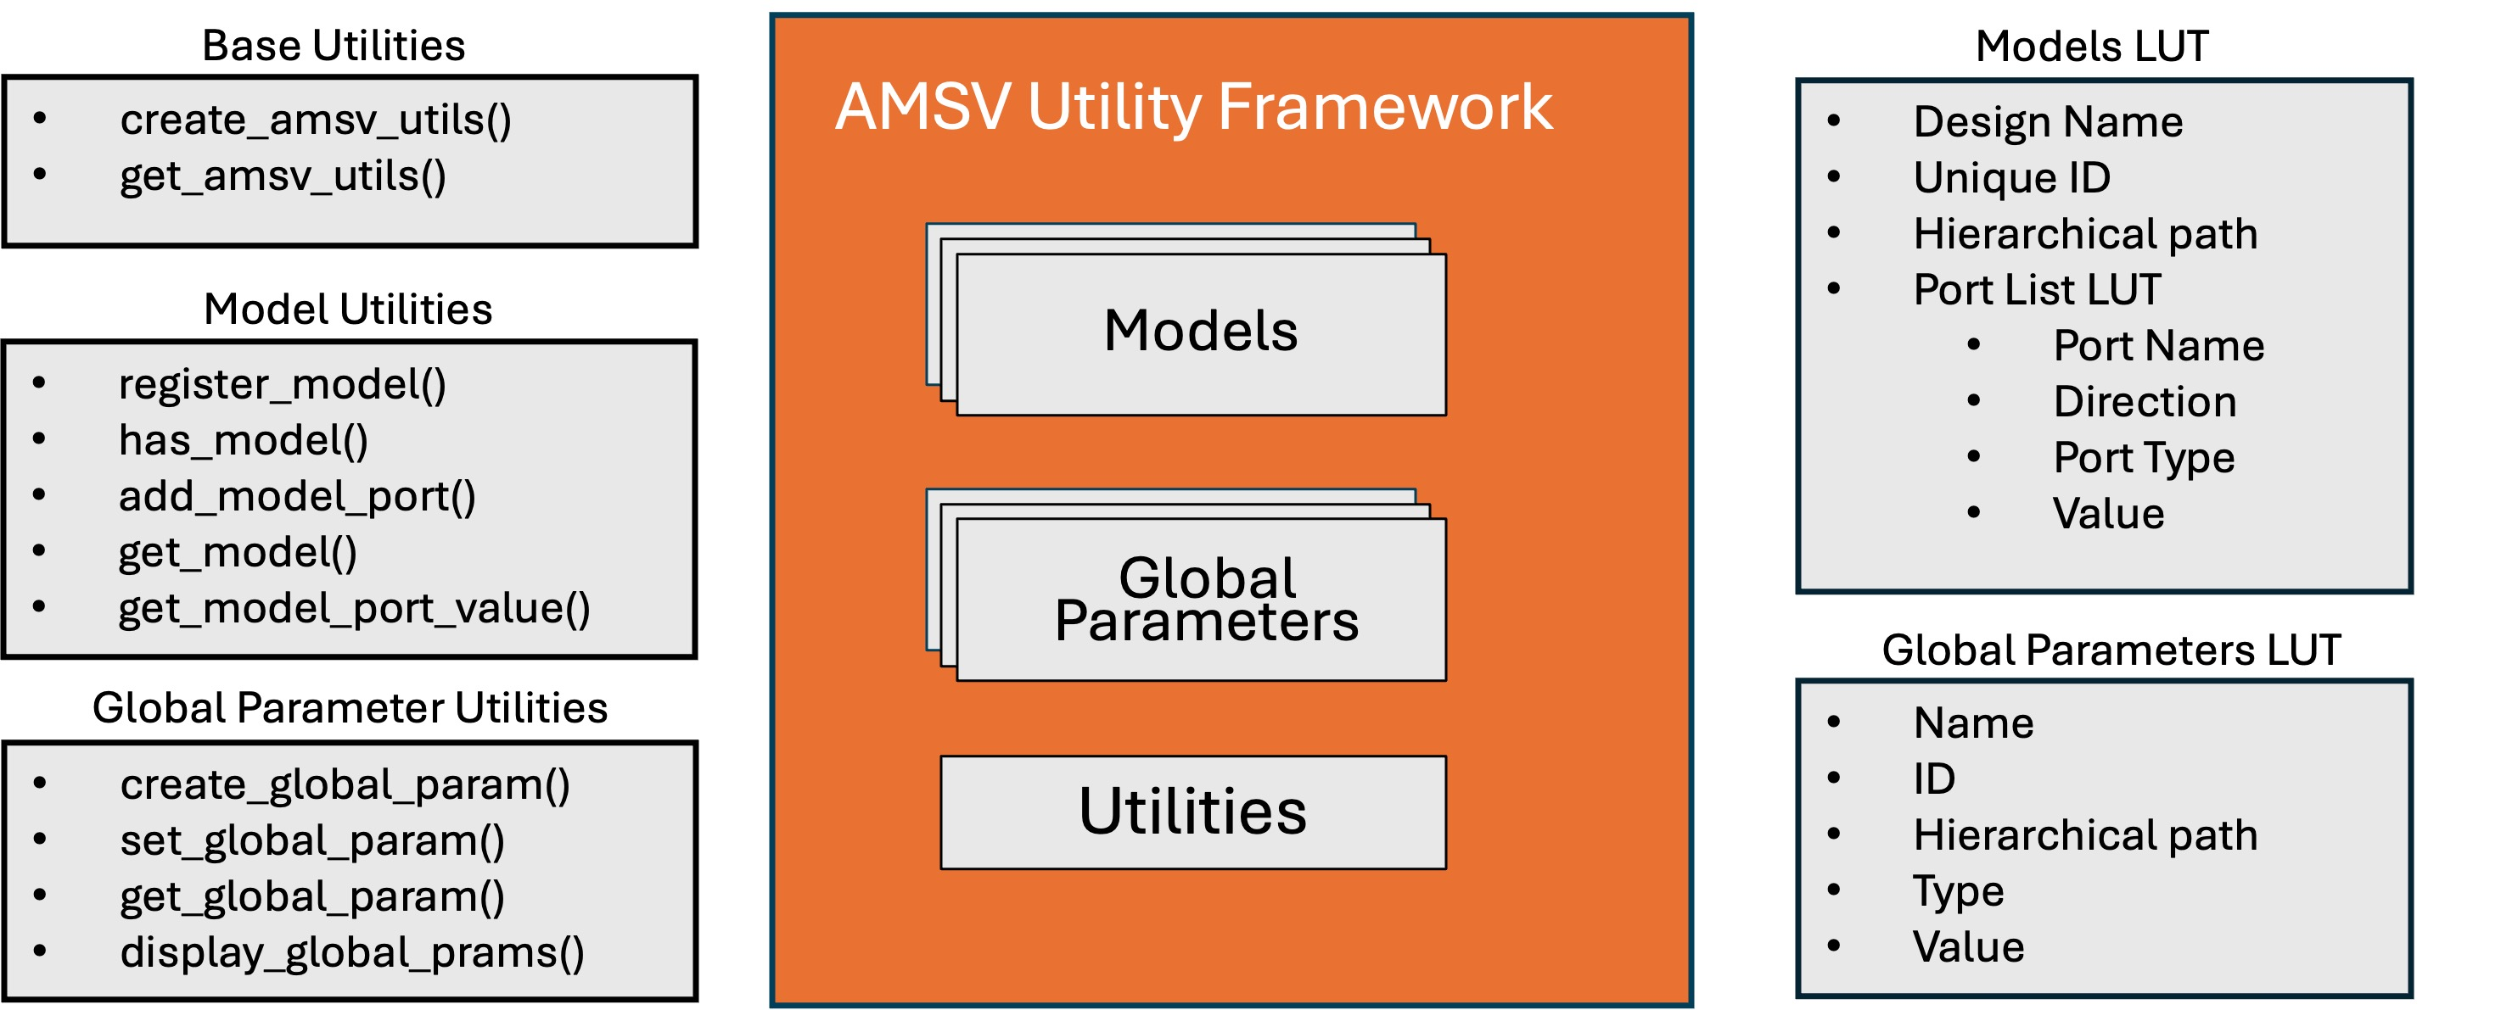
Structure of the AMSV Framework
SystemVerilog package with OOP classes, LUTs, pre-defined macros, and utilities
Stores configuration details and parameters for each analog model
Provide essential functions for framework setup, model management, and dynamic parameter control.
Centralized resource for system-wide variables

Slide 9
Code Snippet of the AMSV Utility Package

Slide 10
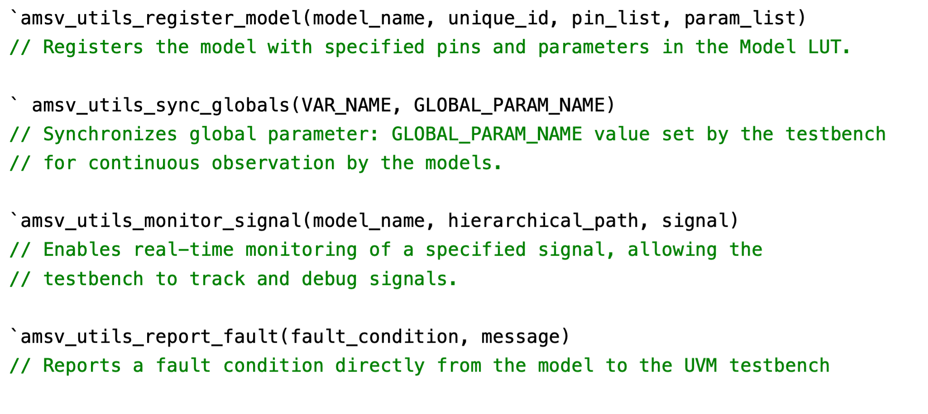
Pre-defined Utility Macros
Simplify integration and reduce repetitive code
Ensure consistent usage across models and verification environments
Minimize complexity, making the framework more accessible and efficient
Key Macros
Model registration macros
Global parameter macros
Signal monitoring macros
Fault reporting macros

Slide 11
Case Study: Application of the AMSV Framework
Design Overview
System-on-chip (SoC) design with digital and analog components.
Includes a Power Management Unit (PMU) and Phase-Locked Loop (PLL)
Key Objectives
Integrate AMSV framework with analog models and UVM testbench
Verify complex scenarios like environmental impacts and safety mechanisms
Critical analog components
PLL: sensitive to system temperature, leading to frequency drift; monitored by a digital control unit for compensation
Thermal shutdown (TSD): monitors system temperature; designed to shut down upon reaching unsafe limits

Slide 12
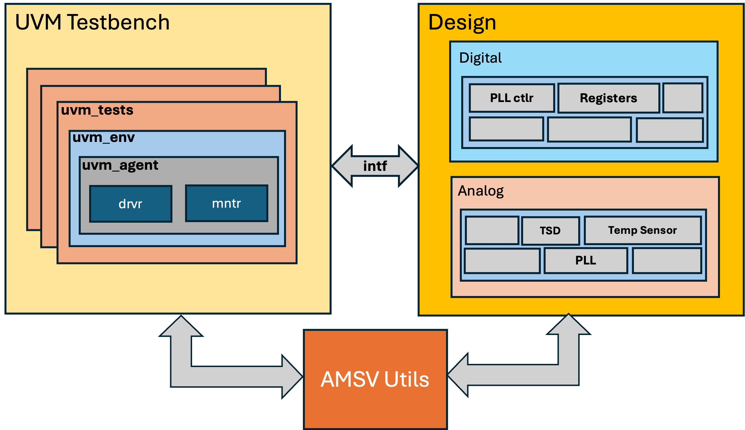
Case Study: AMSV Integration and Verification Scenarios
Verification scenarios
Verify temperature effects on PLL frequency drift
Assess system response when the TSD block fails to trigger
AMSV framework integration
Configure parameters and inject faults via UVM testbench
Real-time control and monitoring through the AMSV framework

Slide 13
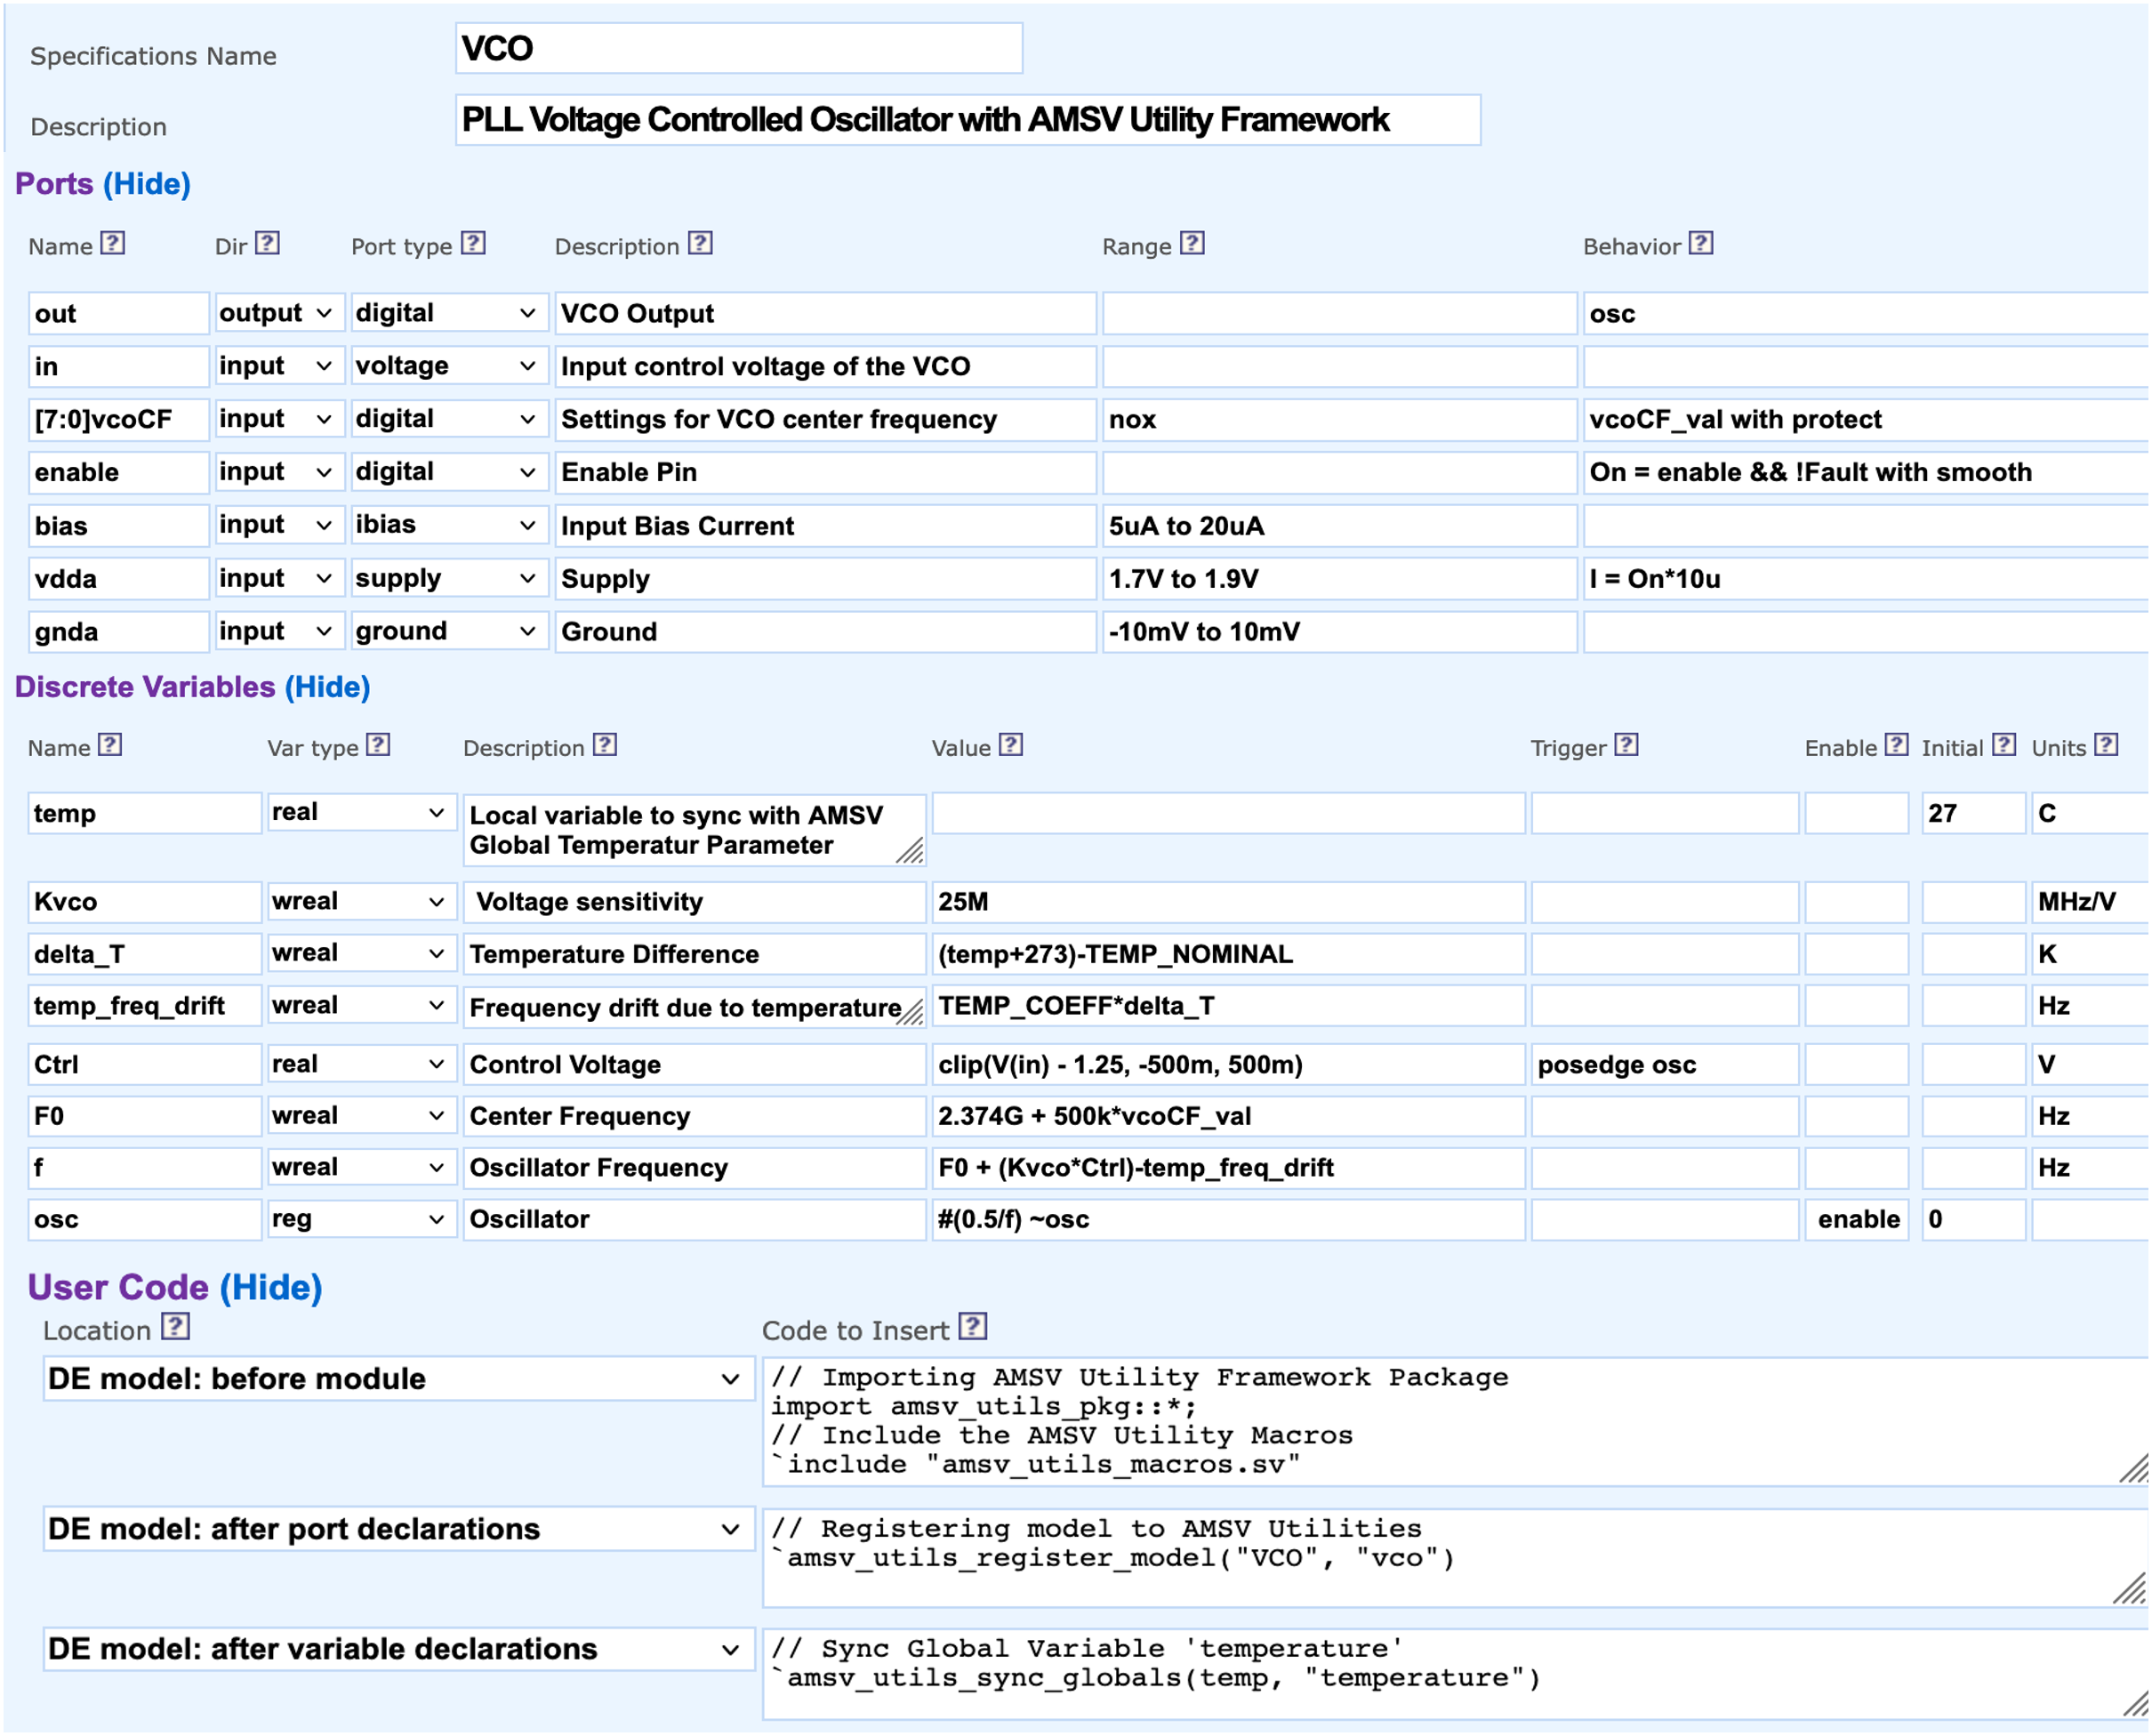
Modeling Analog Blocks & AMSV Integration
Used SystemVerilog discrete electrical (user-defined nettype) approach
Generated validated models and self-checking MVS testbenches with the Model-in-Minutes (MiM) tool
Automatically generates models from a specification
Allows user-defined custom code integration
Enabled seamless AMSV framework integration across multiple models

Slide 14
Integrating the AMSV Framework into Models
`timescale 1s/1ps
// Importing AMSV Utility Framework Package
import amsv_utils_pkg::*;
// Include the AMSV Utility Macros
`include "amsv_utils_macros.sv"
// MODULE HEADER {{{1
module VCO (
output out, // VCO Output
input in, // Input control voltage of the VCO
input[7:0] vcoCF, // Settings for VCO center frequency
input enable, // Enable Pin
input bias, // Bias Input
input vdda, // Supply
input gnda // Ground
);
// Registering model to AMSV Utilities
`amsv_utils_register_model("VCO", "vco")
// Discrete-Electrical (DE) Transceivers {{{2
real in$Vobs, in$Iobs, in$Idrv, in$Gdrv;
DE_norton Xtcvr_in (in, in$Vobs, in$Iobs, in$Idrv, in$Gdrv);
...........................
// Local variable to sync with AMSV Global Temperature Parameter [C]
real temp = 27;
...........................
// Sync temp variable with Global Parameter 'temperature'
`amsv_utils_sync_globals(temp, "temperature")
...........................
// Discrete Variables {{{2
assign Kvco = 25e6;
assign delta_T = (temp + 273) - TEMP_NOMINAL;
assign temp_freq_drift = TEMP_COEFF*delta_T;
...........................
always @(posedge osc) Ctrl <= min(max(in$Vobs - 1.25+0, -500e-3+0), 500e-3+0);
assign F0 = 2.374e9 + 500e3*vcoCF_val;
assign f = F0 + (Kvco*Ctrl) - temp_freq_drift;
always wait (On) osc = #(`fromSeconds(max(500e-3/f, `TIME_PREC))) ~osc;
assign out = osc;
...........................
// ASSERTIONS {{{1
// Check for V(vdda) out of range (1.7V to 1.9V) {{{2
assign #(`fromSeconds(25e-9), 0) _faults.V_vdda = !((
(1.7 <= vdda$Vobs) && (vdda$Vobs <= 1.9))
|| !_locals.enableAsserts);
always @(_faults.V_vdda)_reportFault(_faults.V_vdda, "V(vdda) out of range");
...........................
endmodule
`amsv_utils_register_model macro registers the model in Model LUT
`amsv_utils_sync_global macro synchronizes model variable temp with Global LUT parameter temperature
Models frequency drift due to global temperature changes
AMSV framework reports block-level assertions directly to the system-level testbench
Importing the AMSV package and macros
Registering the model to the Model LUT
Synchronizing local variable temp with global temperature
Modeling temperature-induced frequency drift
Block-level self reporting assertions

Slide 15
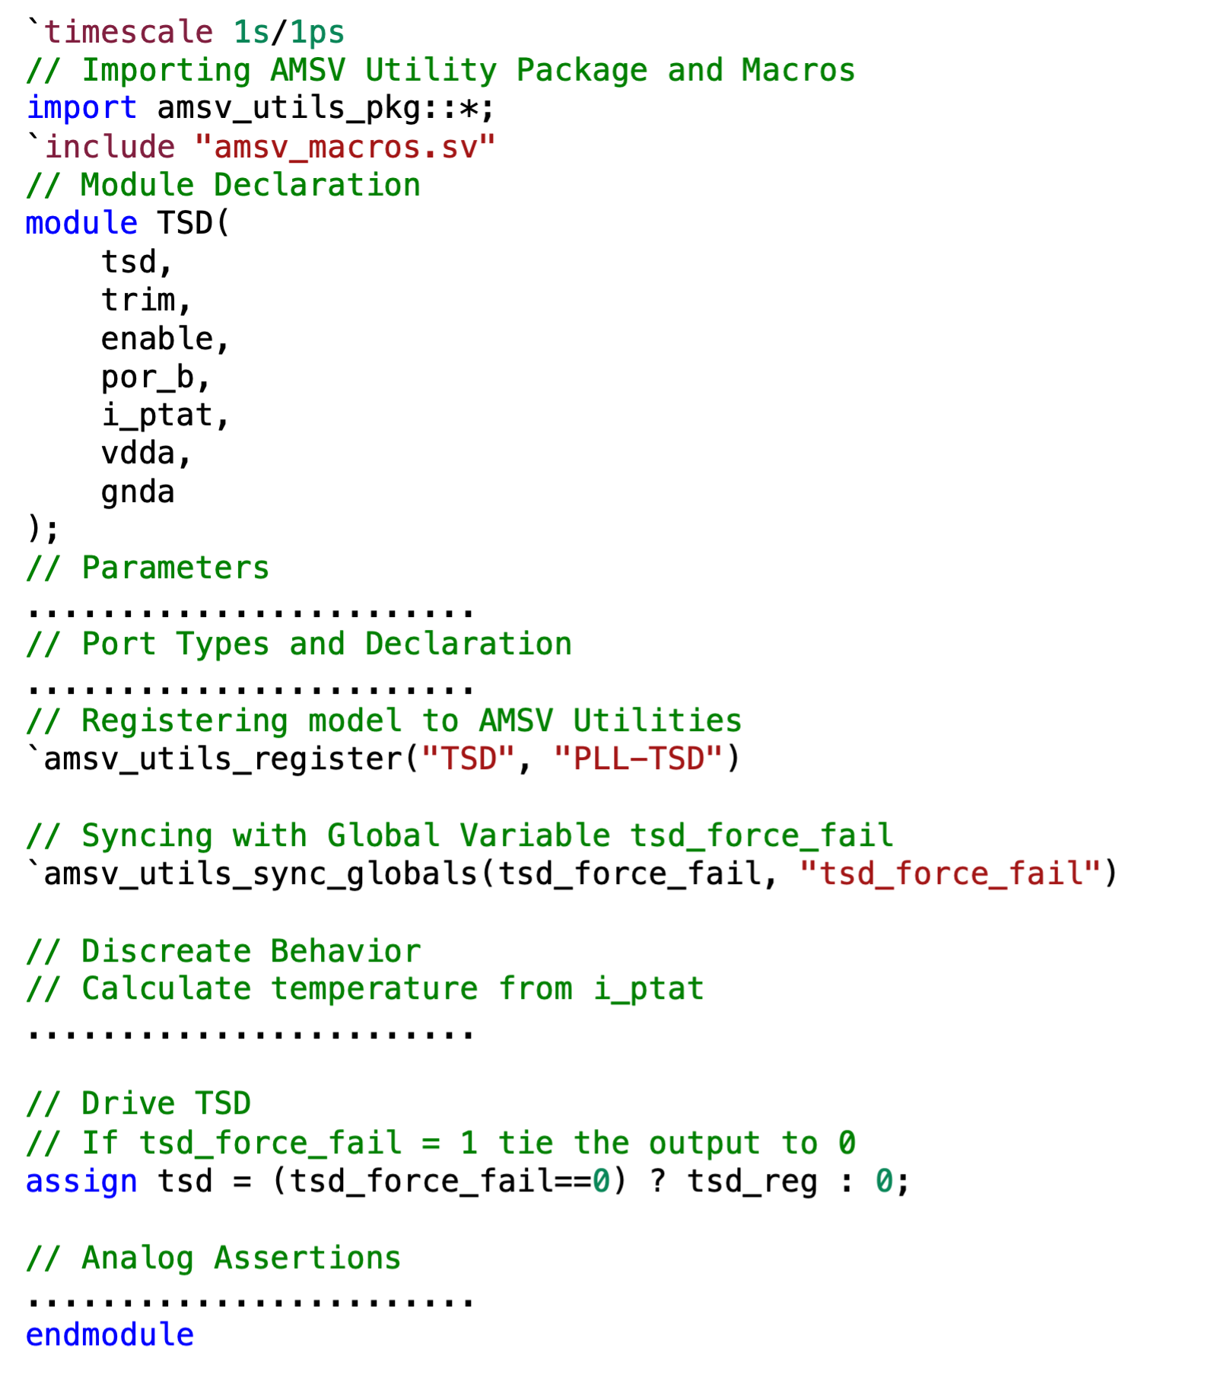
Implementing Safety-Critical Scenarios
Testbench-controlled fault injection mechanism in the Thermal Shutdown (TSD) model
Synchronized with global tsd_force_fail parameter via amsv_utils_sync_globals macro
Bypasses shut down even as the temperature rises
Allows system behavior analysis under failure conditions

Slide 16
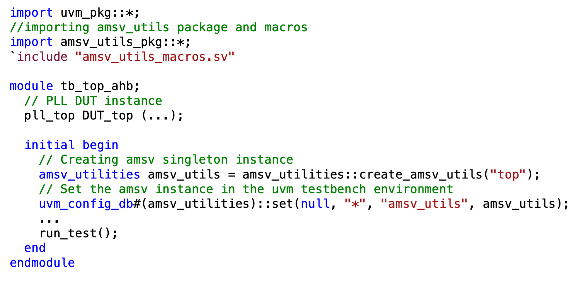
Integration into the UVM Testbench
Import amsv_utils_pkg at the testbench top-level
Create a singleton instance using the create_amsv_utils method
Global testbench access through UVM configuration database

Slide 17
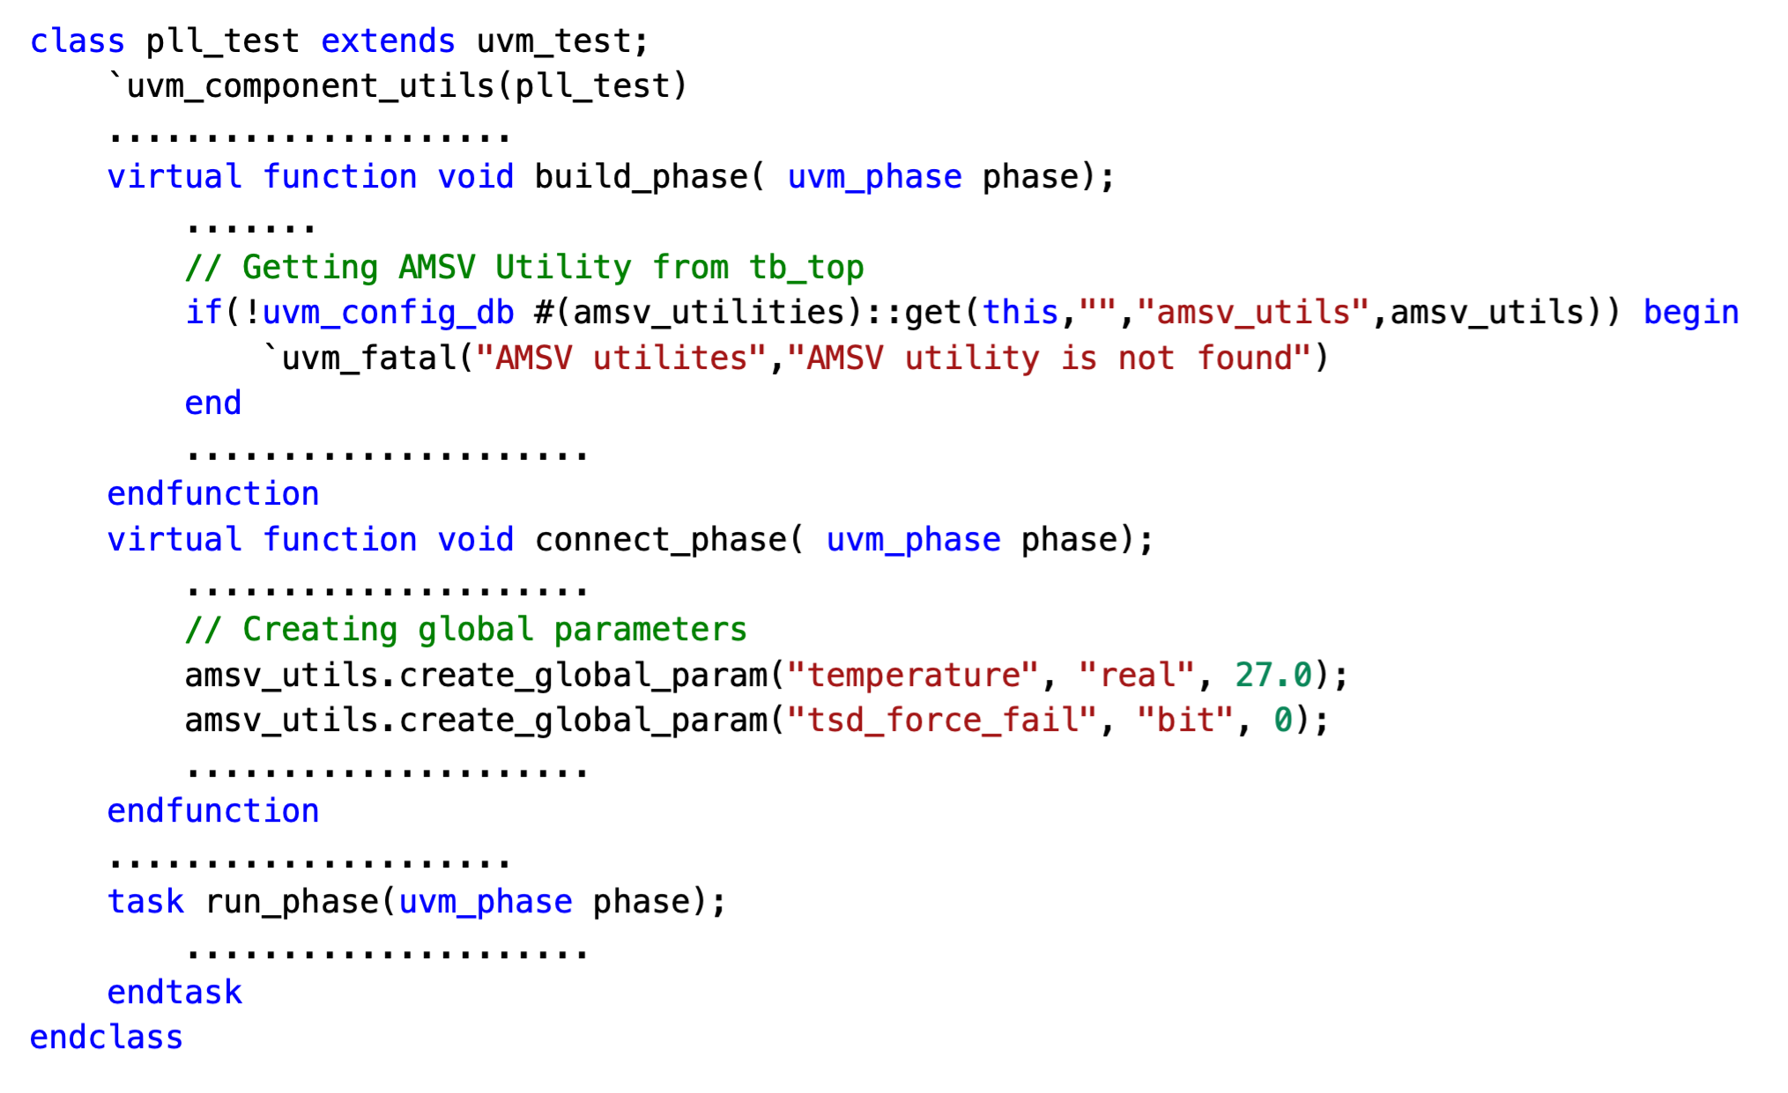
Accessing AMSV Utilities in UVM
Retrieve the AMSV instance from the UVM configuration database
Initialize global parameters using AMSV utility methods

Slide 18
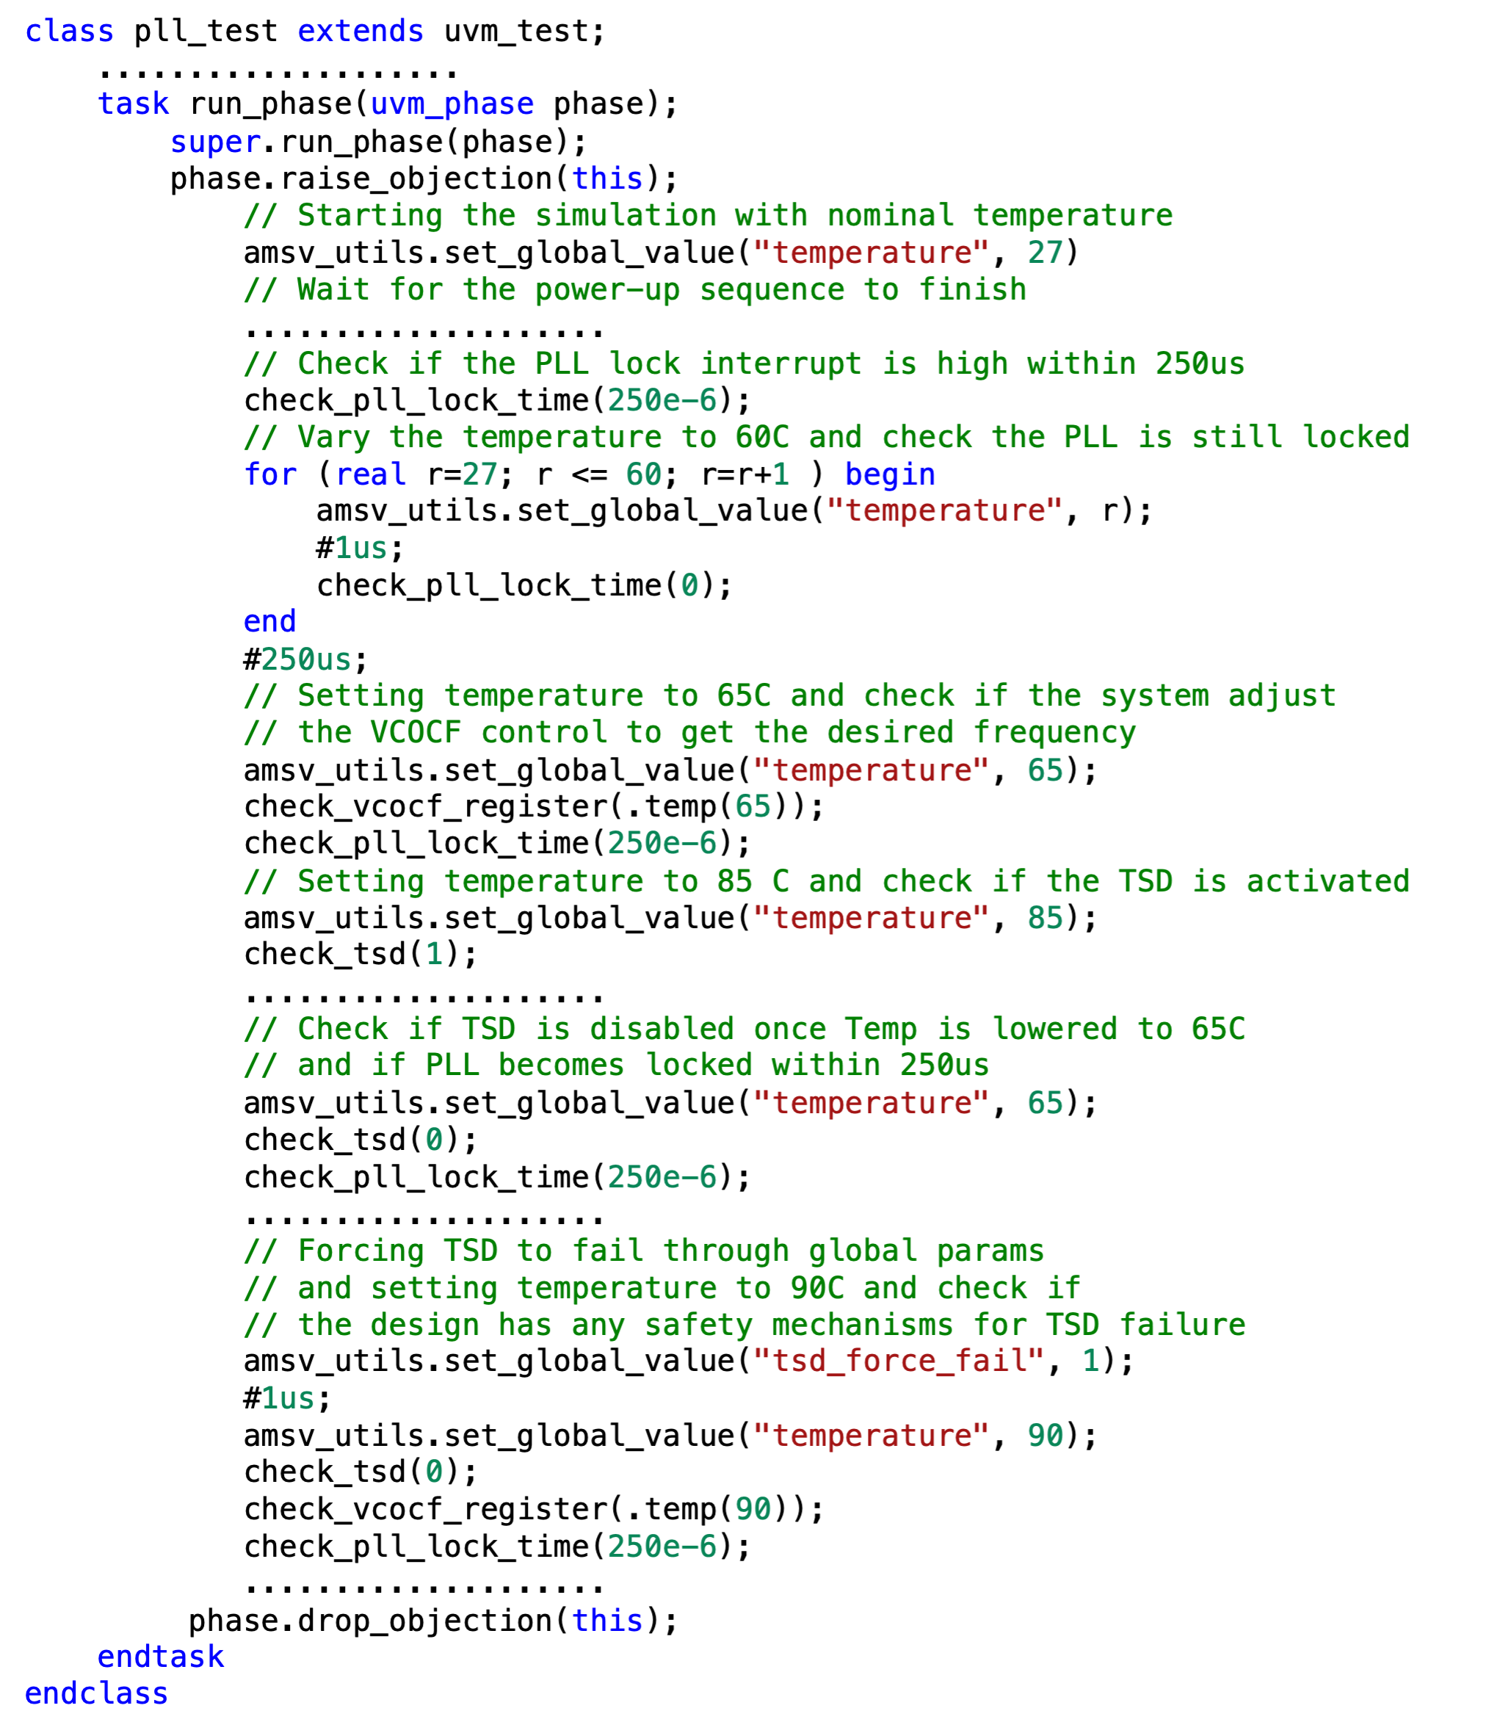
Test Cases
Objective: AMSV utility global parameter variation and system behavior verification
Test Scenarios & Expected Outcomes
Nominal condition (27°C): PLL achieves stable lock
Gradual increase (60°C): PLL maintains lock as the feedback loop compensates
Rapid increase (65°C): PLL controller adjusts VCO frequency; lock achieved within 250µs
Exceeding operational range (85°C): TSD block triggers shutdown, verifying protection
Recovery check (65°C): PLL resumes operation, confirming proper TSD recovery
TSD failure simulation (90°C, tsd_force_fail = 1): Verifies system response without TSD protection

Slide 19
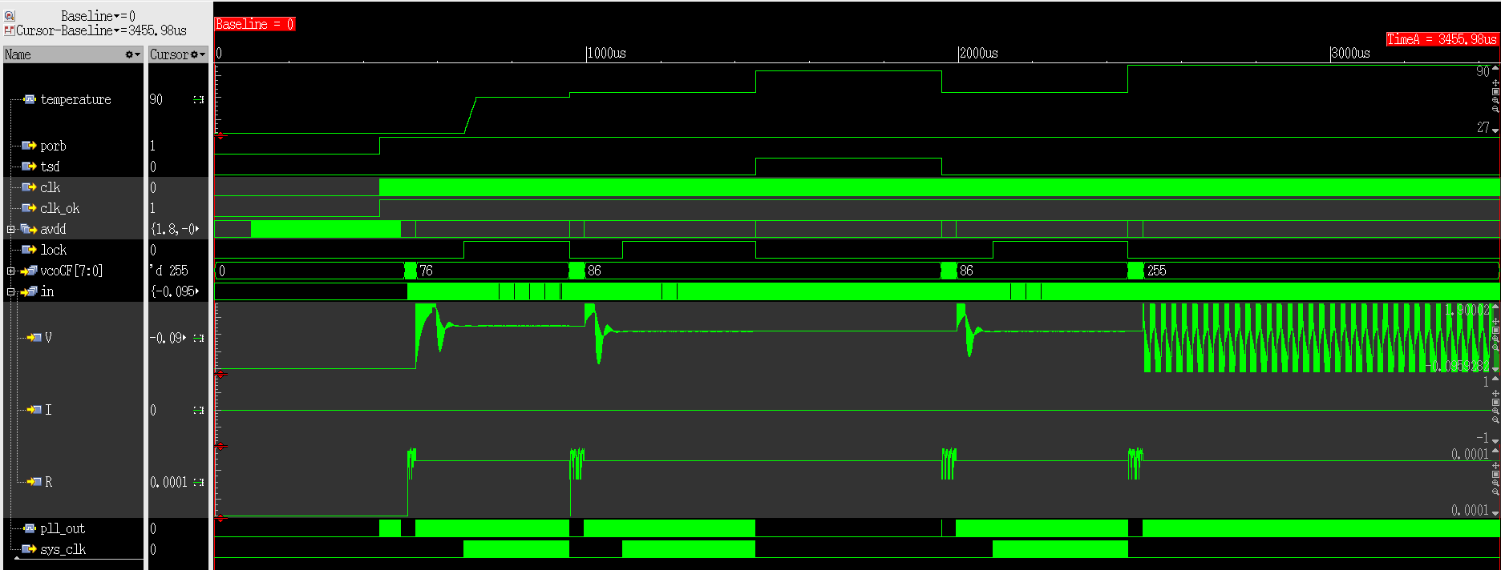
Simulation Results
1
2
3
4
5
6
65°C: TSD resets, PLL reactivated, confirms safe system recovery
60°C: PLL maintains lock (loop compensation)
27°C: PLL establishes a stable lock
65°C: system adjusts vcoCF to regain lock
85°C: TSD activates, shutting down PLL
(90°C, tsd_force_fail=1): TSD inactive, system adjusted vcoCF maxed ('d255), but PLL remains unstable

Slide 20
AMSV Framework – Key Contributions
Introduced as an innovative approach to mixed-signal verification
Seamlessly integrates analog models with UVM testbenches, enabling efficient system-level verification
Simulates real-world conditions such as temperature variations, environmental changes, and fault conditions
Overcomes traditional verification limitations by providing speed, flexibility, and real-time parameter control beyond transistor-level simulations
Enhances connectivity verification, system-level assertions, and coverage of analog-digital interactions
Establishes a new standard in efficiency and accuracy, ensuring robust validation of complex mixed-signal designs

Slide 21
Future Directions
Expanding capabilities
Future updates will include expanded model libraries for broader AMS applications
Support for automatic mixed-signal connectivity check
The Road Ahead
A transformative shift in mixed-signal verification, driving efficiency and innovation
Encouraging industry-wide adoption to refine and advance verification methodologies

Slide 22
Questions
Any questions

