Slide 1
VerifLLMBench An Open-Source Benchmark for Testbenches Generated with Large Language Models
N S. Murthy∗, E. Nelson†, S S. Sapatnekar∗, J. Sartori∗
∗ , Twin Cities, USA
† , Inc., Sunnyvale, USA
Notes:
Good Afternoon Everyone, Myself Nishanth from University of Minnesota, Twin Cities - here to present our work on VerifLLMBench.

Slide 2
Yet another paper that uses AI……
Notes:
This is not another paper that uses AI to generate testbenches, but provides a framework for evaluating the quality of the testbench generated from LLMs
Design and verification methodologies are evolving rapidly with the advent of tool automation assisted by AI/ML.
Recent works have demonstrated how LLMs can generate RTL designs from natural language descriptions.
Once there is an RTL, the obvious next step (engineers are eager to do) is verification.

Slide 3
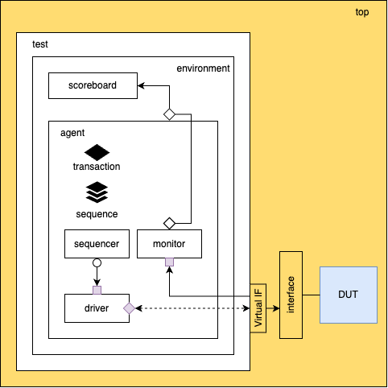
Verif
UVM Based verification
Components Generated
DUT – Verified? RTL designs taken from RTTLLM ^{[1]}
adder_8bit
adder_16bit
accu
fsm
alu
[1] L. Yao, L. Shang, Z. Qijun, and X. Zhiyao, “RTLLM: An open-source benchmark for design RTL generation with large language model,” Asia and South Pacific Design Automation Conference (ASP-DAC), 2024.
Notes:
Breaking down the title of our work, First we have Verification.
There are many ways to Verify an RTL design.
What started as traditional testbenches has evolved into more complex methodologies like Formal, Assertion-Based, Coverage-Driven, Constrained-Random verification.
All of which are industry standard these days created to cope up with the complex designs we are dealing with.
In this work we focus on UVM based verification.
UVM testbench is quite complex, and has several components. So we consider a major subset of the UVM TB in this work.
Looking at this Structural Diagram of a UVM testbench,
The DUTs are verified RTL designs taken from RTLLM
We want to ensure that the LLMs focus is to generate the testbench and not worry about the design flaws, making it easier for evaluations.
Out of the 30+ designs in RTLLM, w pick These designs… which are simple, not something a verification engineer would verify in the industry.
Throughout the presentation we showcase various issues we need to address for even the simplest of designs, so hang tight till the end.

Slide 4
LLM – Large ಭಾಷೆ Model
How do we choose an LLM?
License
Cost (US $/1M tokens)
No. of Parameters
Computation Requirements
Context Window, Quantization, Latency etc.…
The chosen ones
– ChatGPT-4o
– Gemini 1.5 Pro
– Llama3.2
Notes:
The second part of the Title, LLMs stands for Large Language Moels
There are so many LLMs one can choose from the iconic Llama 3.1 from Meta, to the latest and trending DeepSeek’s R1 to the more popular models like Open AI's ChatGPT o1
What are the considerations for choosing an LLM?
If it is proprietary, how much does it cost for the API services?
If it is Open-source, how many parameters does the model have?
DeepSeek’s - 671 B – 405 GB
Llama3.1 – 405B – 243 GB
What resources (usually GPUs) are required to run these models?
Other factors include but not limited to context window, quantization, latency etc.
For our work, we have chosen
All of which are proprietary, and chat based
Towards the end, we are going to show which model performed the best.

Slide 5
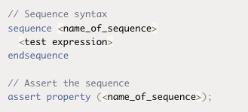
Bench
Compilation-Simulation (Synopsys VCS®)
Success/Fail
Coverage Metrics
Line, Conditional, Toggle, FSM, Branch, Group
No Assertion*
Lint Check (Synopsys Euclide®)
Code Quality, Industry Standards
Errors/Warnings
Notes:
The Final part of the title, Benchmark.
We consider three main aspects, starting with
Compilation – Simulation, where we check for Success or Fail
Different Coverage Metrics like
Assertion coverage is out of scope for our current work. Mostly because it relies on Assertions being added in the design.
And Finally, Lint Check to ensure high code quality and make sure that the generated testbench follows industry standards.
Where we check for Errors or Warnings

Slide 6
Experimental Setup
What happened?
UVM testbench is highly modular & flexible
Unlike other Programming Languages
components, ports/connections, transactions, phases, reporting, db…
Played around with LLM’s and prompts
Need an anchor point
top.sv, includes.svh, interface.sv, etc.
Notes:
Now that we what we are verifying and what LLMs we are using,
Let’s avoid all the technical jargon and talk about what happened.
UVM TB is highly modular and flexible, one can achieve the same functionality in so many ways.
And Unlike other programming languages,
All sorts of responses, some trying to write a version of the DUT, some left out the implementations and just provided comments (like scoreboard)
We need some constant part, an Anchor point
cover-points and cover-groups are manually added in the interface, so they are common between all runs across designs and LLMs

Slide 7
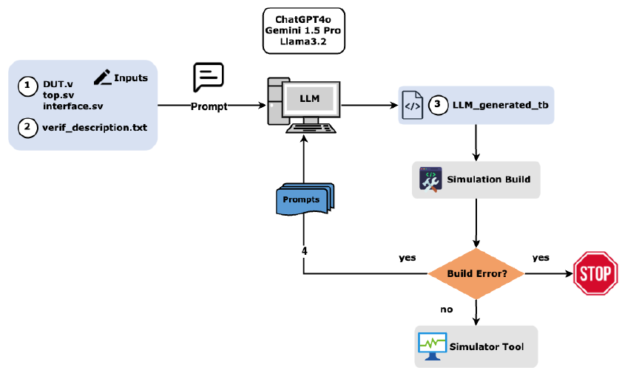
Front-end flow
Notes:
Looking at the front-end flow for a given design, say accumulator.
We have the fixed/constant files – the DUT, Top module, Interface (with cover-points and cover-groups) and the prompt (verif_description.txt) written in natural language.
We prompt the chosen LLMs, which generates the TB that is built using Synopsys VCS,
If the build fails, we have 4 more chances to prompt the LLM to fix the errors in the code.
If the LLMs generated TB does not pass the build even after 4 prompt attempts, we stop the iteration.
If the LLM generated TB build is successful, it is then subjected to simulation, coverage collection and lint checks.

Slide 8
Prompt
Please act as a professional verification engineer.
Verilog design of Accumulator (DUT) is defined as:
// Brief description of DUT functionality
// DUT I/O ports
Notes:
Here is an outline on how we Engineered the prompts.
We Start of by saying, (a tribute to RTLLM paper)
Then we provide a brief description of the DUT functionality
Including I/O ports

Slide 9
Prompt
// Interface
accu_if() Interface is defined.
Instance of the interface, and the virtual interface is set in the TOP module which wraps the DUT.
Utilize the existing top module and interface to handle signal interactions.
Notes:
We provide information about the interface, and
explain the hierarchy of the Top module which wraps the DUT and instantiates the virtual interface.
And insist LLM to use these and not generate them again.

Slide 10
Prompt
Transaction
Required:
// Brief description
Classes
Phases
Test
Sequence
Environment
Sequencer
Scoreboard
Driver
Agent
Monitor
Notes:
Finally, we ask LLMs to generate the various classes, and phases within them

Slide 11
Prompt
Make sure the connections between the sequencer, driver, monitor, and scoreboard are correctly established.
Give me the complete code.

Slide 12
Results
Notes:
Let's see how the different LLMs performed for the designs considered.
Looking at these graphs we can see that Line Coverage is easily achievable by all 3 LLMs across the designs
with some exceptions for Llama3.2 for alu and fsm designs, where it gets to only 60% and 40% respectively.
Along the same lines LLMs performs well and can obtain high Toggle Coverage, except for Llama3.2 on FSM design, where the coverage nearly zero.
Unlike Line and Toggle Coverage, Conditional Coverage depends on the presence of conditional statements in the design. Adder designs do not have any conditional statements in them, resulting in Zero Conditional Coverage.

Slide 13
Results
Notes:
On the same lines, FSM Coverage depends on the presence of finite-states and transitions in the design. All designs report zero FSM coverage except fsm.
Like conditional coverage, Branch coverage depends on branches in the design. So, we observe non-zero Branch coverage metrics for all designs except adders.
Group coverage is a totally different avenue. Since the cover-points and cover-groups are manually added, the coverage for a particular design directly corresponds to LLMs performance.
One anomaly we can observe here (for adder_8bit) the coverage numbers are very low.
This was purposeful. We added cover bins for all bits of input and output (more than required) compared to adder_16bit, where bins were automatically created.
This way we have additional control for benchmarking the LLMs (apart from the DUT itself).

Slide 14
Results (some numbers…)
ChatGPT-4o
Build Success – 84%
Coverage – 70.6%
Gemini 1.5 Pro
Build Success – 88%
Coverage – 79.3%
Llama3.2
Build Success – 64%
Coverage – 46.8%
Notes:
- Summarizing the results, here are the numbers for Build Success and Average Coverage percentages for the different LLMs.

Slide 15
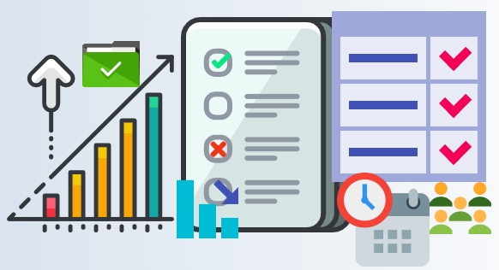
Challenges
Functional – Correctness
Failing tests?
Complexity in design – scoreboard
TLM ports – high impedance
Verbosity?
Functional – Coverage
Constrained Randomization?
Balance between diversity/determinism
Notes:
Throughout the entire work, we faced several challenges
Broadly categorized into Functional Correctness and Functional Coverage
A major challenge for verifying functional correctness is due to failing tests, even though we started with verified RTLs.
This could be due to two reasons, either the designs are complex for LLMs to model the reference model in the scoreboard
Or that TLM ports are not connected, resulting in high impedance (z) values in the scoreboard.
Another challenge is verbosity, simulation runs on LLM generated code were not verbose enough to prove functional correctness
Looking at the Functional coverage, code generated from LLMs did not have constraint randomized inputs, indicating that LLMs faced challenges in understanding the behavior of the DUT
Detailed prompts, led to LLMs generating code with higher build success but low coverage metrics.
Emphasis on improving coverage metrics led to poor build success.

Slide 16
Conclusion – Key takeaways
Prompt Engineering
Larger context window == Better performance
UVM/SystemVerilog specific LLM training needed
Do not forget about HDL designs during training
LLMs are not truly intelligent
Notes:
Prompt engineering plays a crucial role in LLMs performance
From the results of Gemini 1.5 Pro, that has a context length of 2m tokens provides an insight that
All the models considered in this work have not been specifically trained on UVM/SV or HDL.
Training a model with UVM/SV dataset, could potentially perform better.
Knowledge of HDL (DUT) is essential.
LLMs are trained on large amounts of data and use statistical patterns to process information and respond
It is Generative, It is Artificial and provides a perception of Intelligence

Slide 17
Questions?
As promised Open-Source

