Slide 1
Automated Formal Verification of Area-Optimized Safety Registers in Automotive SoCs
Shuhang Zhang, Bryan Olmos
Infineon Technologies AG, Neubiberg, Germany

Slide 2
Outline
Motivation
Area-Optimized Safety Registers
Verification Challenges
Framework
Results
Conclusion

Slide 3
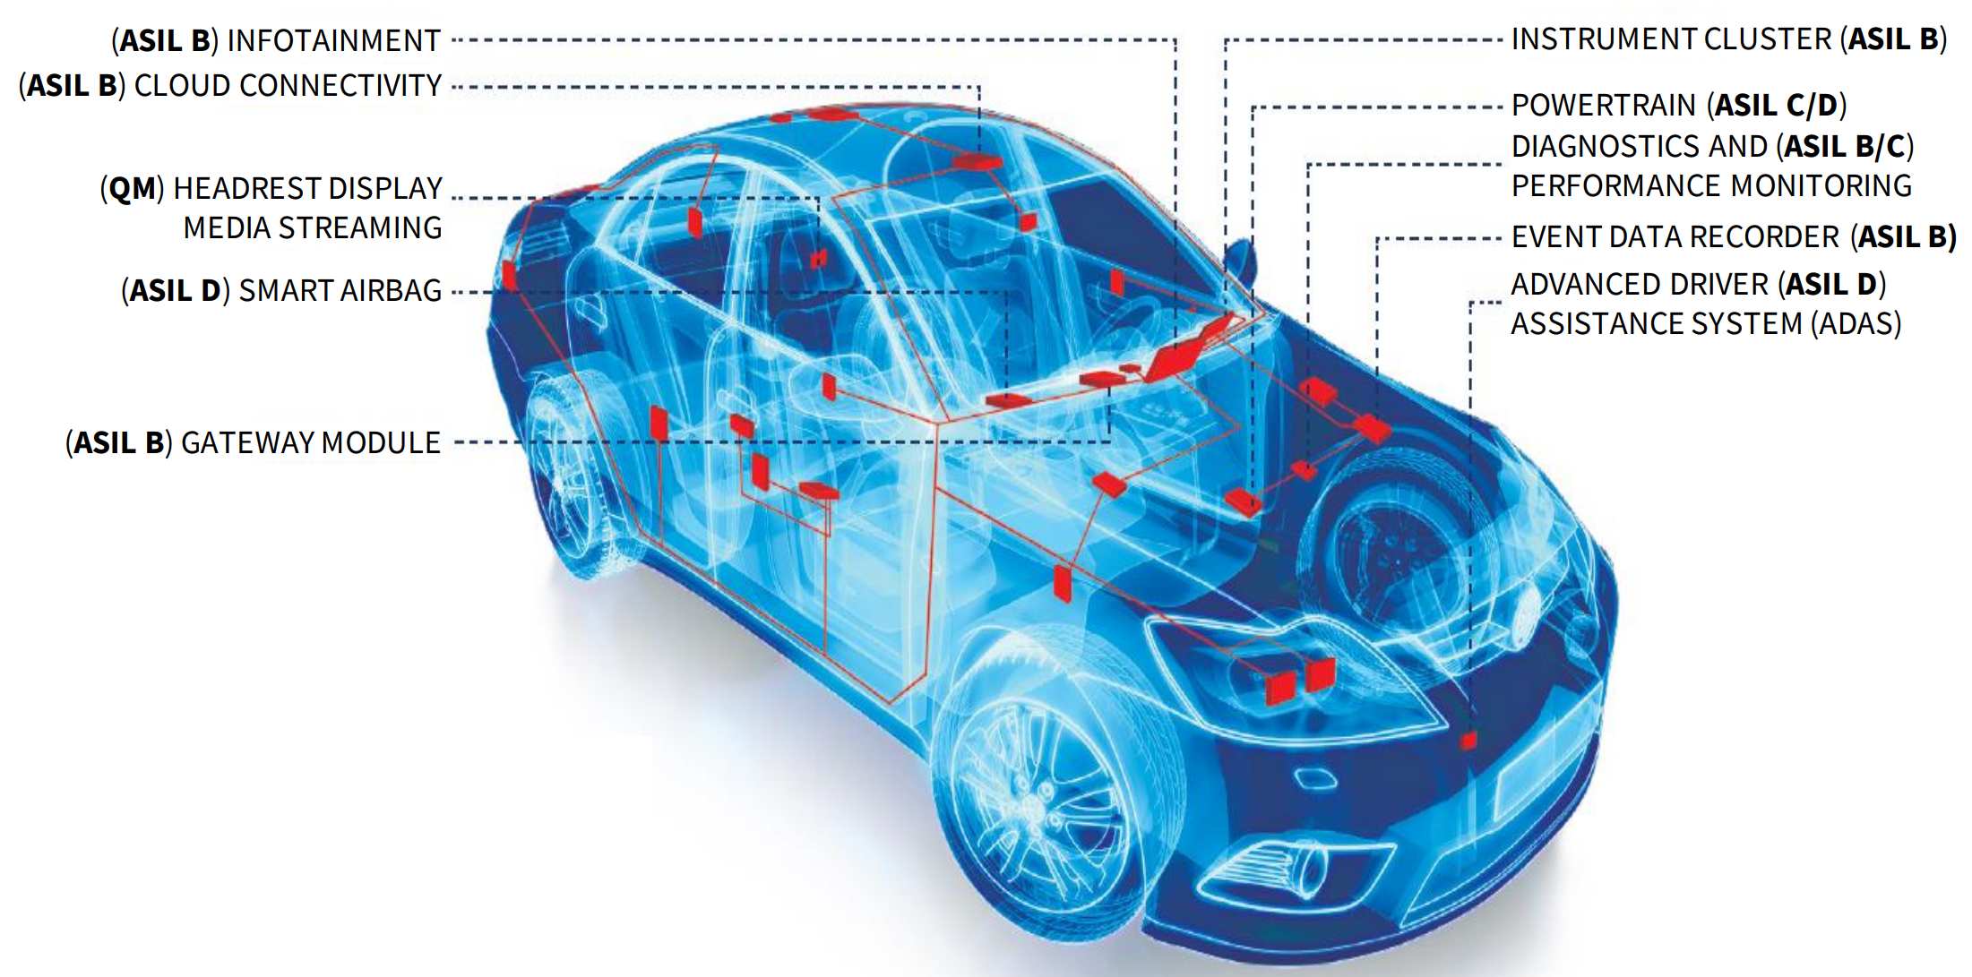
Motivation
Increasing number of car safety features
Smart Airbags
Powertrain
Advanced Driver Assistant Systems
Electric Power Steering
Antilock brakes
Electronic Stability Control
...

Slide 4
ISO 26262 Standard
High Risk
ASIL D
ASIL Classification
Automotive microcontroller, e.g. AURIX™ (ASIL D)
Safety verification on top of functional verification
Diagnostic coverage analysis
Documentation, requirement traceability
Higher product complexity, area and power consumption, higher development and production costs
ASIL C
ASIL B
ASIL A
Low Risk
QM

Slide 5
Safety Register
Error Detection Code (EDC)
Parity (PAR)
Double Error Detection (DED)
Self-test feature
Redundancy
Double Module Redundancy (DMR)
Triple Module Redundancy (TMR)
Self-test feature
d_i
Encoder
encoded
FFs
corrupted
Decoder
d_o
data
data
SFF Wrapper
SFF Wrapper
d_i
FFs
d_o
d_i
FFs
alarm
d_i
FFs

Slide 6
Safety Register
Safety Management Unit (SMU)
SFF Controller
Trigger self-test
Collect self-test and alarm signals
Communicate with SMU
Async clock domain supported
Synchronization in SFF Controller
test_en
test_done
alarm
SFF Controller
test_seq
alarm
test_seq
alarm
SFF PAR
SFF DED
SFF DED
SFF TMR
SFF Domain 0
Sync clock
SFF Domain 1
Async clock

Slide 7
Safety Register
#Redundant bits does not increase linearly with the data width
Code rate higher with a bigger data width

Slide 8
Area-Optimized Safety Register
Solution: Merge multiple safety registers into a bigger one
Area optimization via Best-Fit or ILP technique (w/o or w/ register fragmenting)

Slide 9
Verification Challenges
Parameterized Components and Configurable Safety Structure
Area-Optimized Implementations
Solution: Automated property generation for all safety registers

Slide 10
Framework
S. Zhang, B. Olmos, and B. Naik, “Automated Formal Verification of a Highly-Configurable Register Generator,” in Design & Verification Conference U.S., 2024.

Slide 11
Specification Extraction
MetaModel creation
Define which spec. are extracted
Both register and bitfield level
Model of Things (MoT)
Internal spec.

Slide 12
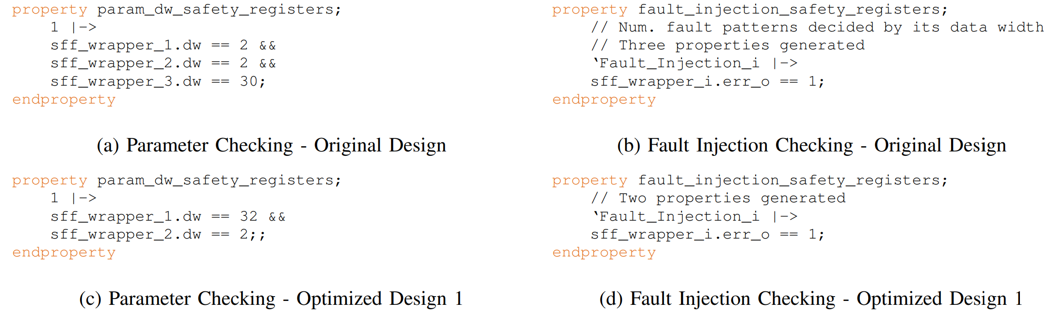
Generated Properties

Slide 13
Results
 | Initial Design | Verification Time Overhead
 | #Safety Registers | BFD (32-bit) | ILP (32-bit)
SoC1 | 1827 | 6.53% | 14.87%
SoC2 | 2392 | 71.05% | 84.32%
SoC3 | 49 | 144.27% | 131.02%
 | Area-Opt. | CEX Trace | Functional | Integration
This Work | yes | yes | yes | yes
DVCon Europe 24 | no | no | no | yes

Slide 14
Conclusion
Safety registers are critical components to ensure automotive chips
Significant area-overhead caused by safety registers
Area-optimized safety registers bring verification challenges
Proposed formal verification framework addresses this issue efficiently but longer verification time due to larger registers

Slide 15
Questions
Thank you!

