Slide 1
Performance verification for AI Heterogenous Multicore Systems using Portable Stimuli Standard
Pietro Locci, Hillel Miller

Slide 2
Agenda
Introduction challenge and motivation
AI application data flow
PSS Solution
Performance optimization and results

Slide 3
1000 TOPS
100 TOPS
10 TOPS
1 TOPS
100 GOPS

Slide 4
Heterogenous AI Multicore System

Slide 5
AI performance verification challenge
Variety and fast evolution of AI Application
AI heterogenous system programming complexity
Configuration space of the system
High simulation time of benchmarks

Slide 6
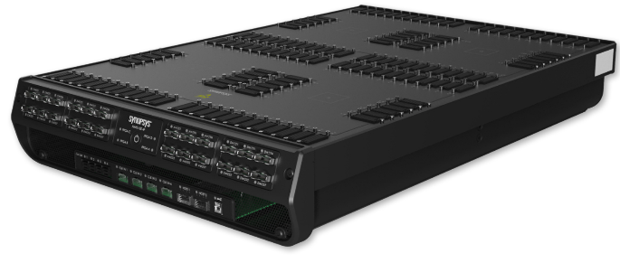
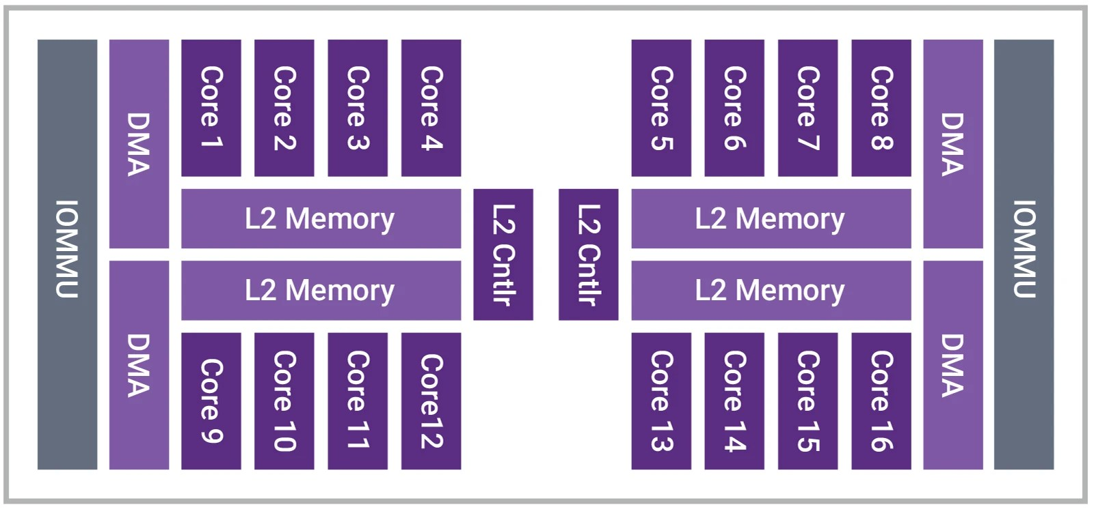
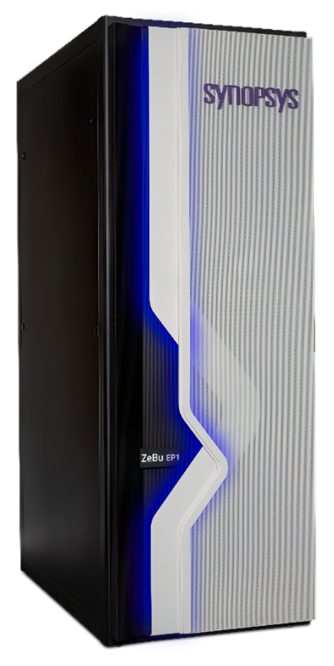
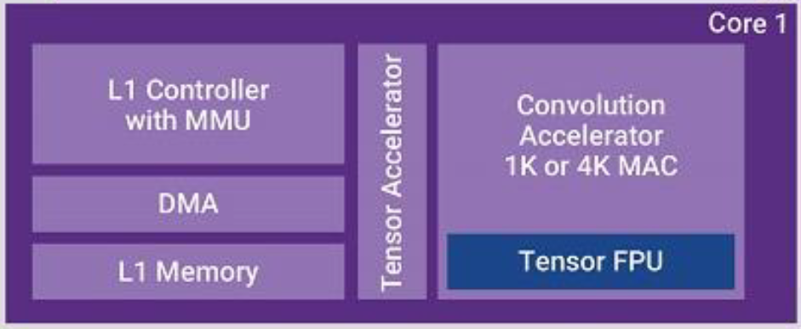
Verification environment reusability requirements
Full system
Technique Reuse
Sub system
Hierarchical Reuse
Single module
Convolution Accelerator
# cores
Memory size
accelerators
Configurability Reuse

Slide 7
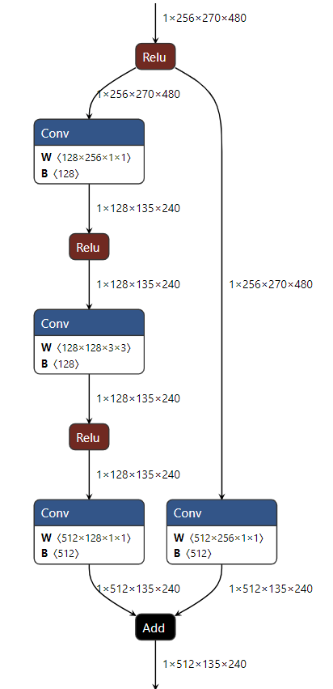
Neural Network concept
Neural networks (NNs) are computational models of interconnected layers that transform input data through successive operations to extract meaningful patterns
A NN Layer is a computational block that transforms input data, producing an output called a feature map
Feature Map is the output of a layer after applying specific operations to the input data

Slide 8
Neural network data flow
L2/L3 memory
L1 Memory
input channels
output channels
tile height
tile height + 2
Input featuremap
output featuremap
input blockbuffer
output blockbuffer
DMA read
1
2
3
N
tile_processing
…
1
2
N-1
N
DMA write
1
N-2
N-1
N

Slide 9
PSS performance network layer test
Network layer tests are defined based the most common NN
The compute part is represented by a single or few layers of the NN (Conv + Relu)
The results of the layer (feature maps) are compared for functional correctness with golden model results
The performance are measured in terms of cycles and compared with KPI that depends on layer time budget and configuration

Slide 10
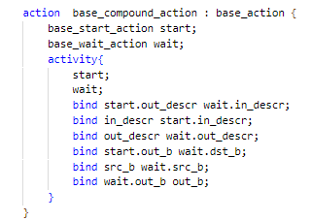
PSS model implementation – base actions
Src_b
In_descr
Dst_b
Start
Start.out_descr wait.in_descr
Start.out_b
wait.dst_b
wait
out_descr
out_b
The base actions are used for all the main atomic and compound actions in the PSS model with for both move and compute actions

Slide 11
PSS model implementation – scenario
PSS model describe the scenario in terms of
actions
dependency of the flow objects (buffers) of the actions
The actions sequences is not directly described in the model

Slide 12
PSS Generated Solutions
PSS solver generates all possible valid solutions
Performance test should measure optimal scheduling only
Optimal scheduling rules
Start has priority over Wait
High exec times Start has priority over low exec time
Low exec time Wait has priority over high exec time

Slide 13
Cost function
Cost functions are analytical representation of the execution time of each action
$$Cf= K_{0}+f\left(p_{0},p_{1}, …,p_{n}\right)$$
They are determined by analyzing the performance of the single kernels under different conditions
Cost functions are used in the PSS model to enforce scheduling priority

Slide 14
Results
Modular PSS model tests enable efficient scaling:
Single-core optimization extended to multi-core
Parallel processing of sub-feature maps
Over 95% of NN layers met exceeded KPIs
Kernel name | Fmap input | number of cores | (exec_time-KPI)/KPI%
Conv W<128×512×1×1> + Relu | (512, 135,240) | 1 | 2.43%
Conv W<1024×256×1×1> + Add + Relu | (256, 66, 117) | 1 | -1.01%
Conv W<64×3×7×7> + BatchNormalization + Relu + Maxpool | (3, 1920, 1080) | 1 | 1.49%
Matmul B<2048×1001> + Add + Identity + 2 * (Softmax + Identity) | (2048, 1, 1) | 1 | -0.19%
SpaceToDepth + Conv W<32×128×3×3> + Relu +DepthToSpace | (32, 128, 512) | 1 | -1.88%
Conv W<64×64×3×3> + Relu | (64, 180, 320) | 2 | -3.18%
Conv W<128×128×1×1> + Relu | (128, 535, 127) | 8 | 2.12%
Conv W<64×64×3×3> + Relu | (64, 180, 320) | 16 | 0.39%

Slide 15
Conclusion
Portable Stimuli Standard (PSS) is a robust framework for AI performance verification
HW/SW co-verification and co-optimization
Configuration scalability
Modular approach
The methodology can be easily applied to other domains

Slide 16
Questions

